Slide 1
Classical Languages
Exploring the strands of study to create meaningful student-centred learning experiences

Slide 2
Oide Timeline of Supports for Classical Languages
Classical Languages Introduction to Ancient Greek and Latin Specifications - Webinar
Classical Languages Online
September 2025
the new specifications for Ancient Greek and Latin begin to be taught in schools
November2024
March 2025
Term 3
2025
Term 1
2025
Full Day Face to Face PLE
Full Day Face to Face PLE

Slide 3
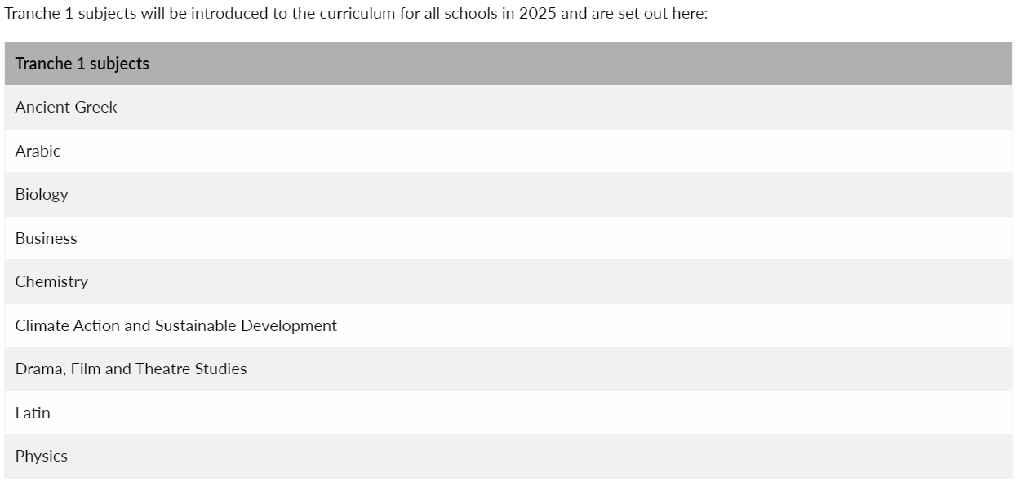
Senior Cycle Redevelopment

Slide 4
Senior Cycle
“Senior cycle educates the whole person and students’ experiences in senior cycle contribute to their intellectual, social and personal development and their overall wellbeing.
During senior cycle students develop a stronger sense of their identity, learning with and from their peers, teachers, other adults, and various media.”
Department of Education, 2024, P. 2 Curriculum Specification for Leaving Certificate Ancient Greek

Slide 5
Guiding Principles
for a Redeveloped Senior Cycle
Wellbeing and relationships
Choice and flexibility
Inclusive education and diversity
Continuity and transitions
GUIDING PRINCIPLES
Challenge, engagement and creativity
Participation and citizenship
Learning environments and partnerships
Learning to learn, learning for life

Slide 6
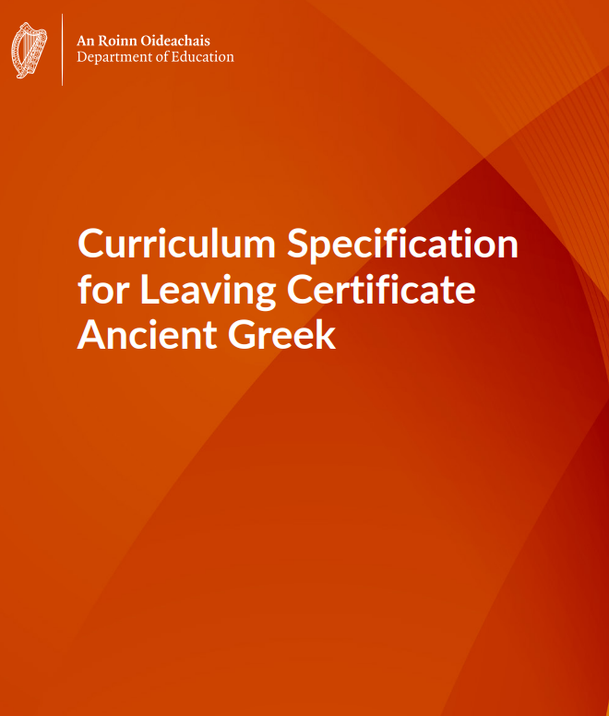
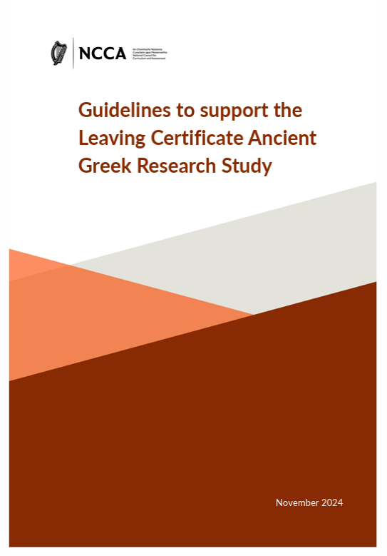
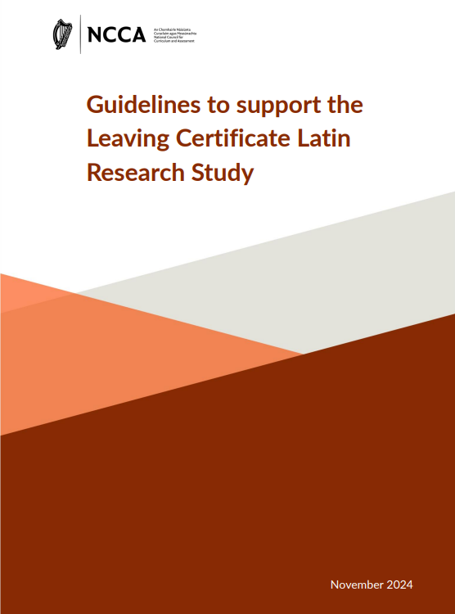
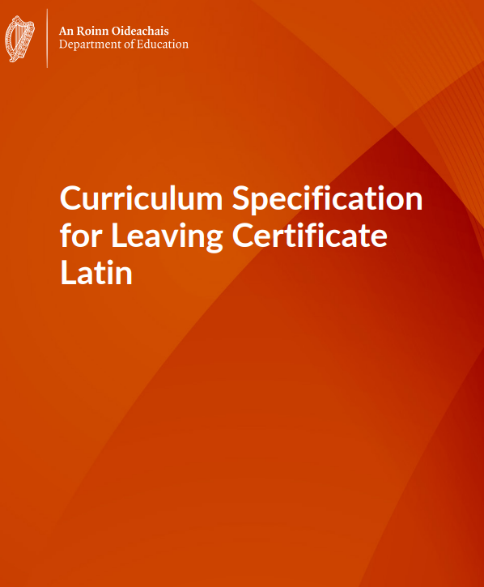
Classical Languages Specifications

Slide 7
Seize the Opportunity
Flexibility in curriculum design
Experiential learning opportunities
Student autonomy in choosing learning paths and focusing on personal interests
What does this look like in the classroom?

Slide 8
Today’s Timeline
9:30-11:00
11:00-11:15
11:20-13:00
13:00-14:00
14:00-15:30
Break
Lunch
Session 1
Exploring approaches to creating meaningful connections across the strands of study.
Session 2
Developing key competencies through authentic classical texts.
Session 3 Collaborate and consider approaches to teaching cultural contexts in the language learning process.

Slide 9
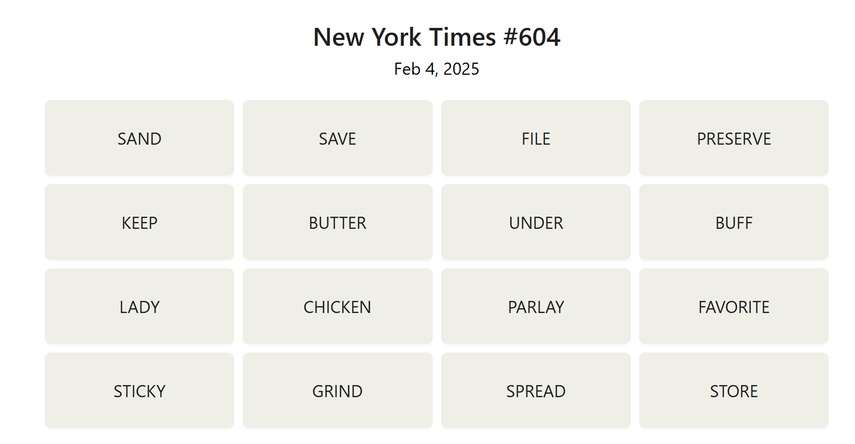
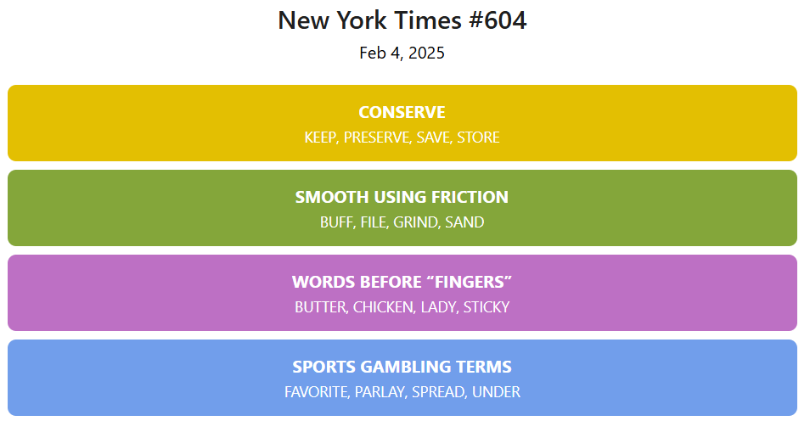
Developing Literacies
Based on the popular game NYT Connections.
Players are given 16 words and find groups of four items that share something in common.
For example:
FISH: Bass, Flounder, Salmon, Trout
FIRE: Ant, Drill, Island, Opal
Each group is assigned a color (Yellow, Green, Blue, or Purple), with Yellow being the easiest category and Purple being the trickiest.
Each puzzle has exactly one solution and is meant to be tricky by having words that could fit into multiple categories.

Slide 10
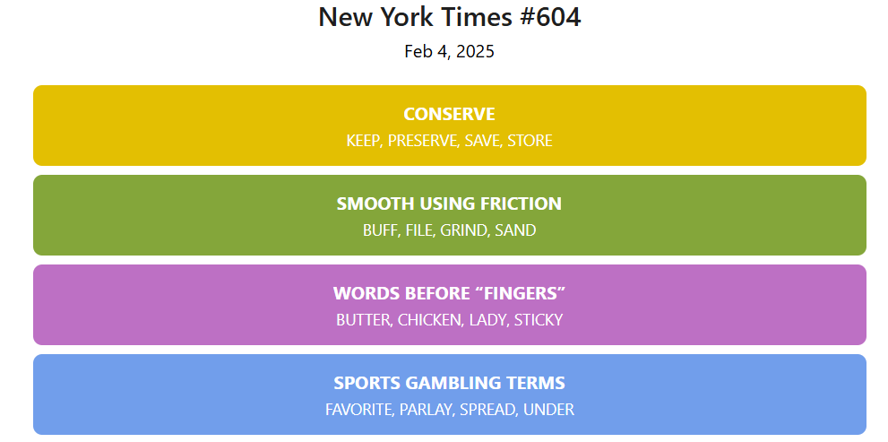

Slide 11
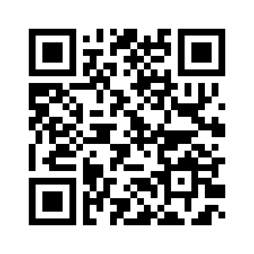
Developing Literacies
https://sam-hu.com/connections/today

Slide 12
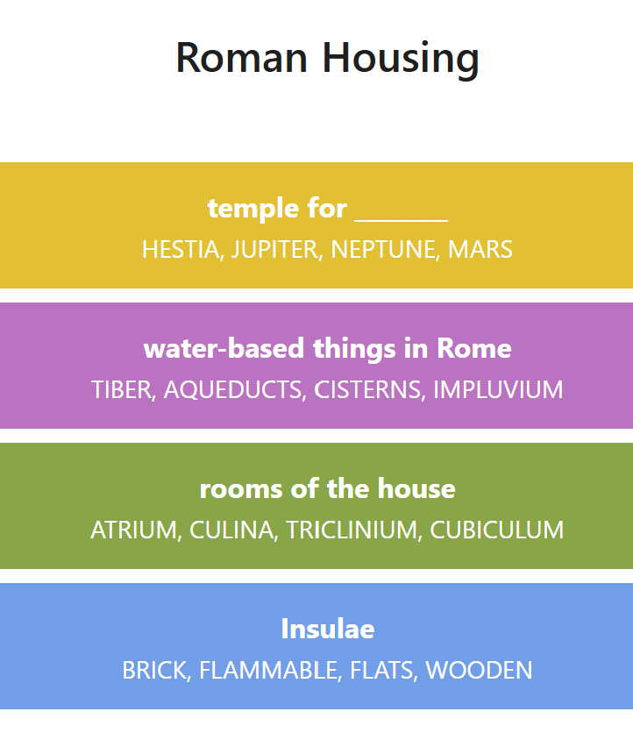
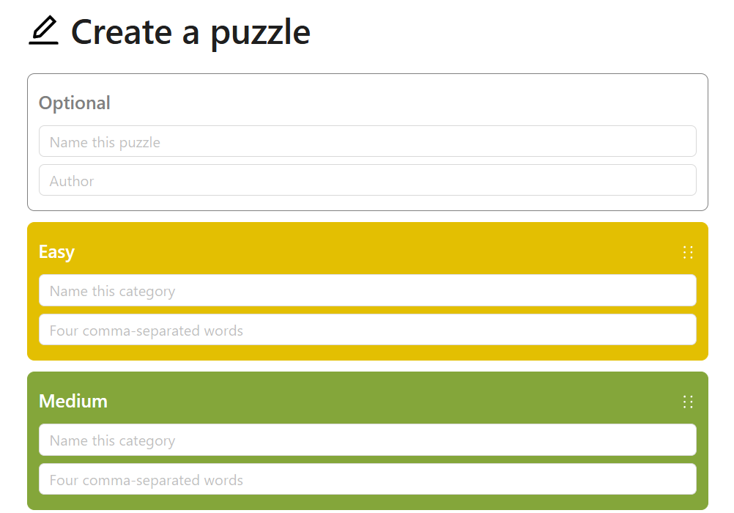
Developing Literacies

Slide 13
Developing Literacies

Slide 14
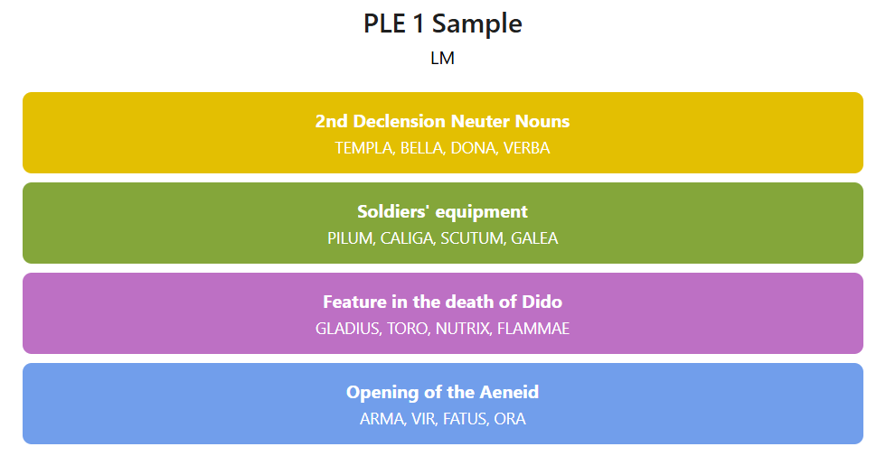
Developing literacies

Slide 15
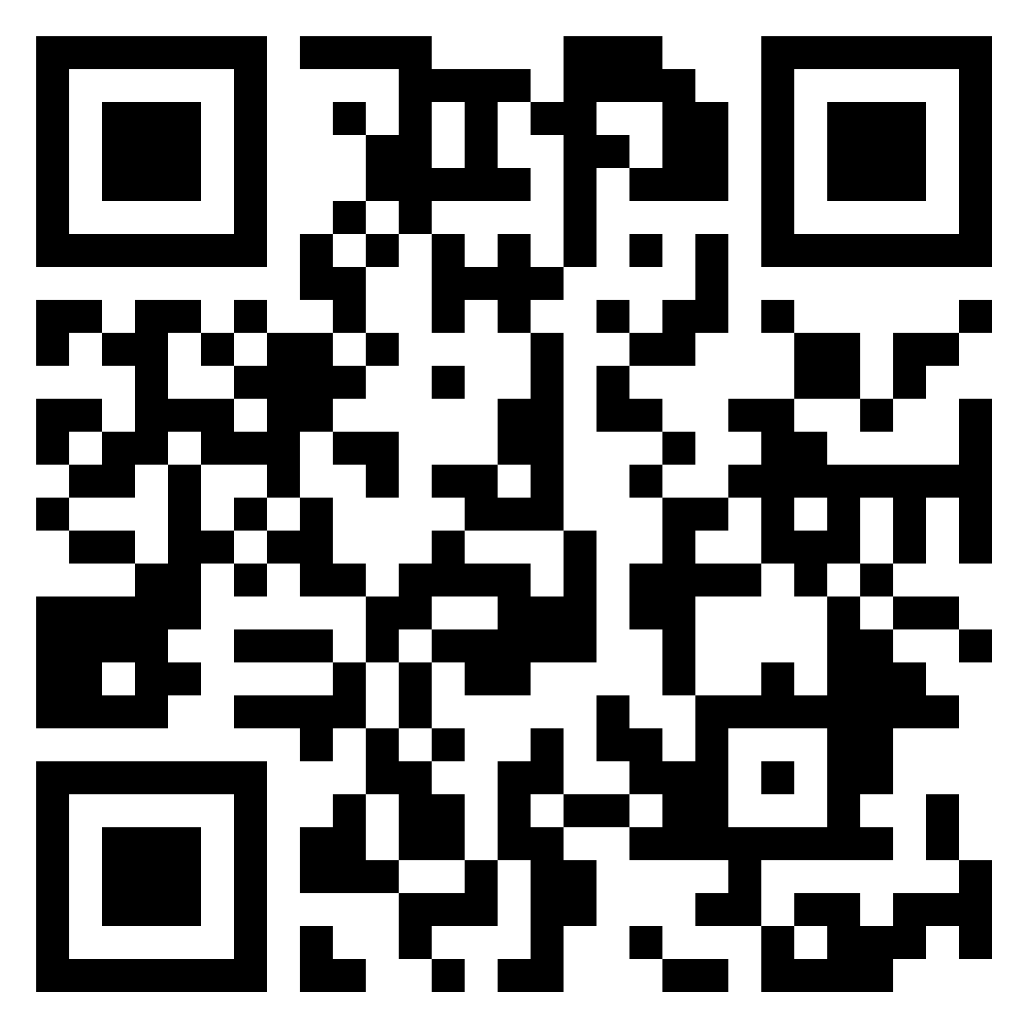
Questions

Slide 16
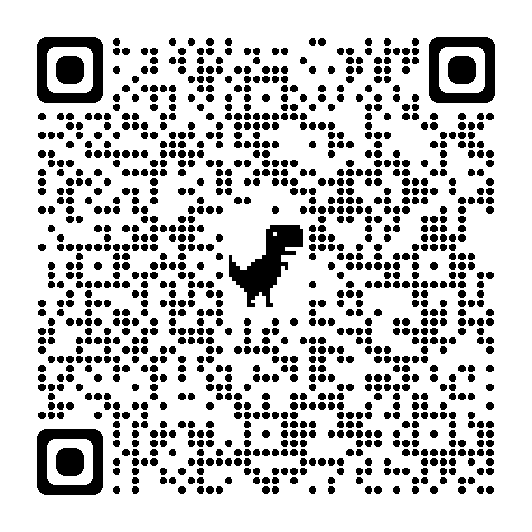
Join our new mailing list to receive news and updates

Slide 17
Session 1
Exploring approaches to creating meaningful connections across the strands of study

Slide 18
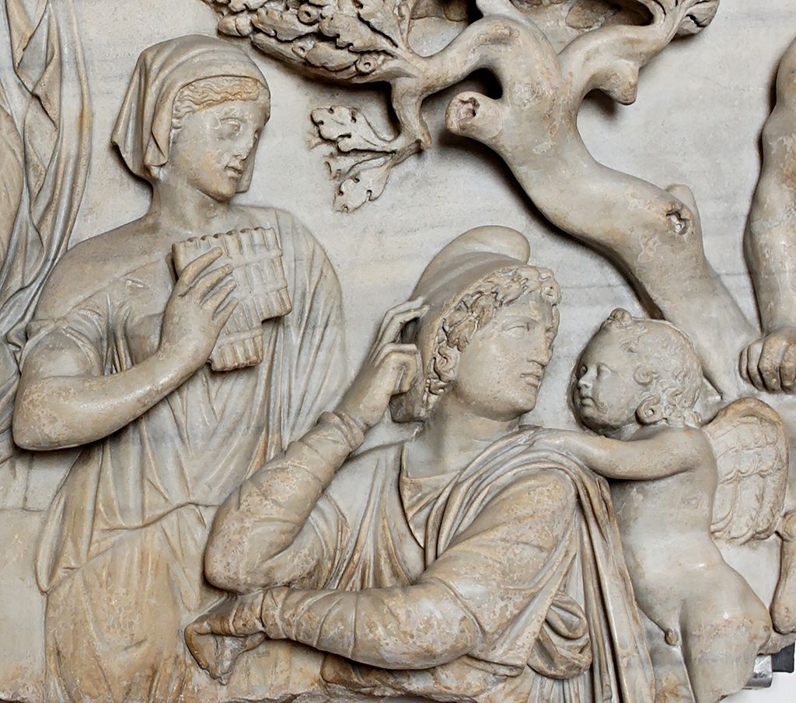
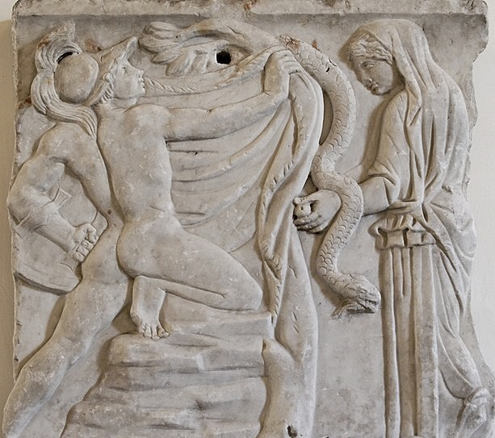
Learning Intentions
Explore and develop approaches to student-centred learning
Making connections within and across the strands of study

Slide 19
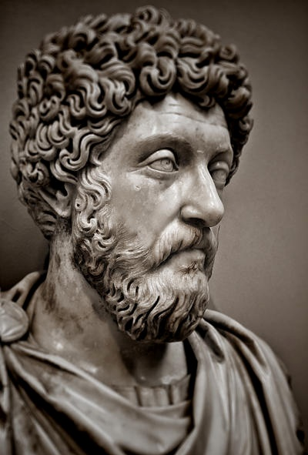
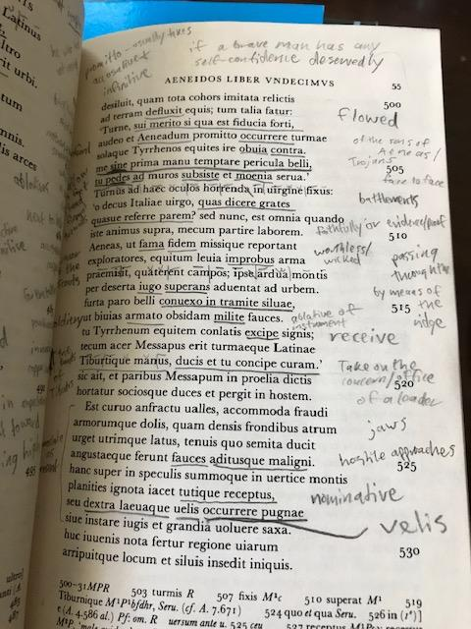
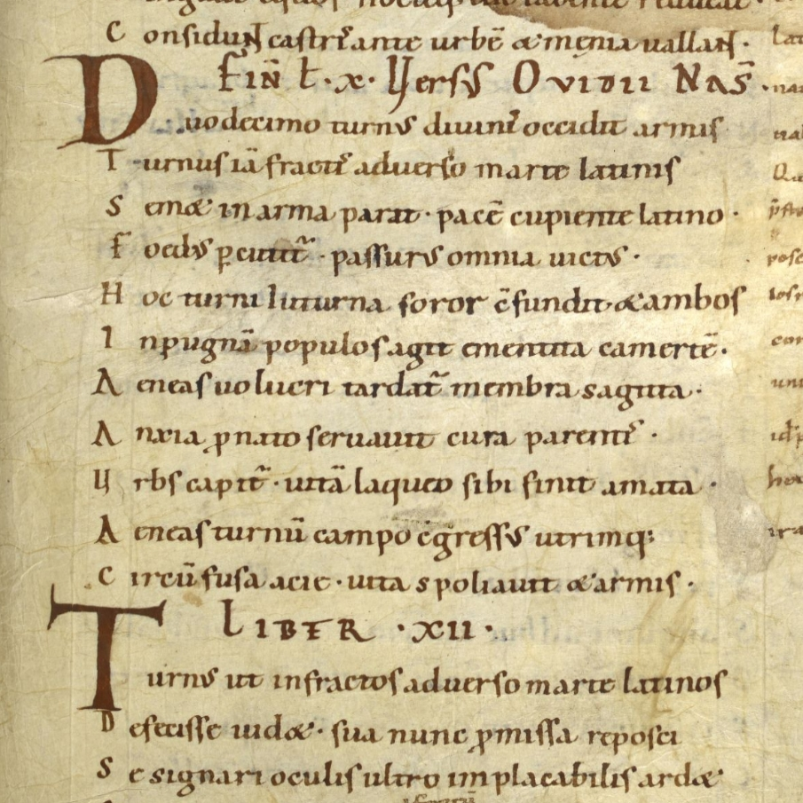
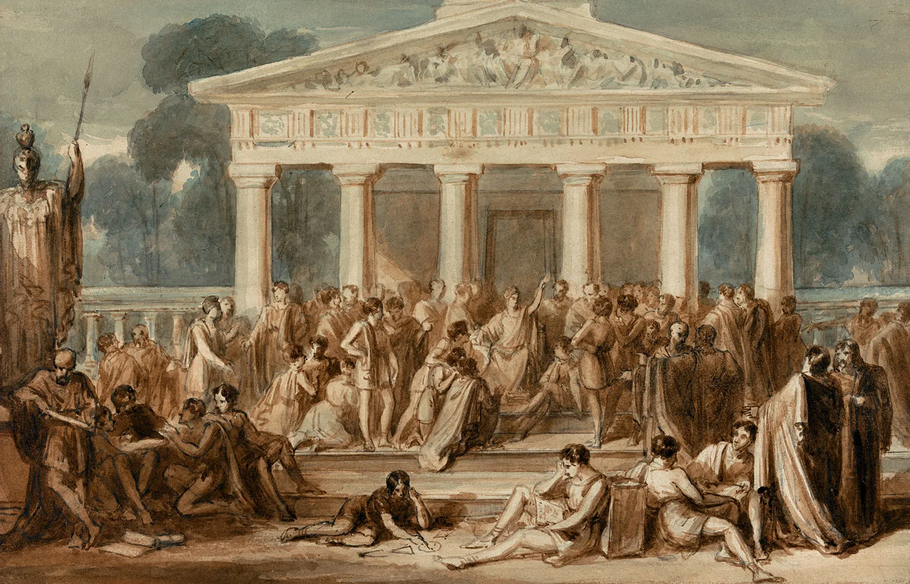
Studying Ancient Greek and Latin
“Through Latin texts, students delve into the values, traditions, and societal norms of antiquity, fostering cultural literacy and awareness.”

Slide 20
Senior Cycle Key Competencies

Slide 21
Key Competencies
The Key Competencies
are linked and blend together
are visible across the curriculum
can help students and teachers to make meaningful connections between and across different areas of learning
can improve students’ overall learning
“The key competencies come to life through the learning experiences and pedagogies teachers choose and through students’ responses to them.”
Department of Education, 2024, P. 8 Curriculum Specification for Leaving Certificate Latin

Slide 22
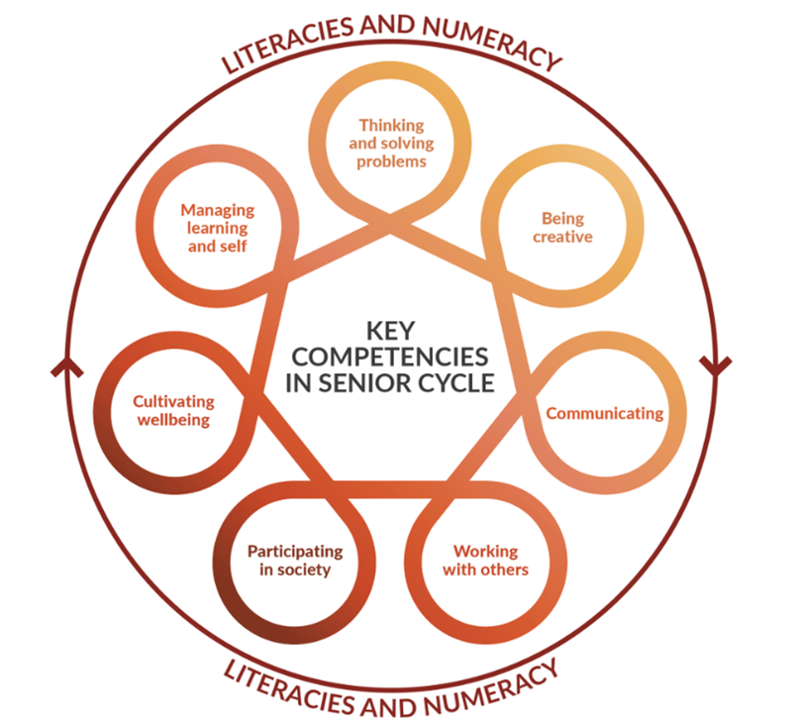
Visibility of Key Competencies
“The key competencies come to life through the learning experiences and pedagogies teachers choose and through students’ responses to them. Students can and should be helped to develop their key competencies irrespective of their past or present background, circumstances or experiences and should have many opportunities to make their key competencies visible.”
Department of Education, 2024, P. 2 Curriculum Specification for Leaving Certificate Latin

Slide 23
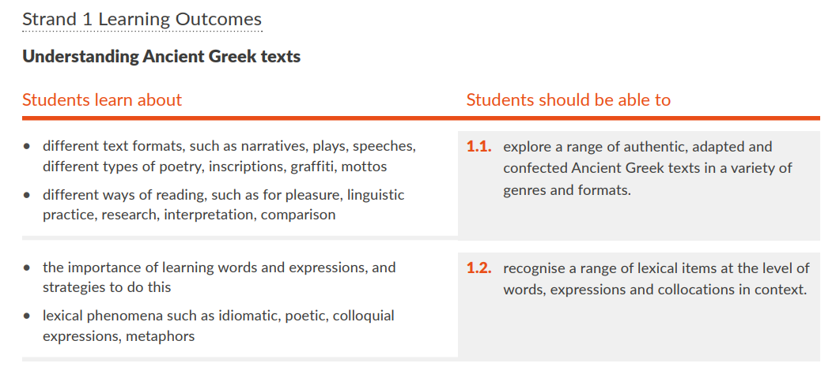
Strands of Study Overview
The left-hand column outlines specific areas that students learn about.
Learning outcomes which describe the knowledge, skills, values and dispositions students should be able to demonstrate after a period of learning.
Learning outcomes promote teaching, learning and assessment processes that develop students’ knowledge, skills, values and dispositions.
An indicative vocabulary list and guidelines - provided by the NCCA as supports for teachers.

Slide 24
Capstone Text
Capstone
Keystone
Key Competencies
Cornerstone
Students should be able to
Students learn
about
Cornerstone

Slide 25
How will you prepare for teaching, learning and assessment using the learning outcomes?

Slide 26
Interrelated Strands
Literature in Context
Understanding Ancient Greek/Latin texts
Developing language awareness and analytical skills
Ancient Greek/Latin Language
Ancient Greek/Latin literature
Hellenic/Roman culture explored through Greek texts
Which learning outcomes could work well together within and across the strands?

Slide 27
Considerations around creating learning experiences
1.10 appreciate distinctive features and aims of Latin/Ancient Greek texts
2.5 consider the significance a literary text has for its audience
Students will listen to a recording of Aeneid 1.1-4/Iliad Book 1, with a printout or digital copy in front of them, and be asked to mark the text at the point that a contemporary of Virgil/Homer would have known they were listening to an epic

Slide 28
Aeneid 1.1-4

Slide 29
Iliad Book 1

Slide 30
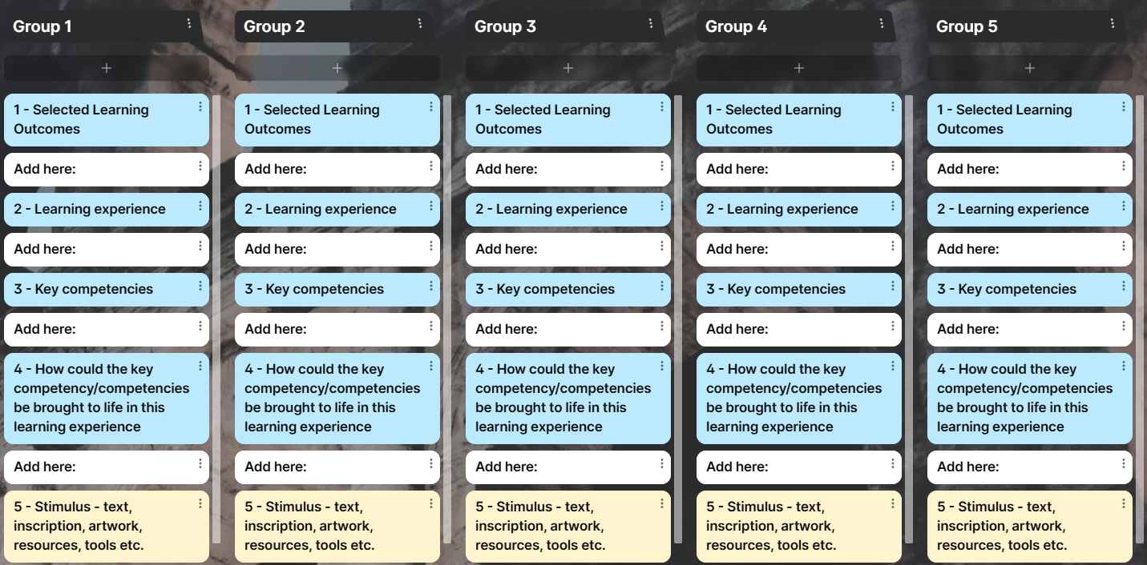
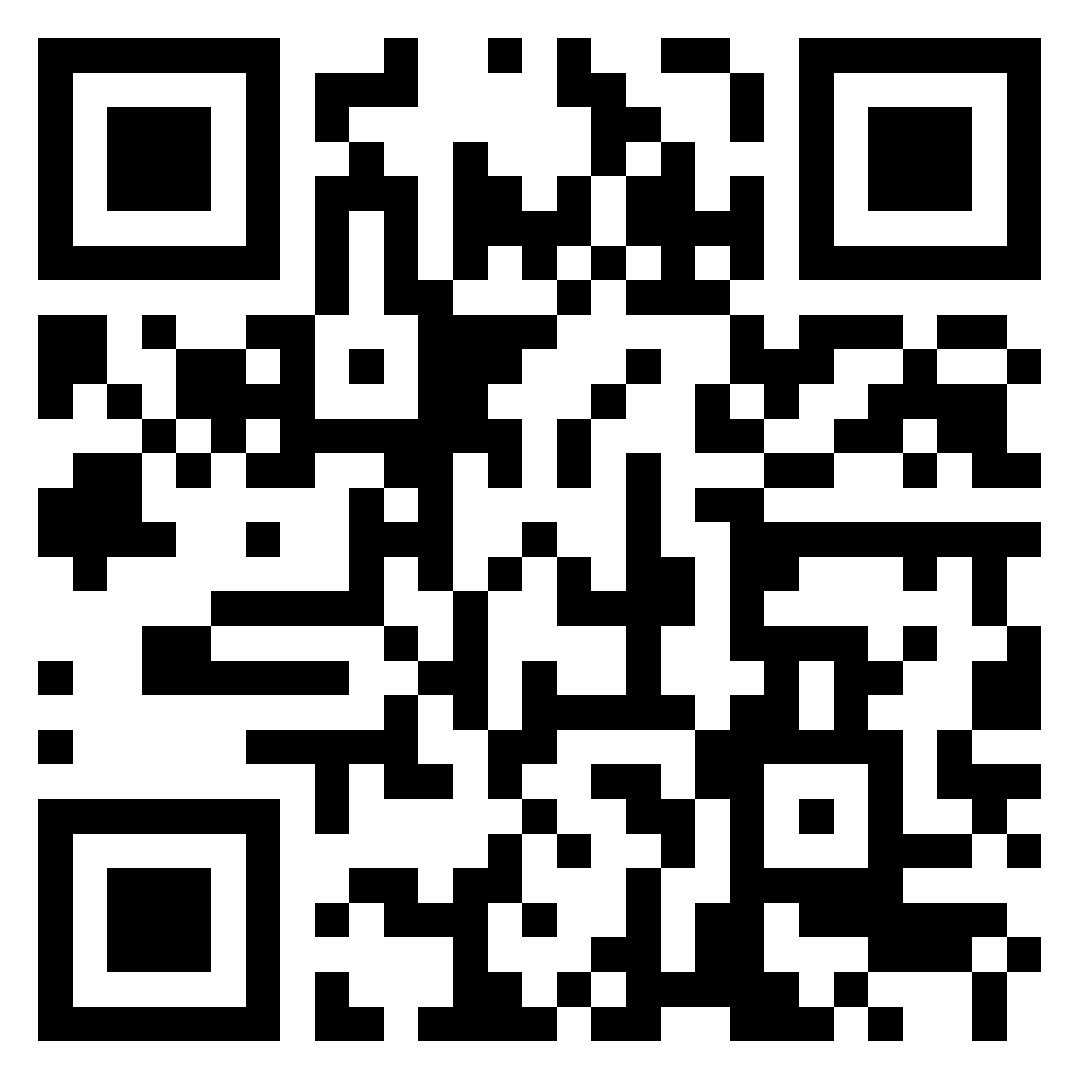
Making connections and developing learning experiences
Select learning outcomes that may connect to each other
Name and list possible learning experience(s)
Identify the key competencies that may be developed and explain how they could be brought to life through this learning experience

Slide 31
How do you put the student at the centre of the learning?

Slide 32
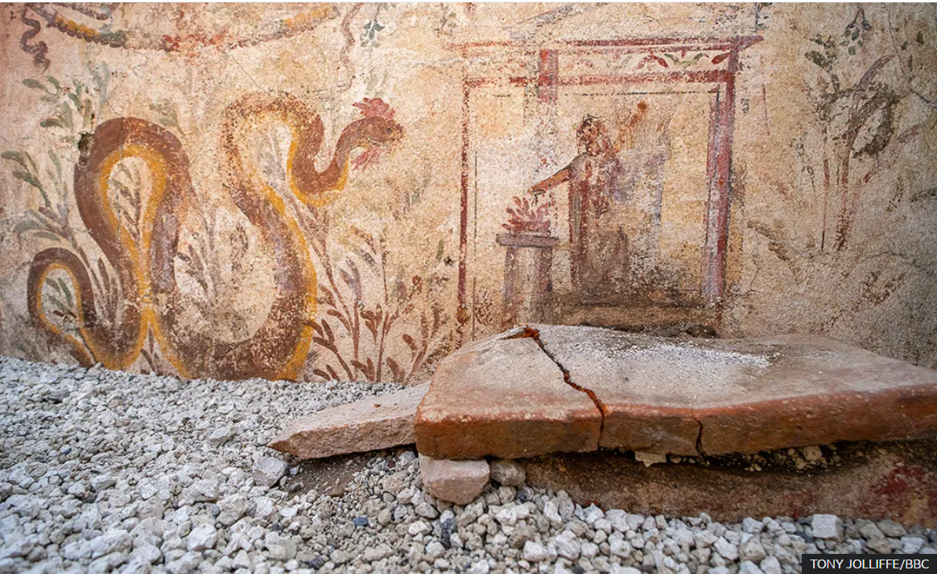
Tea/Coffee Break

Slide 33
Session 2
Developing key competencies through authentic classical texts

Slide 34
CEFR Alignment
“the ultimate goal is not that students become effective users of the classical language, but that they become effective readers of texts written in the language, which is no longer the native language of any community but retains significant cultural and historical relevance.”
Reception
Production
Interaction
Mediation
RECEPTION
MEDIATION

Slide 35
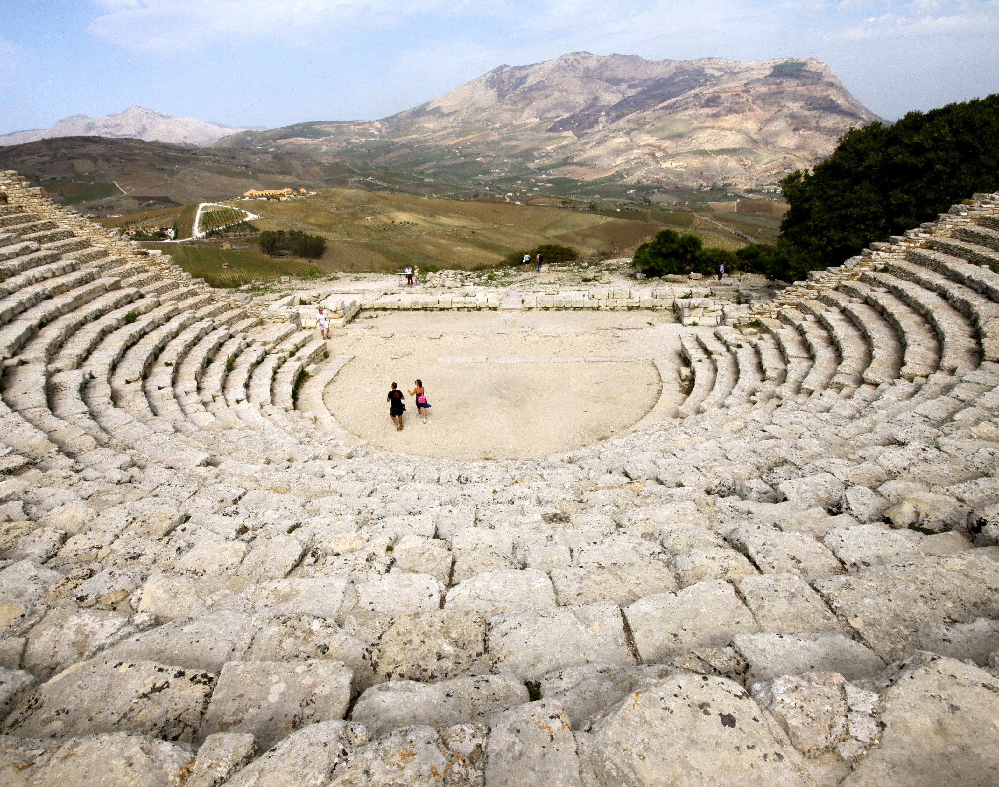
Learning Intention
To examine how the key competencies may be developed using ancient source material
This Photo by Unknown Author is licensed under CC BY-SA

Slide 36
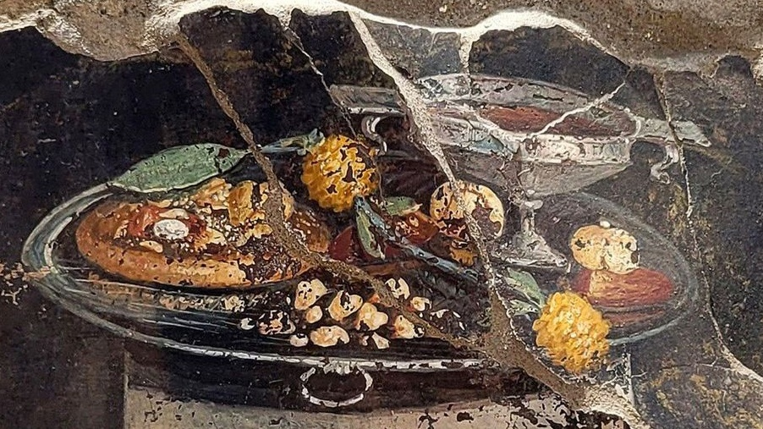
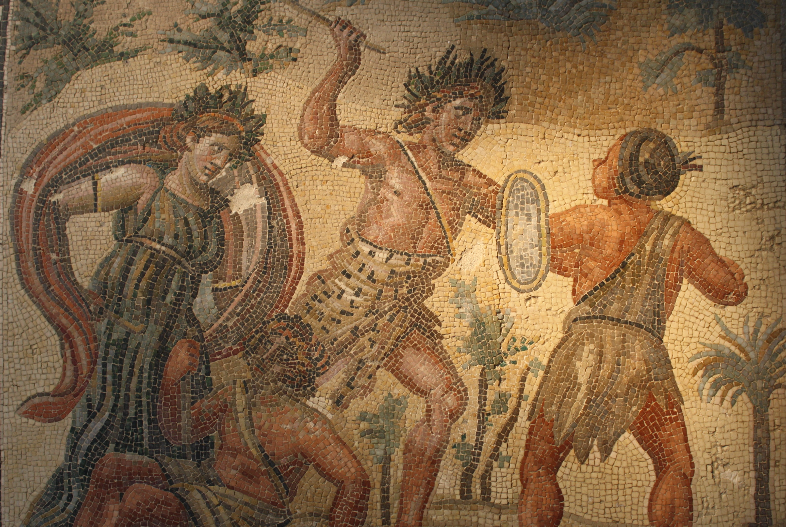
The Importance of Language

Slide 37
What knowledge, skills and values and dispositions are needed, or connect with, your suggested learning experience?
Values and dispositions
Knowledge
Skills

Slide 38
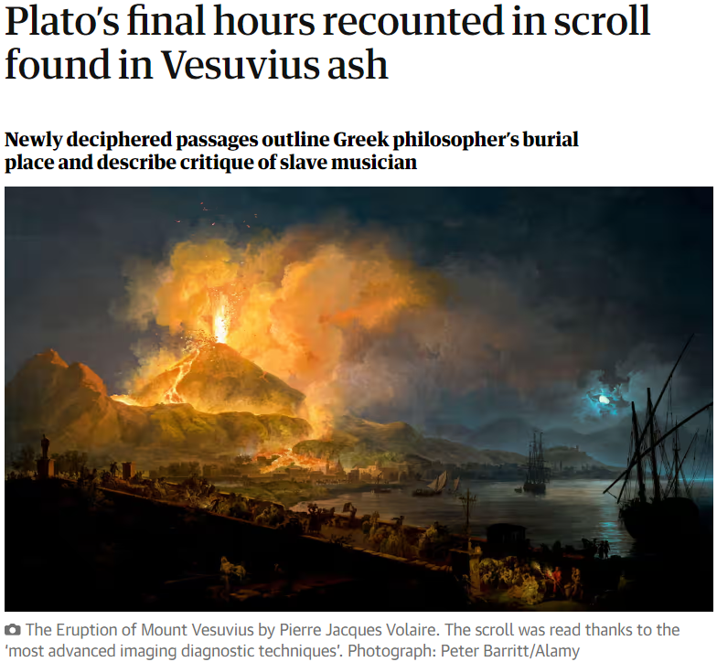
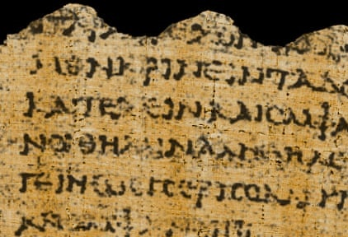
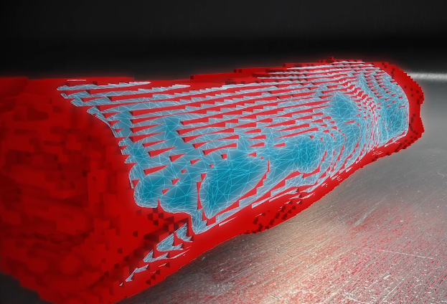
Engaging with Authentic Texts
“The focus of these language specifications is not on acquiring historical knowledge in its own right. Throughout, the emphasis is on the relationship between text and context, and learning about Greek/Roman history, literature, art and culture should happen during the journey of learning to read Ancient Greek/Latin texts rather than as a separate learning activity.”
Department of Education, 2024, P. 18 Curriculum
Specification for Leaving Certificate Latin

Slide 40
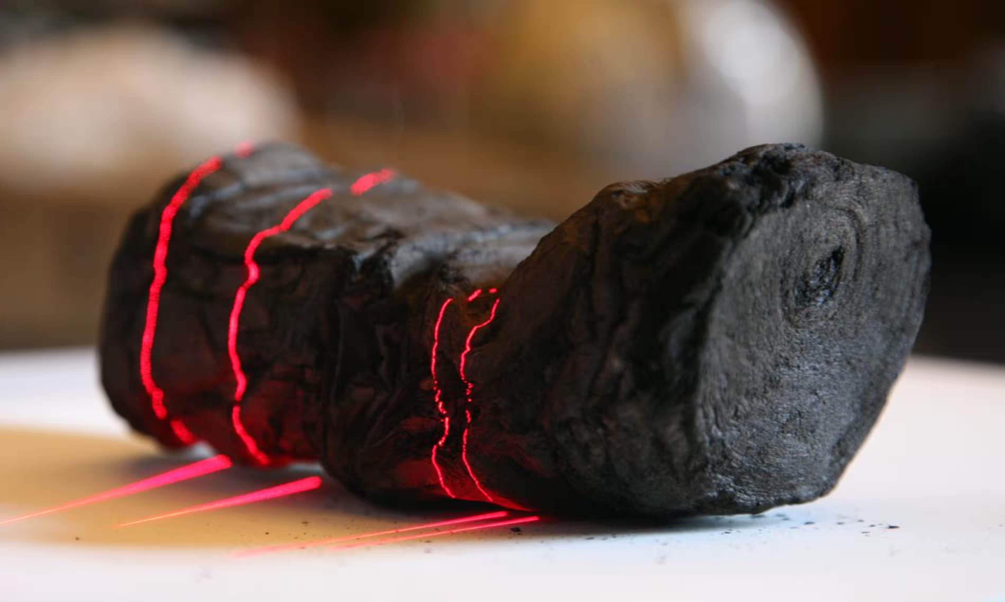

Slide 42
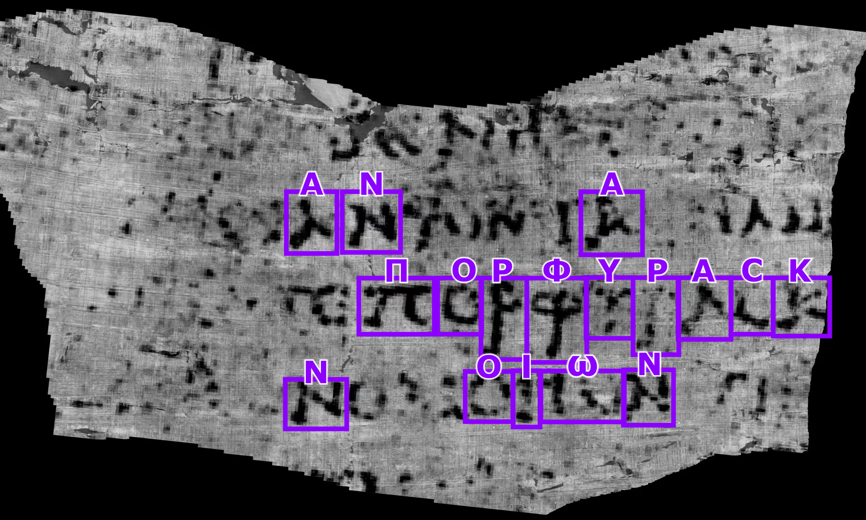
Guardian Piece here

Slide 43
Using Authentic Texts to Support language learning
Knowledge
Skills
Values and dispositions
Who was Plato? What did he do or write? Where was the piece written?
Reading skills: alphabet recognition, punctuation, cases, tenses, comprehension etc.
Context of the text, source, culture, origin, perspective, opinion, considering my own position and my audience.

Slide 44
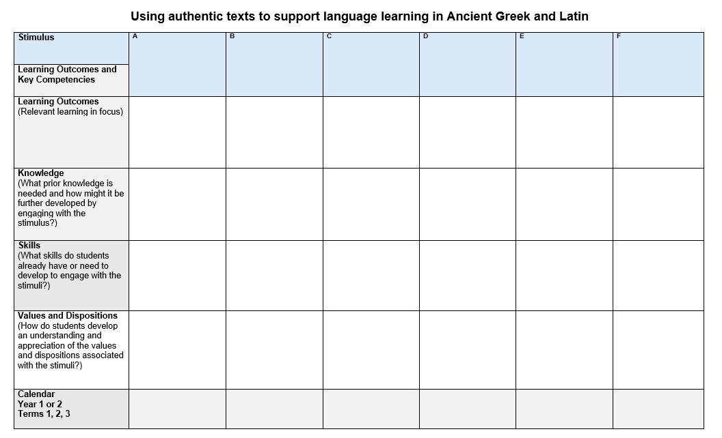

Slide 45
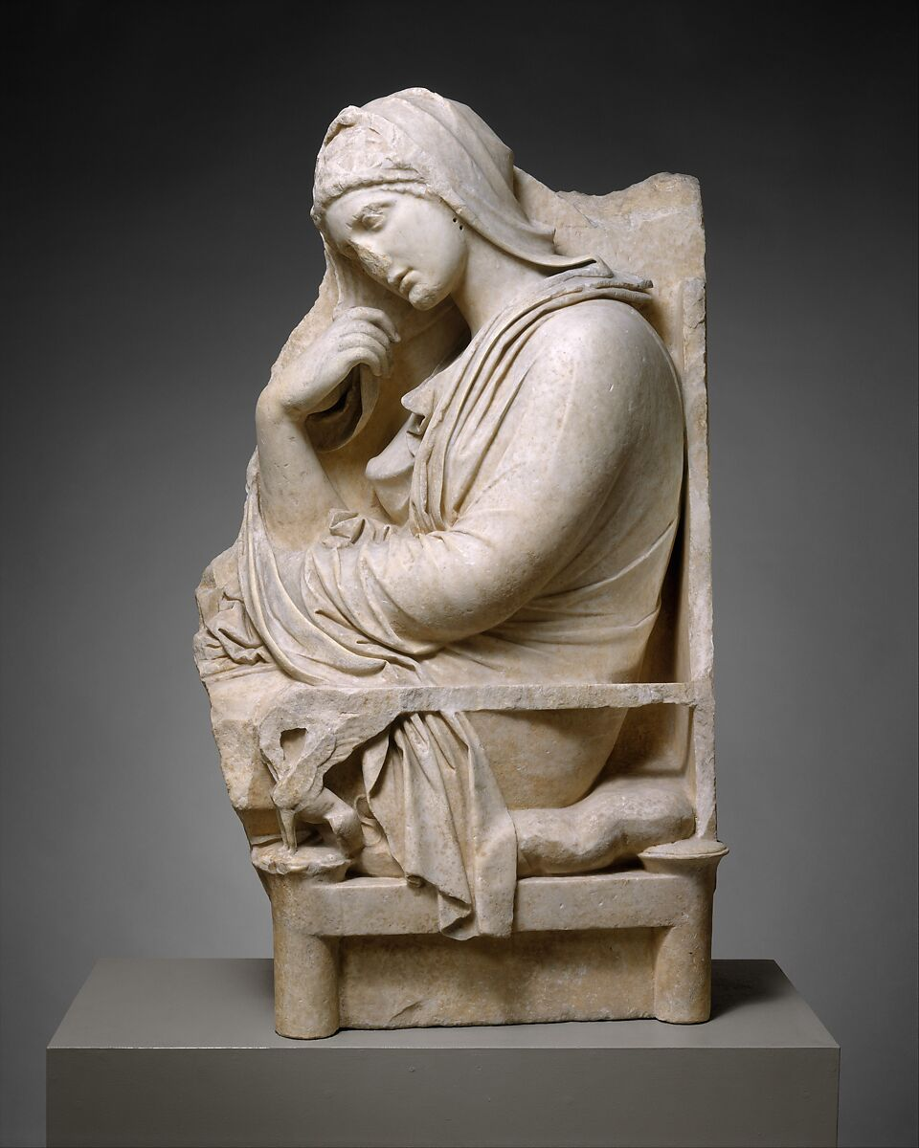
Visibility
What possible connections to the key competencies can be made visible using these sources?
How can we make our students aware of the key competencies they are developing?
Marble stele of a woman Greek, mid-4th century BCE

Slide 46
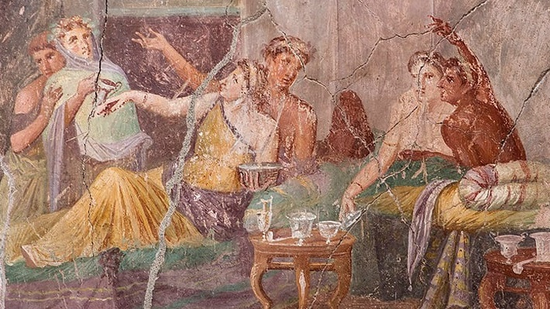
Museum Tour at 12:45-1.15pm

Slide 47
Lunch 1:15-2:00pm

Slide 48
Session 3
Collaborate and consider approaches to teaching cultural contexts in the language learning process

Slide 49
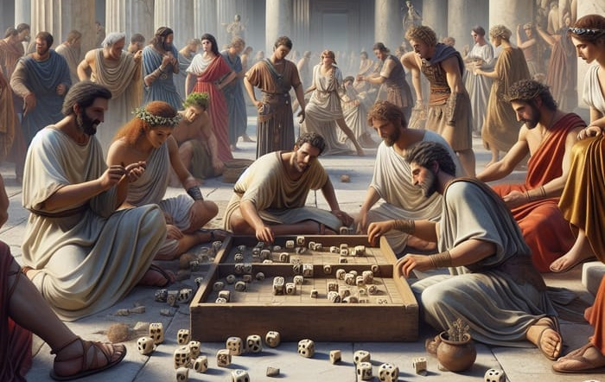
Learning Intentions
Consider approaches to explore cultural contexts in the language learning process
Collaborate to prepare for the introduction of the new specifications into classrooms

Slide 50
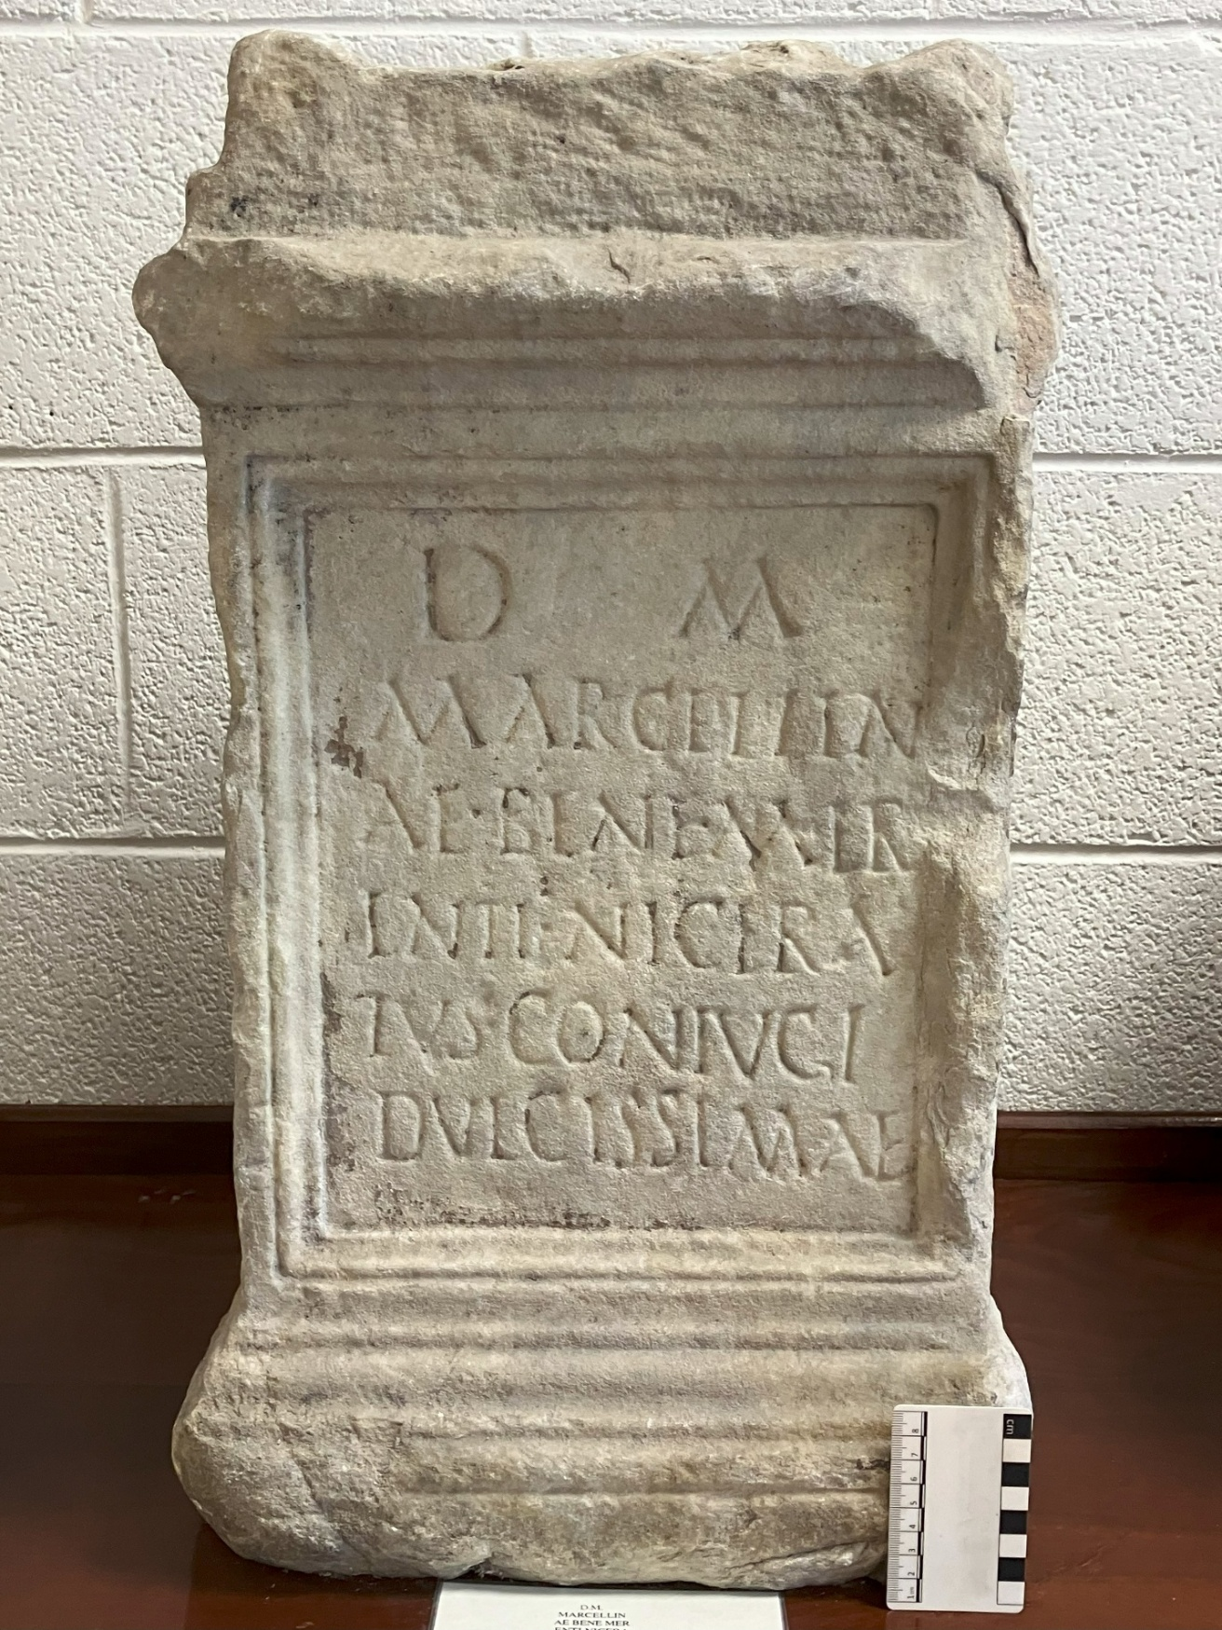
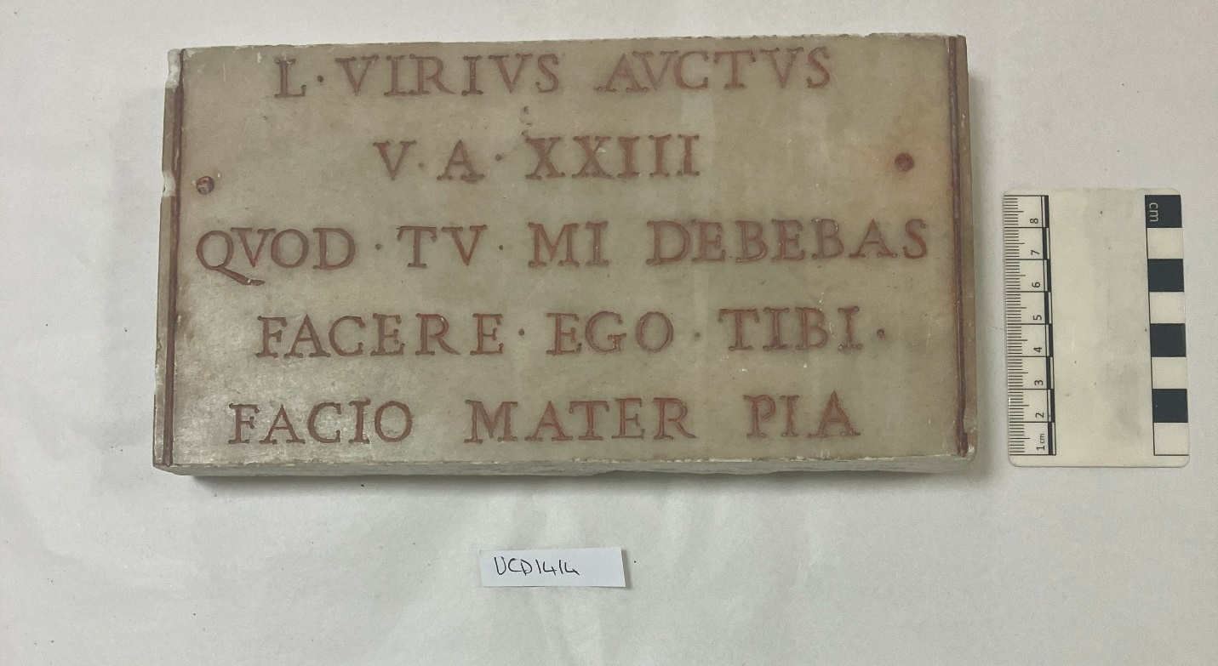
Values and Dispositions

Slide 51
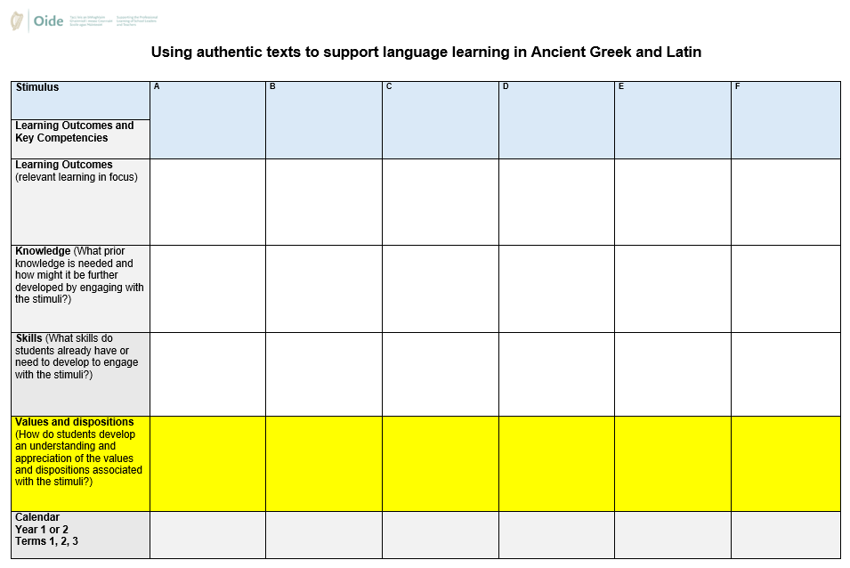

Slide 52
Plurilingual - Plurilingualism is the dynamic and developing linguistic repertoire of an individual user/learner in which they draw on all of their linguistic and cultural resources and experiences in order to participate more fully in social and educational contexts.
Pluricultural - Pluriculturalism: In a person’s cultural competence, the various cultures to which that person has gained access do not simply co-exist side by side; they are compared, contrasted, and actively interact to produce an enriched, integrated pluricultural competence.

Slide 53
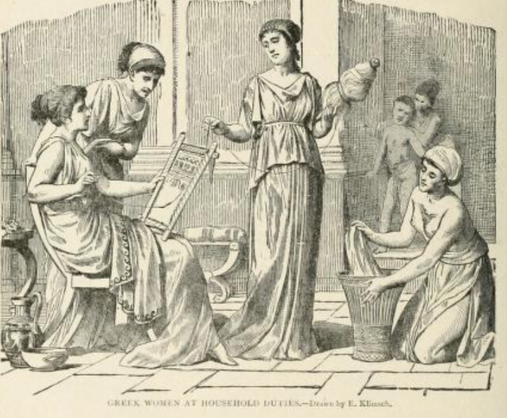
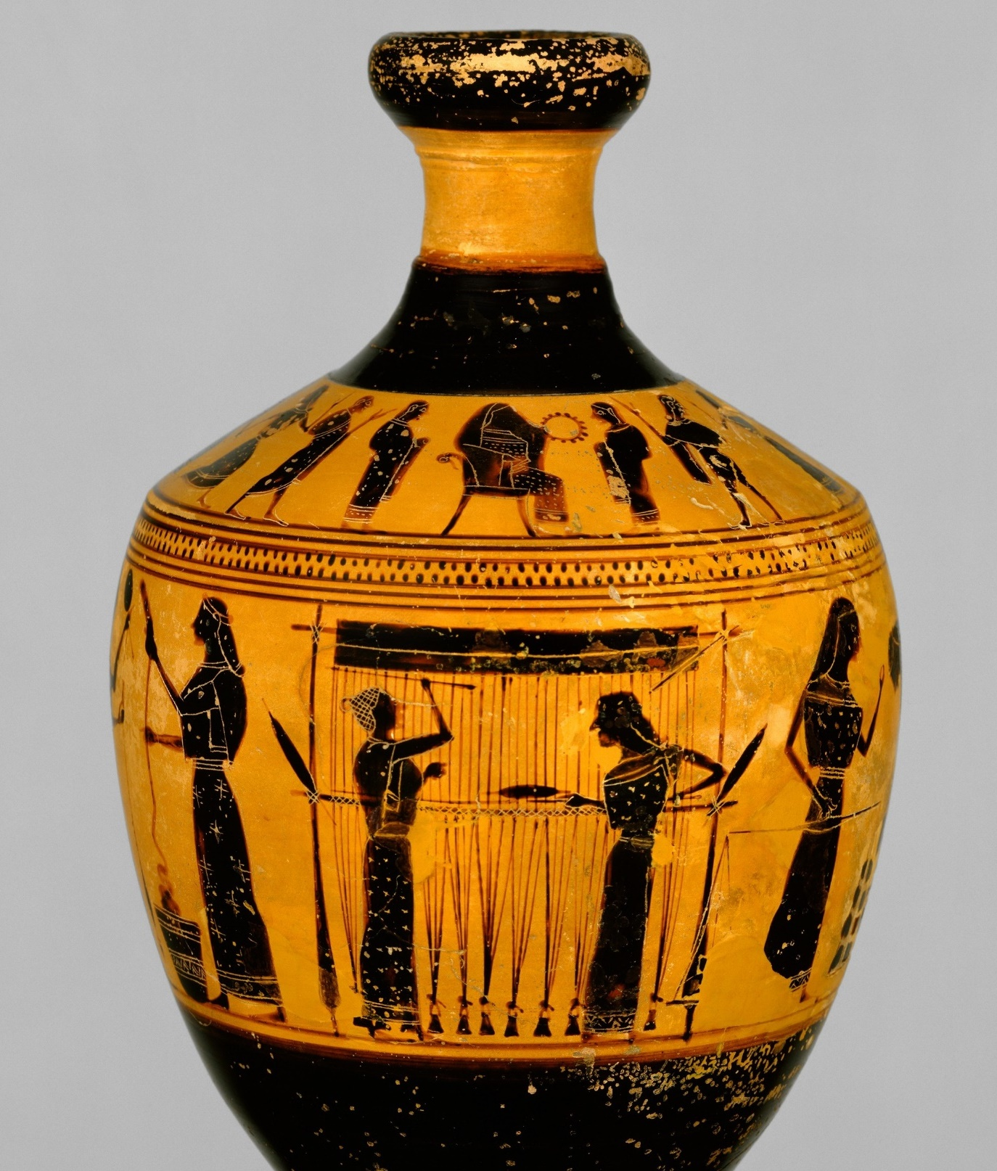
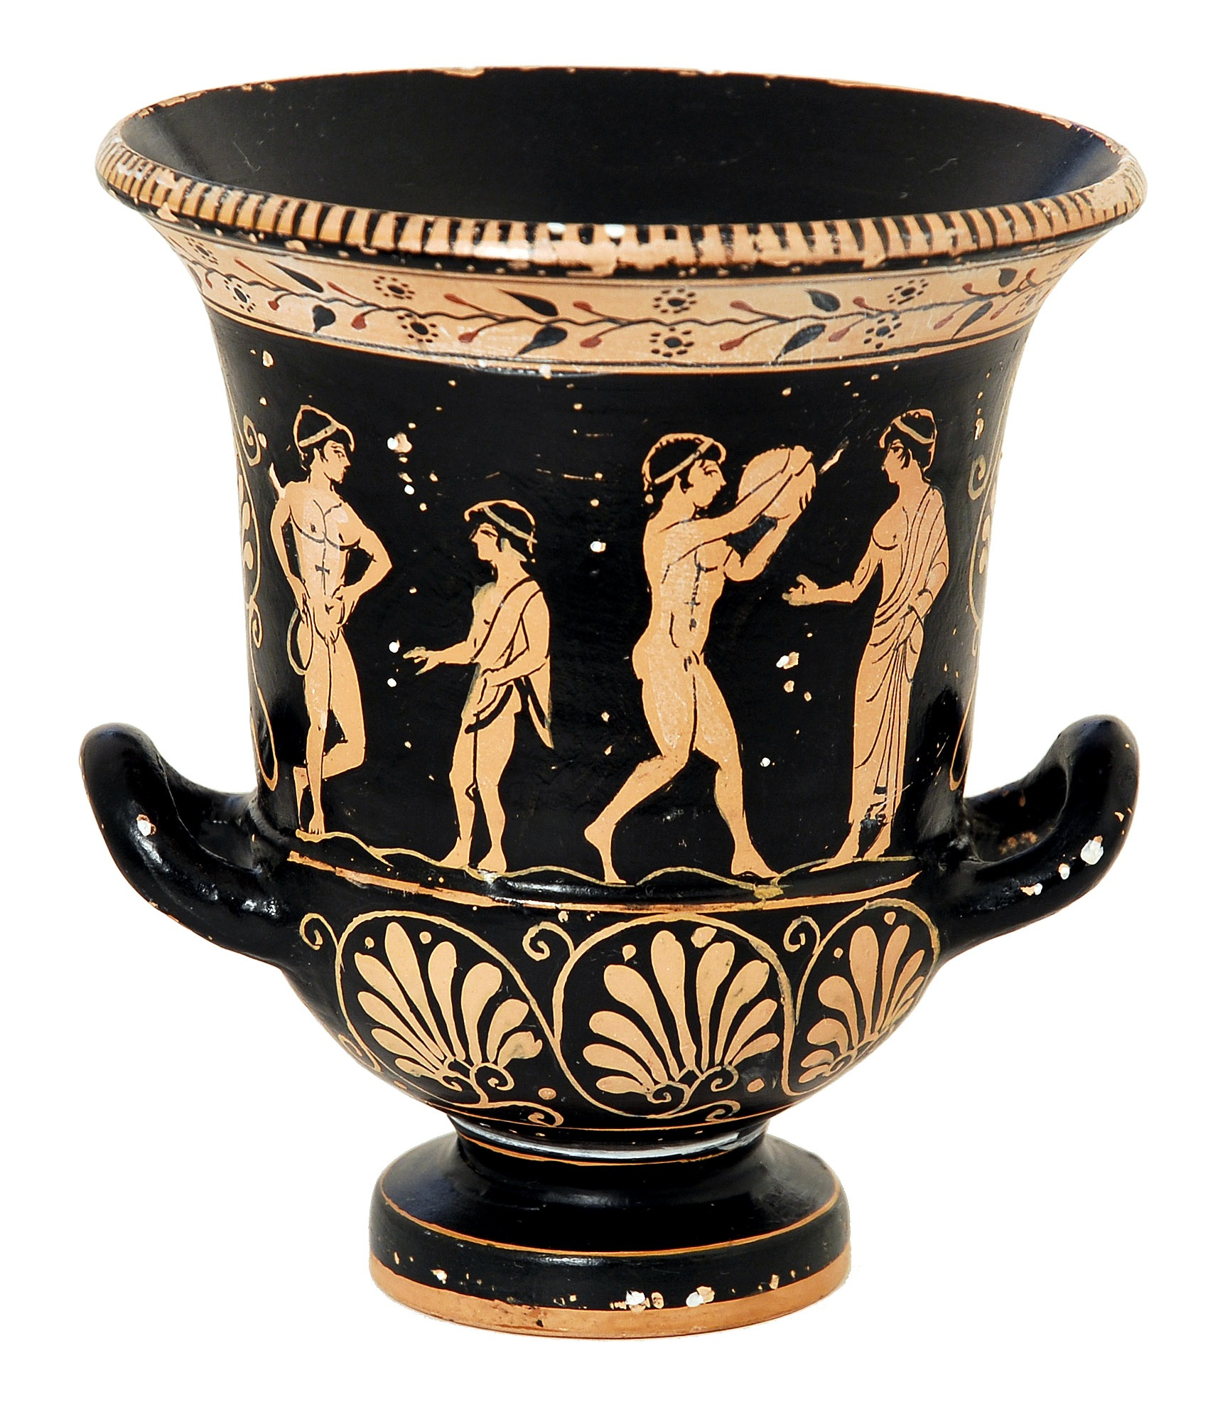
What is the role of cultural context in the language learning process?

Slide 54
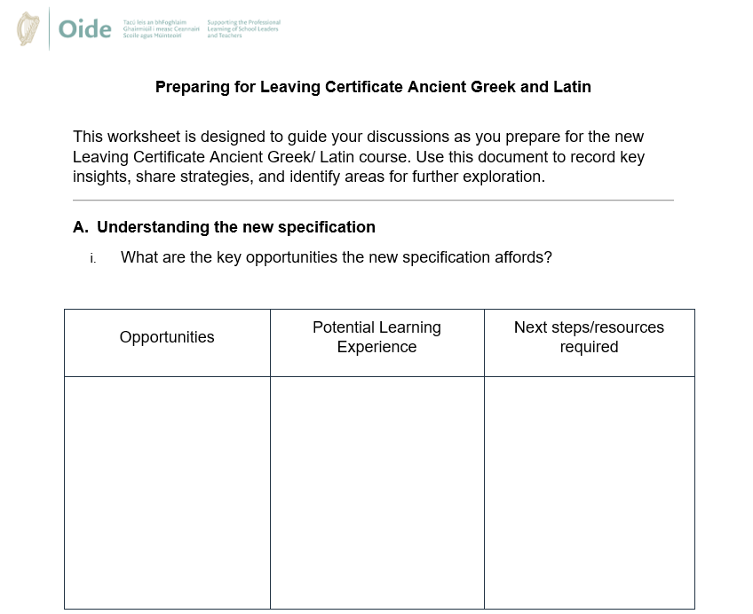
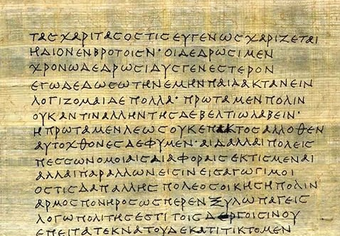
Collaboration

Slide 55
Collaborative Approaches for Student-Centred Teaching, Learning and Assessment

Slide 56
Reflection: What are your next steps?
Familiarise yourself with the specification
Familiarise yourself with senior cycle Key Competencies
Resources: CAI-T, Oide Website, Oide X accounts etc.

Slide 57
Oide timeline of supports for Classical Languages
Classical Languages Introduction to Ancient Greek and Latin Specifications - Webinar
Classical Languages Online
September 2025
the new specifications for Ancient Greek and Latin begin to be taught in schools
November2024
March 2025
Term 3
2025
Term 1
2025
Full Day Face to Face PLE
Full Day Face to Face PLE

Slide 58
Additional Supports
Visit our website www.oide.ie
Contact: info@oide.ie
Join our new mailing list to receive news and updates
Follow us on X
@Oide_Classics

Slide 59
Sharing Resources

