Slide 1
Classical Languages
An Exploration of the Classical Language Specifications
Ancient Greek and Latin

Slide 2
Classical Languages
An Exploration of the Classical Language Specifications
Ancient Greek
and Latin

Slide 3
Oide Timeline of Supports for Classical Languages
Classical Languages Introduction to Ancient Greek and Latin Specifications - Webinar
Classical Languages Online Collaborative
September 2025
the new specifications for Ancient Greek and Latin begin to be taught in schools
November 2024
March 2025
May
2025
November
2025
Full Day Face to Face PLE
Full Day Face to Face PLE

Slide 4
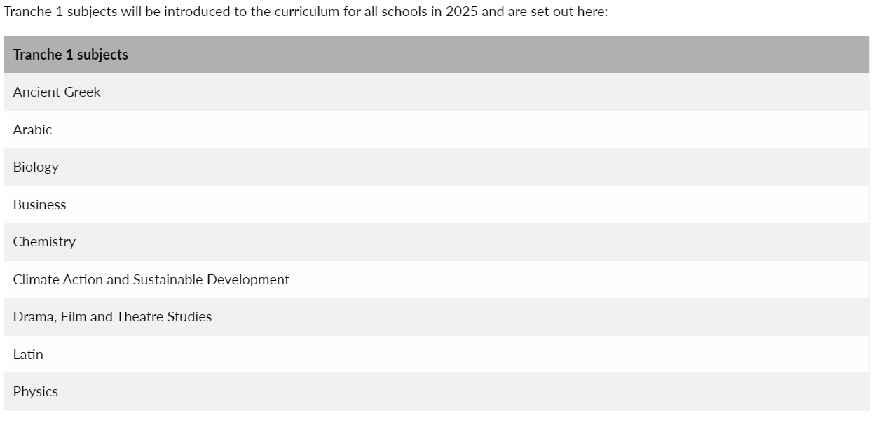
Senior Cycle Redevelopment

Slide 5
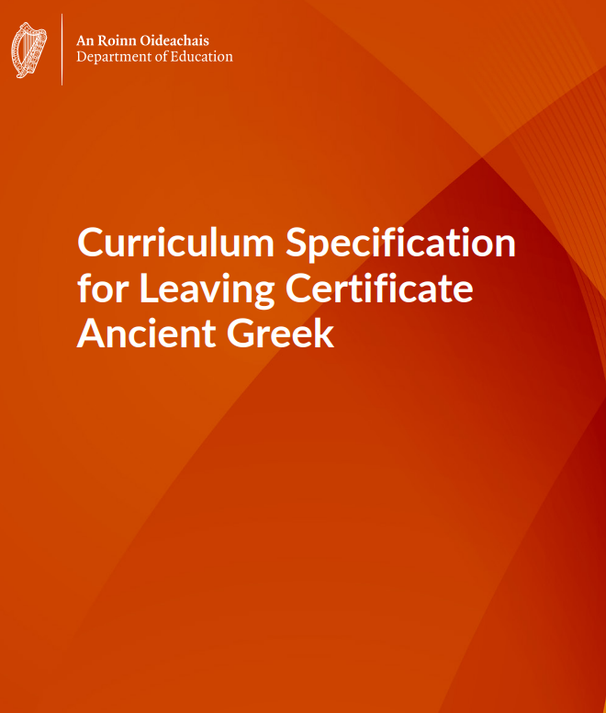
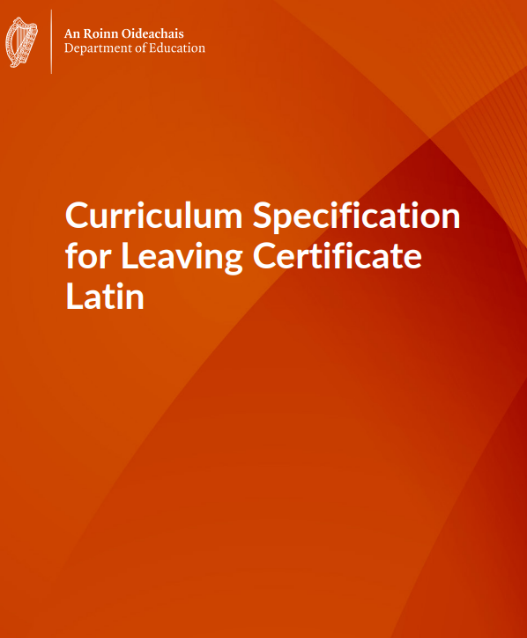
Classical Languages Specifications

Slide 6
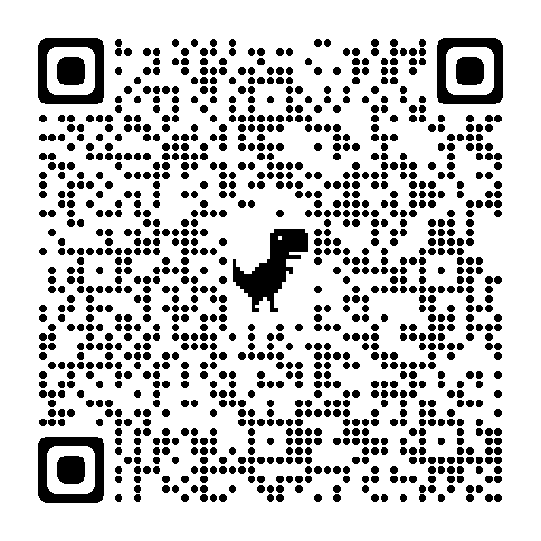
Mailing list

Slide 8
Leaving Certificate Classical Languages Specifications Webinar
General context and overview
Senior cycle key competencies and teaching and learning
Exploring the strands of study and learning outcomes
Assessment for certification

Slide 9
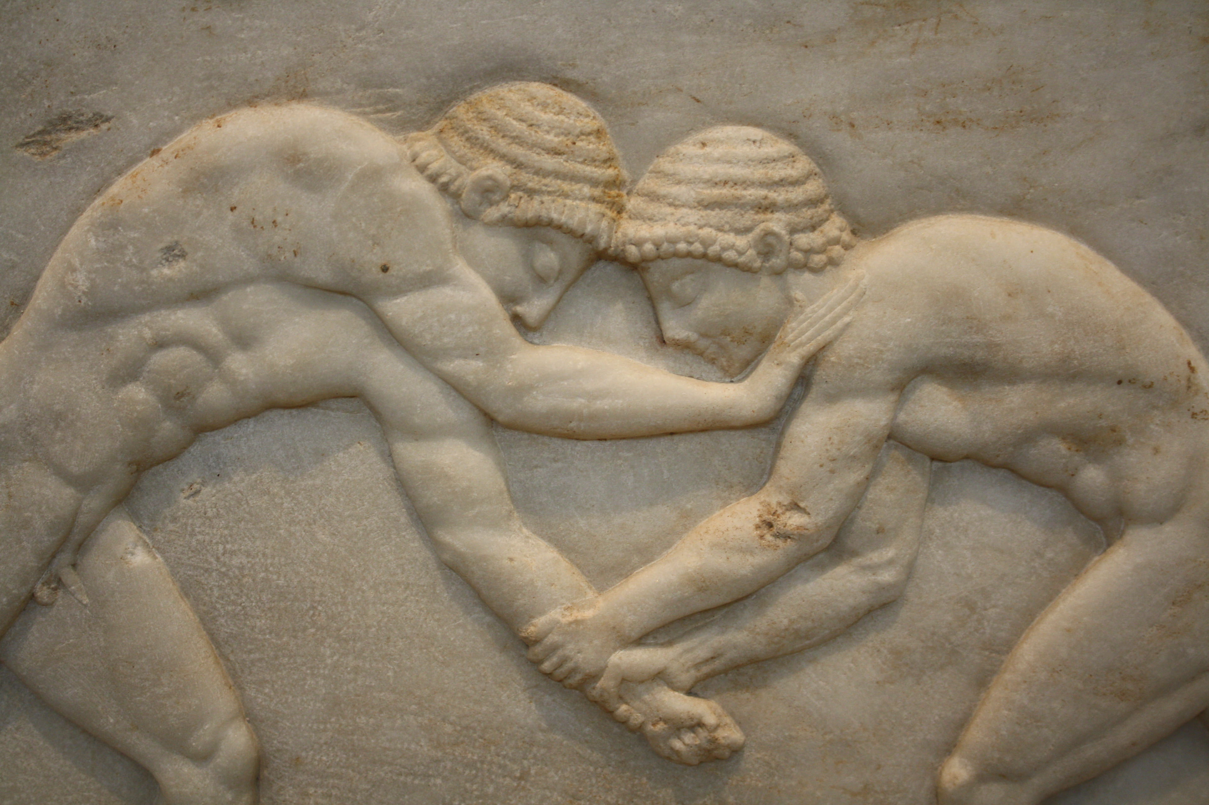
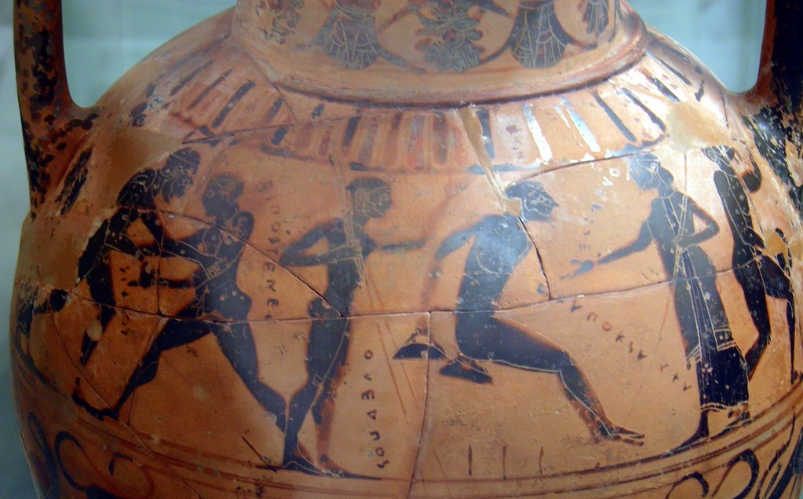
Learning Intentions
Understand the Classical Languages specifications within the broader context of senior cycle
Explore the structure of the Leaving Certificate Classical Language specifications

Slide 10
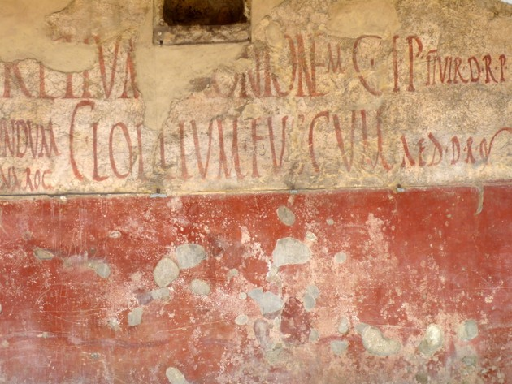
General Introduction
Senior cycle redevelopment
Aims
Rationale

Slide 11
Senior Cycle
“Senior cycle educates the whole person and students’ experiences in senior cycle contribute to their intellectual, social and personal development and their overall wellbeing.
During senior cycle students develop a stronger sense of their identity, learning with and from their peers, teachers, other adults, and various media.”
Department of Education, 2024, p.2 Curriculum Specification for Leaving Certificate Latin

Slide 12
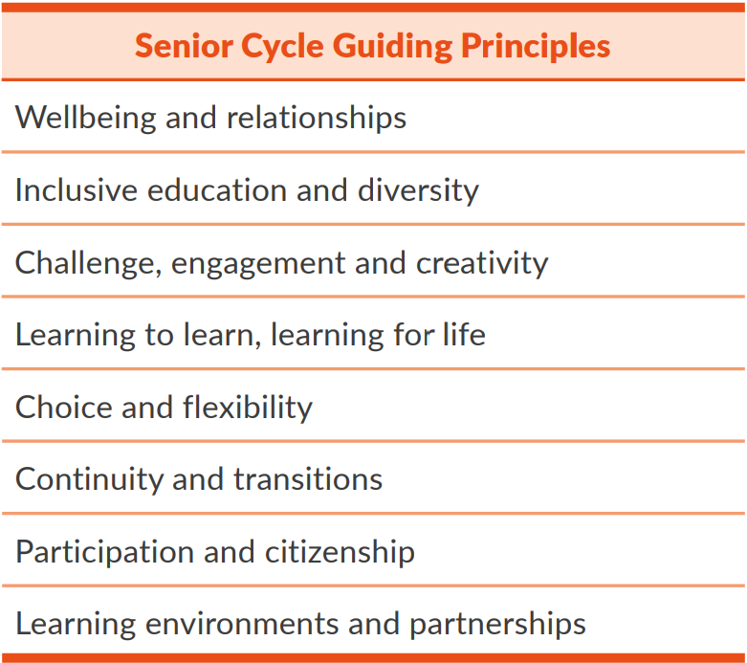
Guiding Principles
Department of Education, 2024, p.2 Leaving Certificate Ancient Greek Specification

Slide 13
Supporting Students
Senior cycle supports students in
making informed choices
preparing them for further education and employment
becoming active participants in society
Senior cycle celebrates
diversity
respects individual strengths and needs
and fosters a culture of inclusivity

Slide 14
Throughout Senior Cycle
Opportunities and Challenges
Deepen
Understanding
Social
Human rights
Environmental
Social justice
Technological
Sustainability
Greater understanding of who they are and their educational journey

Slide 15
Aims of the Ancient Greek and Latin Specifications
Please go to page 5 of the specification.
Read the aims section.
Choose any 2 aims from the bullet pointed list and think of your own classroom context, explain how these aims could be realised.
Break out room to share. (10mins)

Slide 16
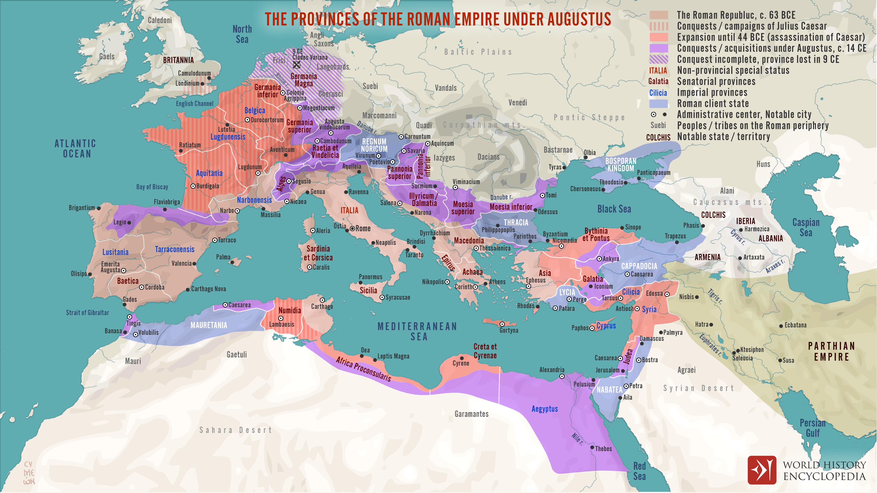

Slide 17
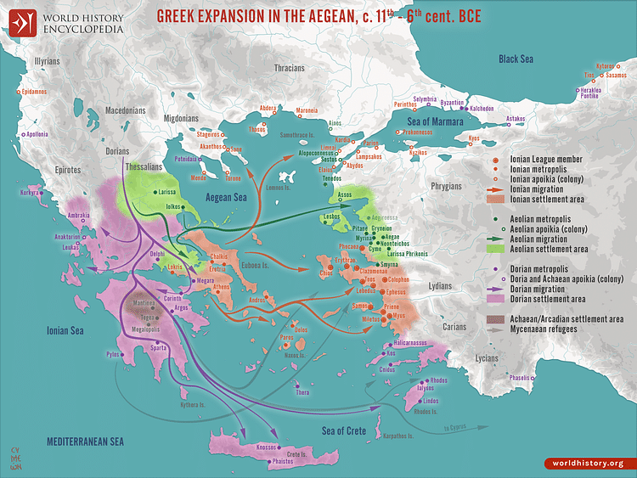

Slide 18
History and Rationale - Latin
pivotal place in history
became a lingua franca as Roman culture spread
shaped intellectual thought and cultural norms
Latin’s influence transcended borders
remains intertwined with technical terminology, law, medicine and the sciences

Slide 19
History and Rationale – Ancient Greek
Athens, in the 5th century BC, became a cultural and political hub, influencing the region
Greek was the language of administration, education, literature and science
famous literature of ancient Greece, especially of Athens, remained a seminal source of inspiration
it has had a major influence on modern foreign languages and technical terminology

Slide 20
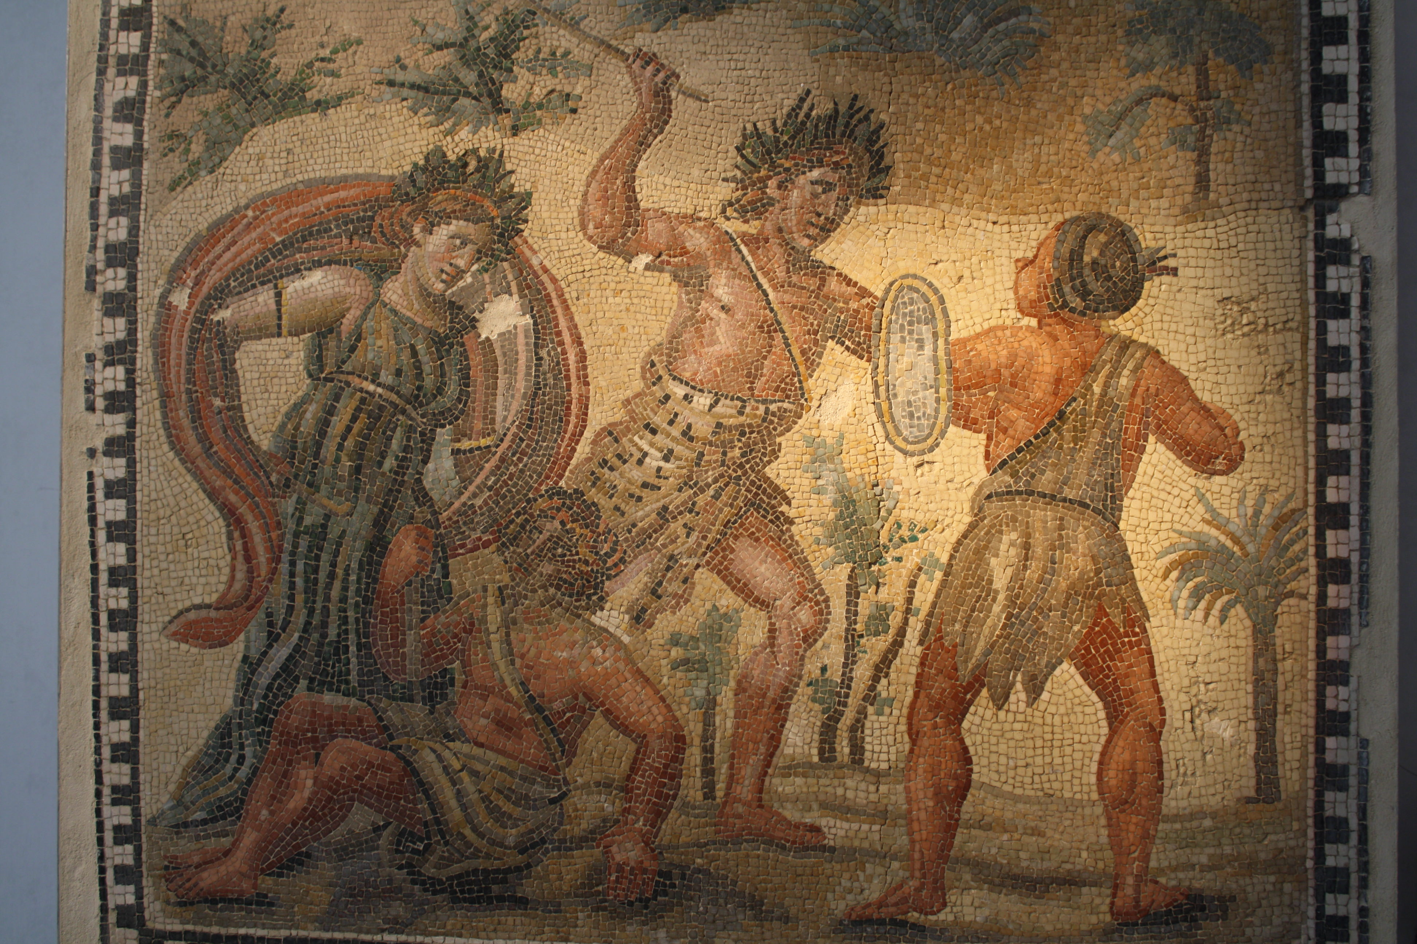
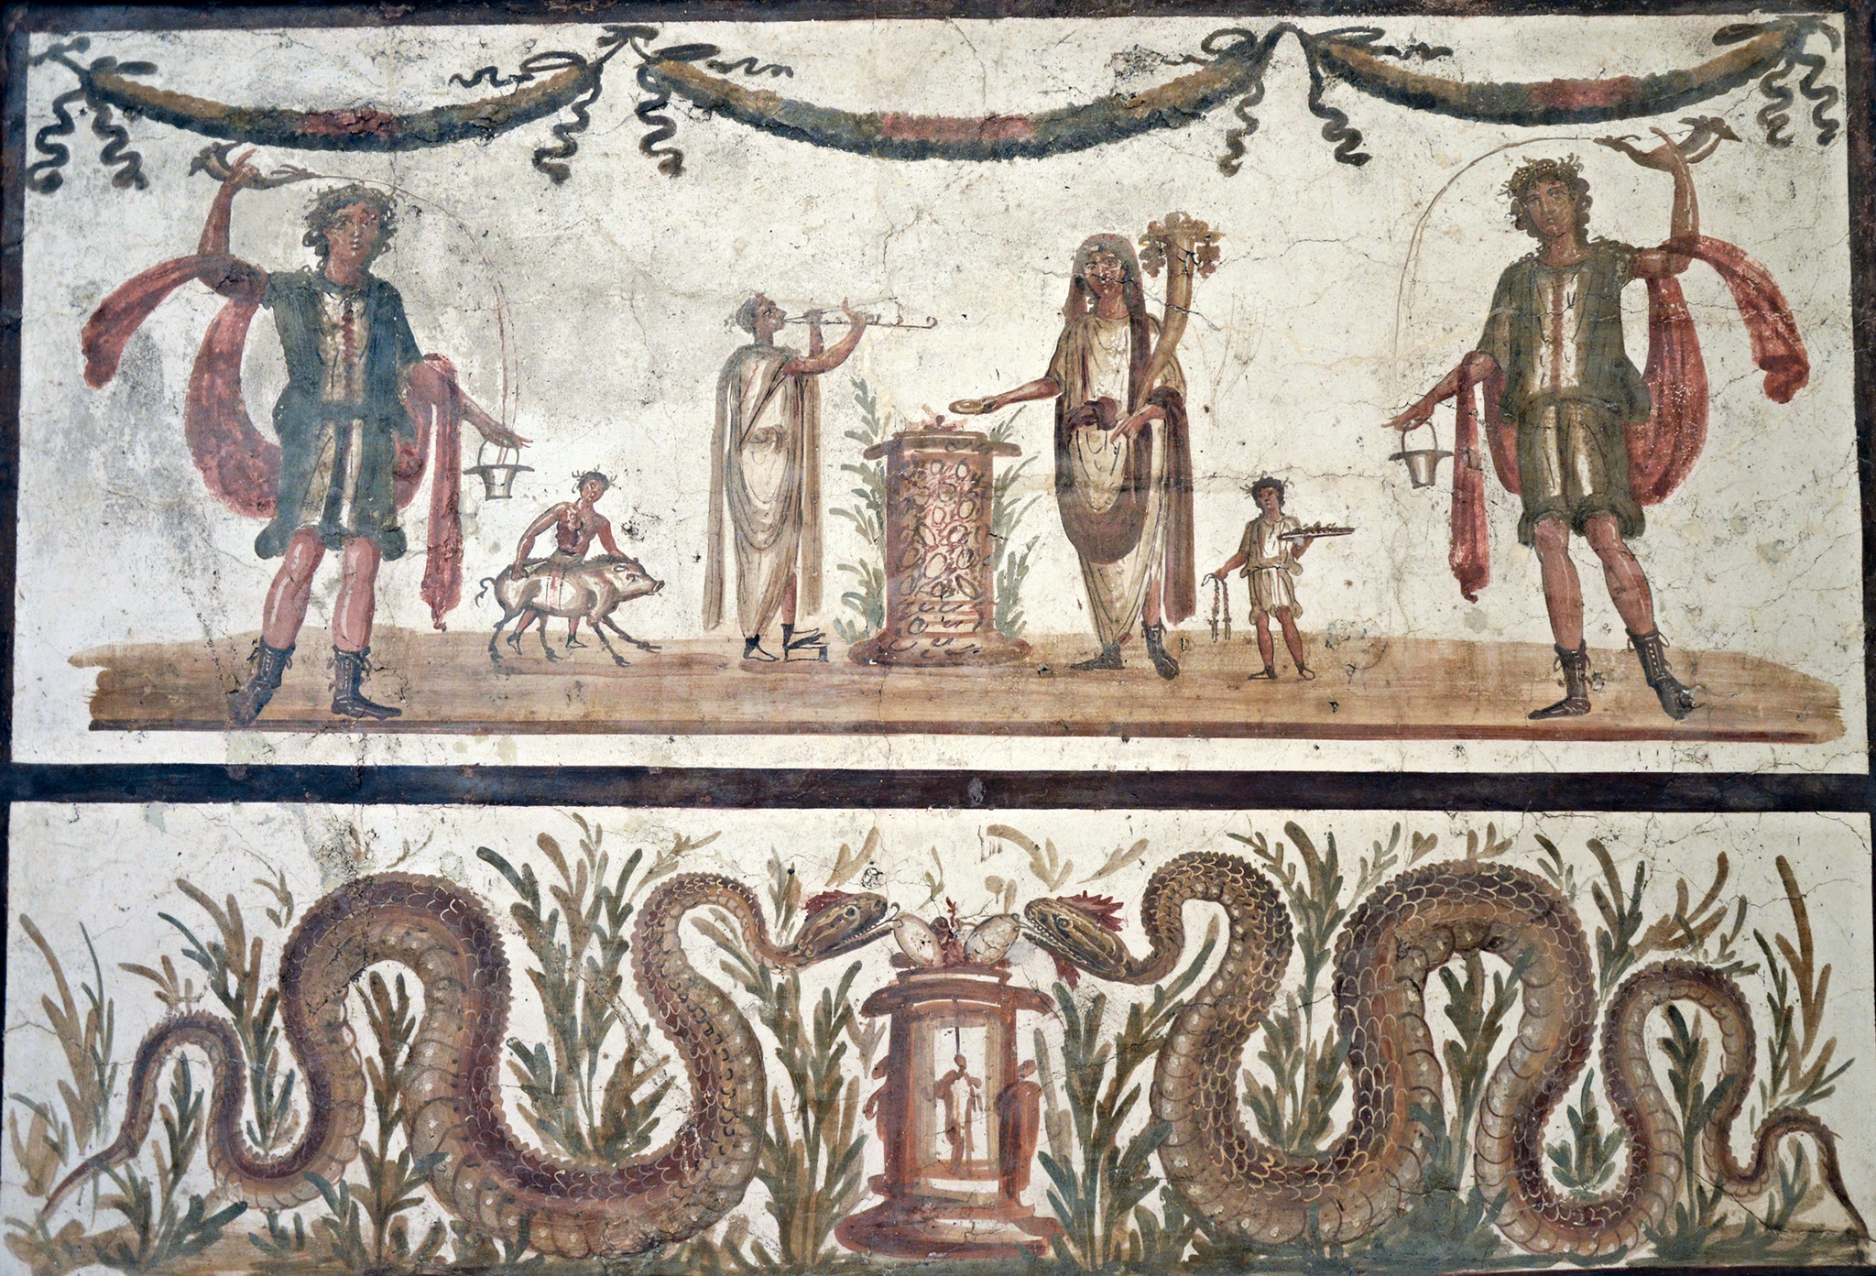
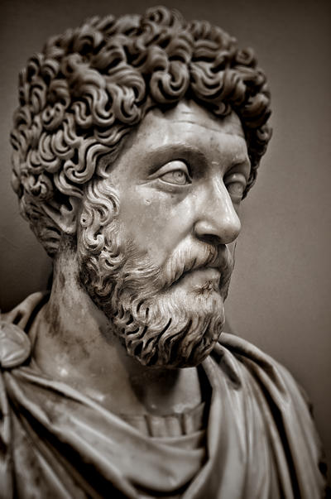
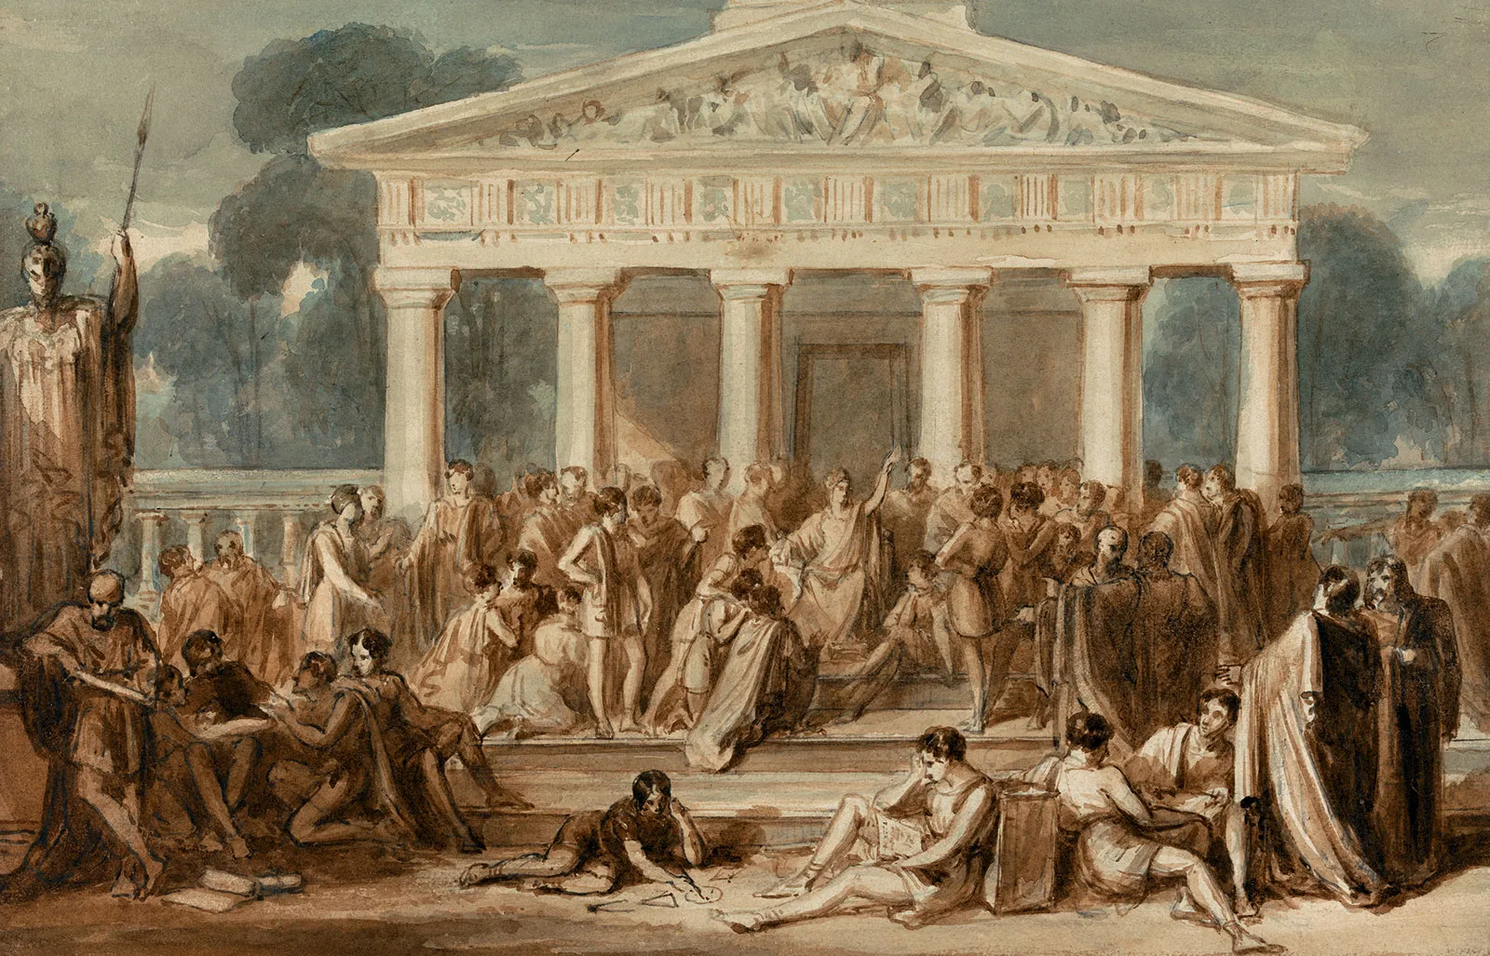
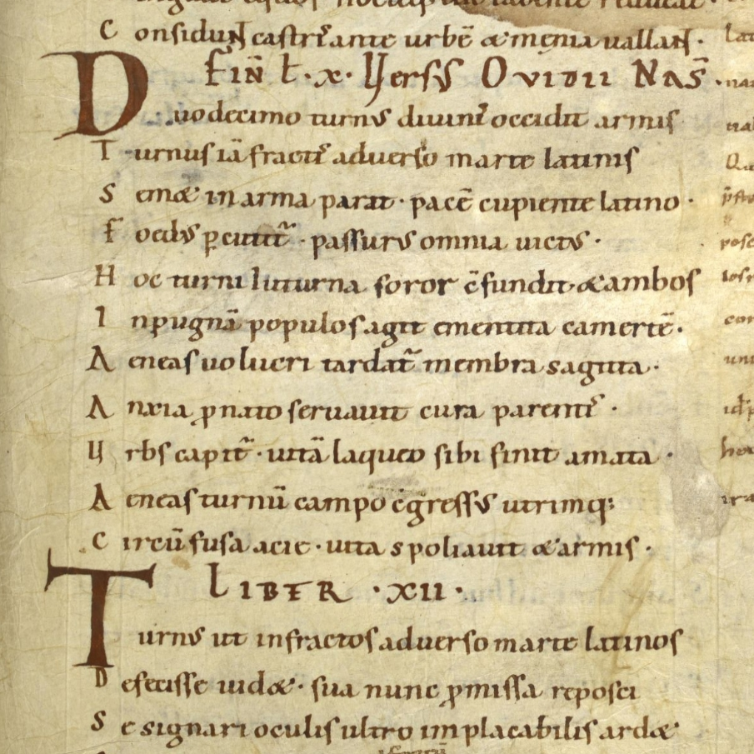
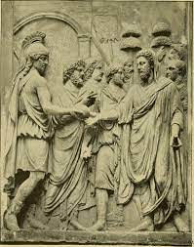
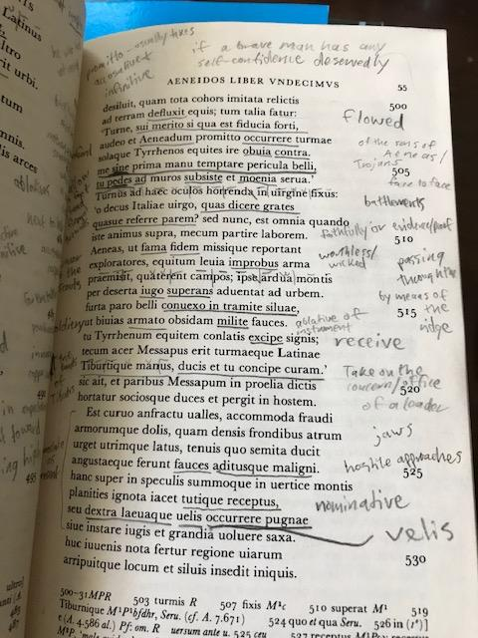
Studying Ancient Greek and Latin
“Through Latin texts,
students delve into the values, traditions, and societal norms of antiquity, fostering cultural literacy and awareness.”

Slide 21
Which of the following do you find most important as a reason for studying an ancient language particularly when considering your students learning experiences.
Historical importance
Influence
Cultural connections
Language skills
Reading skills
Critical thinking and analysis
Cultural reflection
Cross curricular connections
Holistic development
Other

Slide 22
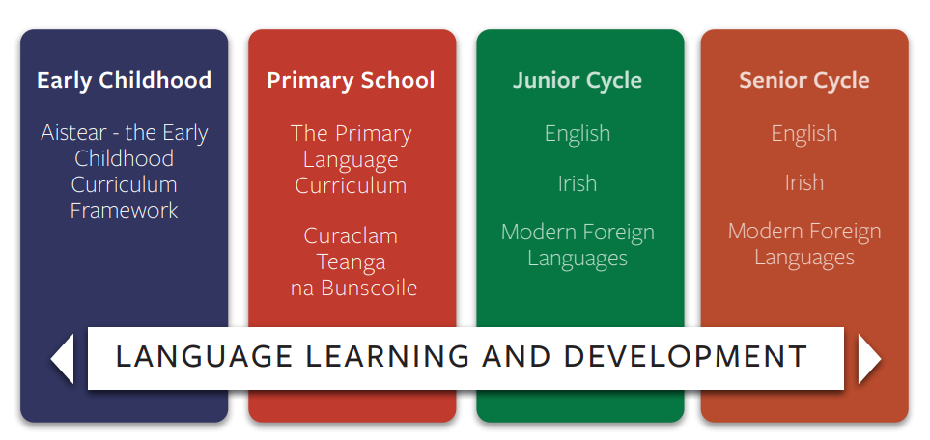
Continuity and Progression

Slide 23
Plurilingual - Plurilingualism is the dynamic and developing linguistic repertoire of an individual user/learner in which they draw on all of their linguistic and cultural resources and experiences in order to participate more fully in social and educational contexts.
Pluricultural - Pluriculturalism: In a person’s cultural competence, the various cultures to which that person has gained access do not simply co-exist side by side; they are compared, contrasted, and actively interact to produce an enriched, integrated pluricultural competence.

Slide 24
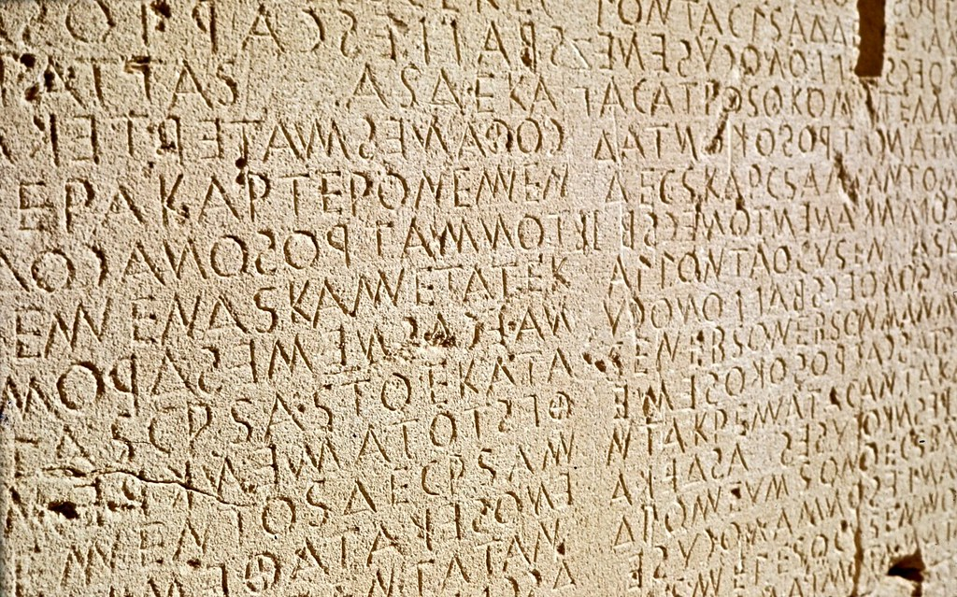
Part 2 Key Competencies, Teaching and Learning
Senior cycle Key Competencies
Teaching and Learning
Language Portfolio

Slide 25
Senior Cycle Key Competencies

Slide 26
Key Competencies
are linked and blend together
are visible across the curriculum
can help students and teachers to make meaningful connections between and across different areas of learning
can improve students’ overall learning
“The key competencies come to life through the learning experiences and pedagogies teachers choose and through students’ responses to them.”
Department of Education, 2024, p.8 Curriculum Specification for Leaving Certificate Latin

Slide 27
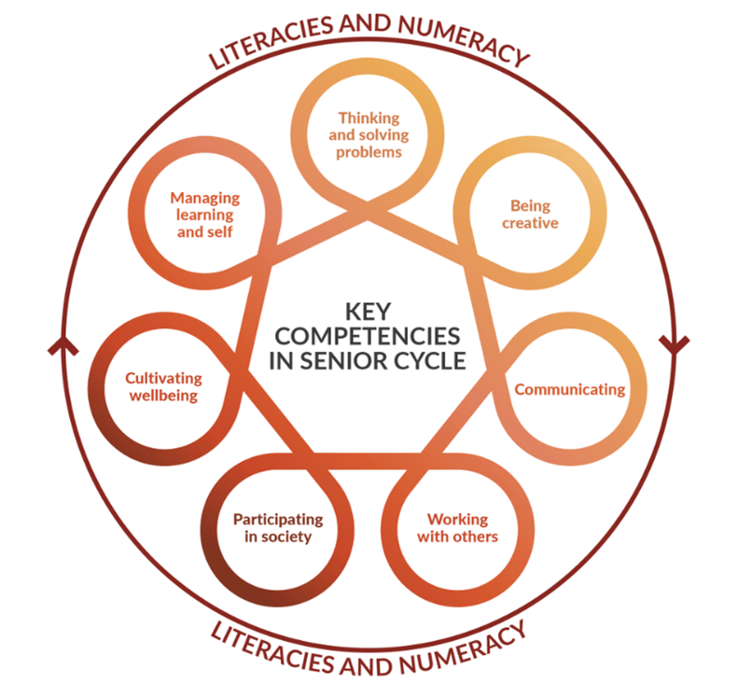
Visibility of Key Competencies
“The key competencies come to life through the learning experiences and pedagogies teachers choose and through students’ responses to them. Students can and should be helped to develop their key competencies irrespective of their past or present background, circumstances or experiences and should have many opportunities to make their key competencies visible.”
Department of Education, 2024, p.2 Curriculum Specification for Leaving Certificate Latin

Slide 28
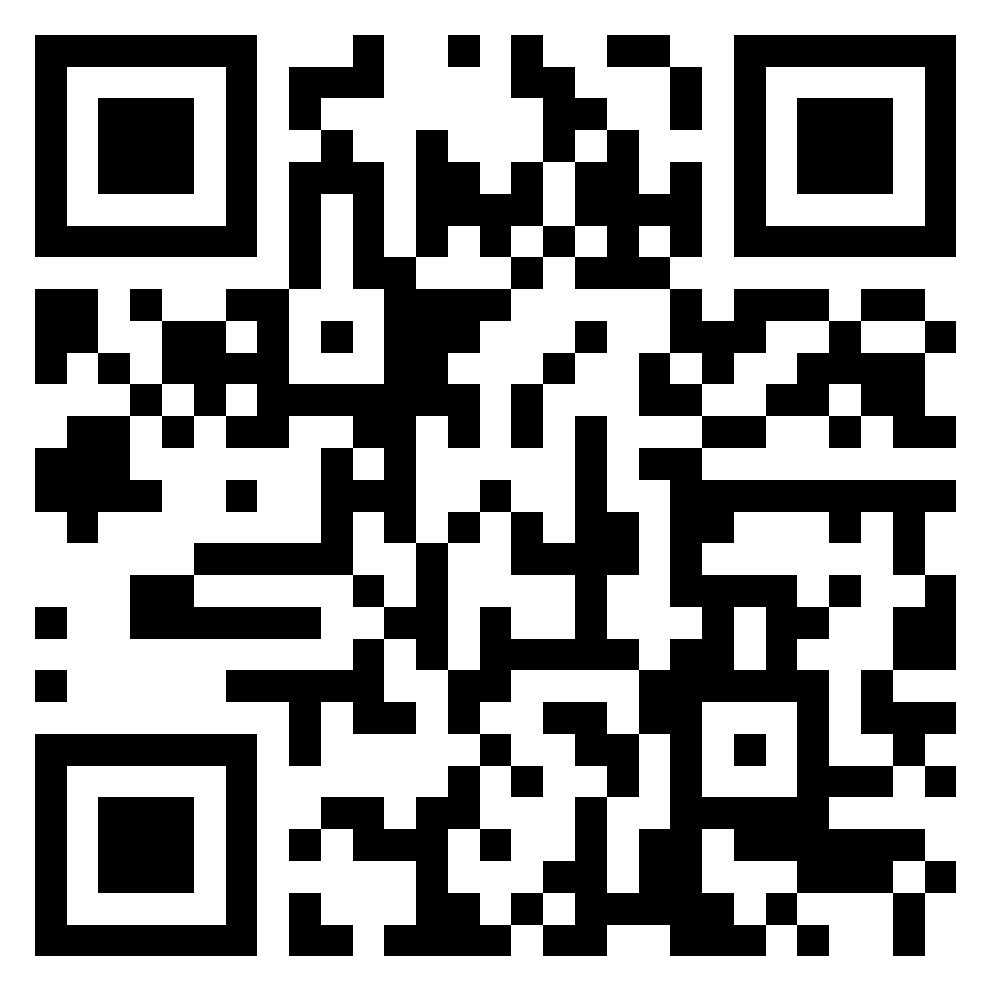
The Role of Ancient Greek/Latin in Developing the Key Competencies
Use the Padlet link to explore how the key competencies can be developed through learning Latin/Ancient Greek

Slide 29
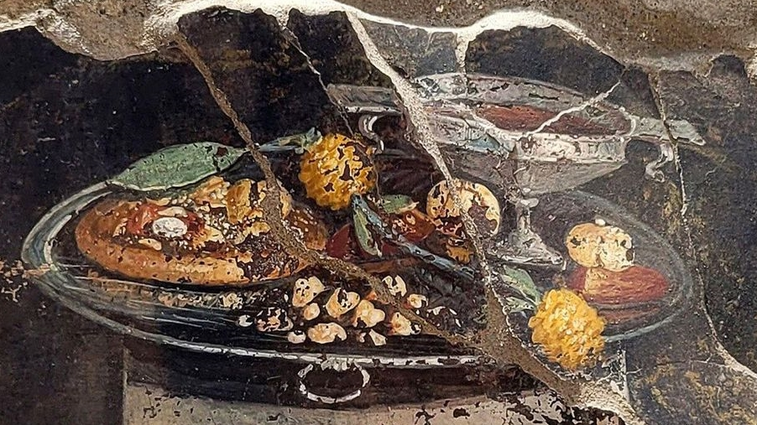
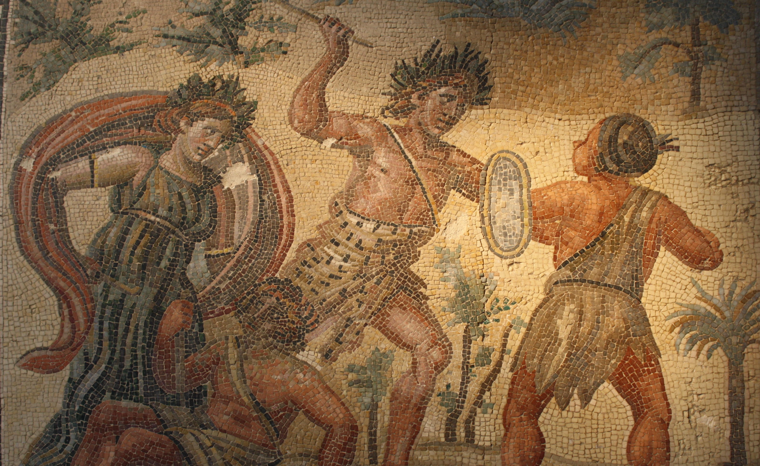
Teaching and Learning

Slide 30
CEFR Alignment
is not that students become effective users of the classical language, but that they become effective readers of texts written in the language, which is no longer the native language of any community but retains significant cultural and historical relevance.
RECEPTION
MEDIATION
Reception
Production
Interaction
Mediation
“the ultimate goal is not that students become effective users of the classical language, but that they become effective readers of texts written in the language, which is no longer the native language of any community but retains significant cultural and historical relevance.”

Slide 32
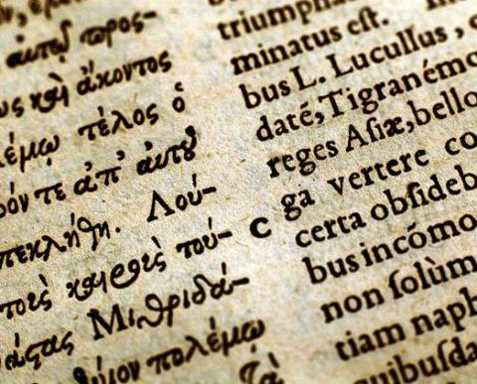
Who can take Ancient Greek and Latin at Senior Cycle?
Students from all language backgrounds.
Students with some/a lot of experience of the language(s).
Students who have no prior experience.

Slide 33
The Language Portfolio – pg 23

Slide 34
The Language Portfolio
Will reflect the student's own language learning journey, process and progress of their language learning experiences
Places the student at the centre facilitating autonomous learning
Assists in reviewing and developing language learning strategies
Creates space to document and reflect on their growing language proficiency
Become more aware of themselves as language learners and users
Provides an opportunity to set personal goals specific to their language learning

Slide 35
Part 3: Exploring the Strands of Study and Learning Outcomes
Strands of Study
Capstone Text

Slide 36
The Leaving Certificate Latin Specification:
2 Strands
2 Elements
The Leaving Certificate Latin specification is designed for a minimum of 180 hours of class contact time.

Slide 37
The Leaving Certificate Ancient Greek Specification:
2 Strands
2 Elements
The Leaving Certificate Ancient Greek specification is designed for a minimum of 180 hours of class contact time.

Slide 38
Exploring the Strands of Study
Reading with purpose
Survey or scan the text
Ask questions
Read
Review
Recall

Slide 39
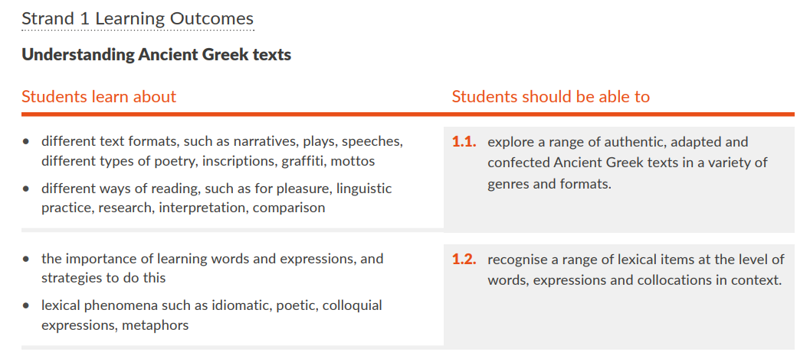
Strands of Study Overview
The left-hand column outlines specific areas that students learn about.
Learning outcomes which describe the knowledge, skills, values and dispositions students should be able to demonstrate after a period of learning.
Learning outcomes promote teaching, learning and assessment processes that develop students’ knowledge, skills, values and dispositions
An indicative vocabulary list and guidelines will be provided by the NCCA as supports for teachers.

Slide 40
Interrelated Strands
Ancient Greek/Latin Language
Understanding Ancient Greek/Latin texts
Developing language awareness and analytical skills
Ancient Greek/Latin literature
Literature in Context
Hellenic/Roman culture explored through Greek texts
Which learning outcomes could work well together from across the strands?

Slide 41
Engaging with Authentic Material
Capstone Text
to provide a common focus of study and examination for all students, regardless of their individual learning pathways
to showcase and apply key knowledge and skills they have acquired in the course to a stimulating and context-rich text of a suitable level of difficulty
the emphasis is not on the quantity of text studied but on the quality of students’ engagement with the original text and the various contexts in which it can be situated, including historical, social, literary and reception contexts.
for each examination year a circular will issue from the Department of Education relating to the prescribed material for examination
the circular will also provide a list of grammatical forms and constructions prescribed for examination at Higher and Ordinary level.

Slide 42
The Capstone text
“provides a culminating and integrative experience, which allows all students to showcase and apply key knowledge and skills they have acquired in the course to a stimulating and context-rich Ancient Greek/Latin text.”
Department of Education, 2024, p.2 Curriculum Specification for Leaving Certificate Latin

Slide 43
Capstone Text
Capstone
Keystone
Key Competencies
Cornerstone
Students should be able to
Students learn
about
Cornerstone

Slide 44
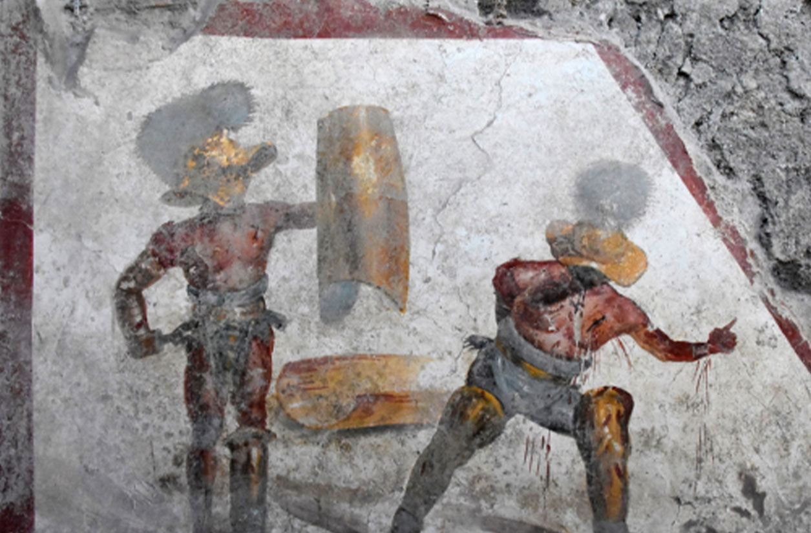
Part 4: Overview of Assessment for Certification
Overview of Assessment Components
Additional Assessment Component
Written Examination
Leaving Certificate Grading

Slide 45
Assessment for Certification Overview

Slide 46
Additional Assessment Component: Research Study - Text in Context
“This assessment component aims to develop in students a spirit of enquiry about the significance and broader context of the language and literature that they encounter, and a range of skills to facilitate that enquiry.”
“This assessment component is also designed to allow students to engage in self-directed study and to pursue in more depth an aspect of their study of the language that animates their interest and curiosity, at a level appropriate to their language competence and restrictions of time and resources.”
Department of Education, 2024, p.2 Curriculum Specification for Leaving Certificate Latin

Slide 47
Additional Assessment Component: Research Study - Text in Context
The research study requires students to:
investigate
evaluate
report
on a language-centred topic.
5th Year
Research Study Brief
Up to 20-hours

Slide 48
Additional Assessment Component: Research Study - Text in Context
Research
research Latin/Ancient Greek texts and process linguistic and contextual information.
Students are required to demonstrate that they can...
Synthesise and evaluate
information using approaches and concepts connected to the specification and make an informed judgement.
Acknowledge
the broader context of the classical world wherein the language existed.
Reflect
on how this knowledge and understanding contributes to their understanding and appreciation of the language and specific texts

Slide 49
Written Examination
The written examination will consist of a range of question types and will include a selection of questions that will assess, appropriate to each level:
the learning described in the two strands of the specification
the prescribed material issued by DE circular for each examination year which will include:
the Capstone text: selected text in Latin and guidance on general context (literary, cultural, historical and prescribed grammar items)
prescribed grammar items and constructions

Slide 50
Leaving Certificate Grading

Slide 51
Sample Assessment Materials Timeline for Tranche 1 Subjects

Slide 52
Reflection: What are your next steps?
familiarise yourself with the specification
familiarise yourself with senior cycle Key Competencies
resources: CAI-T, Oide Website, Oide X accounts, Scoilnet etc.

Slide 53
Oide Timeline of Supports for Classical Languages
Classical Languages Introduction to Ancient Greek and Latin Specifications - Webinar
Classical Languages Online Collaborative
September 2025
the new specifications for Ancient Greek and Latin begin to be taught in schools
November 2024
March 2025
May
2025
November
2025
Full Day Face to Face PLE
Full Day Face to Face PLE

Slide 54
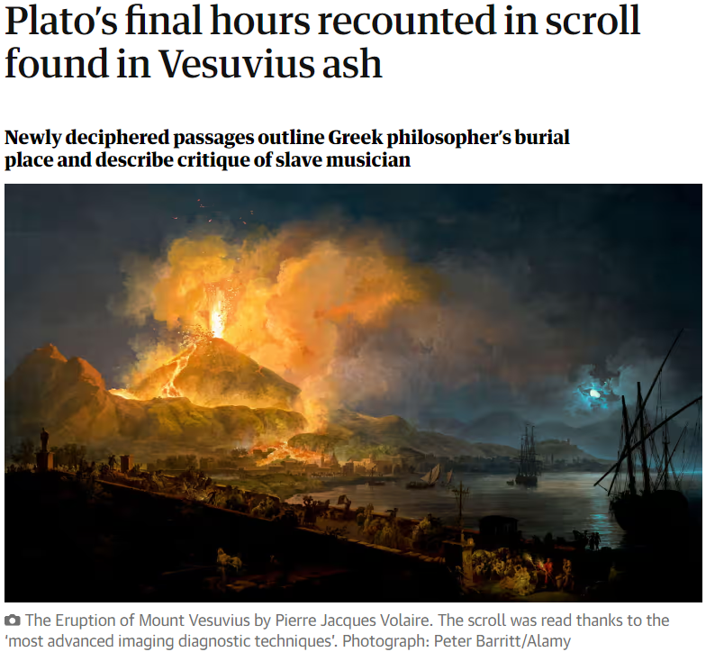
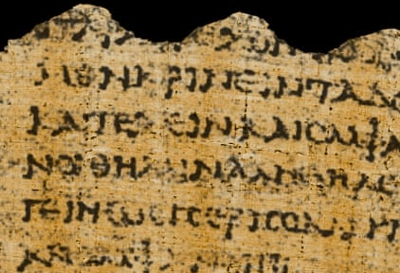
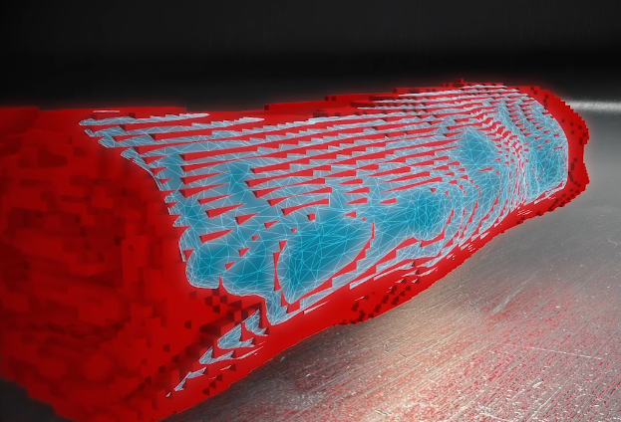
Learning an Ancient Language
“The focus of these language specifications is not on acquiring historical knowledge in its own right. Throughout, the emphasis is on the relationship between text and context, and learning about Greek/Roman history, literature, art and culture should happen during the journey of learning to read Ancient Greek/Latin texts rather than as a separate learning activity.”
Department of Education, 2024, p.18 Curriculum Specification for Leaving Certificate Latin

Slide 55
Additional supports
Visit our website www.oide.ie
Contact: info@oide.ie
Join our new mailing list to receive news and updates
Follow us on X
@Oide_Classics

