Slide 1
Online Webinar – Supporting the development of research skills in the Science classroom
Term 2 2026

Slide 2
Key Messages
Strong investigation work is built on solid background research that genuinely deepens understanding, helps narrow the focus, and keeps the inquiry connected to reliable scientific ideas.
Moving from broad investigative interests toward clear, testable research questions and hypotheses is a pivotal step in high‑quality inquiry enabled by purposeful questioning, structured dialogue, and thoughtful refinement of emerging ideas.
Effective and coherent reporting grows from clear structure, thoughtful planning, and meaningful reflection, enabling students to communicate their scientific thinking and investigative journey with clarity and authenticity.

Slide 3

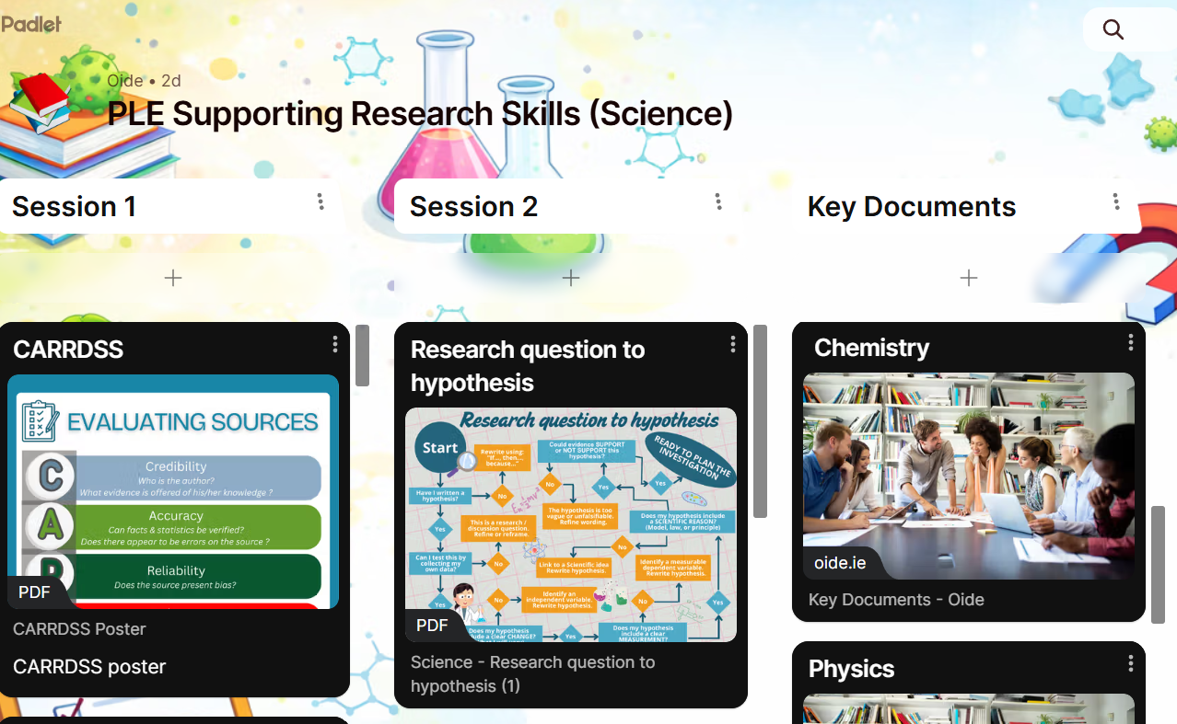
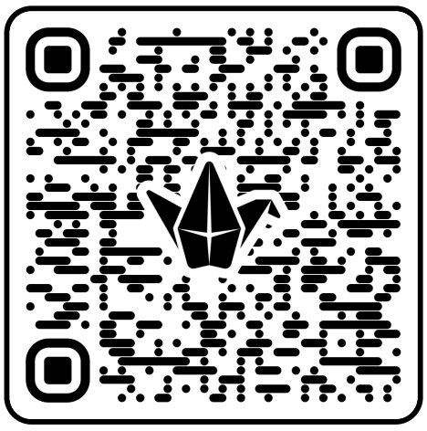
Padlet of Resources
Image of padlet

Slide 4
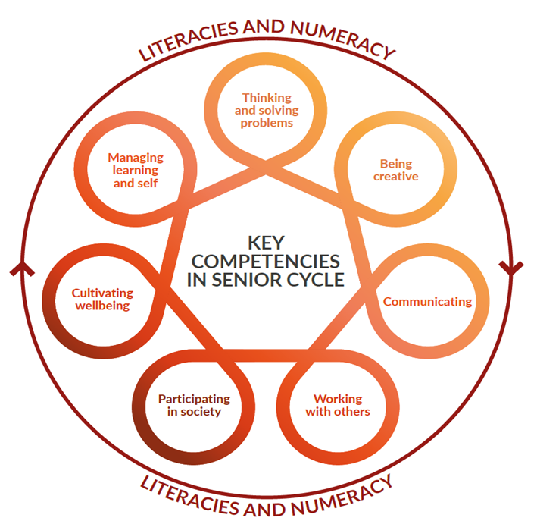
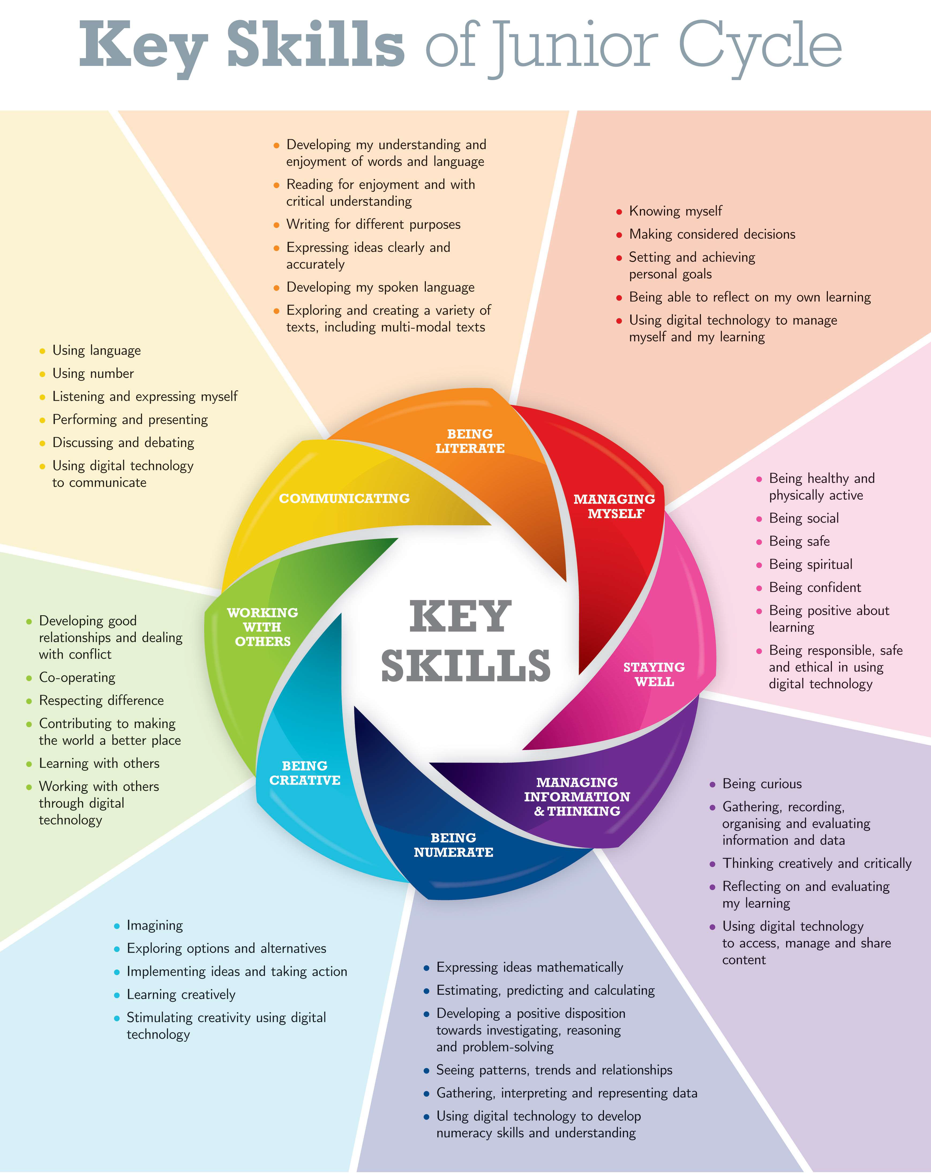
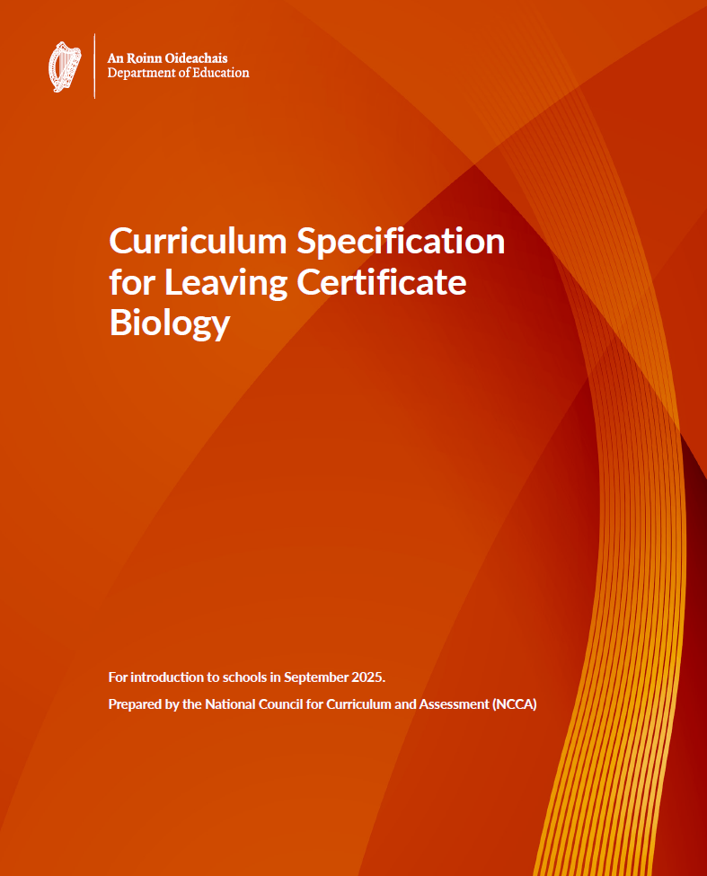
Key Competencies at Senior Cycle
“All of the key skills developed across the
curriculum during junior cycle support student
learning in senior cycle."
(NCCA, p.5)

Slide 5
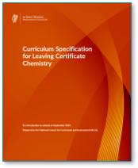
Key Competencies at Senior Cycle
“All of the key skills developed across the
curriculum during junior cycle support student
learning in senior cycle."
(NCCA, p.5)

Slide 6
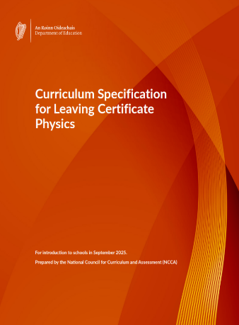
Key Competencies at Senior Cycle
“All of the key skills developed across the
curriculum during junior cycle support student
learning in senior cycle".
(NCCA, p.5)

Slide 7
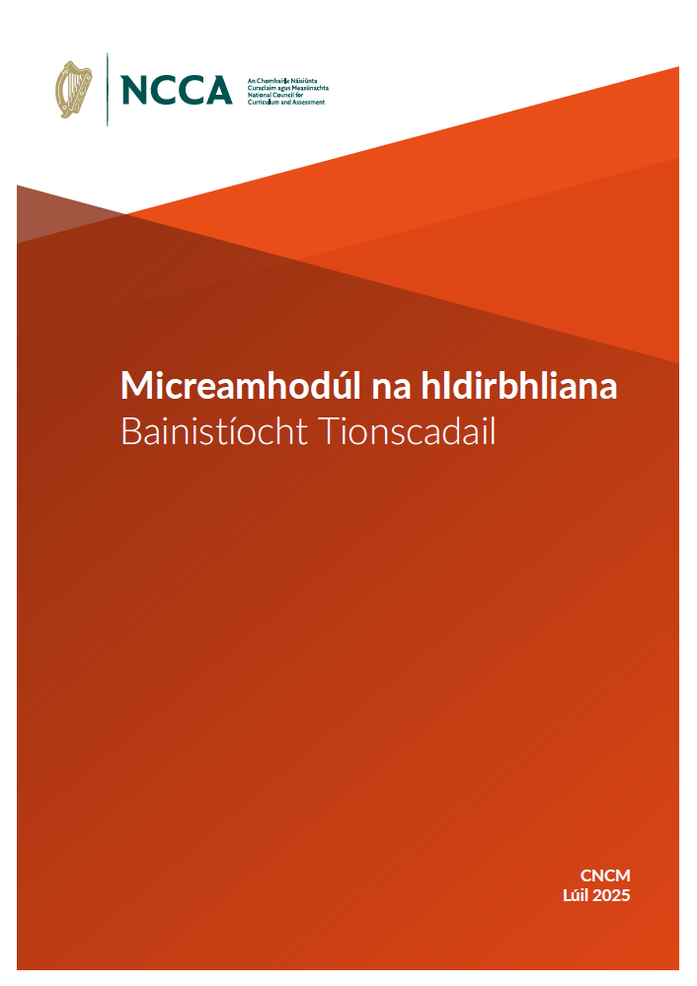
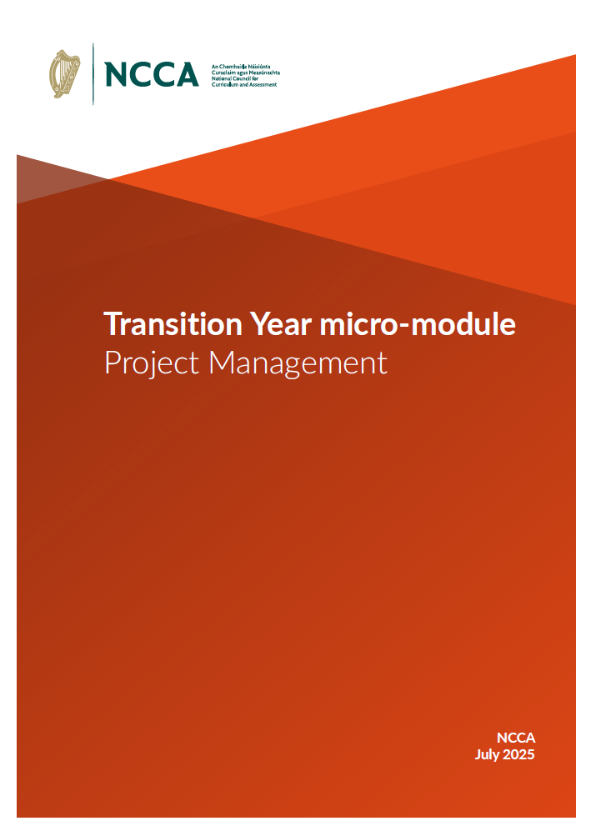
Project Management - TY Micro-module
Project management can support
• planning
• pacing
• organisation
• time management

Slide 8
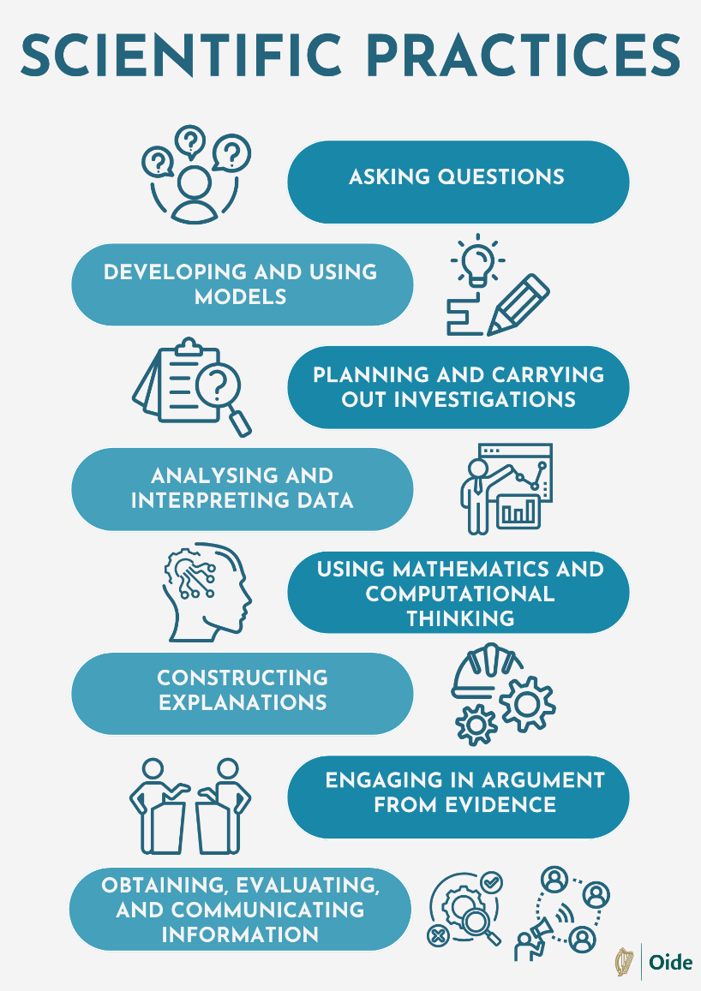
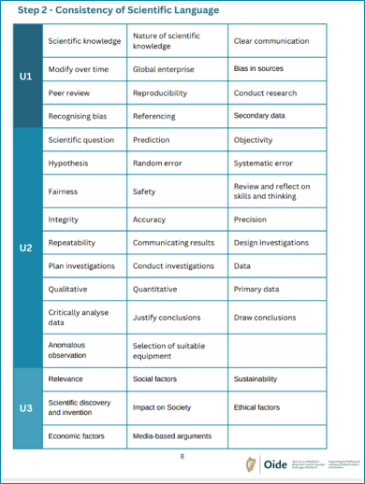
Unifying Strand – Working like a Scientist
“As they learn to work like scientists, they develop a habit of mind that sees them rely on a set of established procedures and practices associated with scientific inquiry to gather evidence, generate models and test their ideas on how the natural world works”
NCCA, 2024Specifications
Biology, p.13, Chemistry p.14, Physics p.12
“It becomes apparent that the process of science is often complex and iterative, following many different paths, but always underpinned by these established principles
and practices.”
NCCA, 2024Specifications
Biology, p.13, Chemistry p.14, Physics p.12

Slide 9
Unifying Strand – Working like a Scientist
“As they learn to work like scientists, they develop a habit of mind that sees them rely on a set of established procedures and practices associated with scientific inquiry to gather evidence, generate models and test their ideas. It becomes apparent that the process of science is often complex and iterative, following many different paths.”
(NCCA, p.12)
“As they learn to work like scientists, they develop a habit of mind that sees them rely on a set of established procedures and practices associated with scientific inquiry to gather evidence, generate models and test their ideas on how the natural world works”
NCCA, 2024Specifications
Biology, p.13, Chemistry p.14, Physics p.12
“It becomes apparent that the process of science is often complex and iterative, following many different paths, but always underpinned by these established principles
and practices.”
NCCA, 2024Specifications
Biology, p.13, Chemistry p.14, Physics p.12

Slide 10
Padlet of Resources
Image of padlet

Slide 11
Session 1
9:15 – 10:25
Supporting Students with Background Research and Referencing

Slide 12
Learning Intentions for Session 1
By the end of this session participants will have:
gained practical strategies to support student research and referencing.
identified common challenges and effective classroom supports.
engaged with research as a learning outcome.

Slide 13
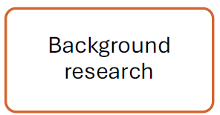

Why Background Research Matters
Background research supports:
understanding the investigation focus
informed experimental decisions
scientific reasoning and justification
reflection and evaluation

Slide 14

Time to Think
Where in your teaching so far have students had opportunities to develop research skills through engagement with learning experiences in your classroom?

Slide 15
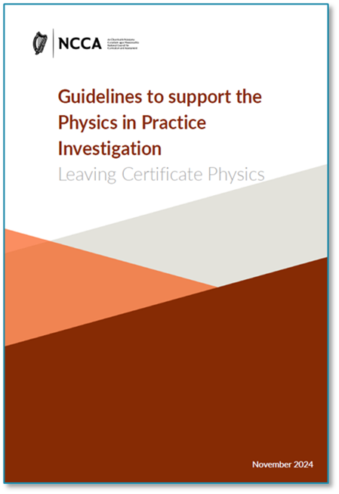
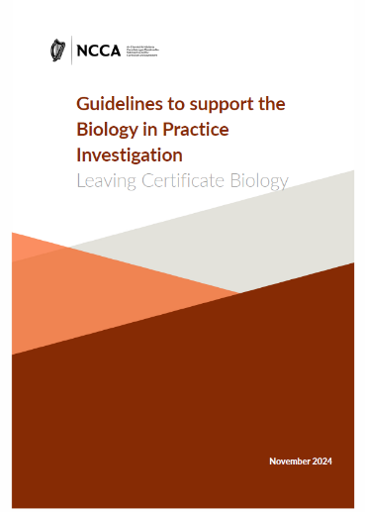

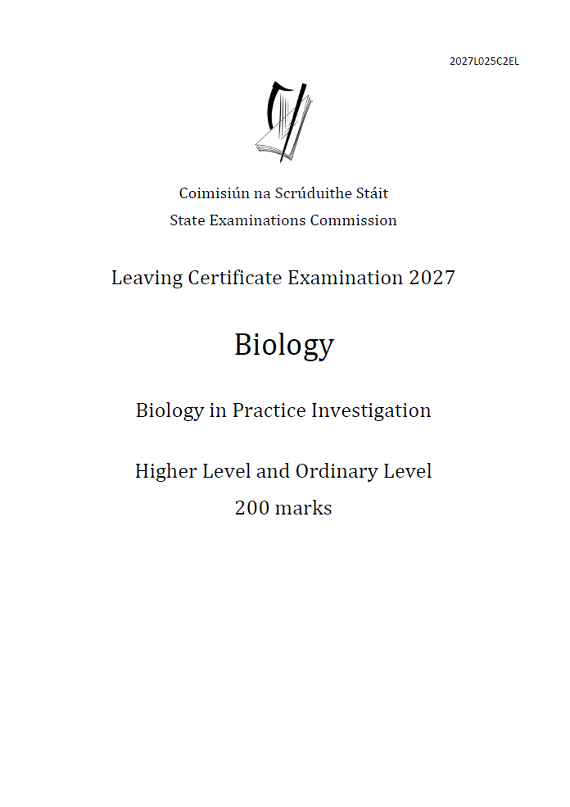
The Physics in Practice Investigation - Research
"Building on their learning to date, students will learn more about the nature of investigation through research and experimentation. Students should be empowered in realising that research and experimentation is more about engaging with and learning from the process, rather than seeking a perfect answer".
"It involves students completing a piece of work during the course and, in Year 2, submitting for marking to the State Examinations Commission (SEC), evidence of their ability to conduct scientific research on a particular issue and to use appropriate primary data to investigate aspects of that issue".
(NCCA, 2024, p. 2)
"They (students) gather, process and evaluate information from secondary sources. The knowledge gained from this phase of the investigation may help to inform their experimental work".

Slide 16

Online Research: Effective Search Strategies
Common Boolean Operators
AND – Narrows the search
OR – Broadens the search
NOT – Excludes unwanted results

Slide 17


Search Vs Research
Search
Research
Finding information
Often quick and surface-level
Focused on answers
Engaging with information
Involves evaluation and judgement
Asking who, why, when and how reliable
Focused on understanding and decision-making

Slide 18

Search Vs Research

Slide 19
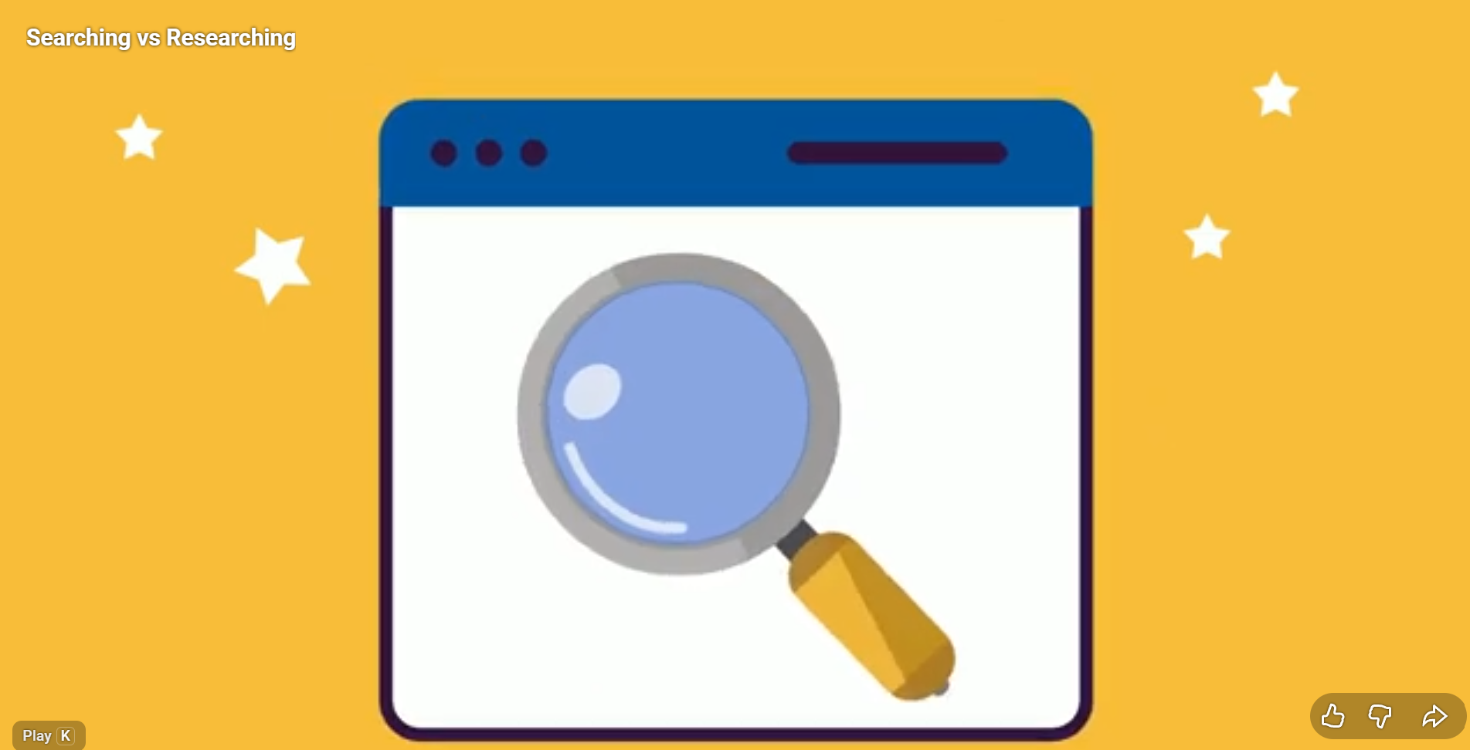
Search Vs Research

Slide 20
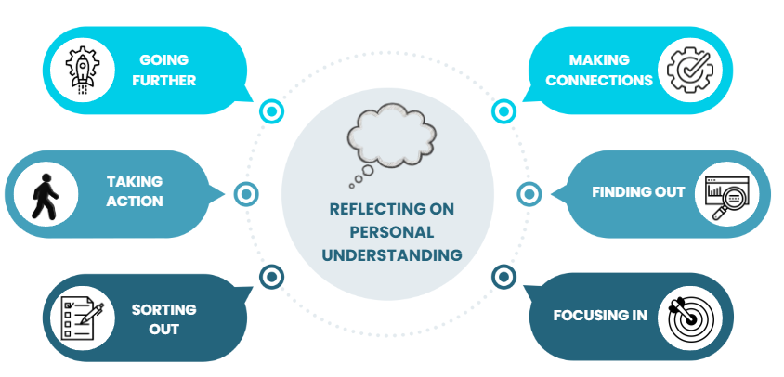
Research as a Process

Slide 21
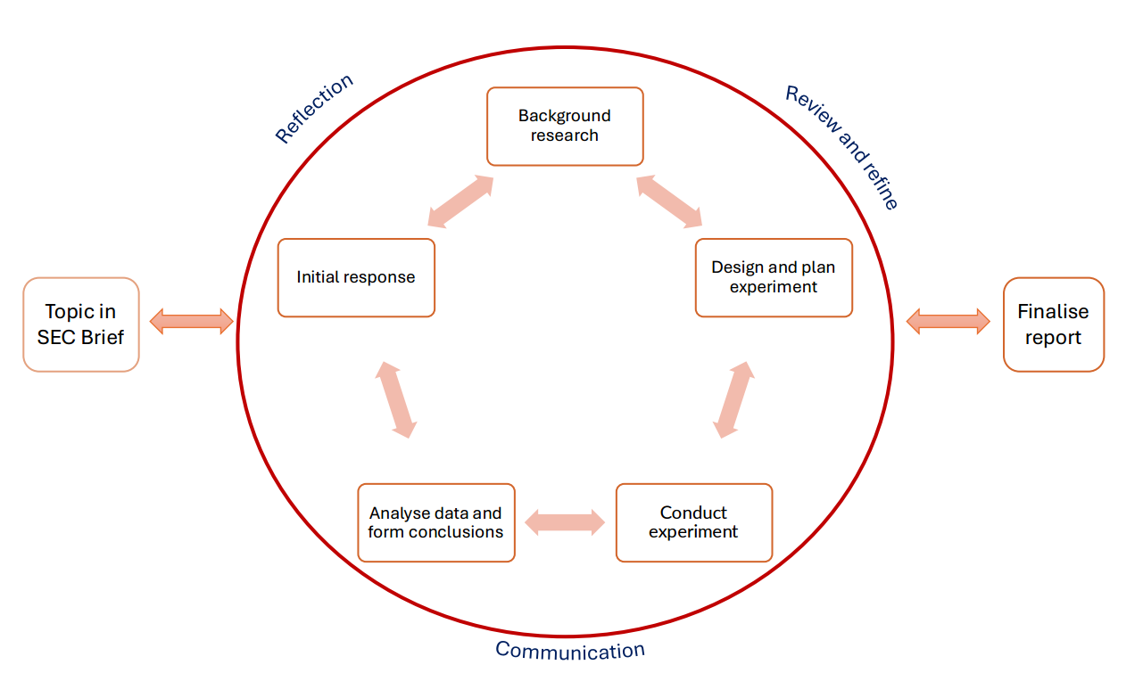
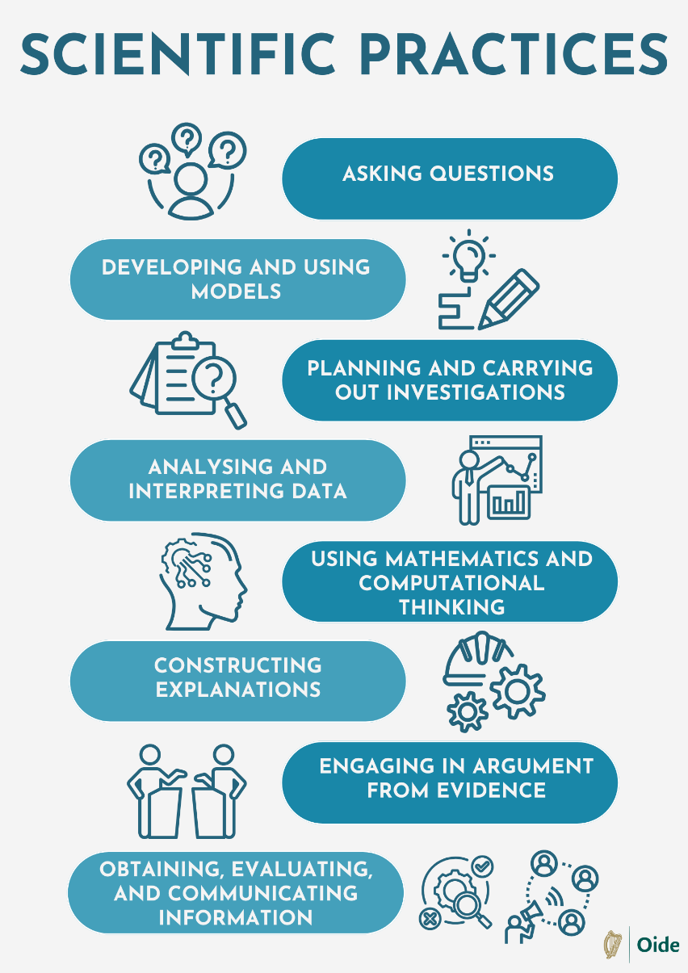
Aligning Process to Practice
NCCA, Guidelines

Slide 22
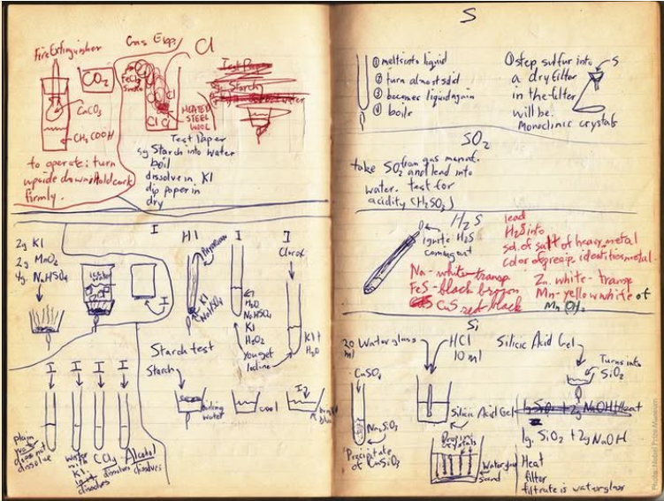
Recording Research:
Investigative Logs as Learning Tools
Investigative logs can capture:
• sources consulted
• key ideas or findings
• questions raised
• decisions influenced
Childhood notebook of Roger Tsien, 2008 Chemistry laureate

Slide 23
Evaluating Sources - CARRDSS
Students can be supported to ask:
• who is the author or source of this information?
• what was the purpose for creating it?
• how current and relevant is it?
• is it supported by reliable, independent sources?

Slide 24
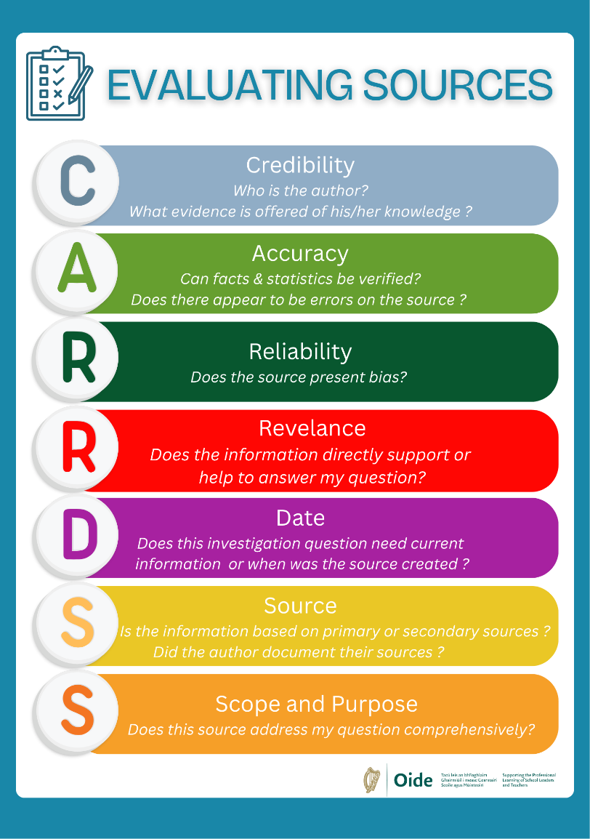


Evaluating Sources - CARRDSS

Slide 25
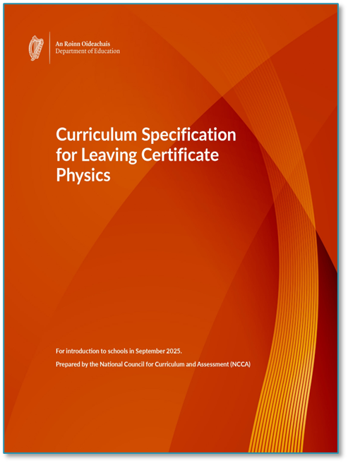
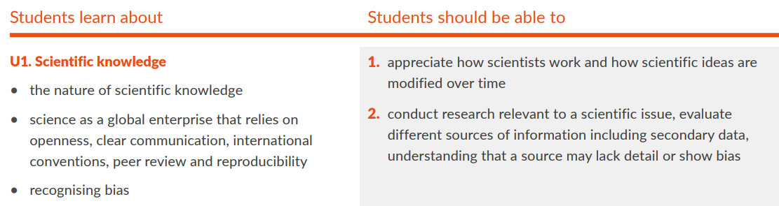
Research in the Learning Outcomes
L.O. U1.2
Research: Inquire specifically, using involved and critical investigation

Slide 26
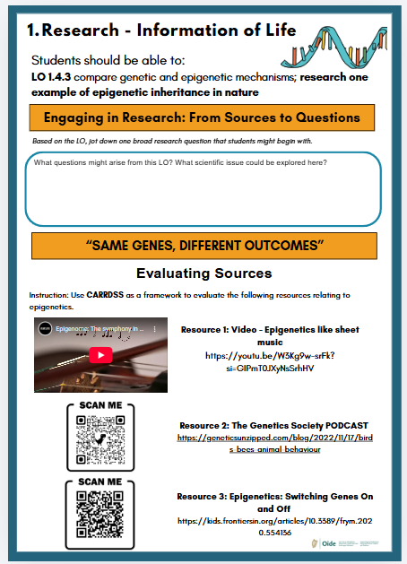
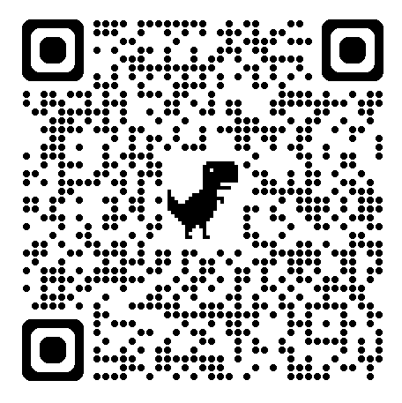
Research in the Learning Outcomes

Slide 27


Research in the Learning Outcomes

Slide 28
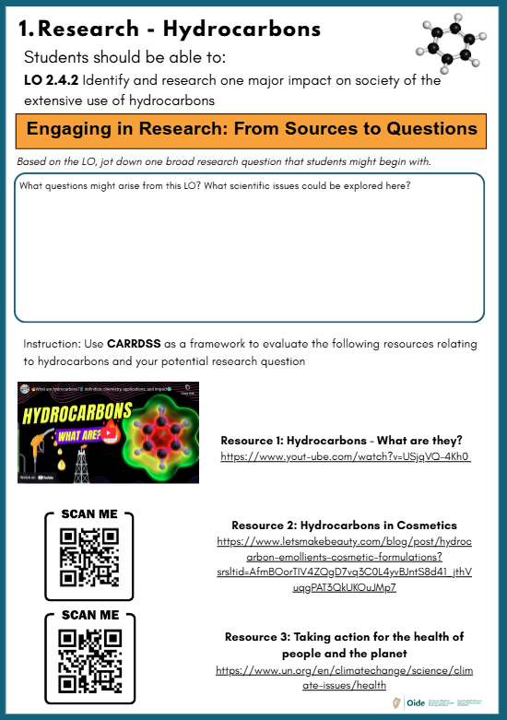
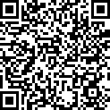

Research in the Learning Outcomes

Slide 29
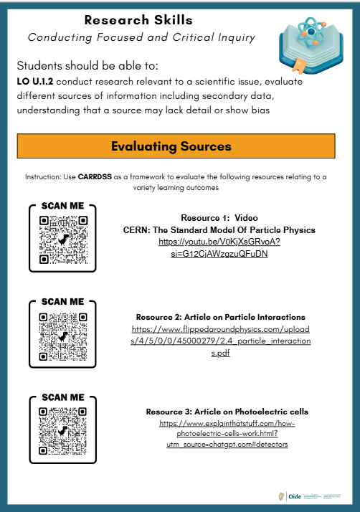
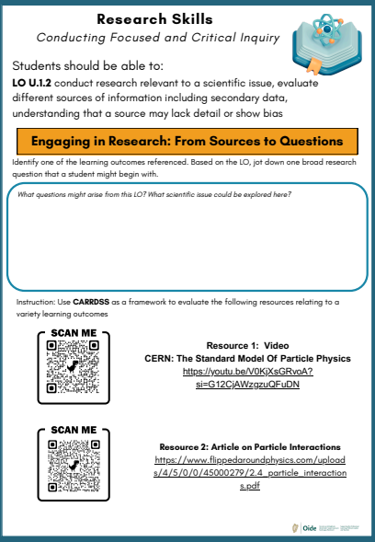
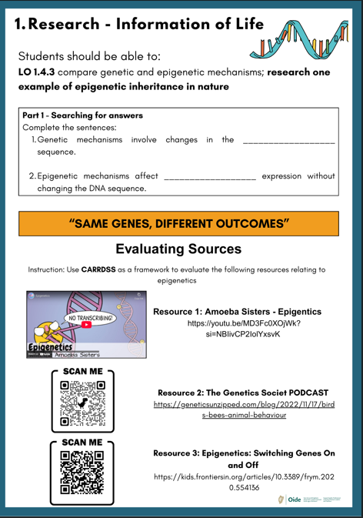
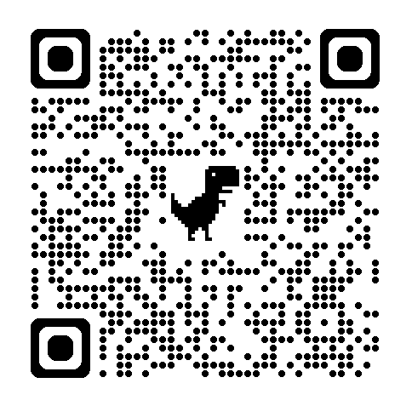
Research in the Learning Outcomes

Slide 30

Time to Think
What other areas of teaching and learning could you plan to use this activity to support your students research skill development within your classroom?

Slide 31
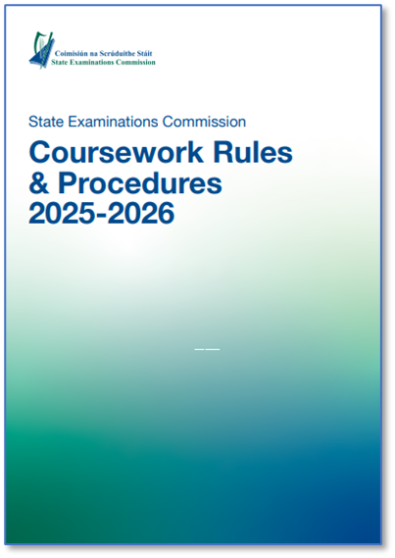
Referencing: Purpose Before Format
Referencing supports:
• academic integrity
• transparency of thinking
• traceability of ideas
Appendix 1 – Guidelines to Support Referencing
p. 15-17
Appendix 1 – Guidelines for referencing in SEC Coursework
p. 32

Slide 32
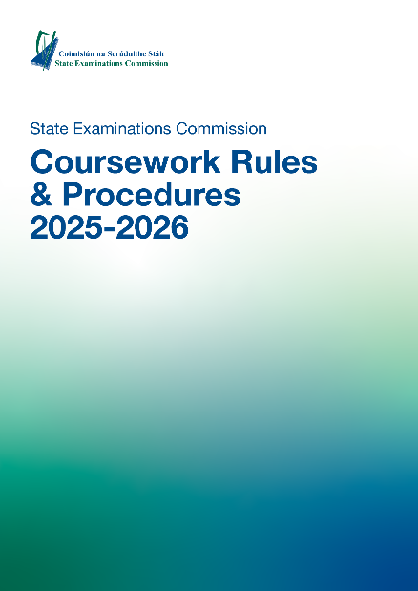
Rules for the Use of AI in SEC Examination Coursework
""Where Artificial Intelligence (AI) tools (including software and applications) are used in State examination coursework, it must be conducted in a responsible and ethical manner. This is essential to maintain academic integrity and ensure that candidates’ work reflects their own understanding and efforts"
(State Examinations Commission, p. 33, 2025)

Slide 33
Guidance on Artificial Intelligence in Schools
"The ethical considerations when using AI and data in education include ensuring that the AI systems used are reliable, fair, safe, and trustworthy and that the management of educational data is secure, protects the privacy of individuals, and is used for the common good"
(Department of Education and Youth, p. 12, 2025)

Slide 34

What is Plagiarism?

Slide 35
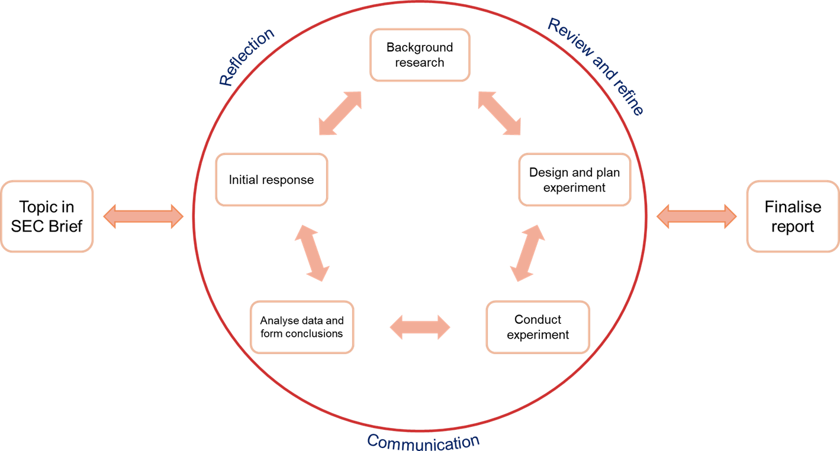

Research Across the Investigation Process
Research supports
• question formation
• hypothesis development
• experimental decisions
• reflection and evaluation

Slide 36
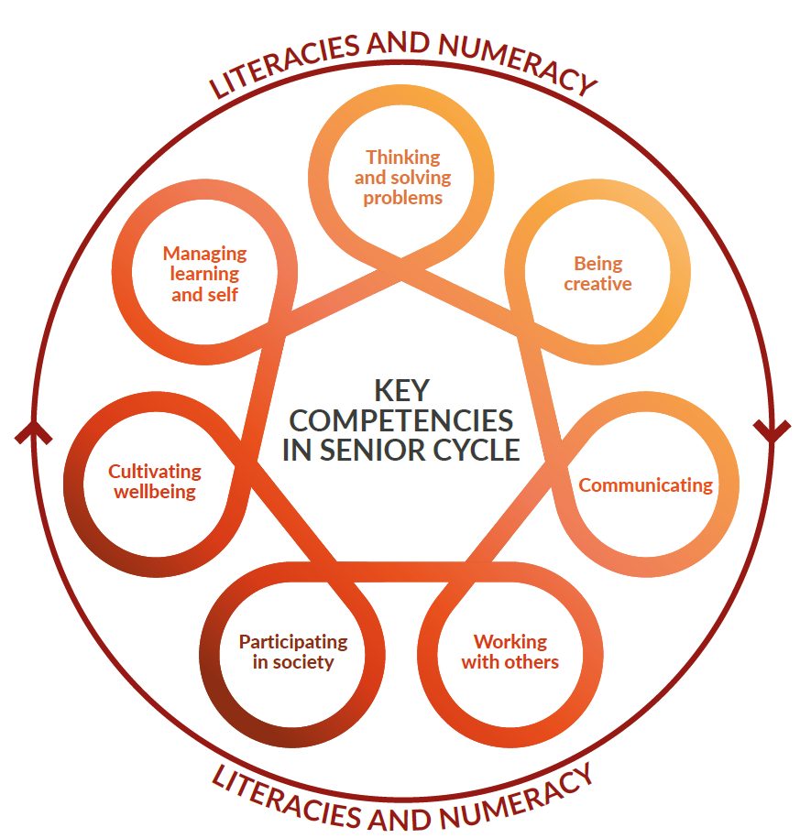
Reflection as Evidence of Learning
Reflection supports students to:
evaluate their decisions and actions
make sense of evidence and outcomes
identify limitations and improvements
articulate what they have learned
“We learn from reflecting on experience"
John Dewey

Slide 37
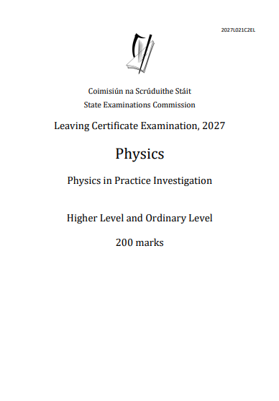
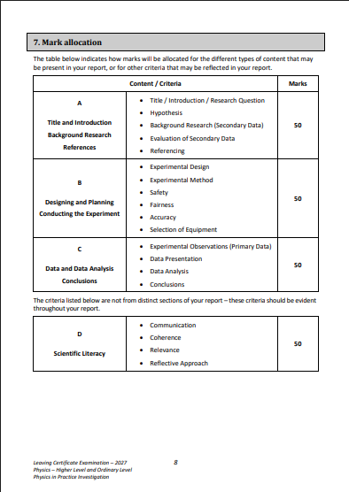
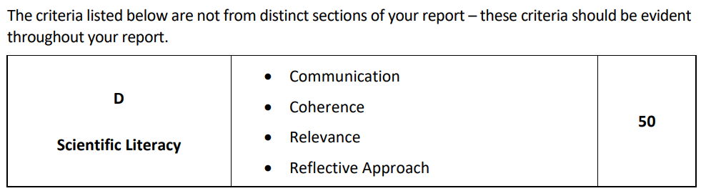
Thinking and Decision-Making Throughout the Investigation

Slide 38
Thinking and Decision-Making Throughout the Investigation

Slide 39
Time to Think
How can I support and empower my students' day to day to further progress their research skills?
What is the next Learning Outcome that you will use to support the progression of these skills?

Slide 40
Padlet of Resources
Image of padlet

Slide 41

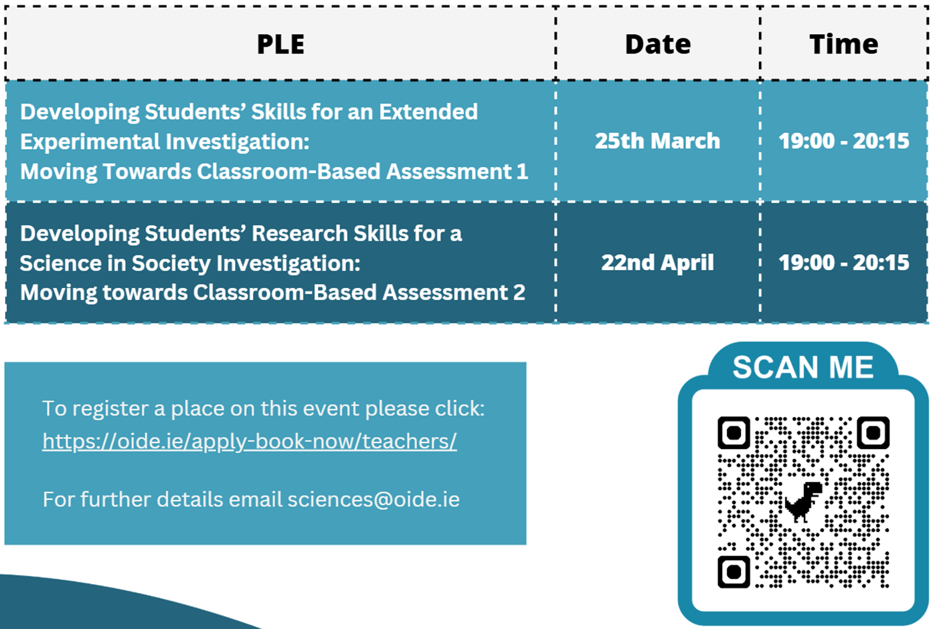

Slide 42
Session 2
10:25 – 11.15
Supporting Students to Form Research Questions and Hypotheses

Slide 43
Learning Intentions for Session 2
By the end of this session participants will have:
engaged with strategies to support students in developing research questions and forming testable hypotheses.
reflected on promoting authenticity and maintaining the integrity of the assessment process.

Slide 44

From Curiosity to Focus
Students often begin with:
• broad interests
• everyday observations
• real-world phenomena
They need support to refine their focus.

Slide 45
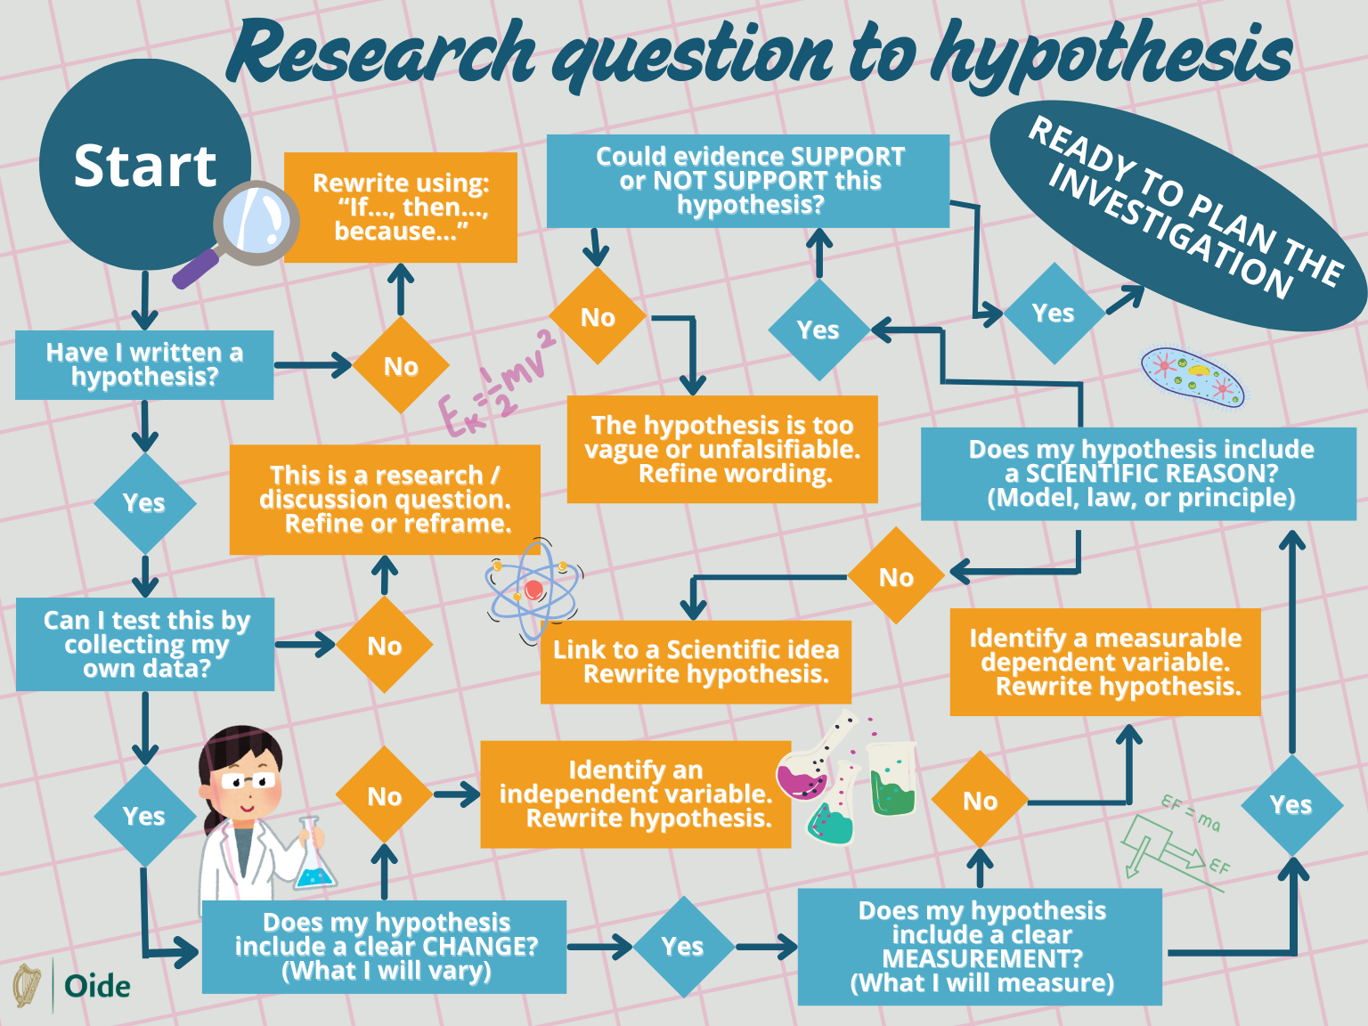
What Makes a Strong Research Question?
A strong research question is:
• clear
• focused
• investigable
• aligned with available resources

Slide 46
Distinguishing Questions and Hypotheses
Research questions
• Ask what or how
Hypotheses
• Make a testable prediction
• Are informed by research

Slide 47
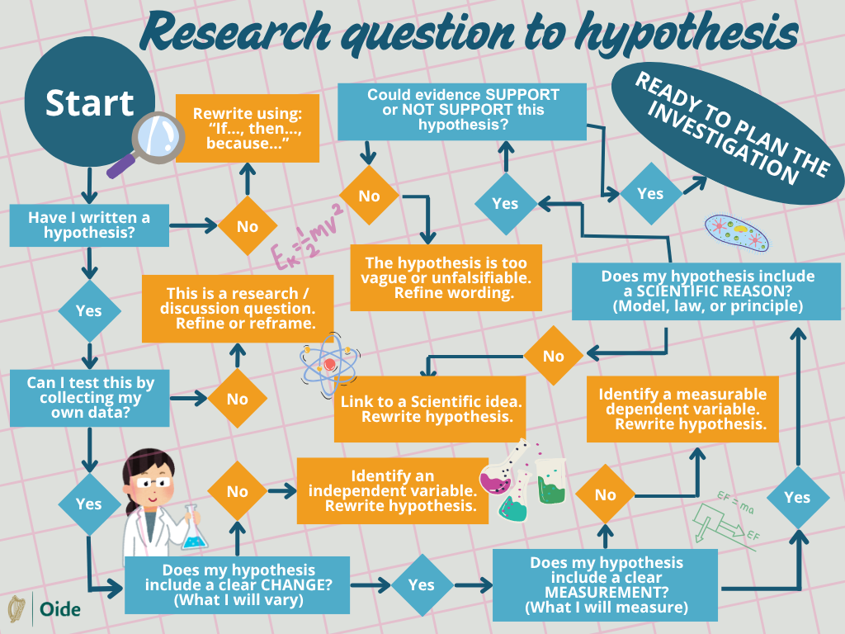


Slide 48
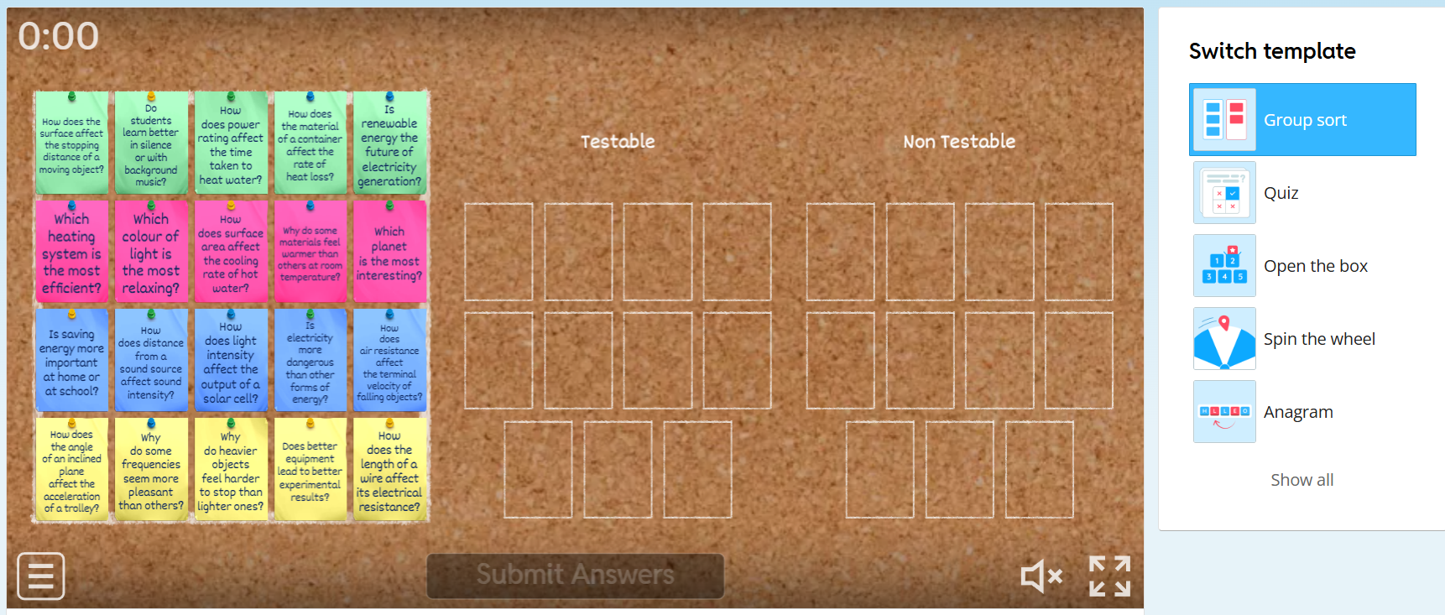
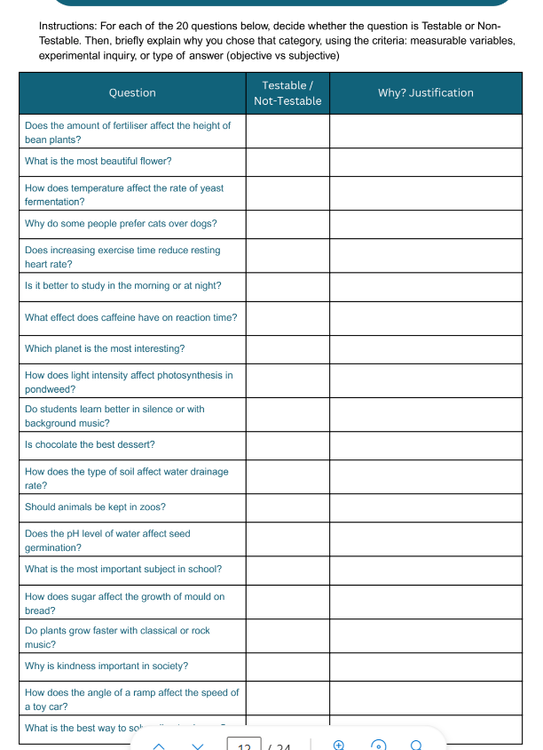
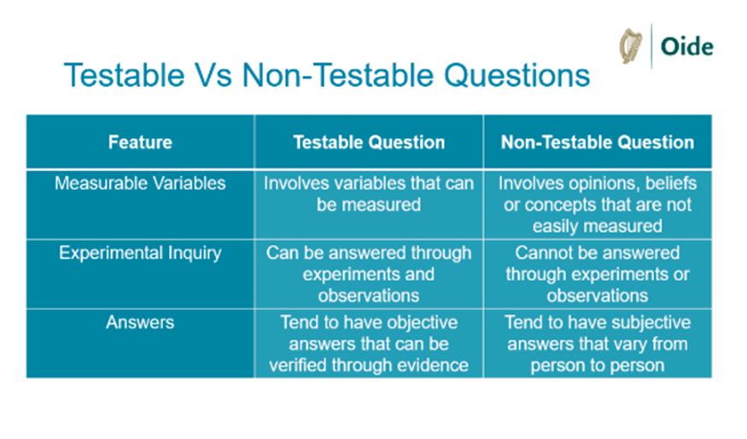

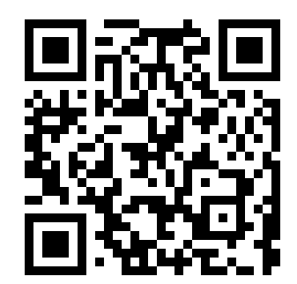
Sorting activity: Testable vs Non-Testable
Wordwall Interactive Game
Padlet Link
wordwall.net/resource/108523910

Slide 49
Sorting activity: Testable vs Non-Testable
Wordwall Interactive Game
Padlet Link
wordwall.net/resource/108523910

Slide 50
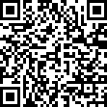
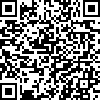
Sorting activity: Testable vs Non-Testable
Wordwall Interactive Game
Padlet Link
https://wordwall.net/resource/108909959

Slide 51
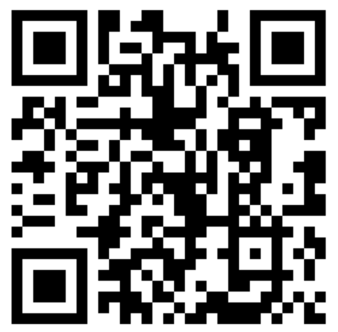
Sorting activity: Testable vs Non-Testable
Wordwall Interactive Game
Padlet Link

Slide 52

Time to Think
What challenges do students typically encounter when they begin refining their research questions or hypotheses?
What learning outcomes offer opportunities to students to develop and refine their research questions and hypotheses?

Slide 53

Supporting Hypothesis Development
Teachers can support students by:
• asking thought provoking questions
• encouraging justification
• highlighting assumptions
• linking to prior learning
Effective questioning is part of the process

Slide 54




Feasibility and Manageability
Key considerations include
Time
Safety about student activity
Equipment
Accuracy and reliability

Slide 55
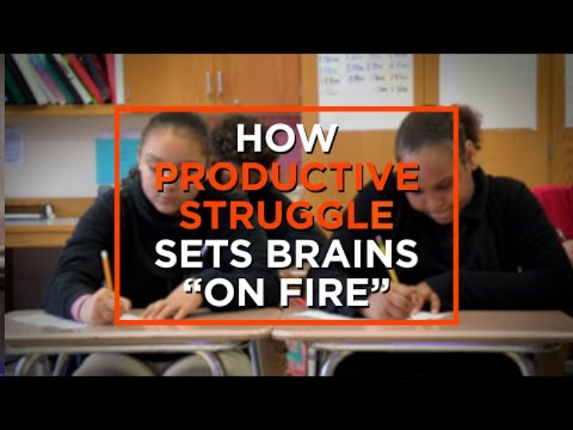
Linking to the Wider Investigation Process

Slide 56
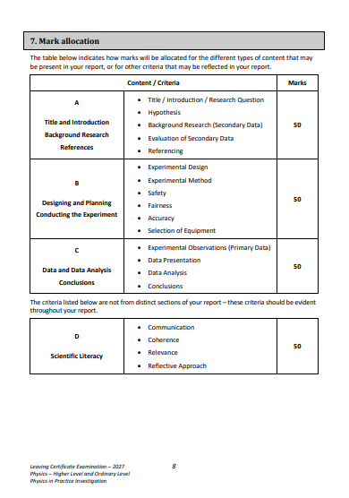

The Report as a Coherent Communication Tool
The investigative report:
communicates the investigative process
explains decisions and reasoning
presents evidence clearly
tells a coherent, connected story
Investigation Brief 2027,
p. 7/8

Slide 57

Maintaining Authenticity
If teachers have supported students to develop their research skills and scientific habits, this will naturally align with the coursework rules & procedures and thus maintaining authenticity of the students work
“They (teachers) do not over-assist or over-direct candidates in the completion of their coursework which may compromise the authenticity of the candidates’ individual coursework.”
Role and responsibility of the class teacher, Coursework Rules & Procedures,
p. 13/14

Slide 58

Maintaining Authenticity
Teacher support should:
prepare, not react
guide, not direct
question, not correct
support independence
maintain integrity
The Role of the Teacher
NCCA Guidelines
p. 12/13
Role and responsibility of the class teacher, Coursework Rules & Procedures,
p. 13/14

Slide 59
Closing Reflection
What skills, practices or competencies do your students need more support with?
What strategy/strategies, from today's webinar or your prior practice, would you revisit to support students to develop their skills, practices or competencies?

Slide 60
Padlet of Resources
Image of padlet

Slide 61

Aiseolas/Feedback
Thank you for taking the time to complete this evaluation
QR CODE FOR FEDDBACK

