Slide 1
Oide Classics Spreagadh JC Classics and LC Classical Studies Online PLE February 2026
Exploring the Homeric Code in the Iliad
Voices, Values and Narrative Structures

Slide 2
Exploring the Homeric Code in the Iliad:
Voices, Values and Narrative Structures

Slide 3
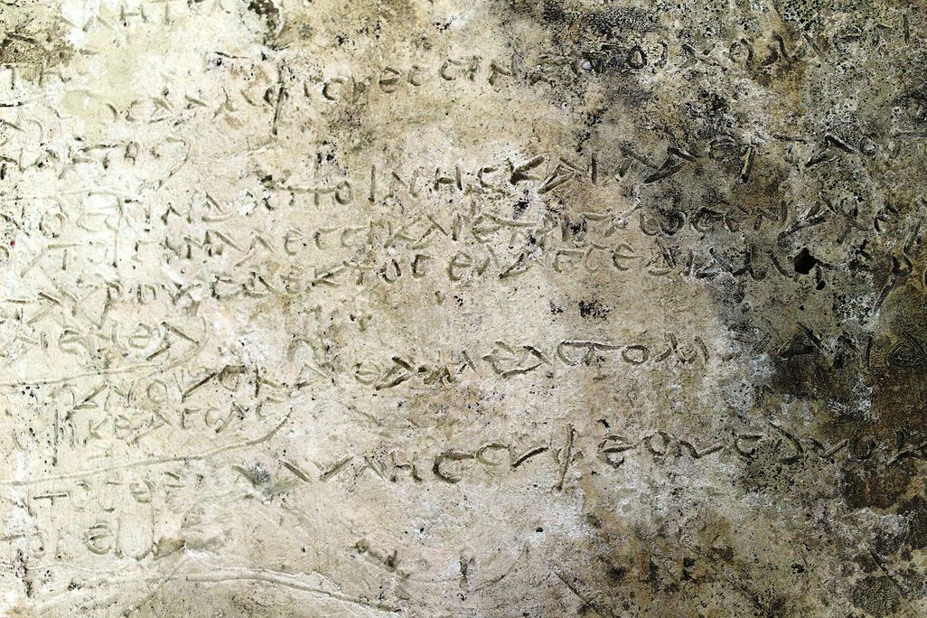
In this elective we will:
explore the values of the Homeric Code
analyse perspectives of heroes, women and marginal characters, identifying key epic literary devices and structures through collaborative close reading
consider how to strengthen and support inquiry-based classroom practice.
Oldest Greek fragment of Homer discovered on clay tablet.
13 verses from the Odyssey chiselled into a clay tablet dating to the 3rd Century A.D., representing the oldest lines of the poet found.

Slide 4

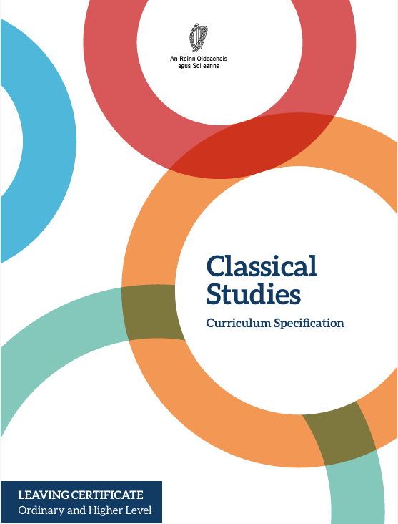
Learning Outcomes
Junior Cycle 2.8 recognise and explain common Greek concepts and words associated with Homeric epic (for example, timé, kleos, aidós, areté, pathos)
2.10 create a code of honour for modern day heroes/heroines with reference to the Homeric code
Senior Cycle
1.13 illustrate by examples the use of poetic devices and techniques that are characteristic of epic poetry (such as epithets and similes) and explain their effects and how they develop from Homer to Virgil
1.14 examine the story telling techniques of Homer and Virgil (such as narrative voice, perspective and bias, use of direct speech, type-scenes, ring composition, and the handling of time and space)

Slide 5
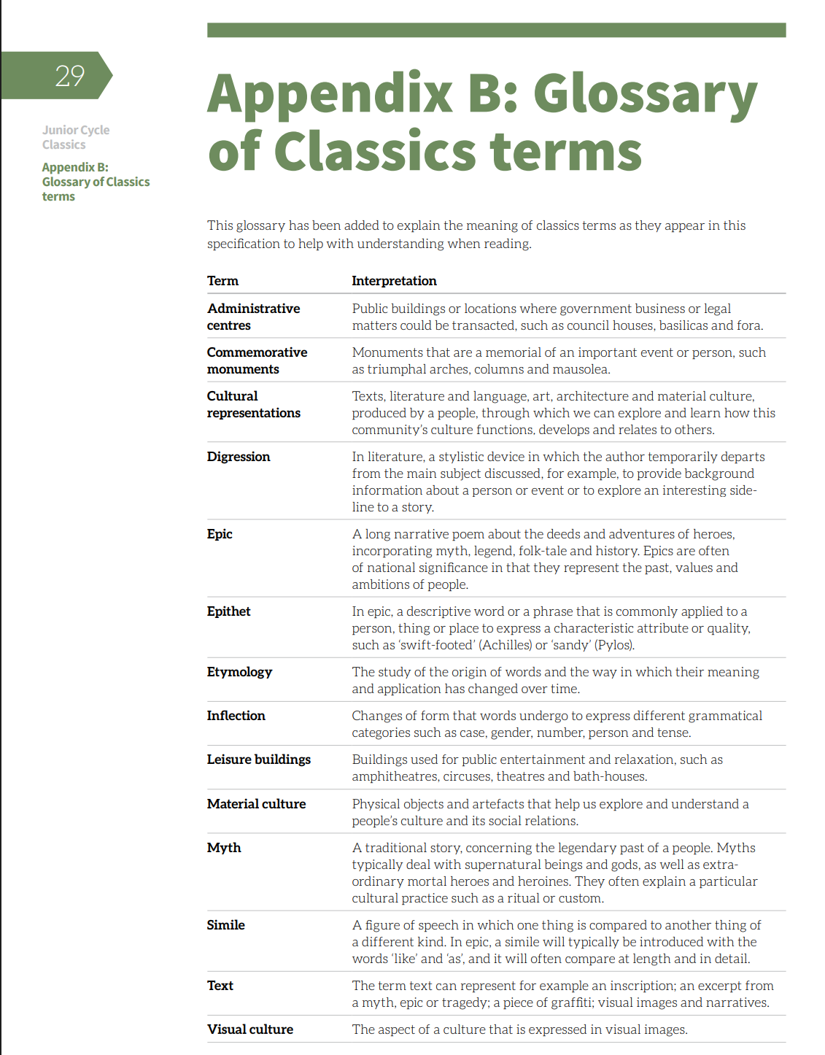
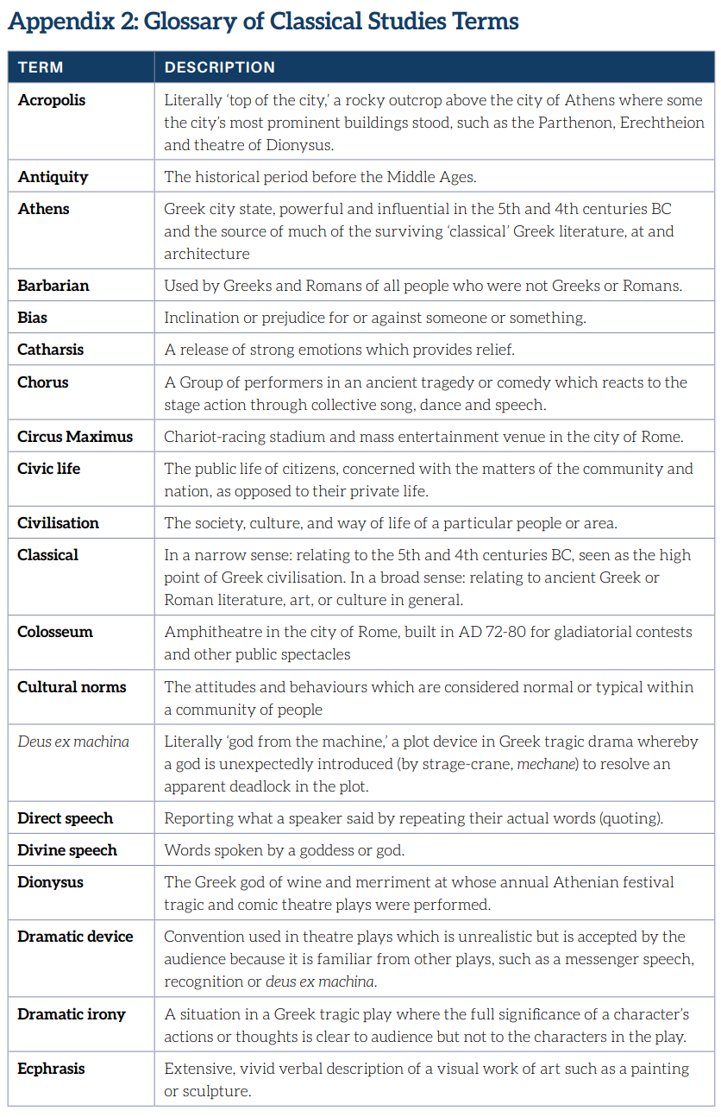
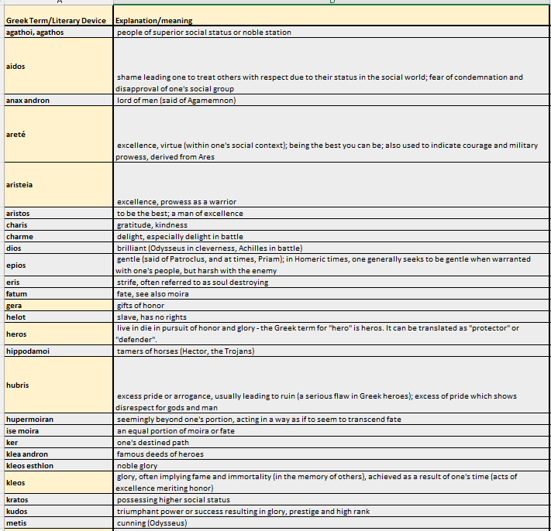
Glossary of Terms
Glossary of Homeric Terms

Slide 6
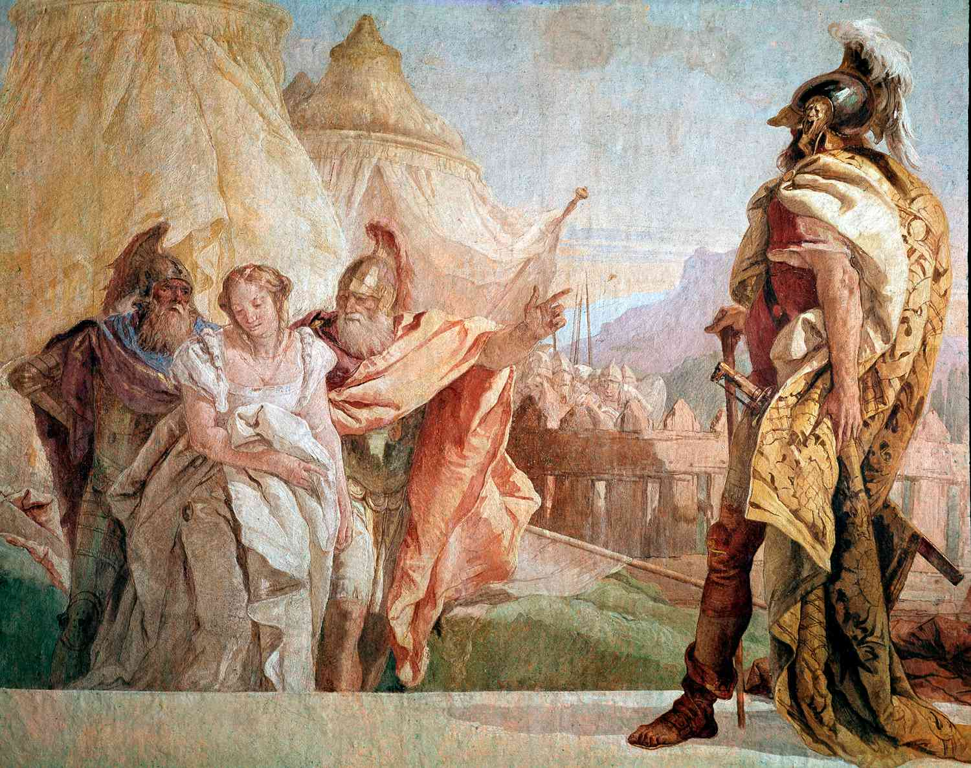
Timé
Homer. The Iliad (p. 8). W. W. Norton & Company. Kindle Edition.
Eurybates and Talthybios lead Briseis to Agamemnon. Giovanni Battista Tiepolo 1757 (Wikimedia commons)
Material and social recognition of a hero’s worth often represented by war prizes, gifts or status.
Example: The treatment of Chryseis and Briseis as trophies.
“Just as Apollo will take Chryseis back, away from me, when I send her to him on my own ship, escorted by my very own companions, so I shall take your beautiful Briseis, your trophy.”

Slide 7
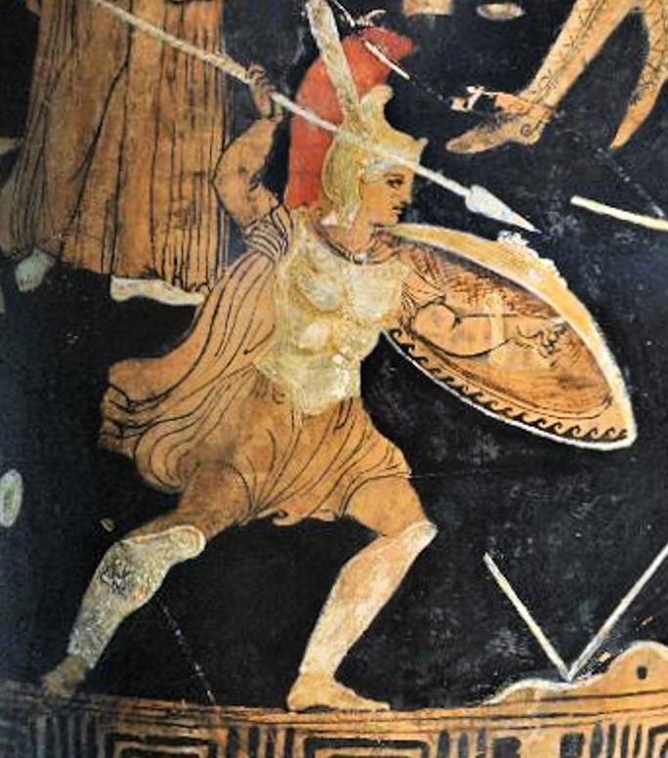
Kleos
Fame or renown that ensures a hero’s memory lives on after death. It is what warriors strive for through great deeds.
Example: Achilles feels his kleos/reputation have been insulted by Agamemnon’s demands.
“By this I swear to you a mighty oath. The Greeks will all be longing for Achilles one day and you will have no power to help, and you will grieve and many men will die at Hector’s murderous hands. Then you will tear your heart inside you in a bitter rage because you failed to pay the best Greek fighter proper respect.”
Ancient Greek polychromatic pottery painting 300BC of Achilles during the Trojan War ( Wikimedia Commons)
Homer. The Iliad (p. 10). W. W. Norton & Company. Kindle Edition.

Slide 8
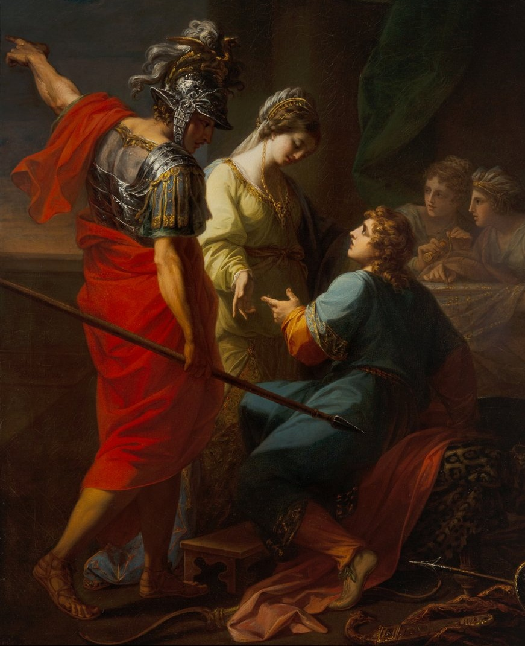
Aidos
A powerful sense of shame, modesty or respect often linked to social expectations or obligations to others (family, comrades, gods).
Example: Hector shaming Paris as he hides from the fighting.
“Seeing his brother, Hector scolded him with words to bring him shame. “You are so strange! It is not right for you to be so angry. The troops around our city and high wall are dying! War is raging round this town because of you! And you yourself would challenge and fight with anyone you saw hold back from hateful war—as you are doing now!”
Hector, Paris and Helen. Angelica Kaufman 1770 Oil Canvas. (Wikimedia Commons)
Homer. The Iliad (pp. 145-146). W. W. Norton & Company. Kindle Edition.

Slide 9
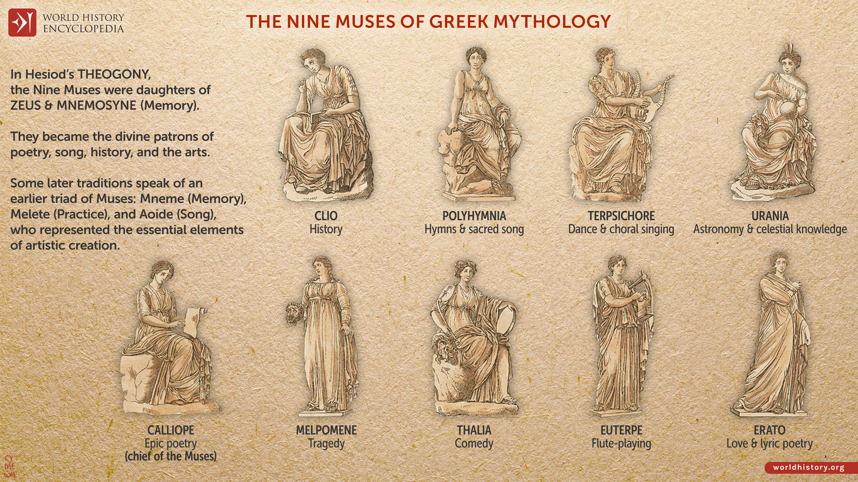
Invocation
Poet calls upon the Muse for inspiration
Example: The opening of the epic as the bard invokes the Muse
“Goddess, sing of the cataclysmic wrath of great Achilles, son of Peleus, which caused the Greeks immeasurable pain and sent so many noble souls of heroes to Hades, and made men the spoils of dogs, a banquet for the birds, and so the plan of Zeus unfolded—starting with the conflict between great Agamemnon, lord of men, and glorious Achilles.”
Homer. The Iliad (p. 1). W. W. Norton & Company. Kindle Edition.
6 of the 9 muses of Greek Mythology – World History Encyclopedia 2023

Slide 10
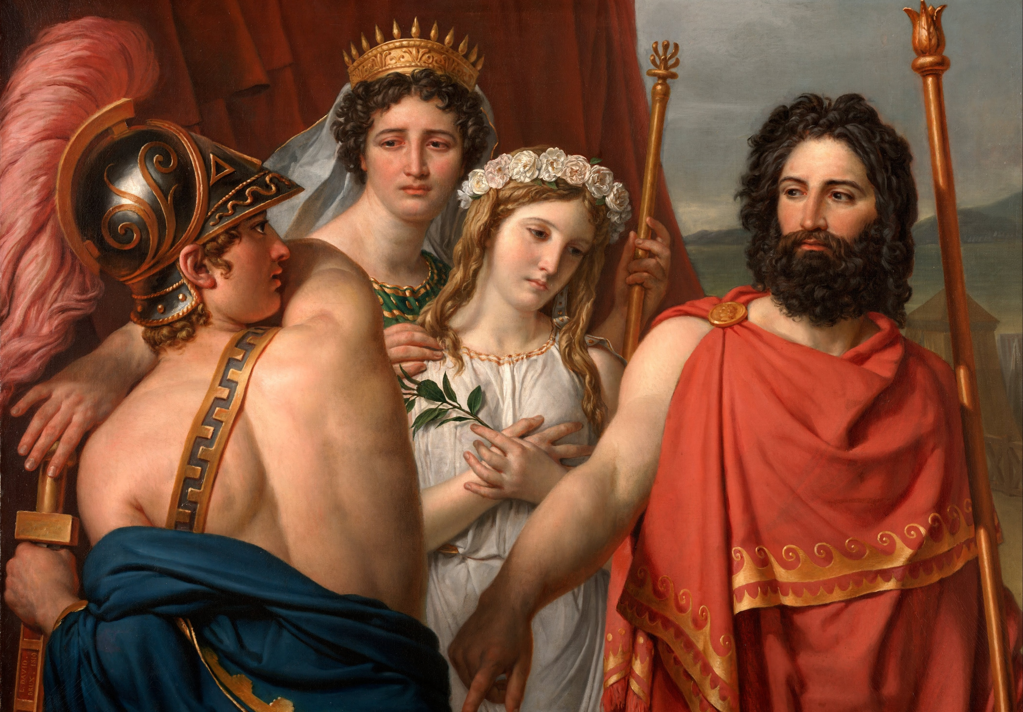
Direct Speech
Characters speaking in their
own voices.
Example: Achilles and Agamemnon’s quarrel in Book 1 of the Iliad
The anger of Achilles 1819 Jacques-Louis David Kimbell Art Museum, Texas (Wikimedia Commons)

Slide 11
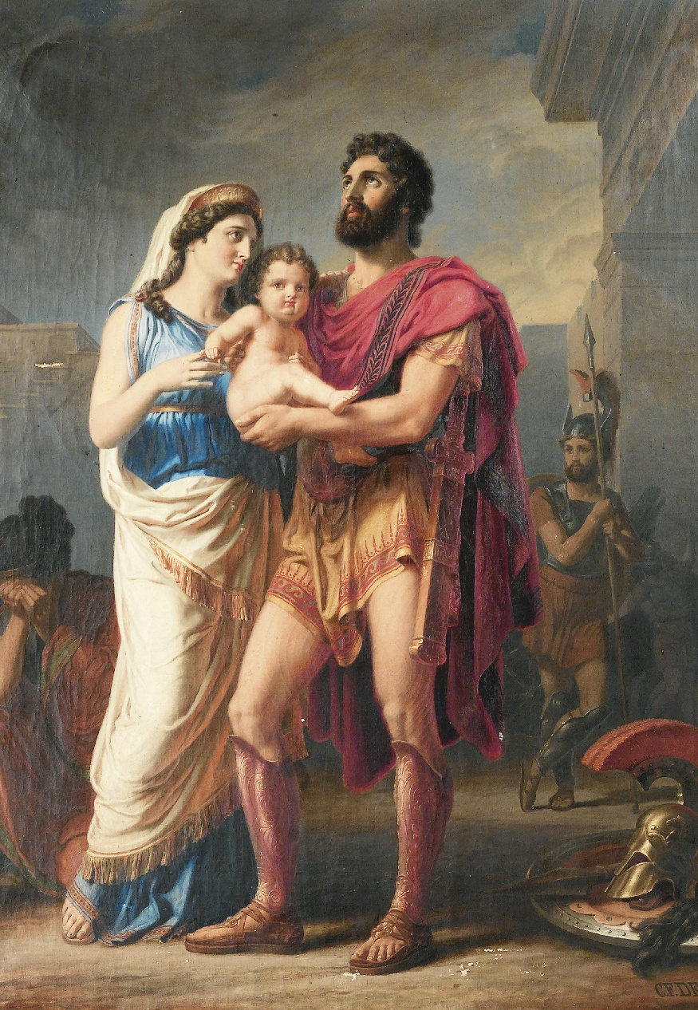
What is the Homeric Code?
A shared value system governing heroic behaviour, motivation and reputation in Homeric epic.
key values include honour (timē), glory (kleos) and reputation, loyalty, respect of status and hierarchy, bravery and avoidance of shame
it shapes decisions, relationships and conflicts throughout the Iliad.
The farewell of Hector to Andromache by Carl Friedrich Deckler 1900. (Wikimedia commons)

Slide 12
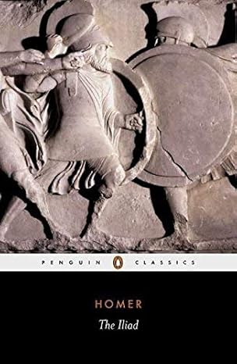
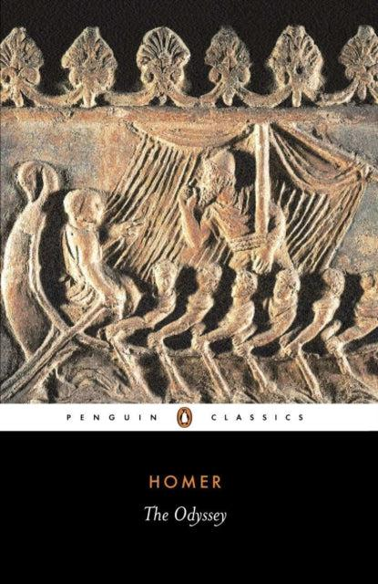
Why does the Homeric Code matter in the classroom?
The Homeric Code:
provides a framework for analysing character motivation
helps students understand why heroes act in seemingly extreme ways
supports close reading and thematic exploration.

Slide 13
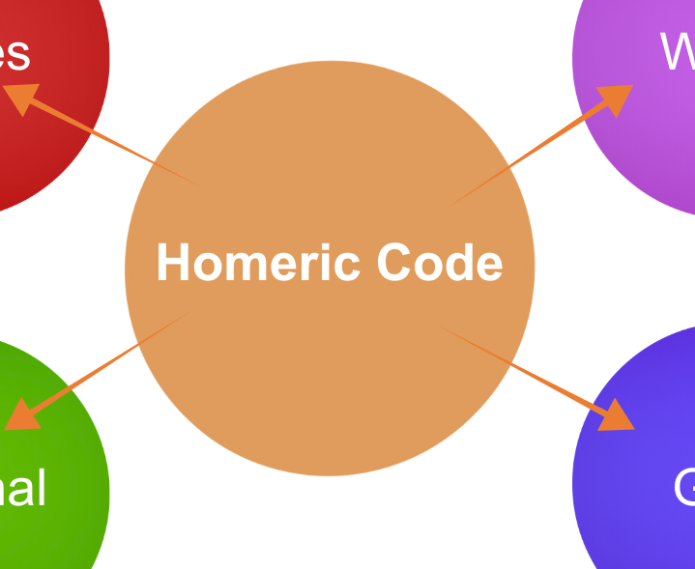
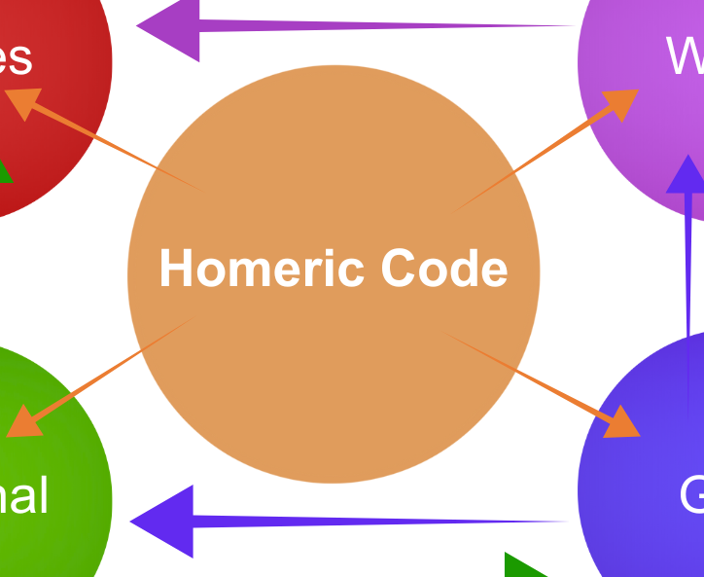
Character Types and the Homeric Code

Slide 14
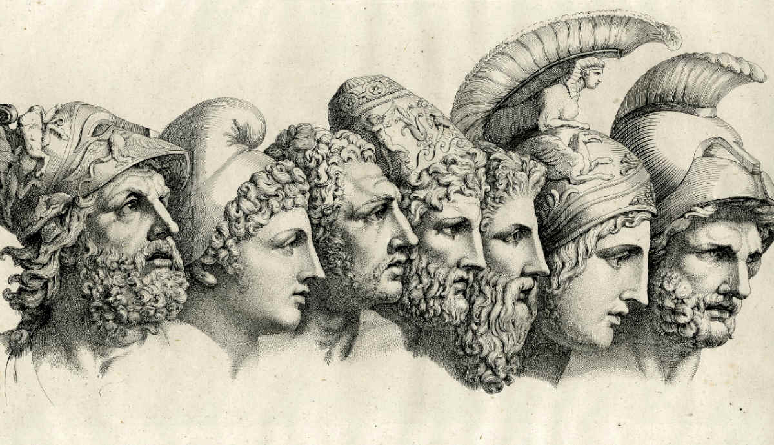
Homeric Heroes
In the Iliad, Homeric heroes are seen as greater human beings than the ordinary warriors, some may have a divine or semi-divine parent, though the hero himself is still mortal and subject to death, unlike the gods.
Heroes are of such stature that they sometimes provoke the gods and on occasion may even fight with a god.
Each hero is distinguished by a virtue (a good quality), but may also have a bad quality, e.g. Achilles is the greatest warrior, but he is also petulant (impatient, irrational) and self-centred.
Their heroic power is double-edged.
The seven heads of heroes from Homer’s Iliad. Heinrich Dieterich 1801-1805 Etching (British Museum)
“conflict within heroism between individual ambition and collective good, and the dangers of putting personal honour above all else.” William Allan, Bloomsbury 2012

Slide 15
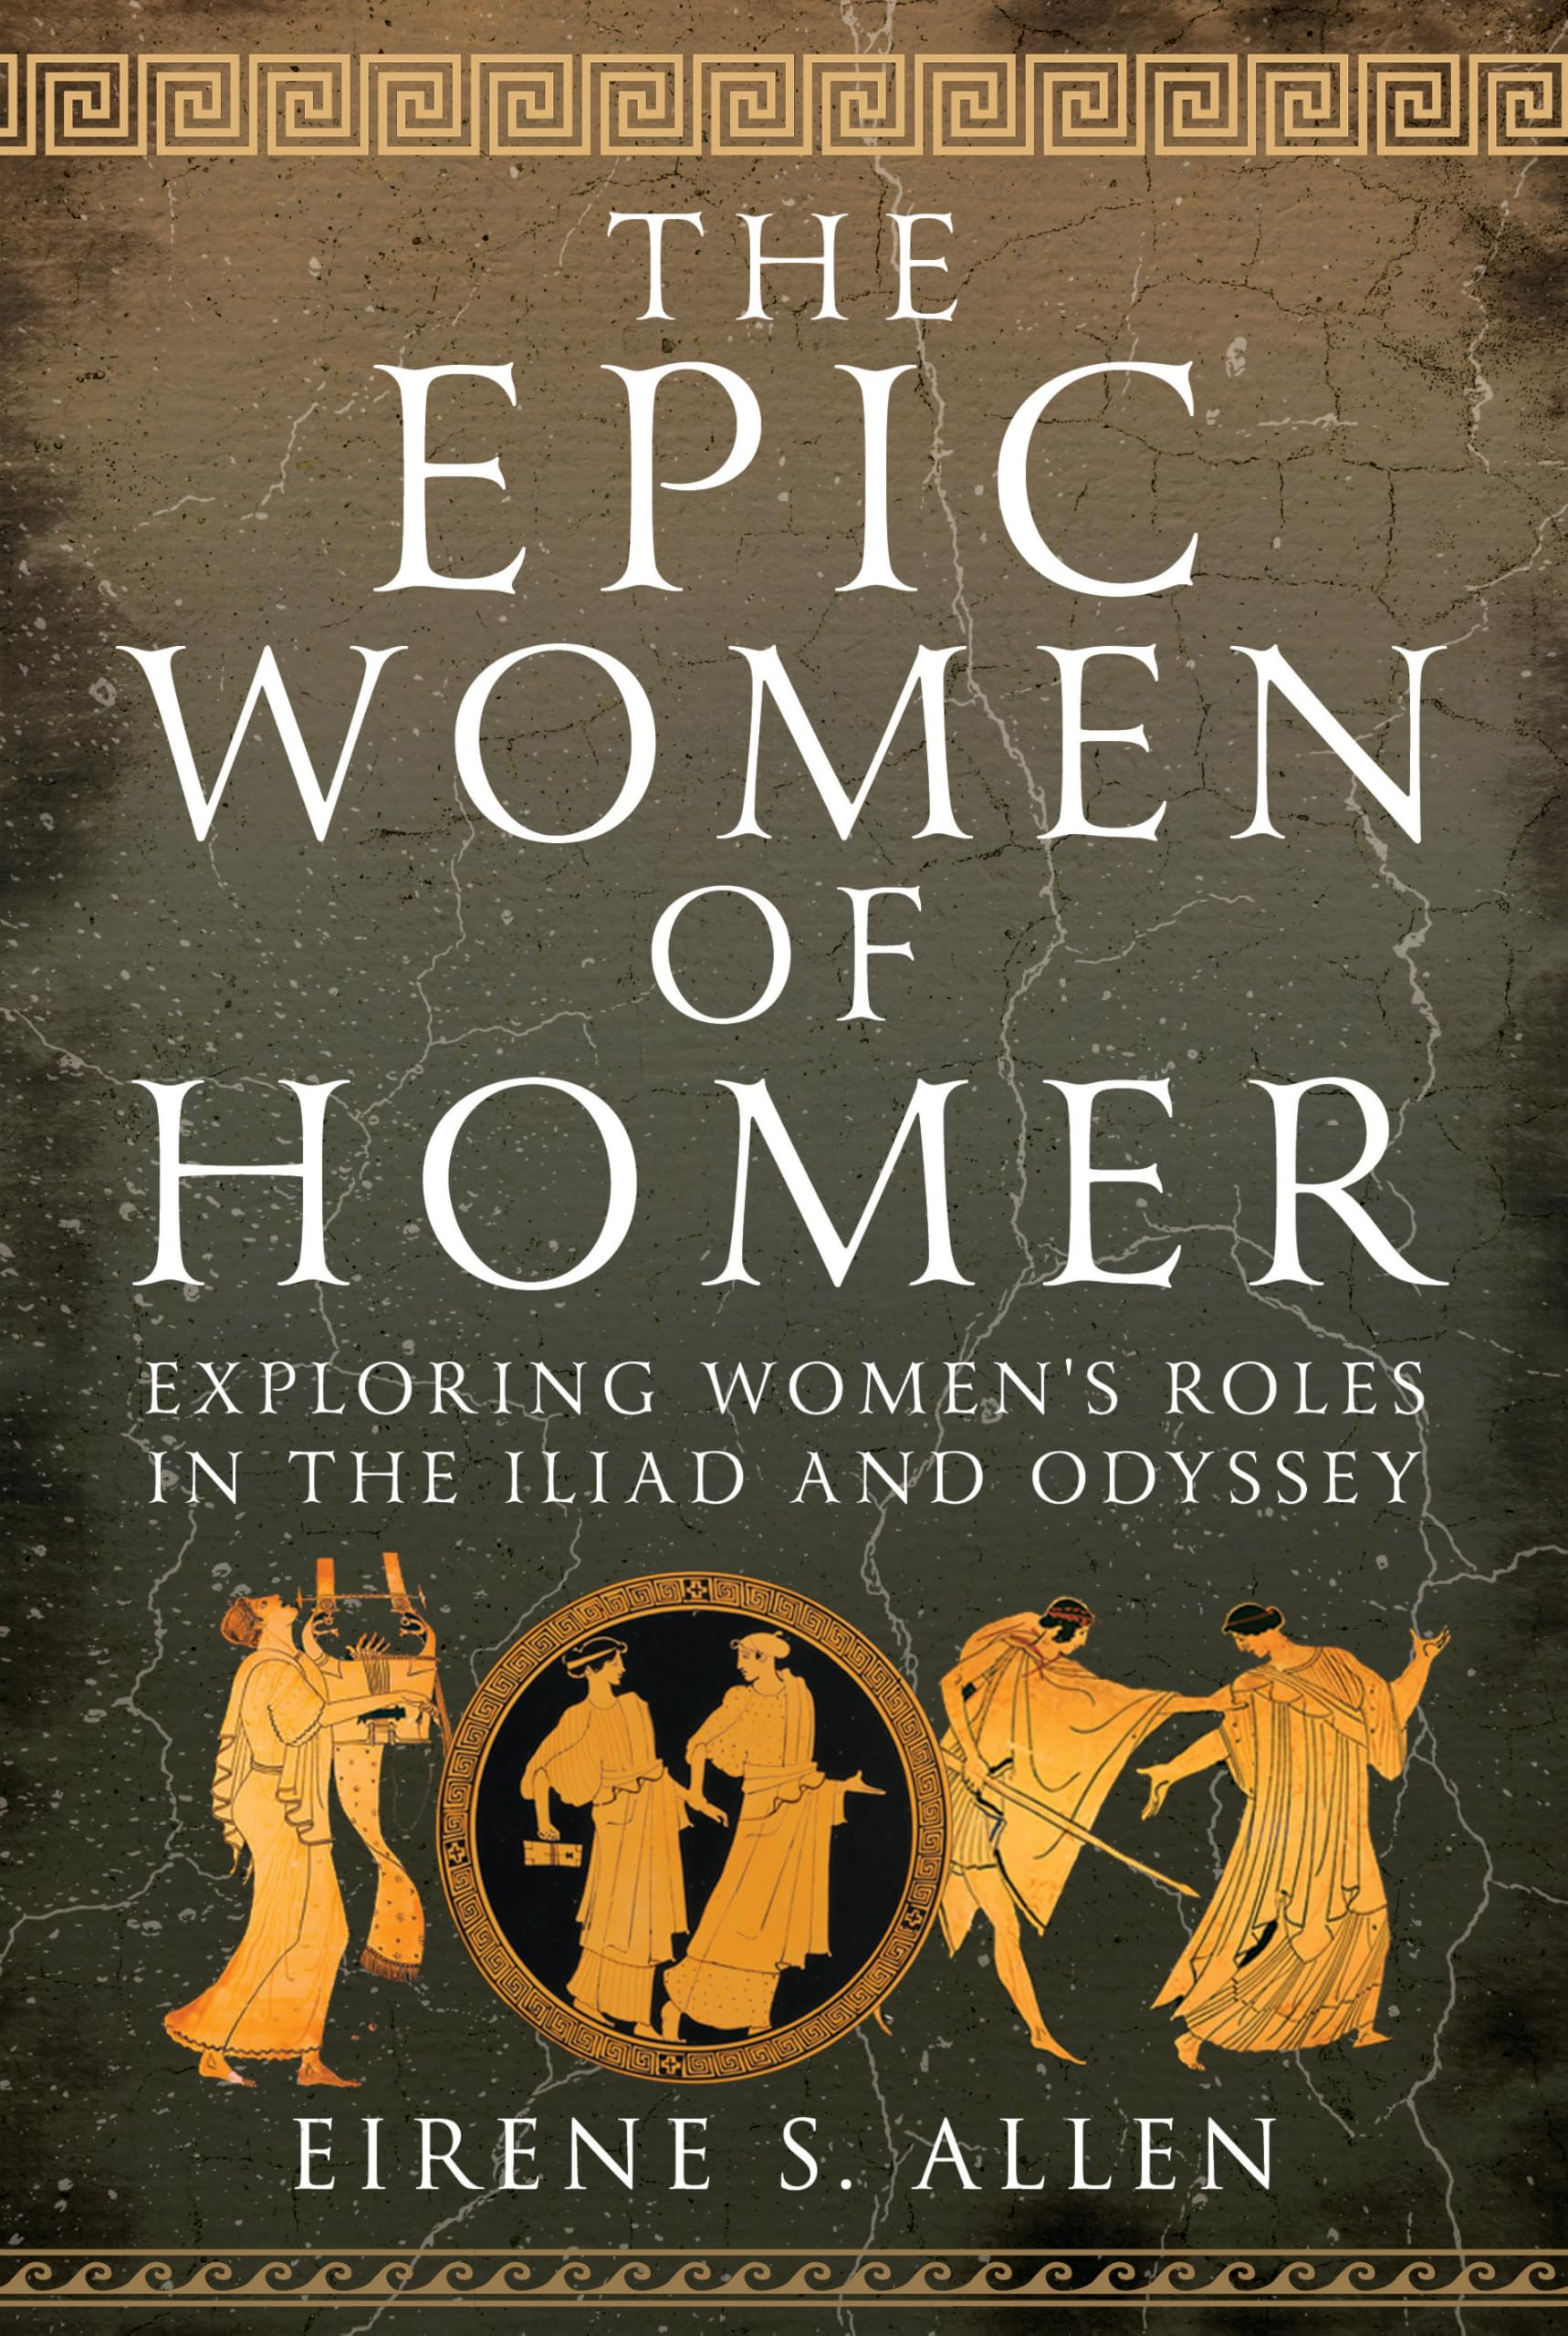
Women in the Iliad
Women are excluded from heroic power but possess strong moral and emotional authority.
They expose the personal and social cost of heroic values such as honour and glory.
Through lament, memory and protest, they challenge the heroic narrative of war.
Example: Andromache reveals how Hector’s heroism leads to the destruction of family life.

Slide 16
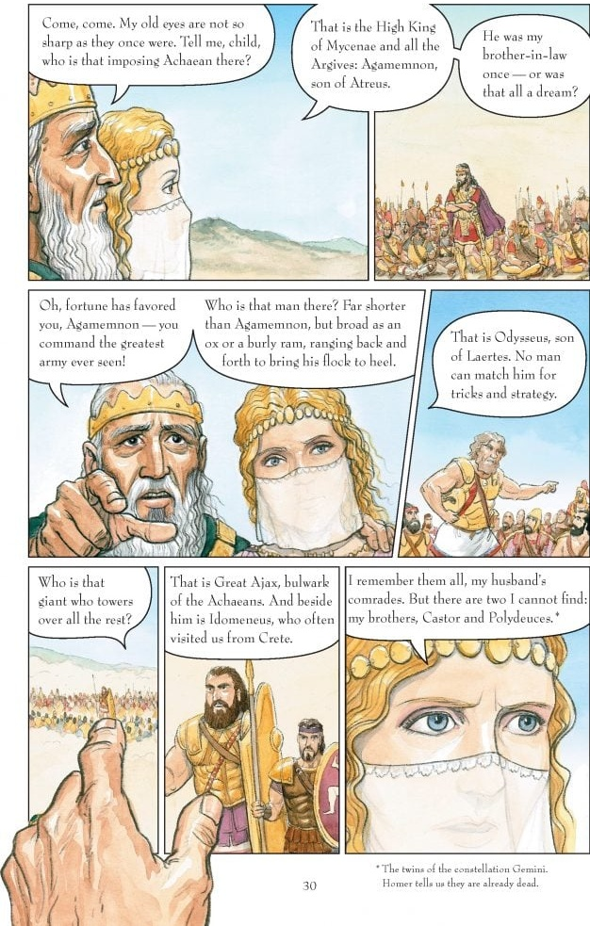
Marginal Characters
Marginal characters exist outside the heroic elite and lack social or military power.
They offer alternative perspectives on heroism, leadership and justice.
Their voices often expose hypocrisy, imbalance, or suffering within the heroic system.
Example: Thersites highlights inequality and suppressed opposition. A common Greek soldier who openly criticises Agamemnon for greed and poor leadership.
Thersites is described as physically ugly and socially inferior - lacking any status. Many of his complaints echo what Achilles has already said, but he is publicly humiliated and beaten by Odysseus. (Book 2 line 210)

Slide 17
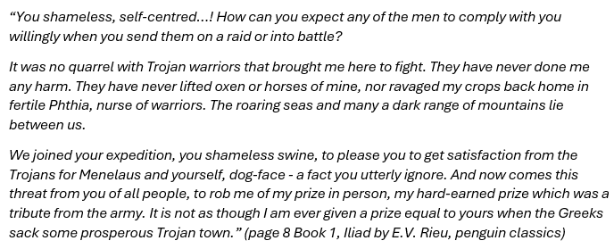
Close Reading and Text Analysis
3 key questions
What values are presented in the passage/extract?
How does Homer use literary devices or narrative structures to shape our understanding?
What narrative purpose does this character or scene serve within the epic?

Slide 18
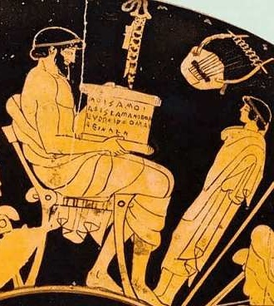

Close Reading
Group work – Breakout Rooms - Padlet
Using the extract allocated to your group from the Iliad, discuss the 3 associated questions.
Make reference to the glossary of terms as you formulate your responses to each of the questions.
Consider and discuss in the breakout room how you could use this approach to support students in the classroom?
Ancient Greek man with wax tablet. Painting by Douris 500BC – Berlin Museum – (Wikimedia commons)

Slide 19

How could this inquiry-based approach support students in the classroom?
Achilles
How does Achilles’ speech in Book 1 challenge the idea that heroic honour is fair or just?
Andromache
How does Andromache’s speech change our understanding of Hector’s heroism?
Hector
How does Hector’s farewell speech change our understanding of what it means to be a hero in the Homeric world?
Priam
How does Priam’s supplication force Achilles, and the audience, to rethink vengeance and honour?

Slide 20

How do/could you provide formative assessment opportunities for your students to understand these epics terms and literary devices?
Example:
Group work – sentence starters
Achilles is angry because Agamemnon does not respect him…
Andromache and Priam show how war affects those who are not celebrated as heroes…
Andromache’s speech exposes the human cost of heroic values in a world dominated by war and reputation…

Slide 21
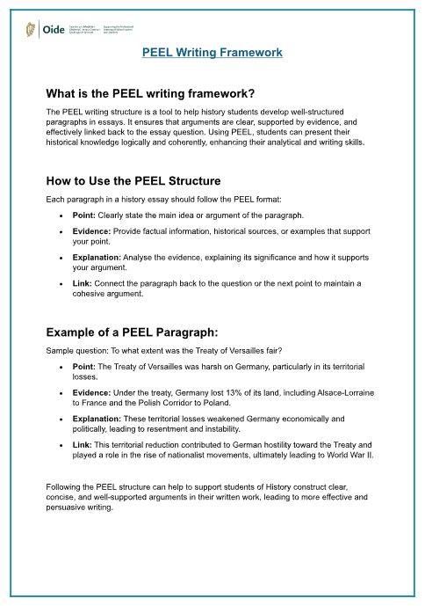

Slide 22
In this elective we:
explored the values of the Homeric Code
analysed perspectives of heroes, women and marginal characters, identifying key epic literary devices and structures through collaborative close reading
considered how to strengthen and support inquiry-based classroom practice.
Oldest Greek fragment of homer discovered on clay tablet.
13 verses from the odyssey chiselled into a clay tablet dating to the third century A.D., representing the oldest lines of the poet found.

Slide 23

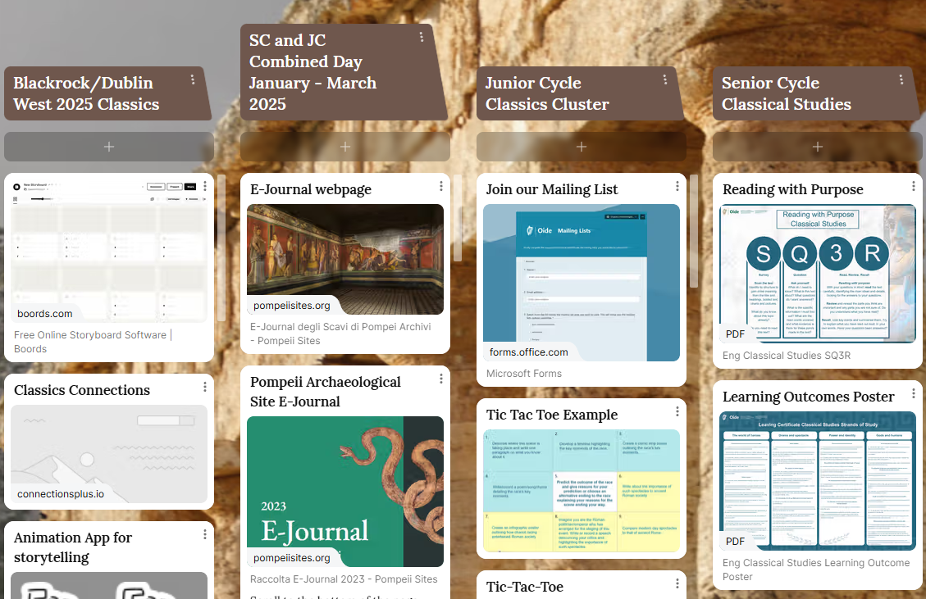
Classics Padlet

Slide 24



Additional supports
Visit our website www.oide.ie
Contact: info@oide.ie
Join our new mailing list to receive news and updates
Follow us on X
@Oide_Classics

