Slide 1
Oide Senior Cycle Classical Studies
Collaborative

Slide 2
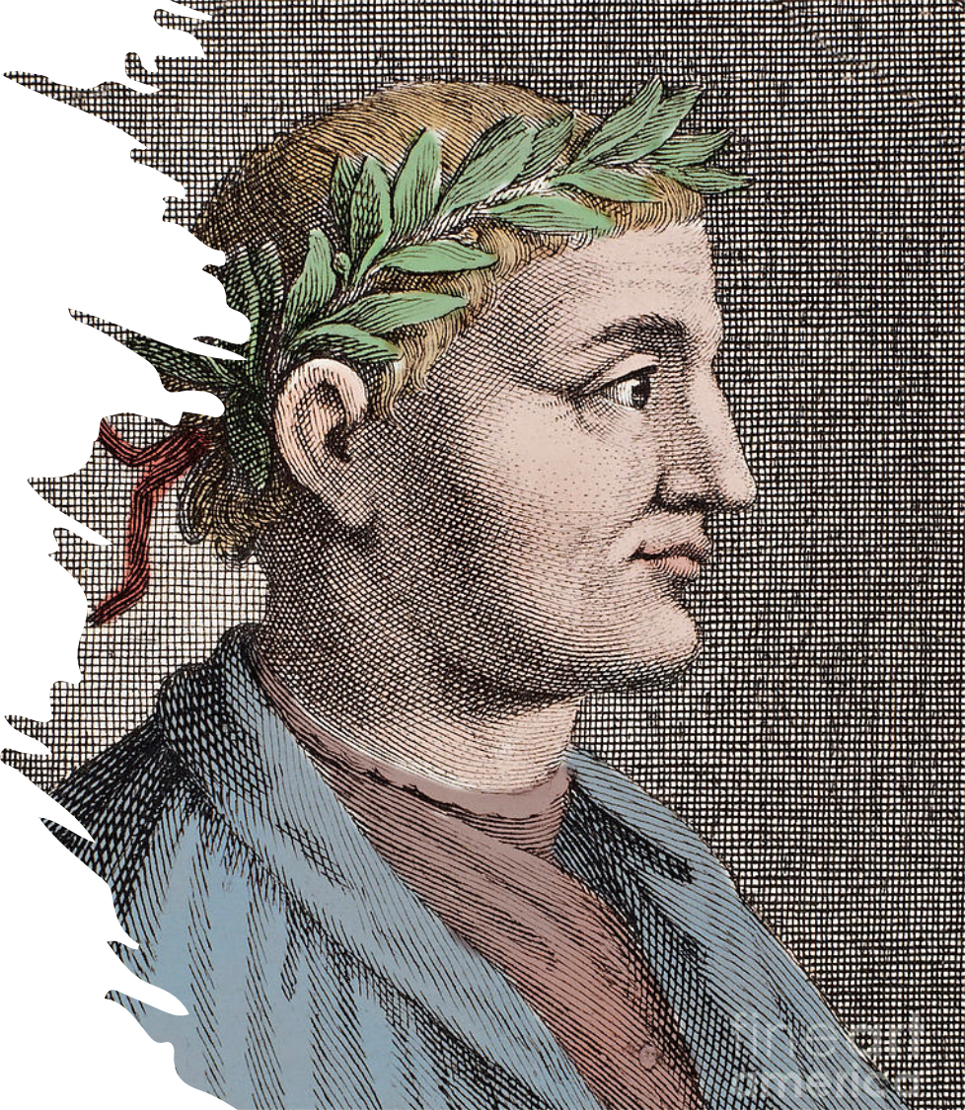
Carpe Diem!
An exploration into the
poetry of Horace

Slide 3
Philosophical ideas about mortality and living well
4.13. Examine what constitutes ‘living well’ when faced with the inevitability of death according to Socrates as depicted in Plato’s Crito and Horace in the Odes and Epodes.
4.14. Explore how the relationship between human decision and responsibility on the one hand and divine will and fate on the other is viewed by Socrates as depicted in Plato’s Crito and Horace in the Odes and Epodes.
4.15. Examine how their own views about what it means to live well relate to the ideas of Socrates as depicted in Plato’s Crito and Horace in the Odes and Epodes.

Slide 4
Introducing philosophy

Slide 5
Horace

Slide 6
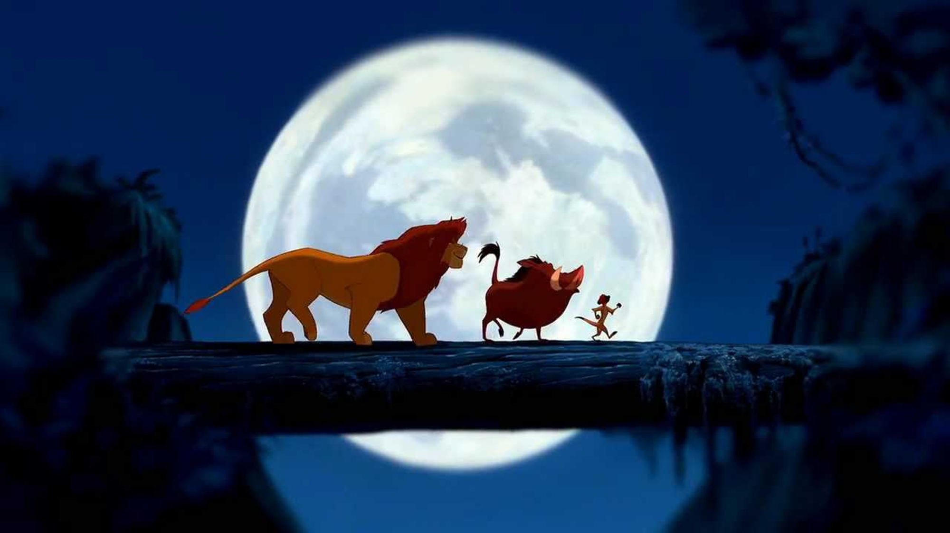
Initial stimulus material

Slide 7
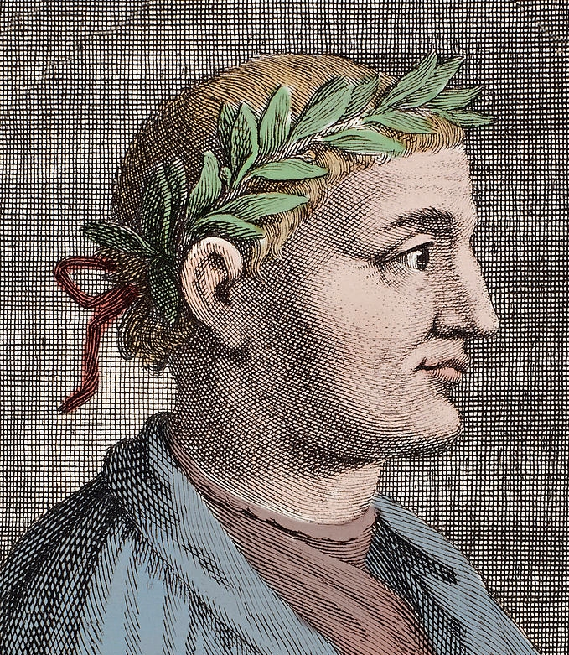
Horace: biography
In 65 B.C., Horace was born in the region of Samnium in Southern Italy.
Horace’s father was a libertus or freedman. He had probably been enslaved during the Social War in 80 B.C. – a war over full Roman citizenship for all of Rome’s Italian allies.
Horace had a close relationship with his father, who spent a lot of money to ensure his son had a good education in Rome.
He even wrote a poem as tribute to his father (Horace. The Satires. Book I: Satire VI).

Slide 8
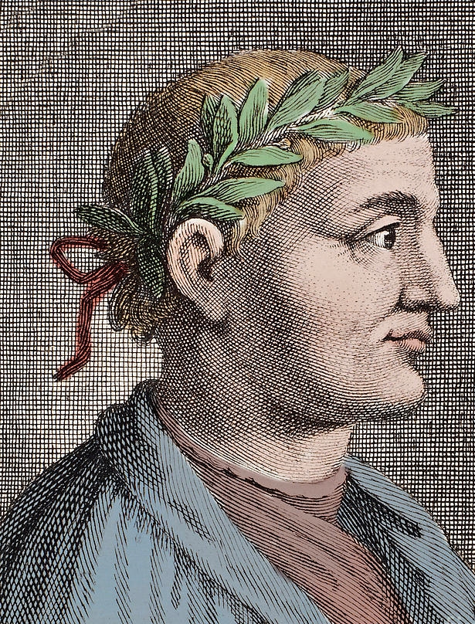
Horace: biography
As a young adult, Horace left Rome and headed for Athens, Greece.
Here he studied philosophy in Plato’s Academy after Plato was long deceased.
In Horace’s day the primary philosophers teaching there would have been Epicureans and Stoics.

Slide 9
Carpe Diem
Carpe Diem – seize the day – is a quote from Horace and a common phrase today. However, it is also misinterpreted too.
What you might consider Carpe Diem is to seize any opportunity no matter what it is. However, it is actually more complex than that, because Horace also supports the idea of a quiet, simple life.
This is because the two most popular philosophical schools of thought at the time were Epicureanism and stoicism. The latter is probably the one that had the bigger influence on Horace.

Slide 10
Stoicism

Slide 11
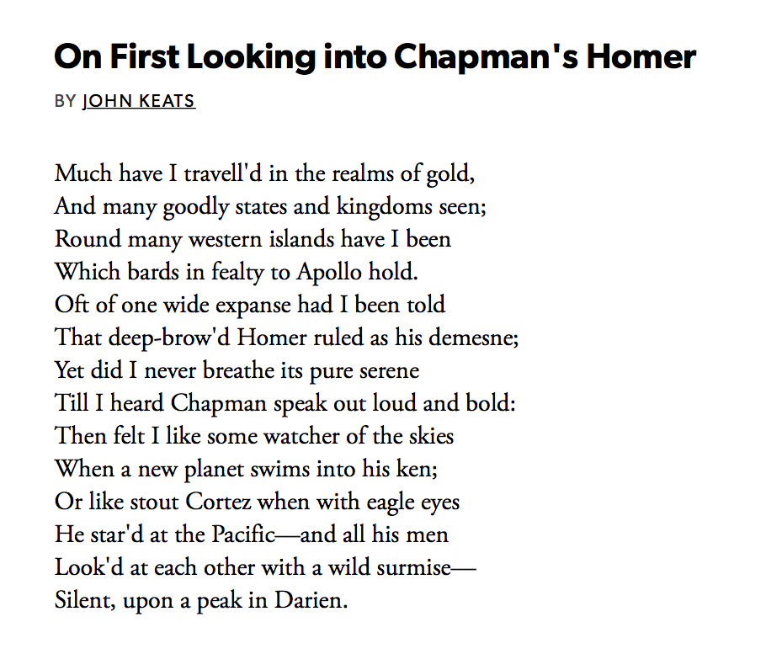
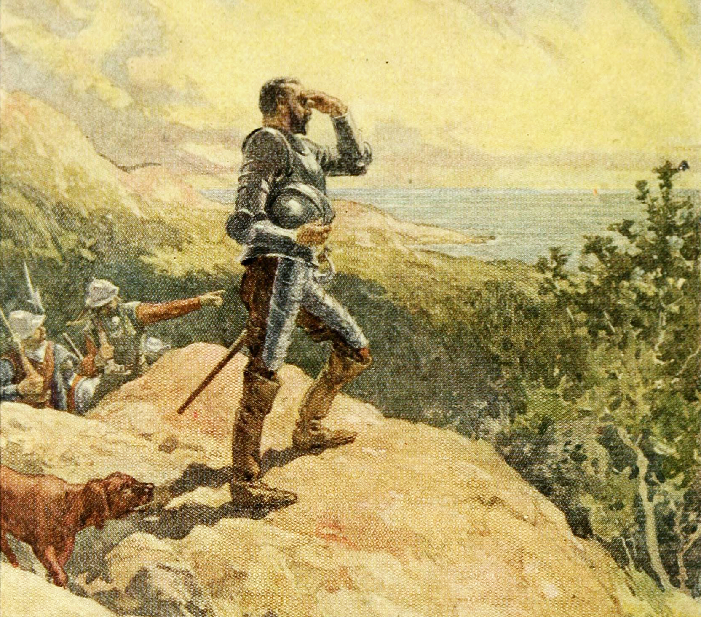
Cross-curricular opportunities

Slide 12
Epicureanism

Slide 13
Making connections

Slide 14
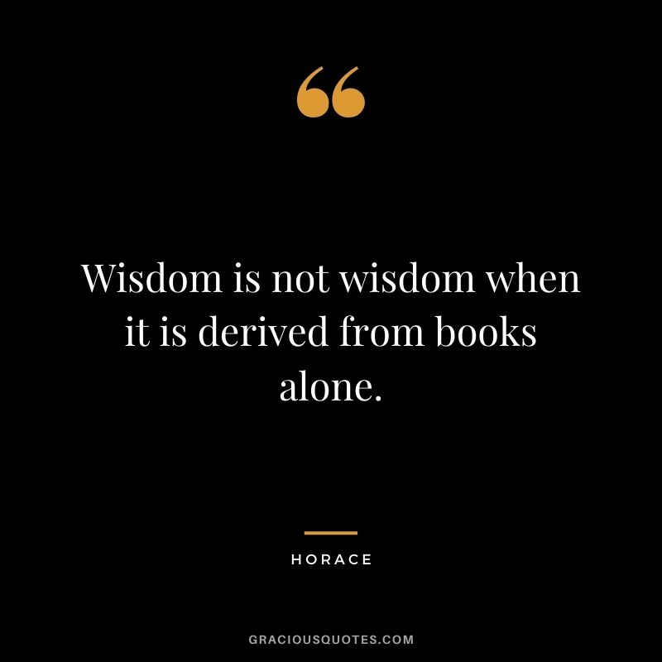
Horace’s views
Death is inevitable.
The shortness of life – time is fleeting.
Enjoy the present hour – Carpe Diem.
The simple/quiet life is best.
Friendship is important to a happy life.

Slide 15
Living well
Gather ye Rosebuds
Enjoy The Present Hour
We All Must Die
Cease to Mourn
The Good Man Need Fear Nothing
Enjoy Your Possession While They Are Yours
Ode to Spring
A Quiet Life
Rustic Joys

Slide 16
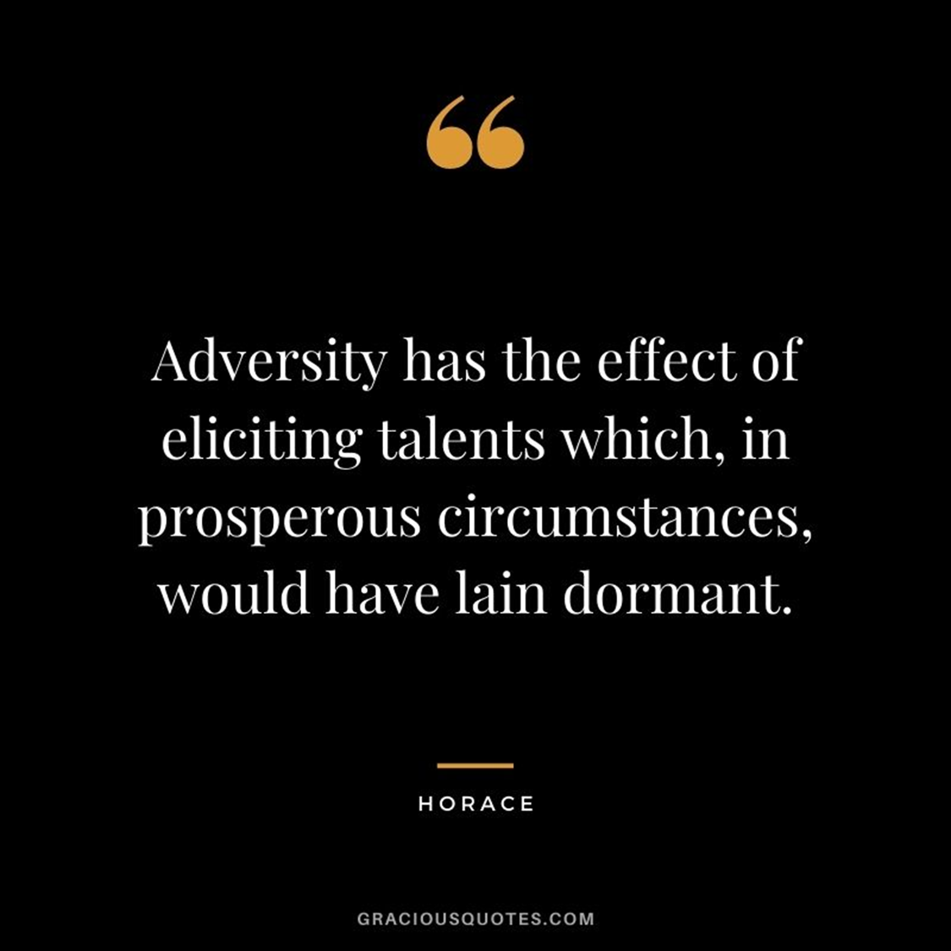
Human will vs divine fate
Gather ye Rosebuds
Enjoy The Present Hour
Enjoy Your Possession While They Are Yours
Ode to Spring

Slide 17
Feedback

