Slide 1
Python Skills: Pygal
Leaving Certificate Computer Science
Notes:
Title slide test: font automatically resizes if more than 2 lines in title. Write title of workshop (should we call them seminars or workshops in the future?!), then move the cursor to in front of the title then hit enter once or twice and the font will automatically resize
Probably don’t need different slides for start of the two days – this should do for both. Will need to

Slide 2





Meet the LCCS Team
Caroline Sheils,
Senior Leader for
Mathematics & Computer Science
Carol Cronin
carol.cronin@oide.ie
Clement Byrnes
clement.byrnes@oide.ie
Mary Looney
mary.looney@oide.ie
Administrator: Grainne Haughney
computerscience@oide.ie
@Oide_compsci
Notes:
Timeframe: 2 Min
Purpose: To introduce members of CS Team and their role
Script:

Slide 3
Supports Provided by Oide
Text
Professional Learning Events (PLE)
Webinars
School Support
Scoilnet
Skills Workshops
Collaboratives
Oide website

Slide 4


Upcoming events
Phase 6
Collaboratives
PLE 6
Python (Dictionaries)
PLE 7
Phase 7
Collaboratives
Advanced Micro bit
Python (Dictionaries)
PLE 3
PLE 4
Fundamental Web Skills

Slide 5


Purpose for the Day
To develop skills working with the Pygal library for Python, to aid in
modelling tasks in ALT 3 and interactive web design in ALT 1

Slide 6



Key Messages
Effective pedagogies can enhance teaching and learning, however, the emphasis for this workshop is on skills development.
All learning outcomes (LOs) are interwoven. This means that the specification can be used in many ways.
LCCS can be mediated through a constructivist pedagogical approach.
Group work is a key feature in the teaching, learning and assessment of LCCS.

Slide 7
Workshop Overview
Session 1 10:00 - 11:30 | Introduction, Installation and Charts and Maps in Pygal
Tea/Coffee 11:30 – 12:00
Session 2 12:00 - 13:30 | Styles for Charts Configuration: charts, series, values, sparklines, tables
Lunch 13:30 - 14:30
Session 3 14:30 - 16:30 | Output in Pygal, Embedding in webpages (+ Breakout Activities)

Slide 8
By the end of this workshop participants will have had the opportunity to…
Learning Intentions
Develop an understanding of the Pygal library in Python and its uses
Create different types of charts in Python with Pygal
Use chart styles and configurations to customise charts
Create output in SVG format to embed in webpages/websites
Notes:
Timeframe:
Purpose:
Script:
Learning intentions ….
Consider putting these on the wall so that participants can see them for the entire day. Magic Whiteboard!
Ask teachers for their opinions e.g.
does anyone here have something they would like to take from today that is not included on this list?

Slide 9
Session 1
Introduction to Pygal,
Installation of Pygal,
Charts and Maps in Pygal

Slide 10
What is Pygal?
A python library for generating SVG-based charts
Produces scalable, crisp and interactive graphics
Suitable for use in websites, reports and ALTs
Charts remain high-quality at any size
Scalable vector graphics (SVG) use mathematical points instead of pixels which allow graphics to scale infinitely without losing image quality or becoming blurry.

Slide 11
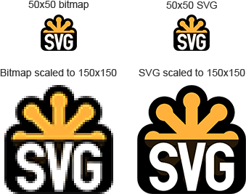
Why SVG?
Vector-based graphics (no pixelation).
Small file sizes.
Interactive elements (hover labels, tooltips).
Easy to embed in HTML.
Notes:
Source of image: https://www.sculpteo.com/en/glossary/svg-definition/

Slide 12
Using Pygal in Computer Science
Supports ALT2 visualisation tasks
Supports ALT1 interactive web design
Enables students to present findings in coursework

Slide 13
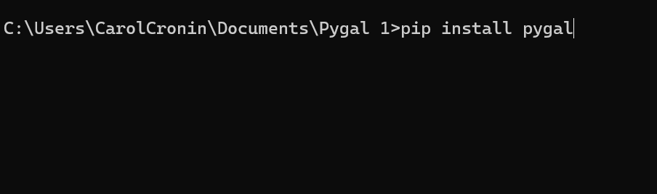
Installing and Importing Pygal
Pygal works in any Python environment, e.g. Thonny, IDLE
Thonny installation:
Tools > Open system shell >
Type pip install pygal at the prompt
Click Enter

Slide 14
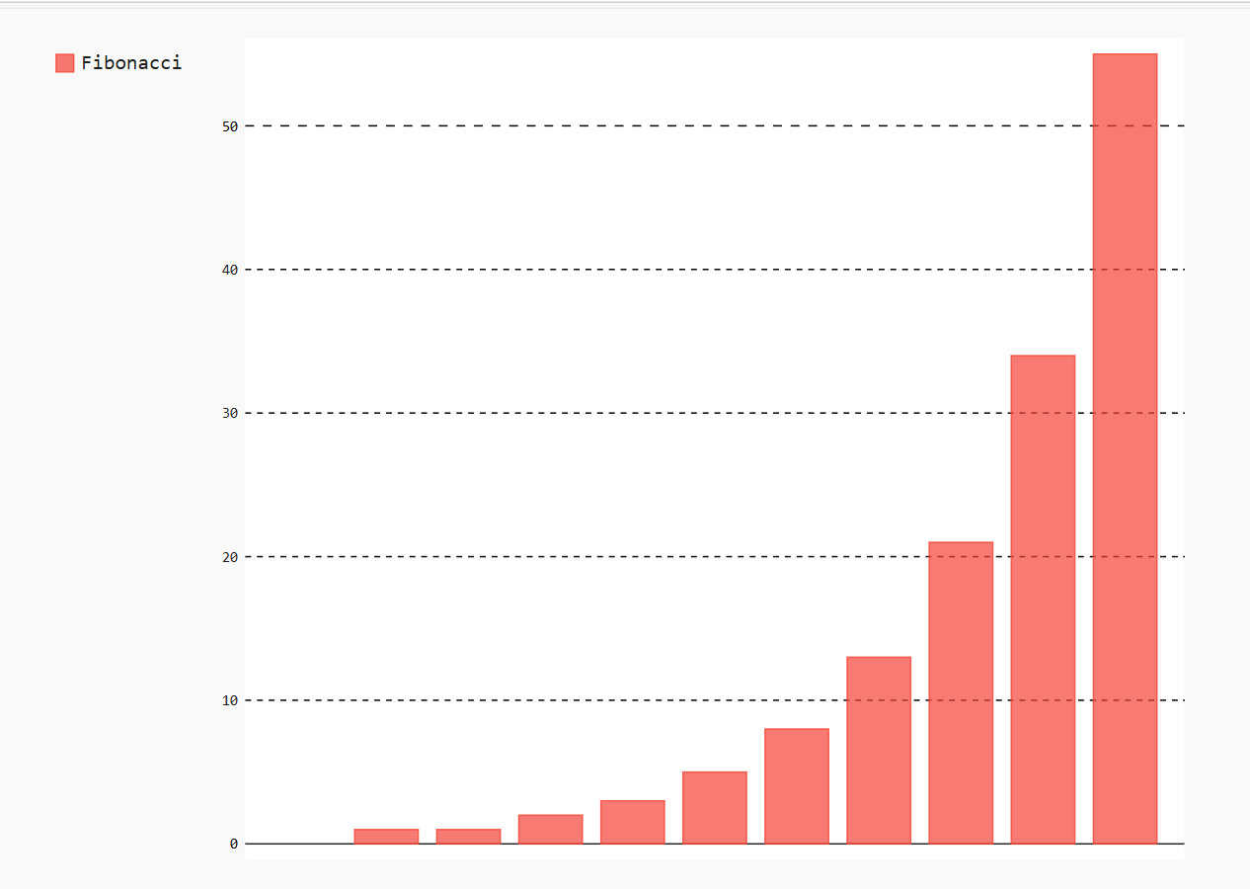
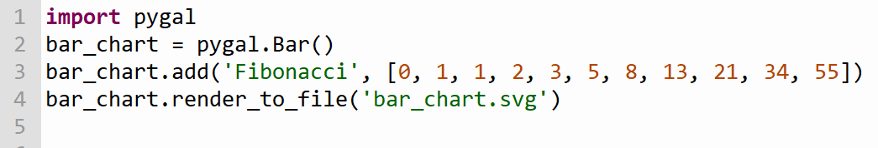
Creating a chart with Pygal
Import Pygal
Create a variable and set the variable to a chart type
Add data to the chart
Render to SVG file
Save the file in a directory
To open the file click on the file in the directory and it will be opened in a web browser
Notes:
See accompanying handbook with coding examples and activities.

Slide 15
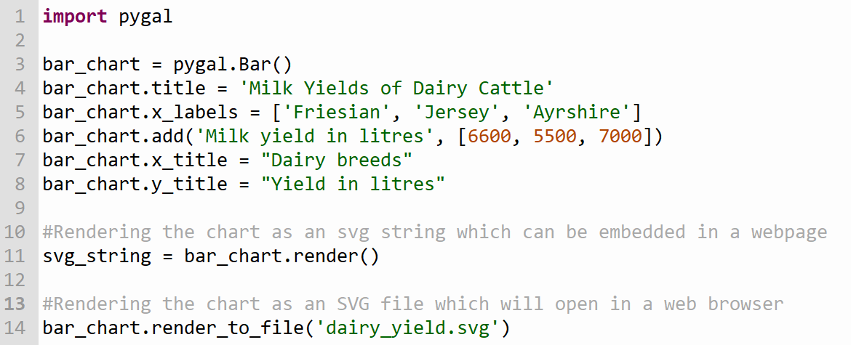
Rendering options
Rendering is how charts are output and displayed
Pygal makes SVG graphics by default
bar_chart.render()
This method will output a SVG string which can be embedded directly in HTML
bar_chart.render_to_file(‘sample_chart.svg’)
This method will output an SVG file which will be saved in the default folder and can be opened in a web browser

Slide 16
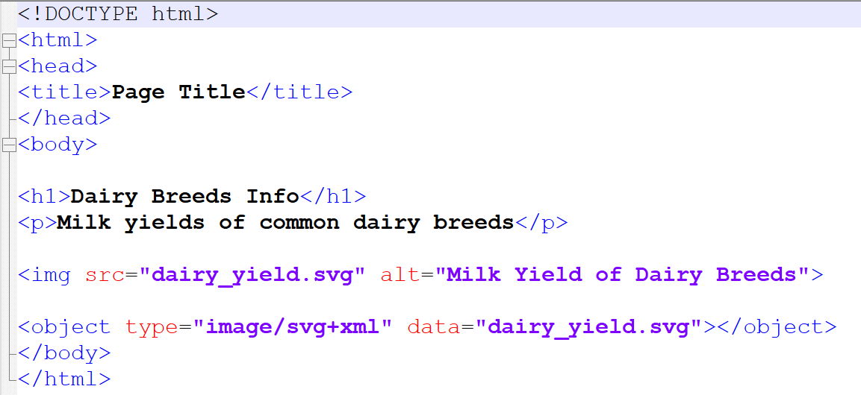
Displaying rendered objects
SVG files can be embedded in webpages like a normal image using the <img src> tag which will work in all browsers, but the image is static
SVG files can also be embedded inline using the <object> tag which allows for interactivity. The file is separate to the webpage and remains scalable
Static image
Interactive image

Slide 17
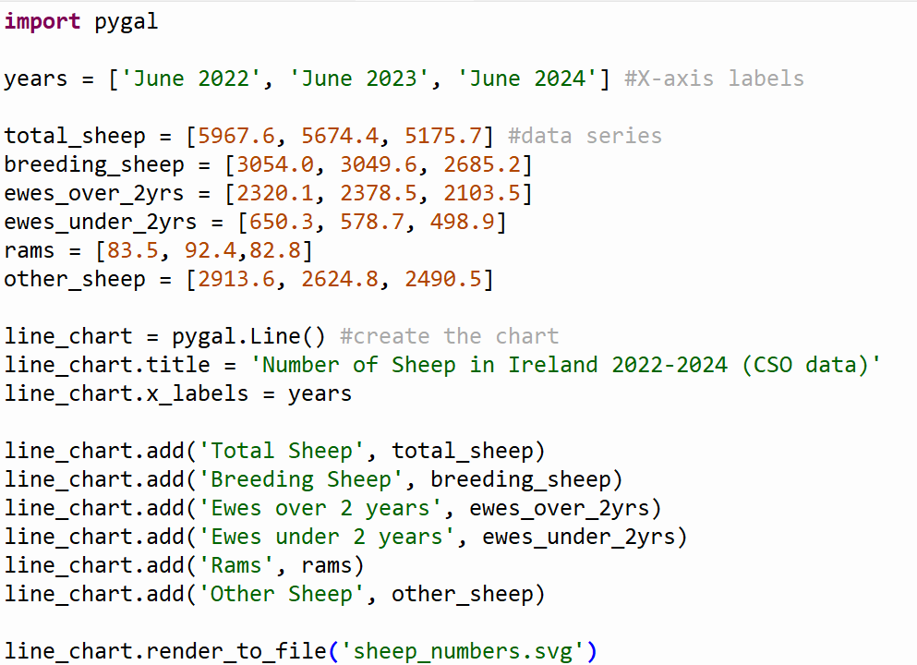
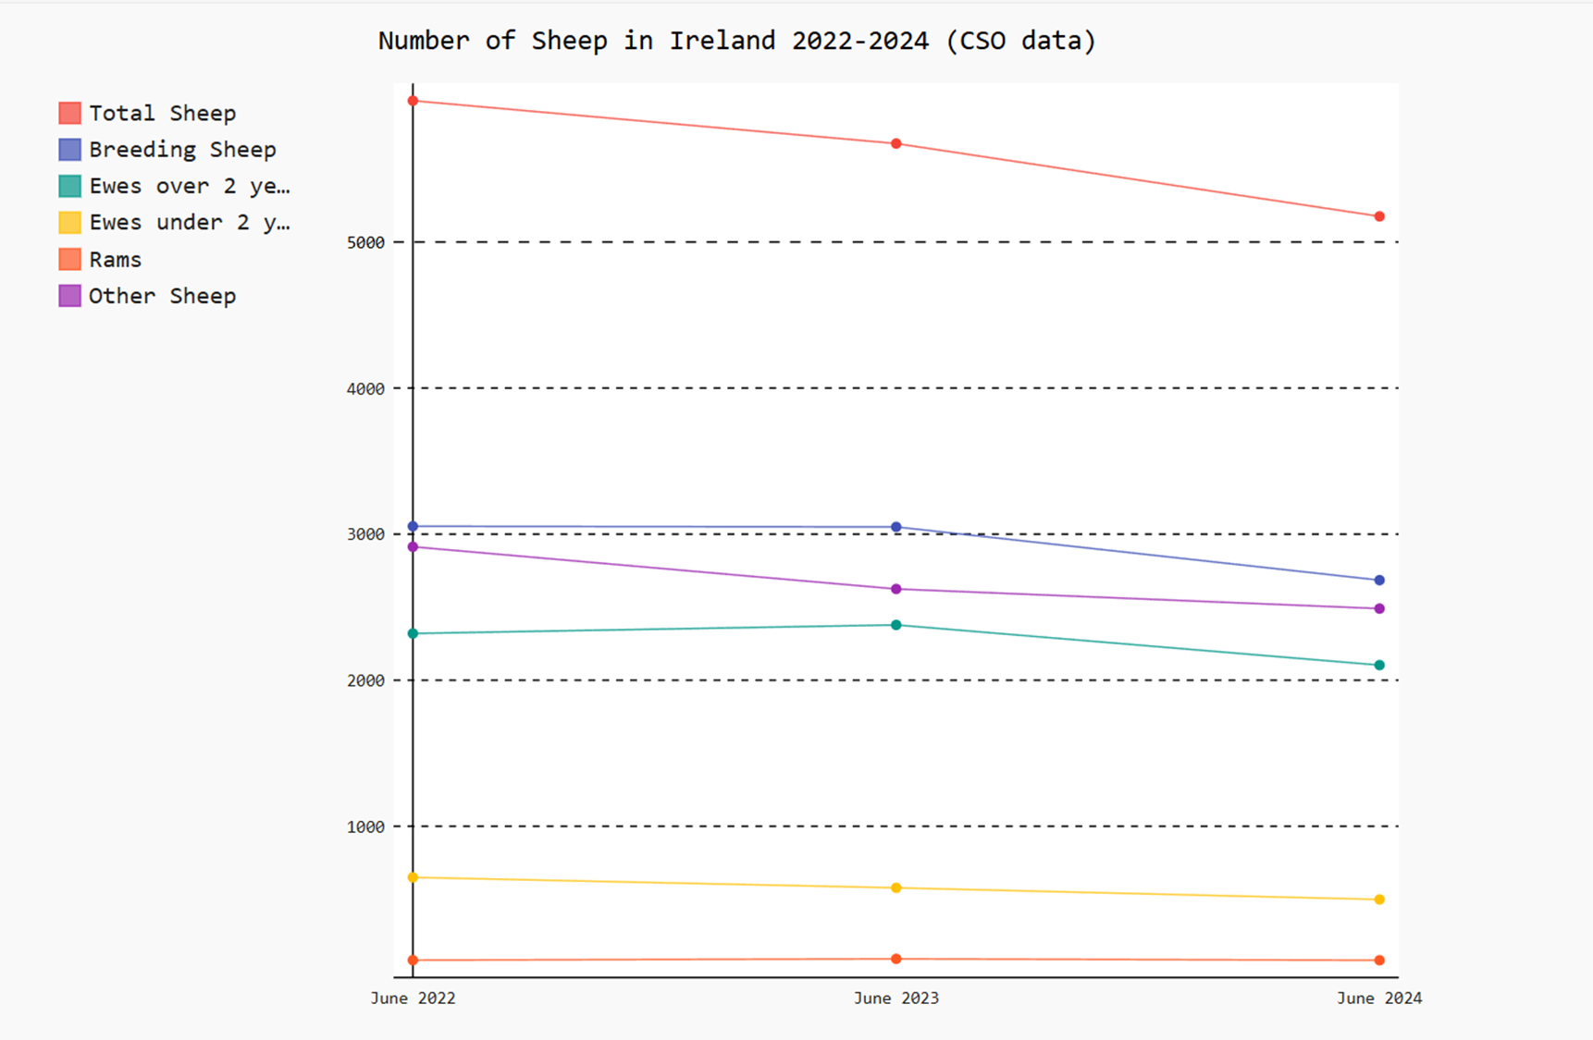
Creating a line chart
Create a variable to store your chart created by the pygal method Line()
e.g. line_chart = pygal.Line()
Add a title to the chart
Add the data series and labels
Render the chart to file

Slide 18
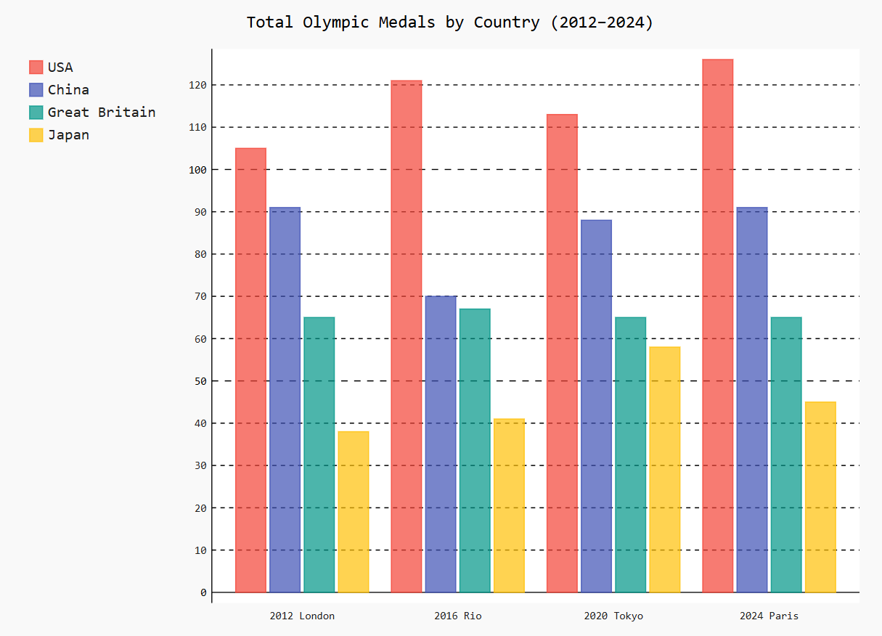
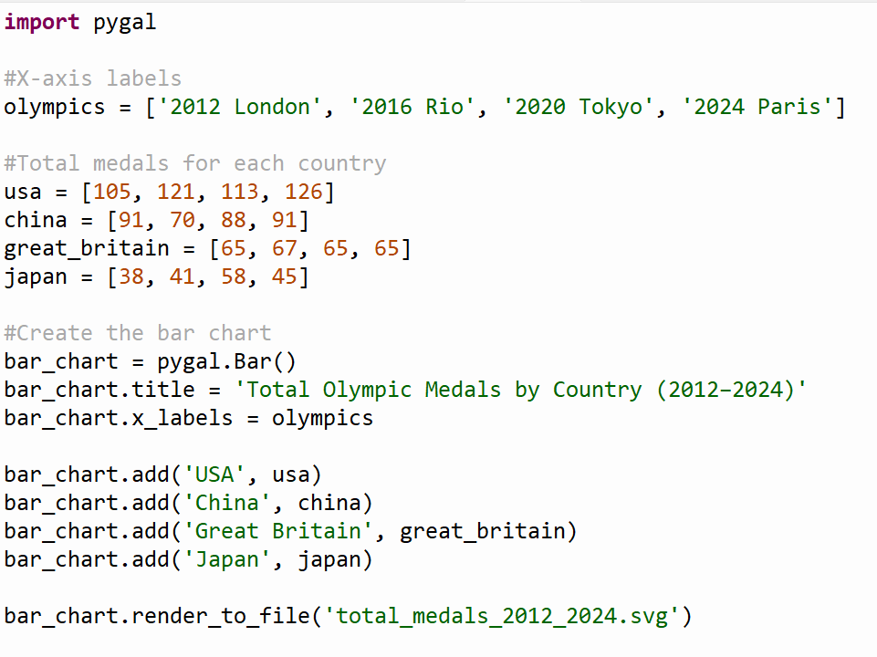
Bar charts
Bar charts are created with the method pygal.Bar()
Titles and axis labels are added as in line charts
Data series are added to the bar chart
Render the chart to display in the web browser

Slide 19
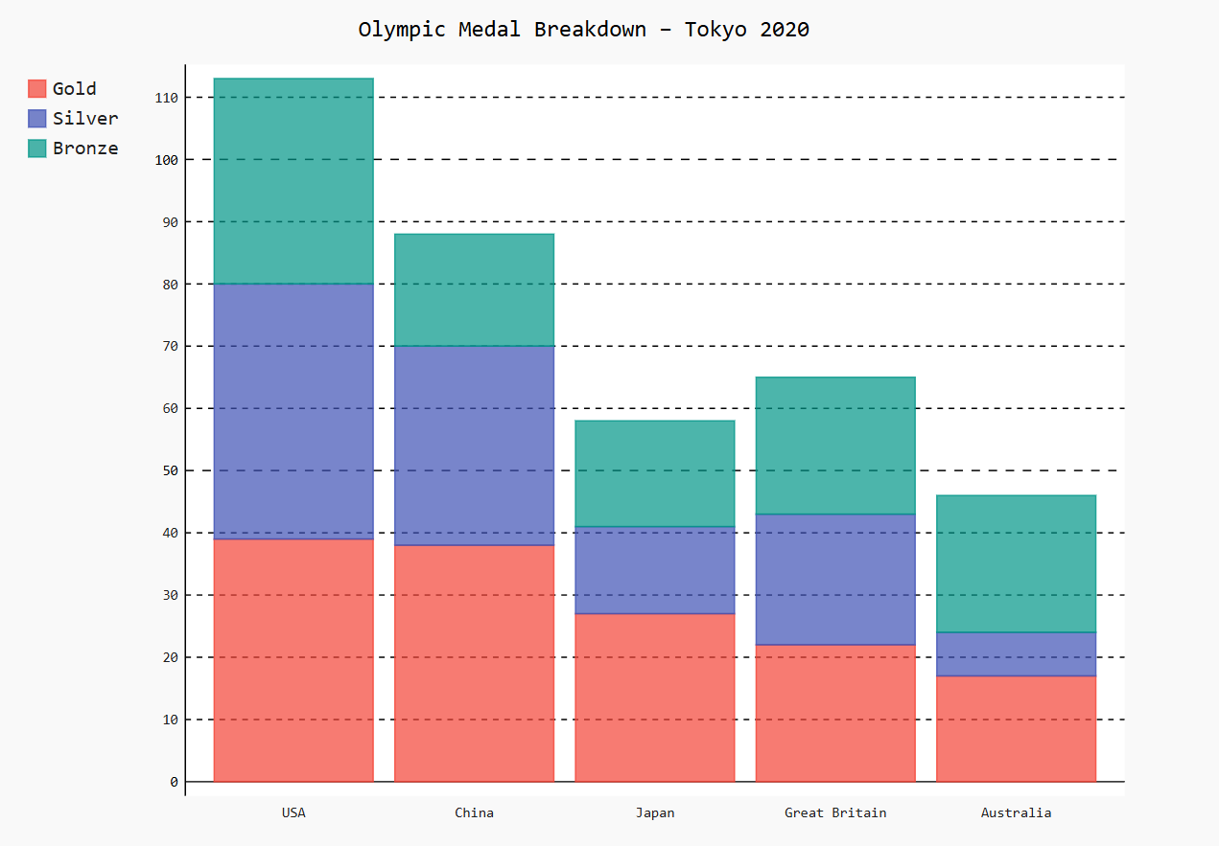
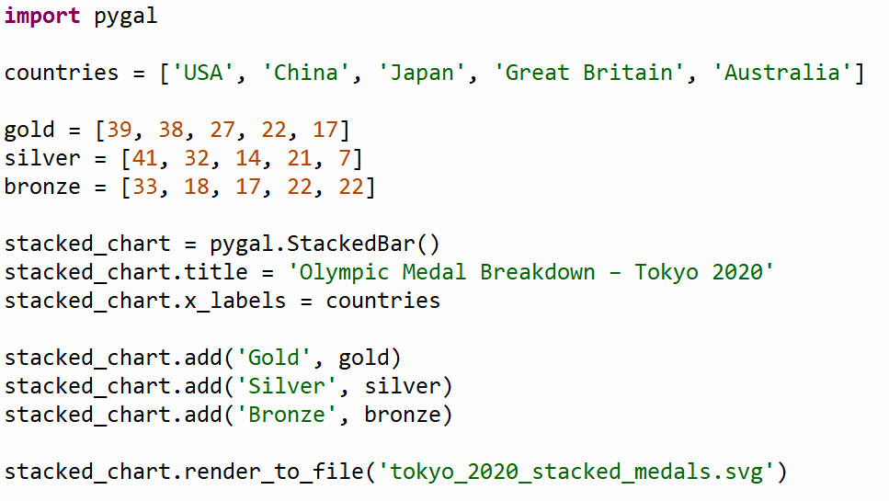
Stacked Bar Charts
A stacked bar chart can be used to show the breakdown of values within a category, e.g. total medals broken down into gold, silver and bronze.
It uses the method pygal.StackedBar()

Slide 20
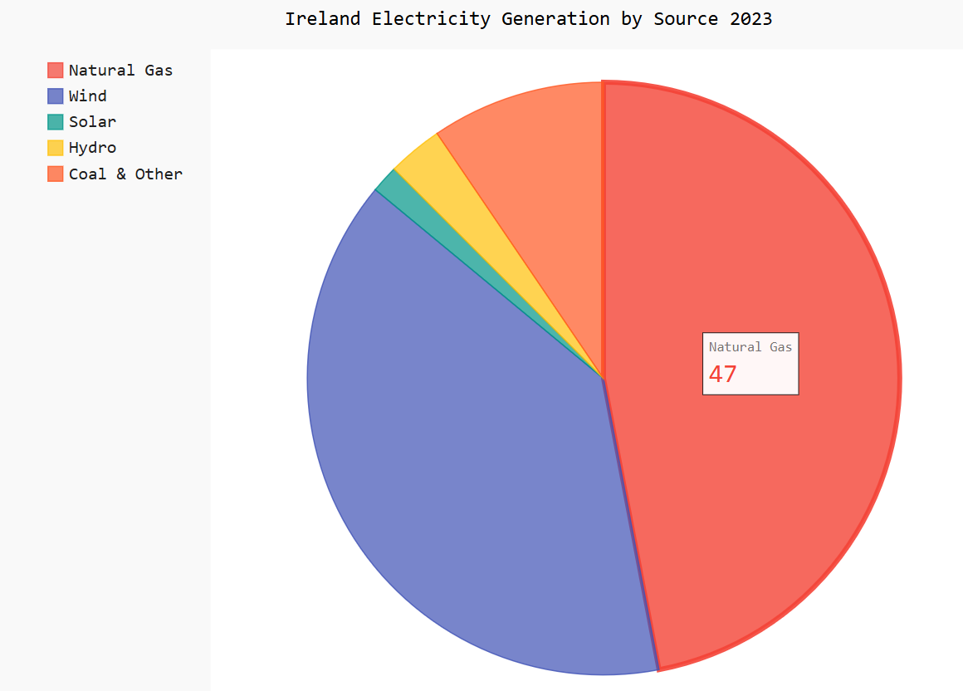
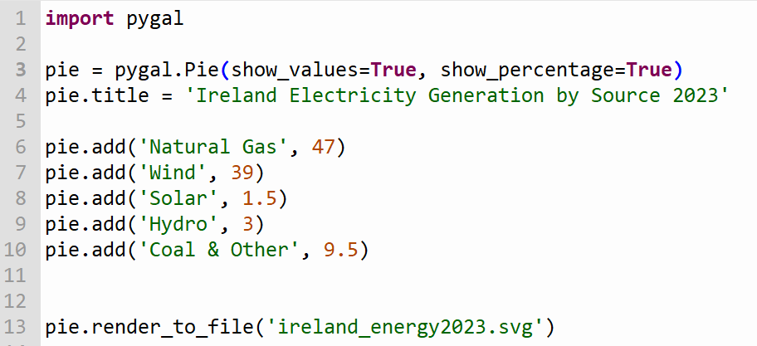
Pie Charts
The method pygal.Pie() is used to create pie charts
Add a title and data values to the chart
Render the file to display in a web browser

Slide 21
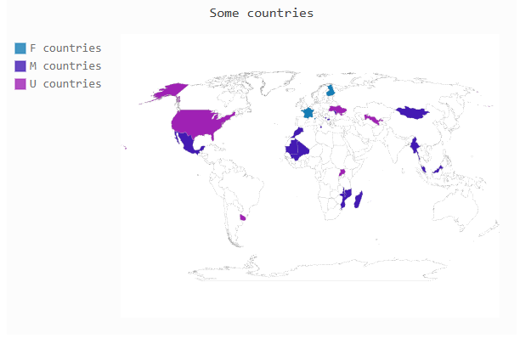
Maps with Pygal
The world map can be installed on Thonny with:
pip install pygal_maps_world
Countries on the map can be plotted by their specific two letter code
Values can also be attributed to specific countries

Slide 22
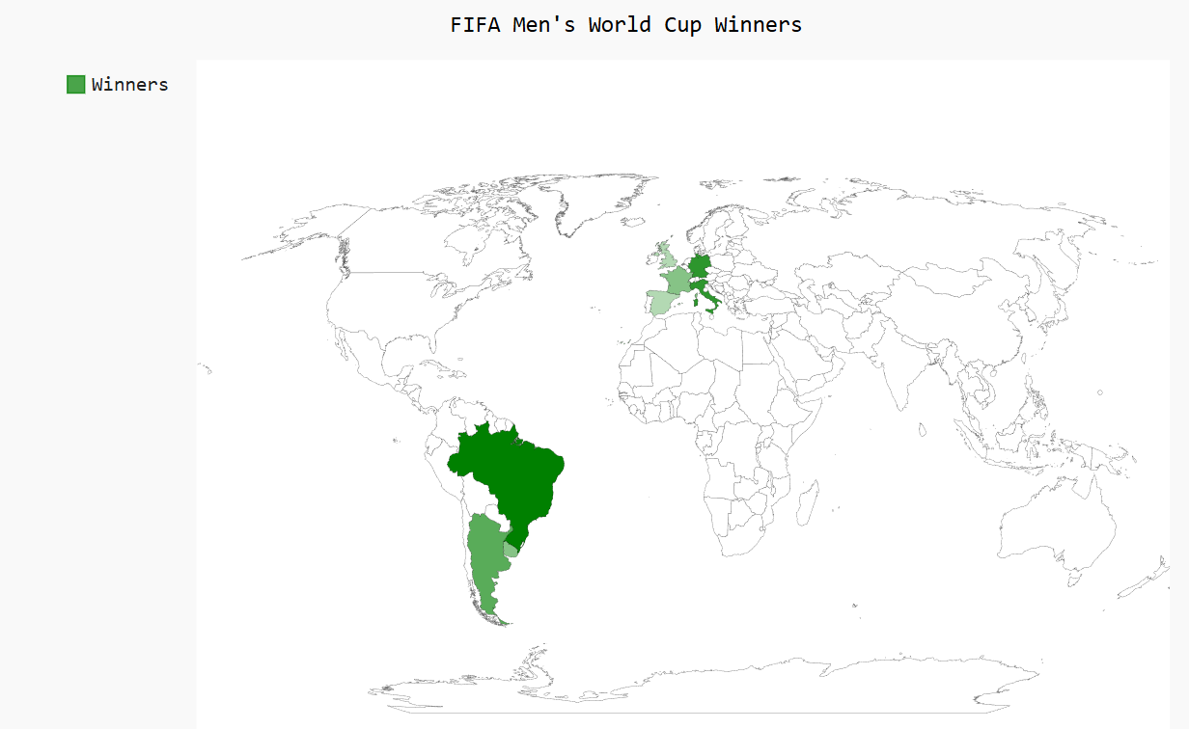
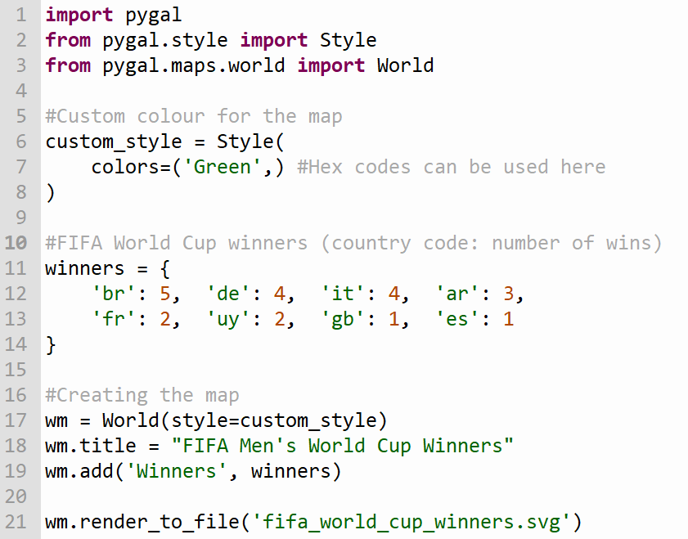
Maps with Pygal
Choose a specific colour to apply to the chosen countries
Dictionary of countries and number of wins for each.
Creating the map and adding the winners to the map from the dictionary

Slide 23

Group Activity
Breakout 20 mins

Slide 24
Session 2
Styles for Charts
Configuration: charts, series, values, sparklines, tables
Notes:
Timeframe:
Purpose:
Script:
We are now going to begin our first group activity …
Experience Coursework Through THE LENS OF YOUR STUDENTS
Think beyond the examples experienced so far – strive to be more creative – more originality by students
Although the CWA is individual (unlike the ALTs) we are going to work in groups today

Slide 25
Chart configuration
Chart sizing attributes can be configured to customise the way the chart is displayed
Attributes include:
Width
Height
Spacing
Margin

Slide 26
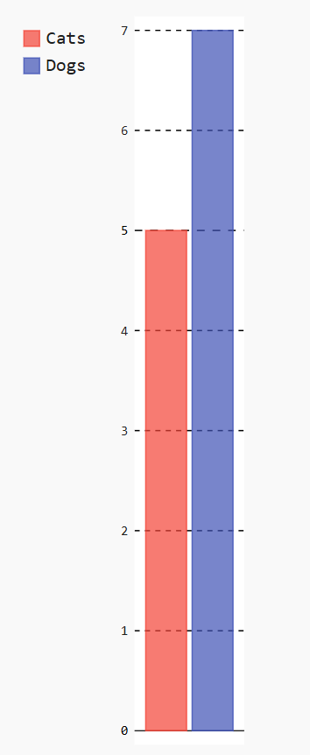
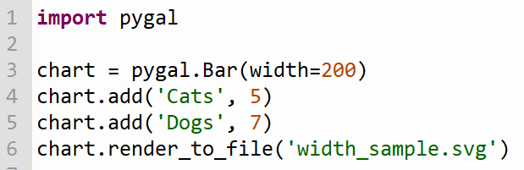
Chart width
Specify the width of the chart

Slide 27
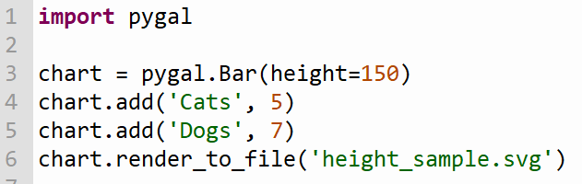
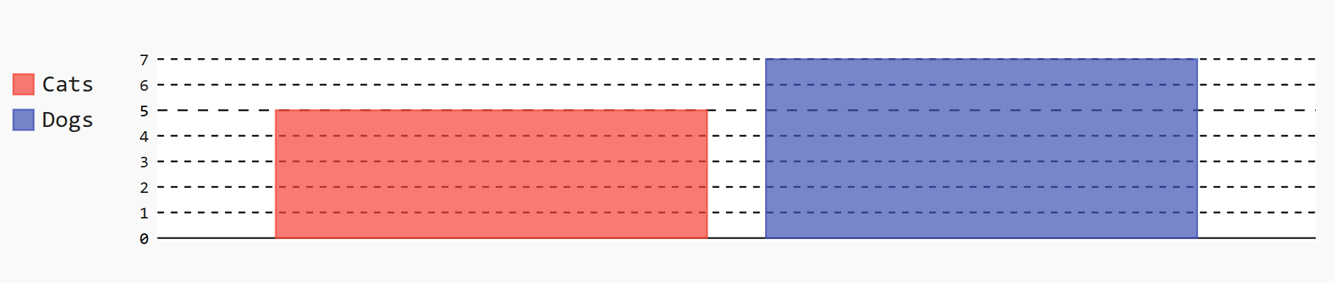
Chart height
Specify the height of the chart

Slide 28
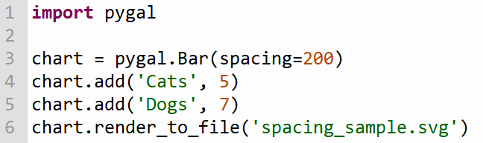
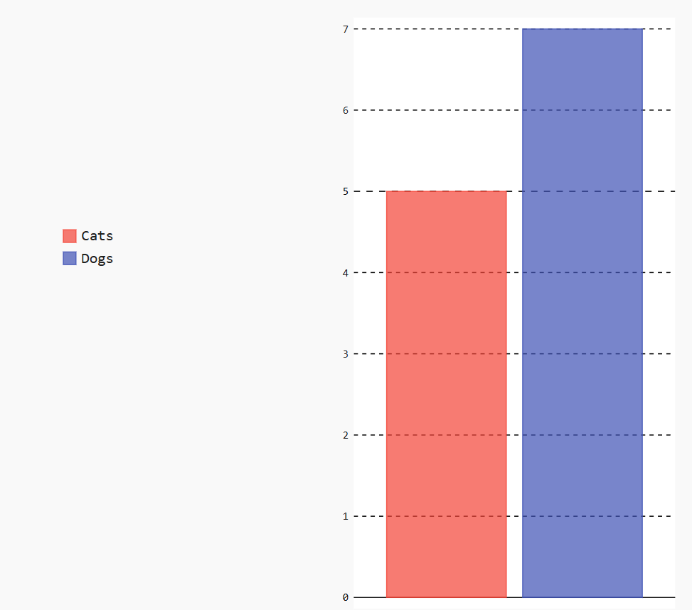
Chart spacing
Specify the spacing of the elements on the chart

Slide 29
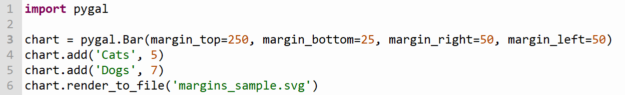
Chart margins
Individual chart margins can be set for any side of the chart and can be different values
Multiple arguments can be specified when creating the bar chart, e.g. individual margins, height, width, spacing

Slide 30
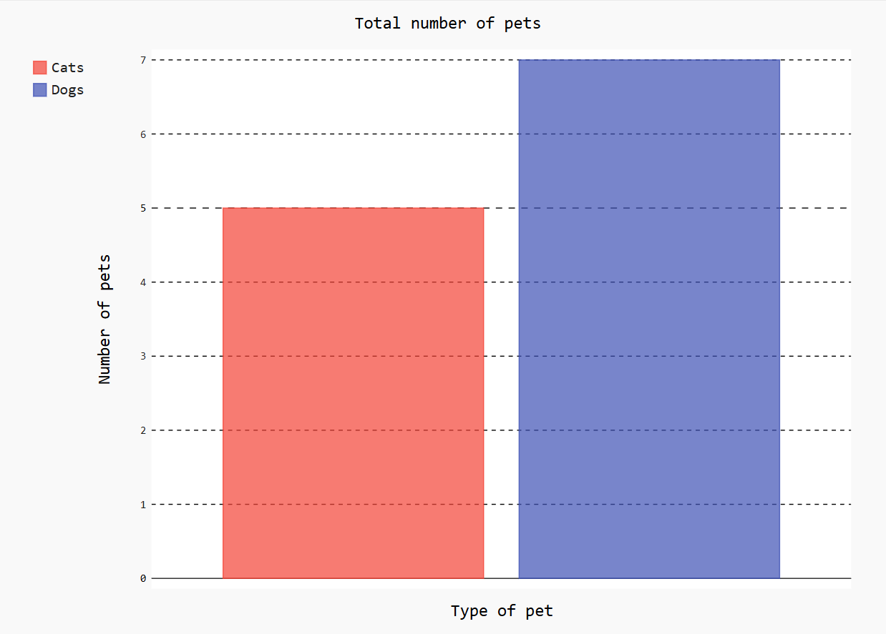
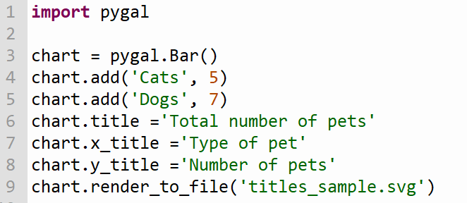
Chart title and axis titles
Assign values to each of the attributes, title, x_title and y_title

Slide 31
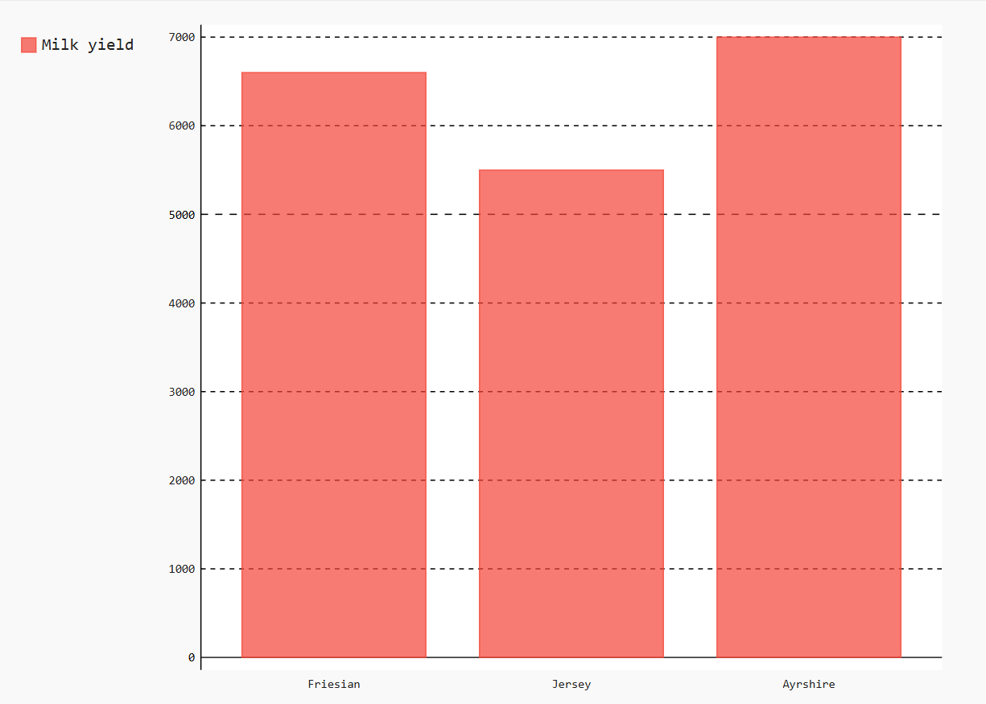
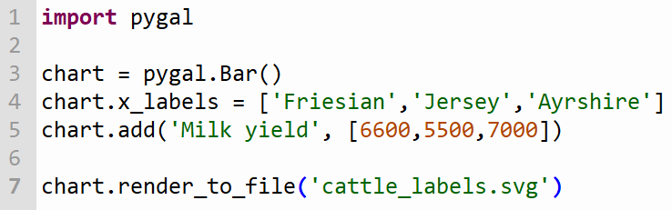
Chart labels
Labels are used to identify each data point or category.
The add method is used to specify the name of the data series and the corresponding list of values

Slide 32
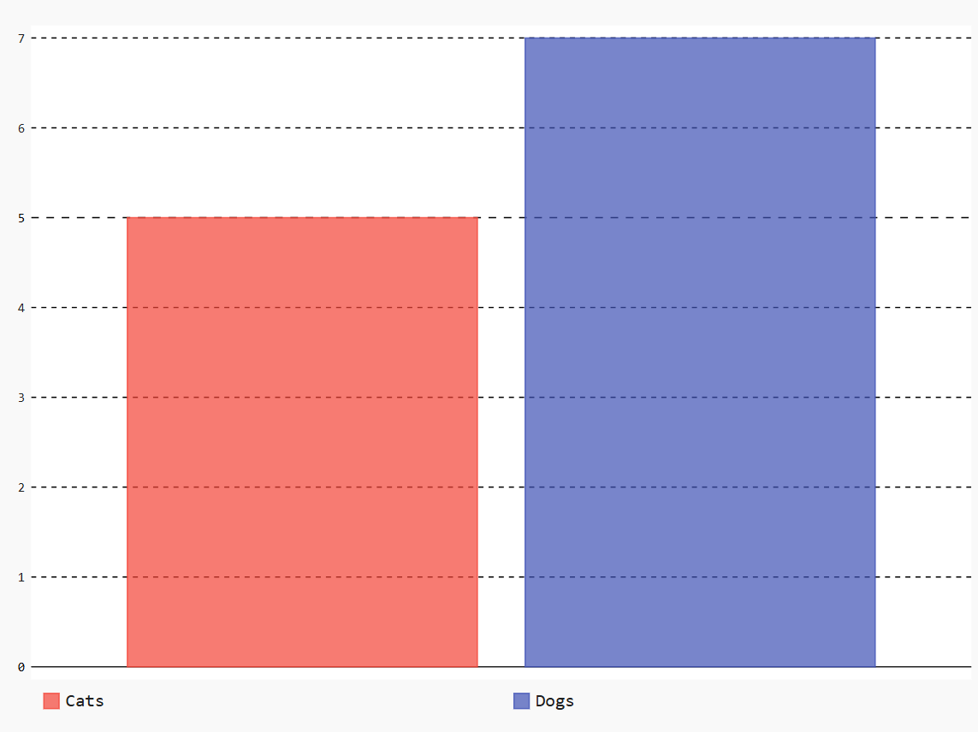
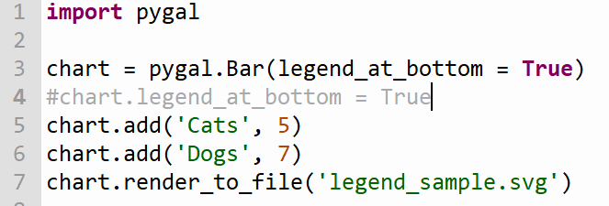
Chart legend
The chart legend is shown on the top left of the graphic by default
The attribute legend_at_bottom can be used to change the location of the legend.

Slide 33
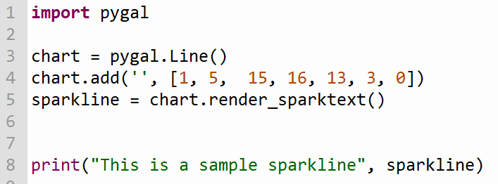
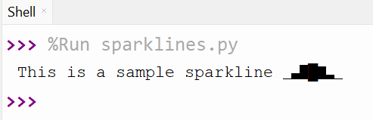
Sparklines
Sparklines are miniature charts that can be embedded in a line of text or a table to show a trend.
They do not show the detail of the chart as there are no axes, gridlines or labels

Slide 34
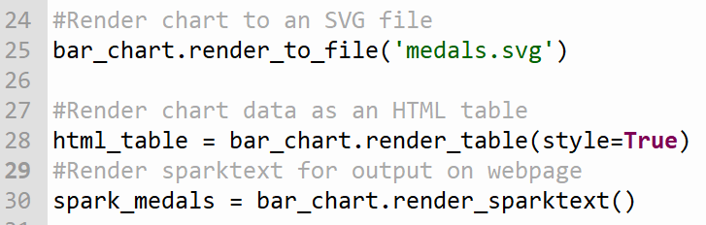
Tables
Data used to create charts can also be rendered as a table and displayed in and embedded in a webpage
The library lxml needs to be installed for this functionality
Create a variable to store the rendered table data for output
Table data will be stored and embedded in a webpage
Sparktext can also be stored in a variable and embedded in a webpage

Slide 35
Group Activity
Breakout 20 mins

Slide 36
Session 3
Output in Pygal, Embedding in webpages
(+ Breakout Activities)
Notes:
Timeframe:
Purpose:
Script:
We are now going to begin our first group activity …
Experience Coursework Through THE LENS OF YOUR STUDENTS
Think beyond the examples experienced so far – strive to be more creative – more originality by students
Although the CWA is individual (unlike the ALTs) we are going to work in groups today

Slide 37
Using Pygal in web development
Can create interactive charts
SVG graphics are scalable for any screen size
Charts can be embedded directly into HTML
Charts can be generated automatically from Python scripts
Sparklines can be used to display trend

Slide 38
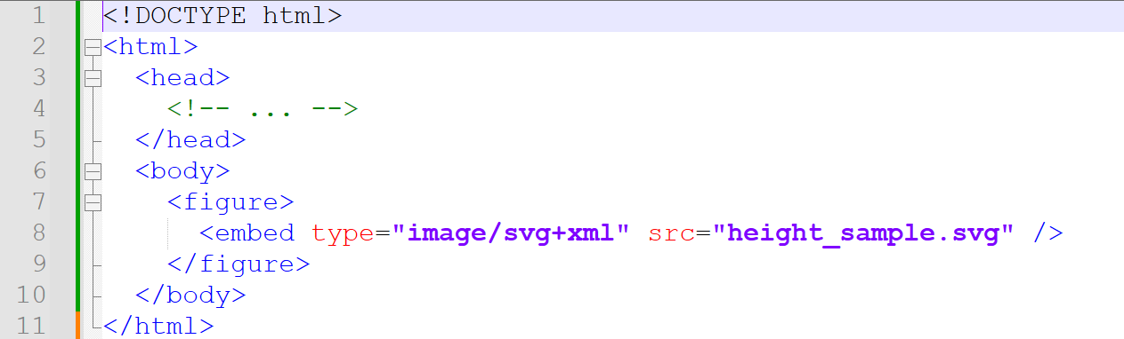
Embedding SVG files in webpages
Chart remains interactive when embedded

Slide 39
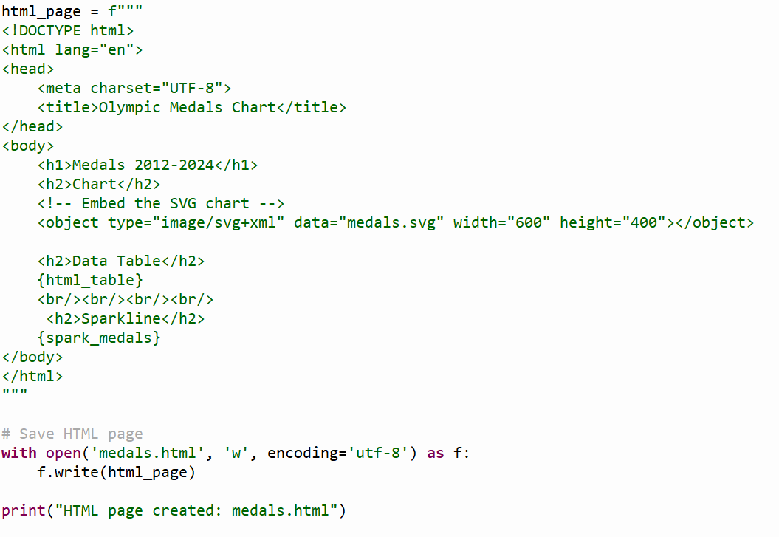
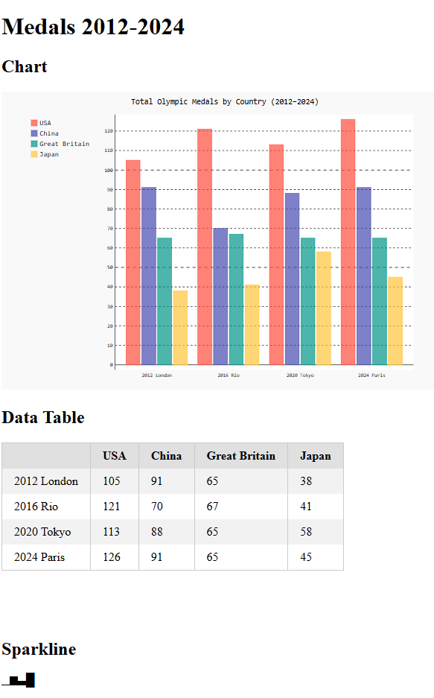
Embedding table and sparkline in webpage
The HTML required to embed the table and sparkline in the webpage is included in the booklet

Slide 40
Breakout Activity
30 mins

Slide 41
Evaluation and Travel
Notes:
Source: Registration (TBF) slide 29/05/23

