Slide 1
Leaving Certificate Ancient Greek and Latin
Senior Cycle Redevelopment Webinar
SEC Sample Papers for Tranche 1 subjects

Slide 2
Welcome
Webinar 2025
Leaving Certificate Ancient Greek and Latin

Slide 3
Links to all documents used in this presentation can be found by clicking the logo below.

Slide 4
Oide Timeline of Supports for Classical Languages
Classical Languages Introduction to Ancient Greek and Latin Specifications - Webinar
Classical Languages Online
September 2025
the new specifications for Ancient Greek and Latin begin to be taught in schools
November2024
March 2025
Term 3
2025
Term 1
2025
Full Day Face to Face PLE
Full Day Face to Face PLE

Slide 5
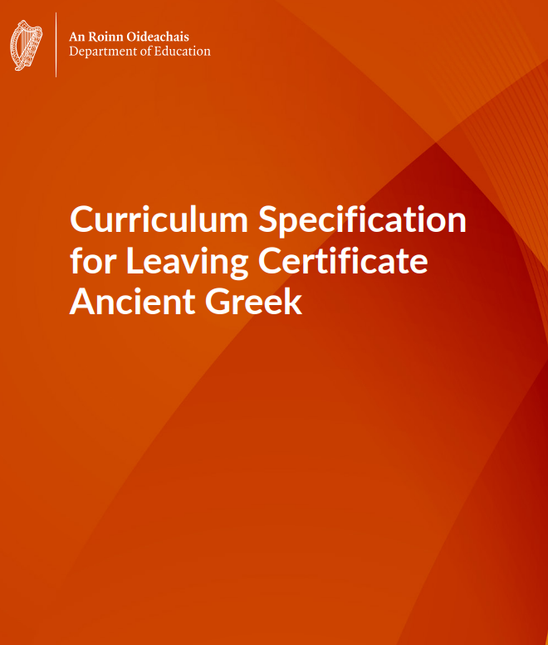
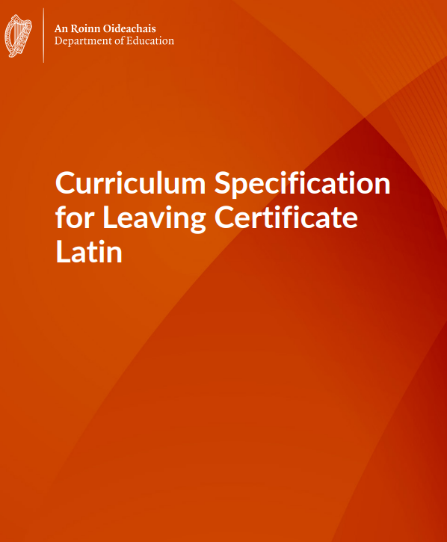
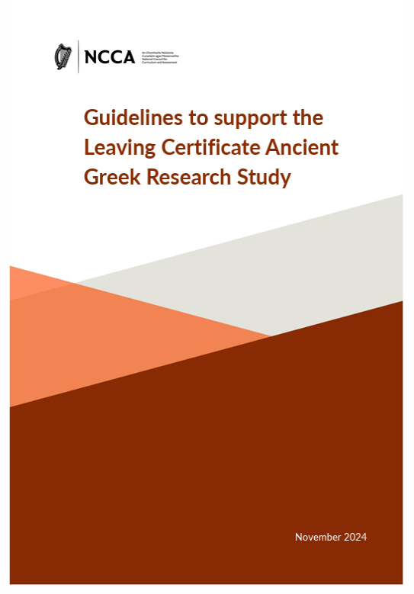
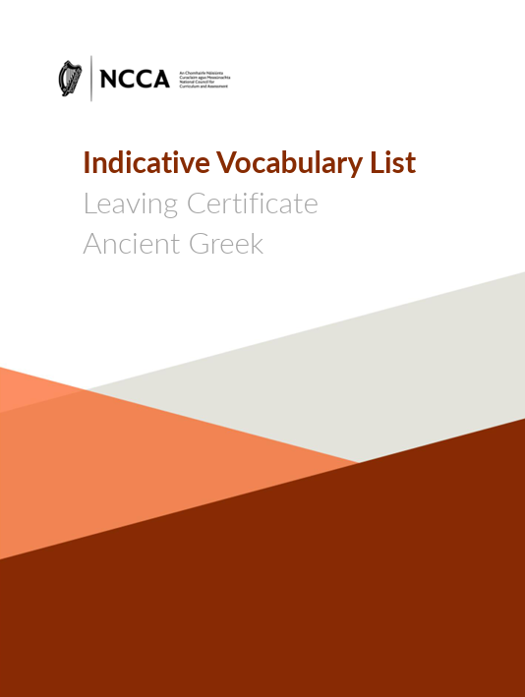
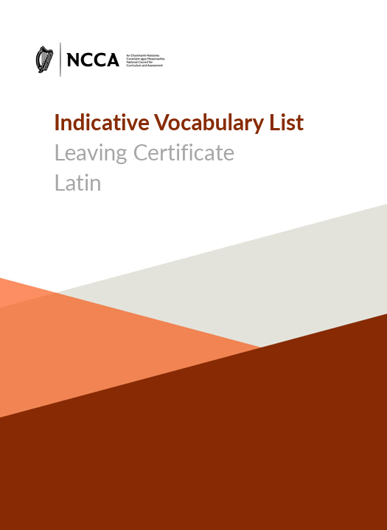
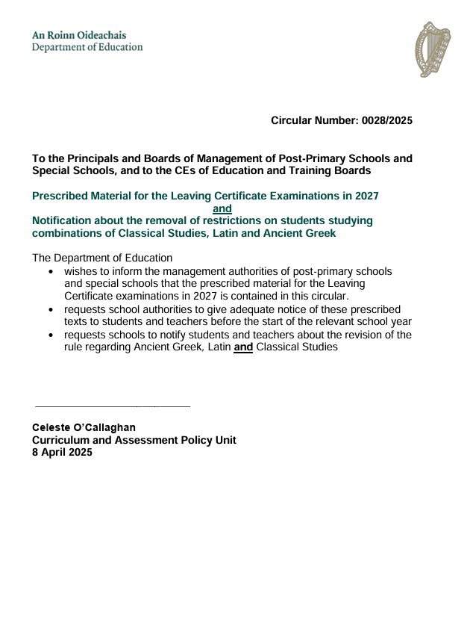
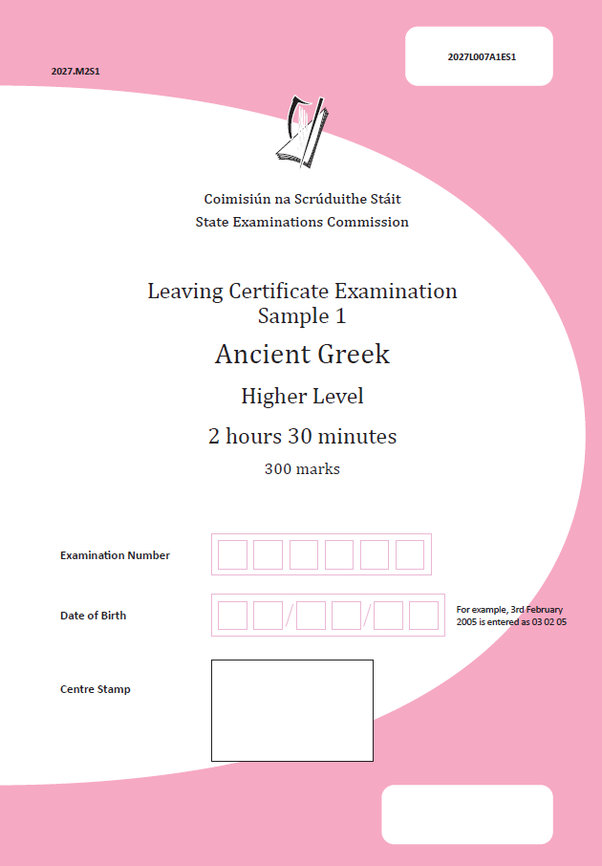
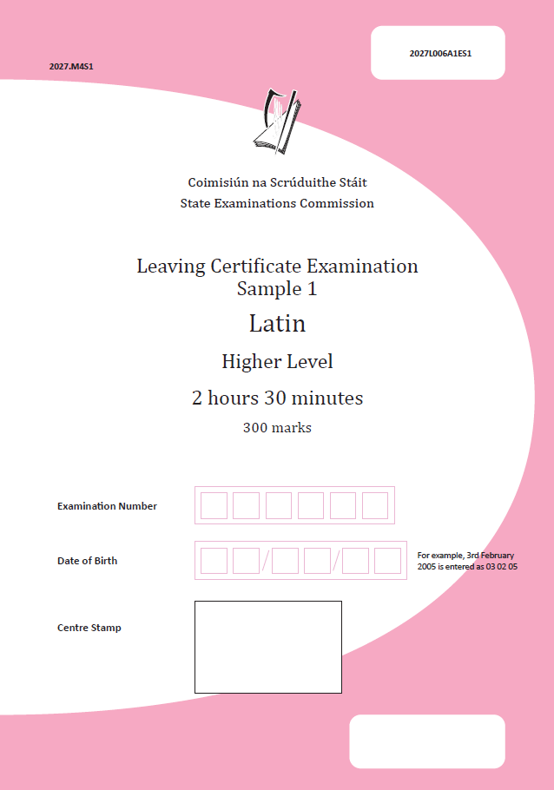
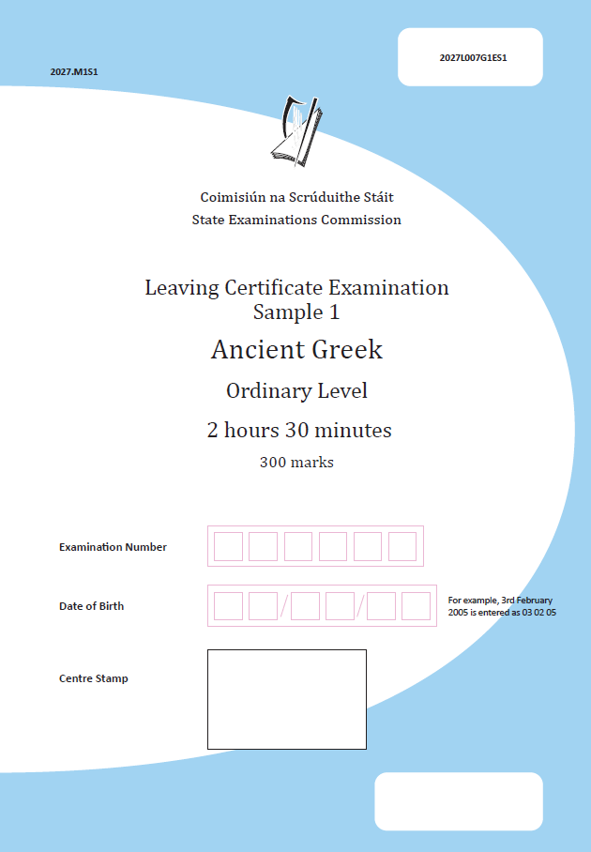
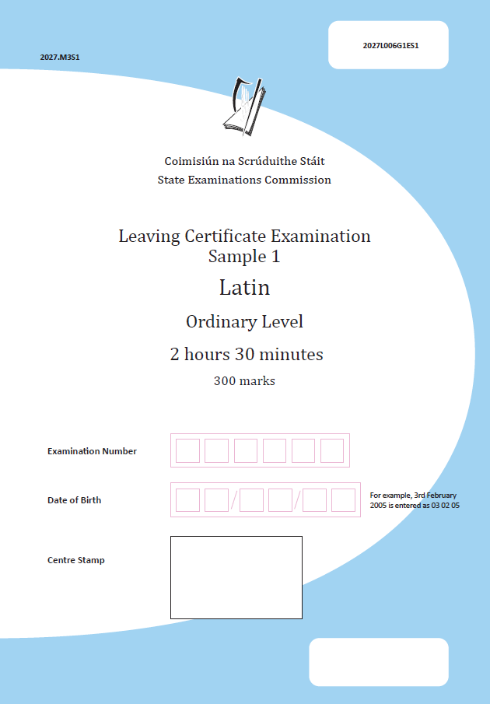
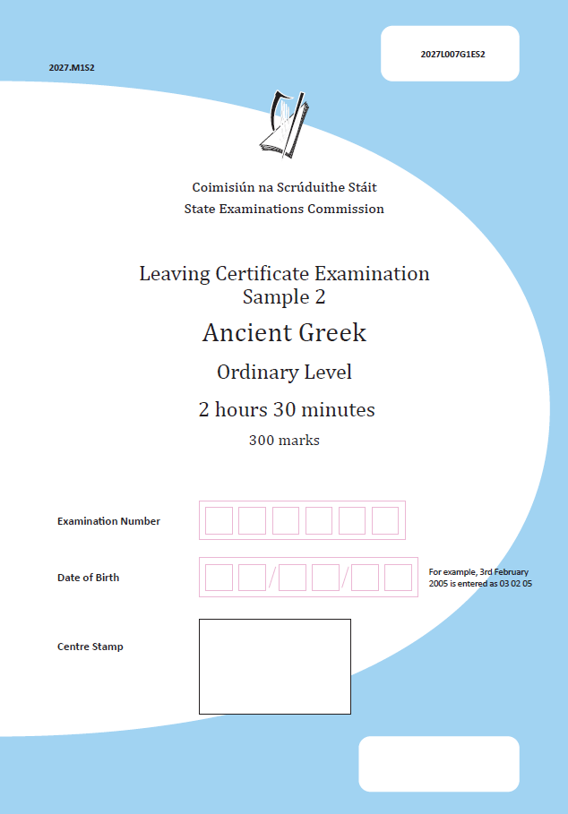
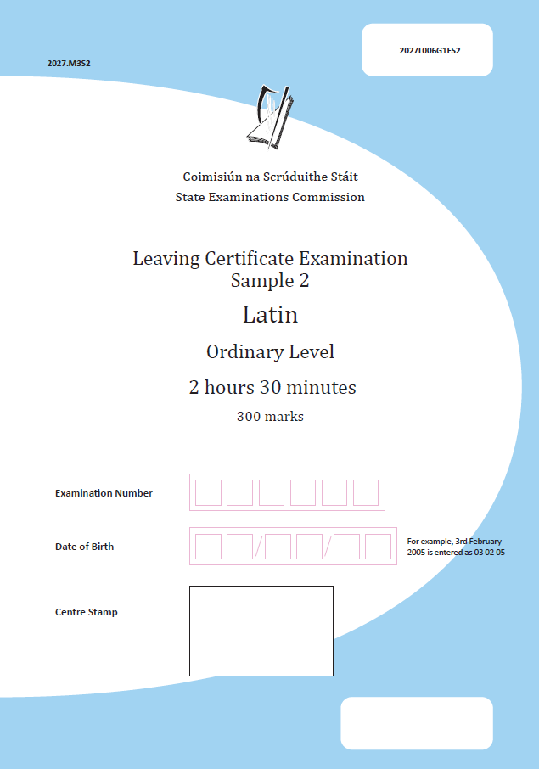
Classical Languages Key Documents
September 2025
Ancient Greek
Sample brief for the AAC introduced
September 2025
Latin
Sample brief for the AAC introduced
January 2026
Ancient Greek
Live brief for AAC issued
January 2026
Latin
Live brief for AAC issued

Slide 6
Where to find the key documents

Slide 7
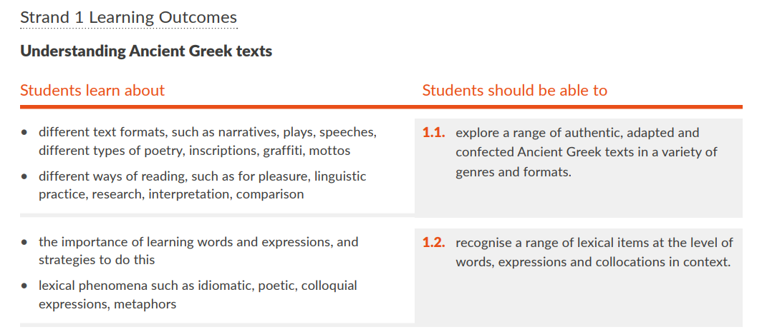
Strands of Study Overview
The left-hand column outlines specific areas that students learn about.
Learning outcomes which describe the knowledge, skills, values and dispositions students should be able to demonstrate after a period of learning.
Learning outcomes promote teaching, learning and assessment processes that develop students’ knowledge, skills, values and dispositions.
NCCA Indicative vocabulary lists, and Department of Education prescribed material: Capstone Text and grammar for unseen texts

Slide 8
Today’s Webinar
Part 1: Approaches to differentiation
Part 2: Key documents
Part 3: Sample paper structure and layout
Part 4: Sample paper analysis
Part 5: Questions and collaboration

Slide 9
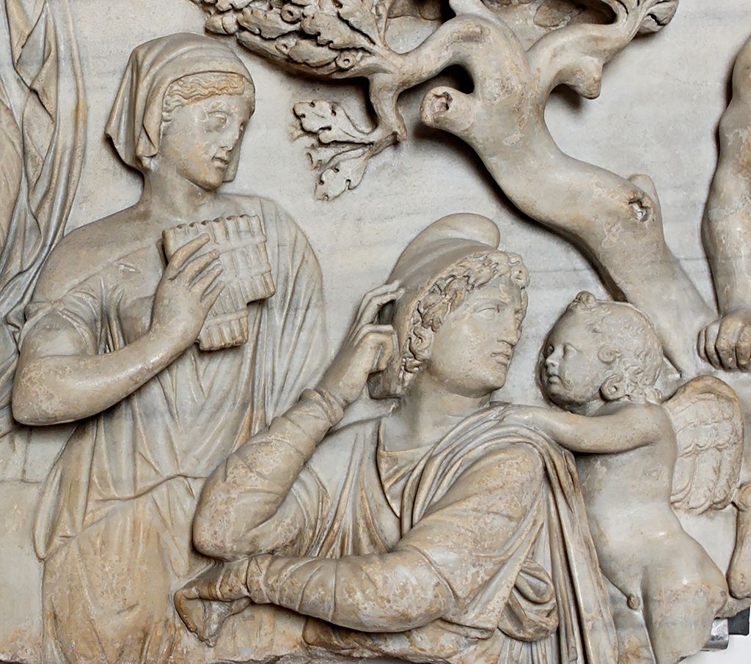
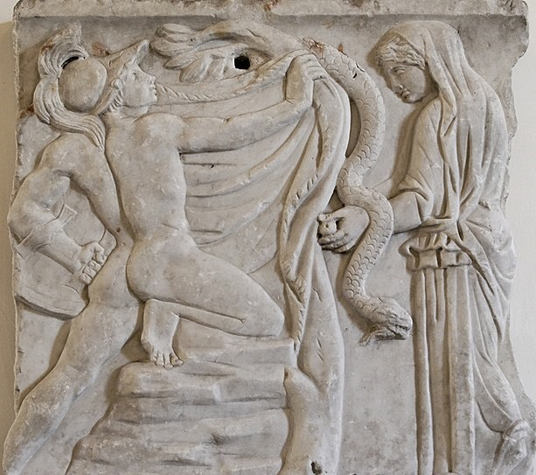
Learning Intentions
Explore approaches to support differentiation in the Classical Languages classroom
Develop an understanding of key documents that inform teaching, learning and assessment

Slide 10
Part 1
Approaches to differentiation

Slide 11
Students at the Centre of Teaching, Learning and Assessment
“Students’ participation in the classroom and their understanding of the classical language and society will be
enhanced
when teachers stimulate them to connect the content of learning to
their own lives and experience.”
“The educational experience in senior cycle should be
inclusive of every student,
respond to their learning strengths and needs,
and celebrate, value, and respect diversity.”
Department of Education, 2024, p.3 & 19 Curriculum Specification for Leaving Certificate Latin

Slide 12
Students at the Centre of Teaching, Learning and Assessment
“students may have varying levels of classical language skills and plurilingual and pluricultural competence, arising from their prior learning.”
“The Leaving Certificate Classical Languages specifications are intended for students from all language backgrounds.
“This includes students who have some previous experience with the language
and students who have
no prior experience with the language.”
“learning outcomes and experiences are intended to meet the needs
of all students.”
Department of Education, 2024, p. 20 Curriculum Specification for Leaving Certificate Latin

Slide 13
Learning outcomes in the specification are not distinguished between higher and ordinary level
Each action verb is described in terms of what the learner should be able to do once they have achieved the learning outcome
The learning outcome action verb details the highest level achievable by student
Command words are used for examination purposes in the examination papers

Slide 14
Part 2
Key Documents

Slide 15
Ancient Greek/Latin
Specification
Grammar for Unseen Texts
Capstone
Text
Capstone Oide Support Document
Department Circular 0028/2025
Indicative Vocabulary List
Teaching, Learning
and Assessment
Learning Outcomes
Key Competencies
AAC Guidelines
Additional Assessment Component
40%
Examination
60%
Sample Papers x4

Slide 16
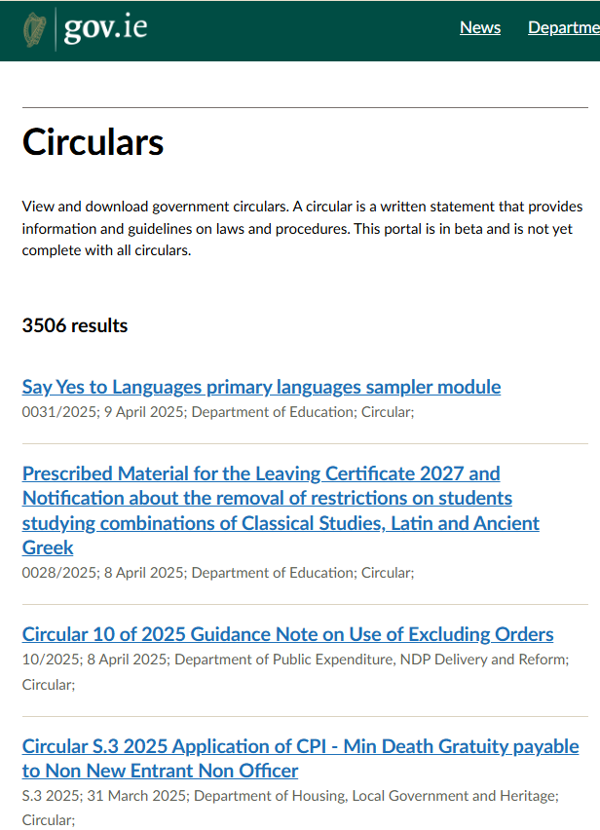
Prescribed Material for the Leaving Certificate 2027 - the Capstone Text
Circular 0028/2025

Slide 17
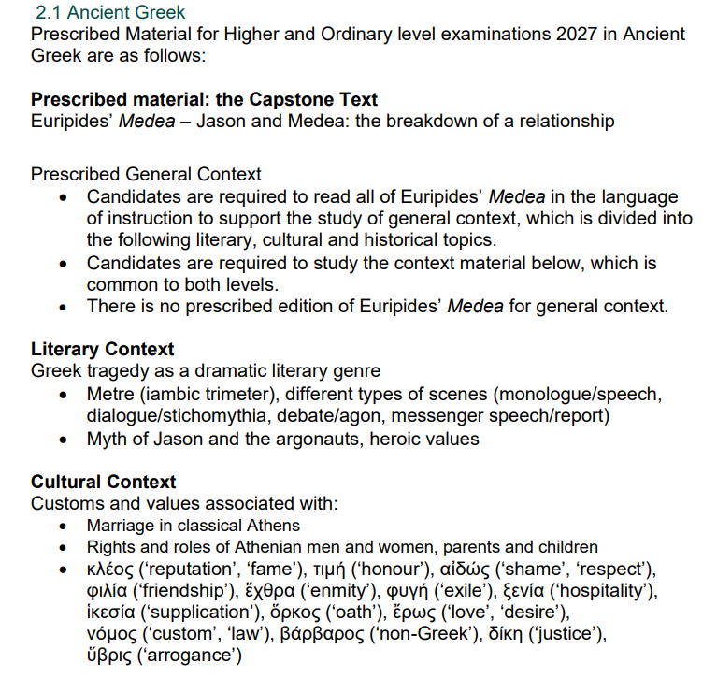
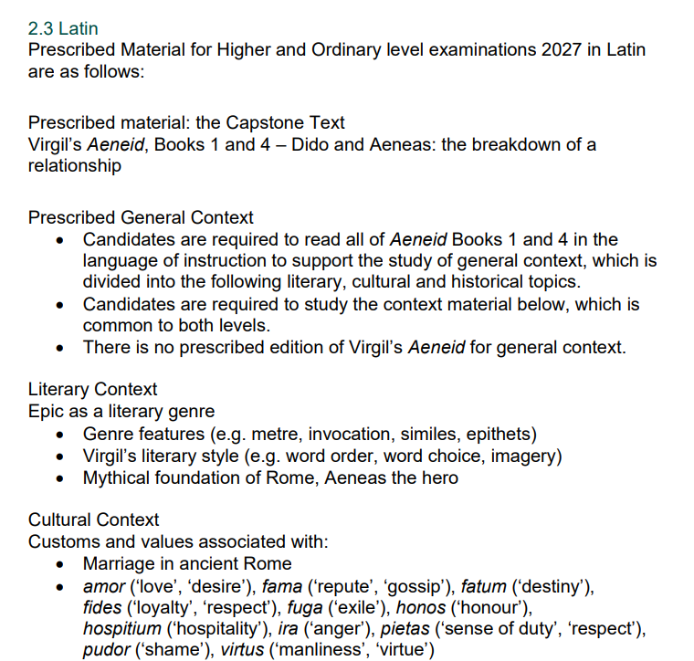
Prescribed Material for the Leaving Certificate 2027
Ancient Greek
Latin

Slide 18
Capstone Text: Ancient Greek Euripides Medea: Jason and Medea the breakdown of a relationship
General context: Euripides’ Medea to be read in full in the language of instruction
Topics: Literary, cultural and historical
Edition: There is no prescribed edition for general context
Prescribed Ancient Greek Extracts: Higher Level
Prescribed Ancient Greek Extracts: Ordinary Level
214 lines in total to be studied in Ancient Greek
Lines 214-268: Medea’s first speech
Lines 316-347: Medea and Creon
Lines 446-541: Jason and Medea
Lines 1136-1166: Messenger Speech
118 lines in total to be studied in Ancient Greek
• Lines 214-268: Medea’s first speech
• Lines 316-347: Medea and Creon
• Lines 1136-1166: Messenger Speech

Slide 19
Capstone Text: Latin Virgil’s Aeneid, Books 1 and 4 – Dido and Aeneas: the breakdown of a relationship
General context: Aeneid Books 1 and 4 to be read in full in the language of instruction
Topics: Literary, cultural and historical
Edition: There is no prescribed edition for general context
Prescribed Latin Extracts: Higher Level
Prescribed Latin Extracts: Ordinary Level
211 lines in total to be studied in Latin
Book 1: 44 lines
Lines 1-14: Opening lines
Lines 613-642: Aeneas and Dido meet
Book 4: 167 lines
Lines 1-30: Dido and Anna
Lines 173-197: Fama
Lines 296-361: Dido’s outrage, Aeneas’ duty
Lines 584-629: Dido’s curse
134 lines in total to be studied in Latin
Book 1: 44 lines
Lines 1-14: Opening lines
Lines 613-642: Aeneas and Dido meet
Book 4: 90 lines
Lines 1-30: Dido and Anna
Lines 173-197: Fama
Lines 296-330: Dido’s outrage

Slide 20
The Capstone Text: Oide Support Document

Slide 21
Prescribed Material: Grammar for Unseen Text
Students are required to be familiar with all grammar (forms and constructions) which is detailed in the tables
When an asterisk is included, this form/construction is restricted to the words included in the NCCA Latin Indicative Vocabulary List, which is subdivided into Core and Extended Sections.
*Asterisks included in the Higher Level table refer to the full NCCA Ancient Greek/Latin Indicative Vocabulary List (both Core and Extended Sections).
**Asterisks included in the Ordinary Level table refer to only the Core Section of the NCCA Ancient Greek/Latin Indicative Vocabulary List.

Slide 22
Ancient Greek/Latin
Specification
Grammar for Unseen Texts
Capstone
Text
Capstone Oide Support Document
Department Circular 0028/2025
Indicative Vocabulary List
Teaching, Learning
and Assessment
Learning Outcomes
Key Competencies
AAC Guidelines
Additional Assessment Component
40%
Examination
60%
Sample Papers x4

Slide 23
Indicative Vocabulary List: Ancient Greek
The indicative vocabulary list – will support students in vocabulary building and language proficiency.
Divided into Core and Extended sections.
Contents: 780 words across three parts:
General vocabulary (717 words: 395 Core, 322 Extended)
Names (22 words, all Core)
Numbers (41 words: 22 Core, 19 Extended)
Words are listed alphabetically (Α–Ω) with grammatical notes, including noun genders (ὁ, ἡ, τό) and verb principal parts (present, future, aorist active, aorist passive).
Designed for learning and revision, with a sortable spreadsheet format for filtering by verb tense, prepositions etc.
Follows standard Ancient Greek lexicon practices, indicating case requirements for prepositions and non-accusative verbs.

Slide 24
Indicative Vocabulary List: Latin
The indicative vocabulary list – will support students in vocabulary building and language proficiency.
Divided into Core and Extended sections.
922 words across three parts:
General vocabulary
(841 words: 535 Core, 306 Extended)
Numbers
(40 words: 23 Core, 17 Extended)
Names
(41 Core words).
Alphabetical order with grammatical notes to aid recognition of language structures.
Useful for learning, revision, and sorting by category (e.g., declensions, prepositions).
Standard Latin vocabulary rules followed (e.g., noun genders, verb principal parts, case indications).
Varying formats – word, pdf and excel

Slide 25
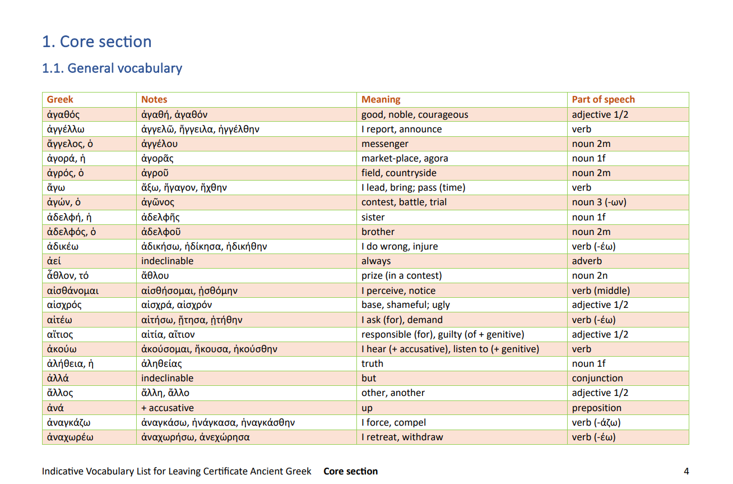
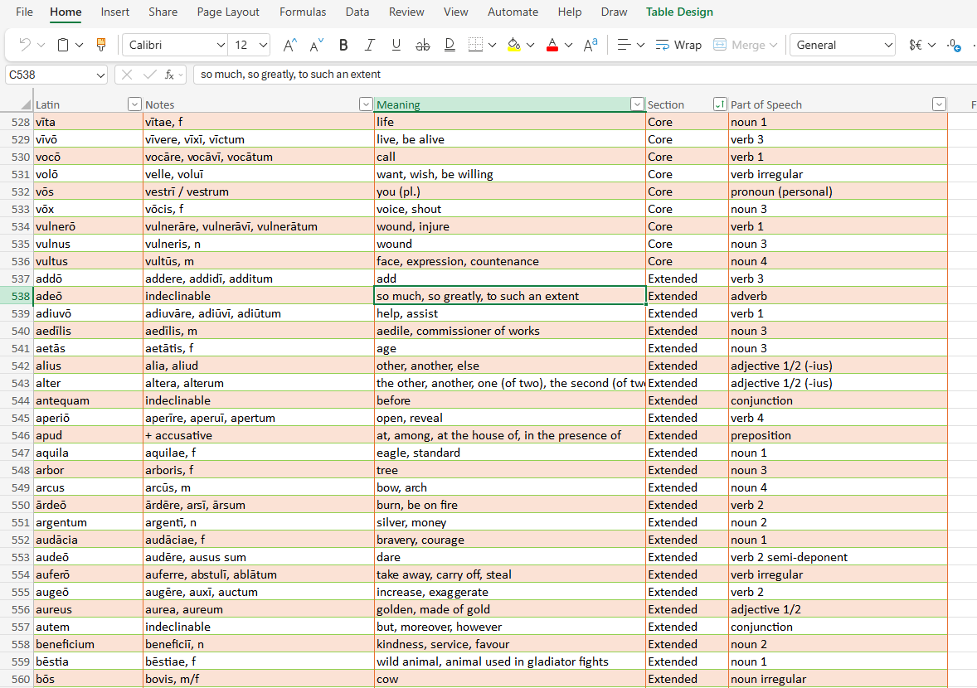
Indicative Vocabulary List

Slide 26
Ancient Greek/Latin
Specification
Grammar for Unseen Texts
Capstone
Text
Capstone Oide Support Document
Department Circular 0028/2025
Indicative Vocabulary List
Teaching, Learning
and Assessment
Learning Outcomes
Key Competencies
AAC Guidelines
Additional Assessment Component
40%
Examination
60%
Sample Papers x4

Slide 27
Prescribed Material for the Leaving Certificate 2027 - Grammar for Unseen Texts
Circular 0028/2025

Slide 28
Part 3
Leaving Certificate Examination Sample papers

Slide 29
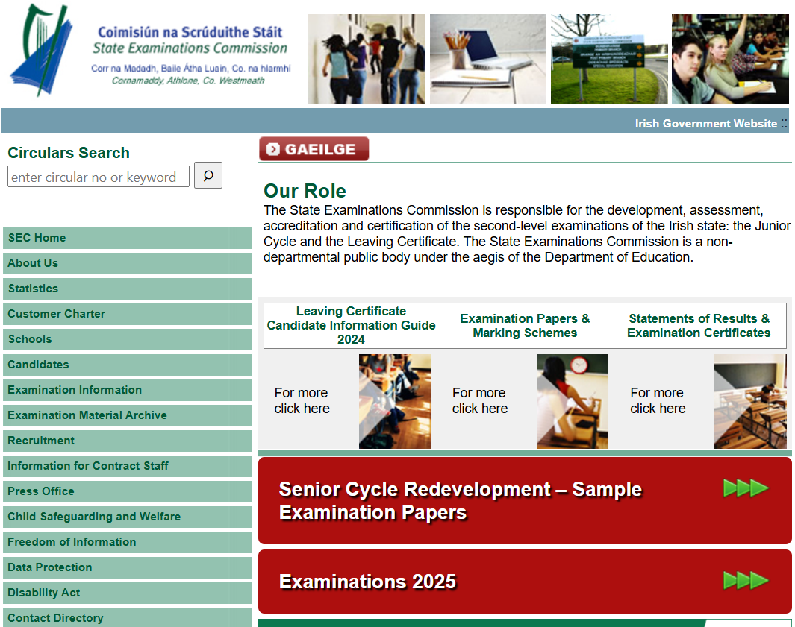

Slide 30
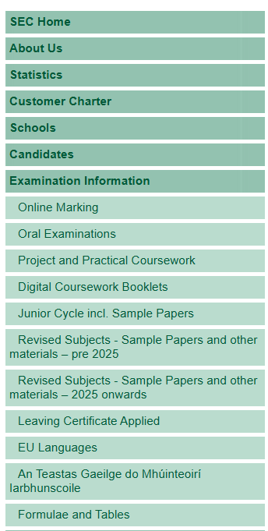
examinations.ie

Slide 31
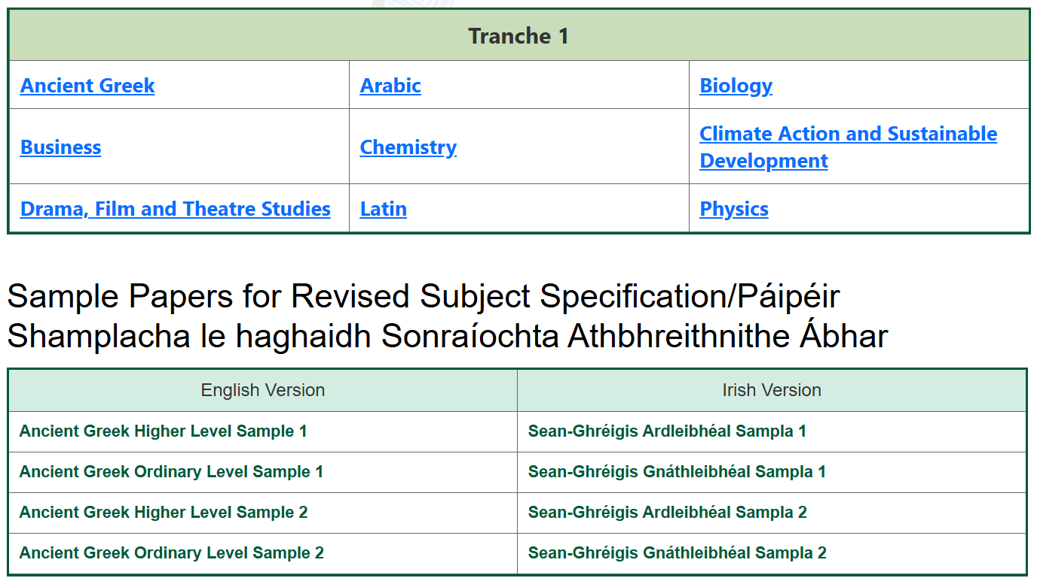
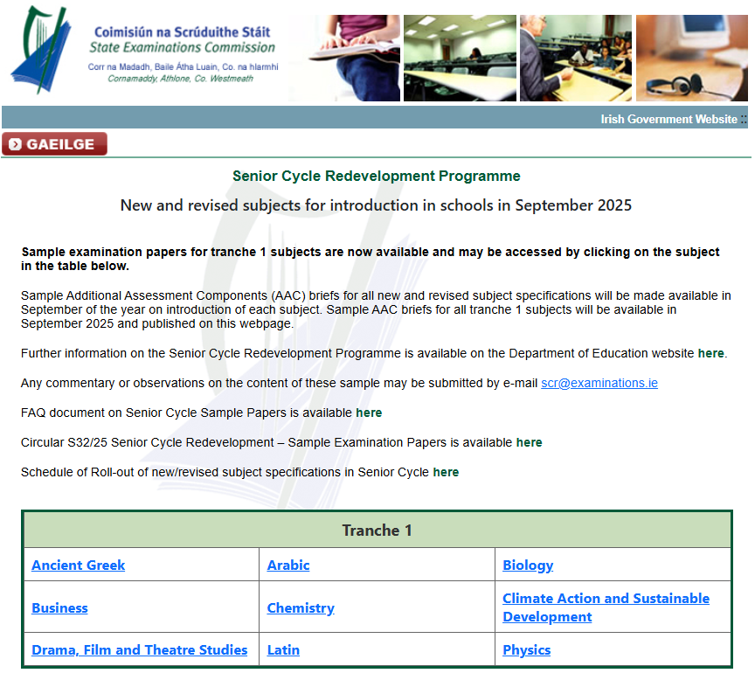
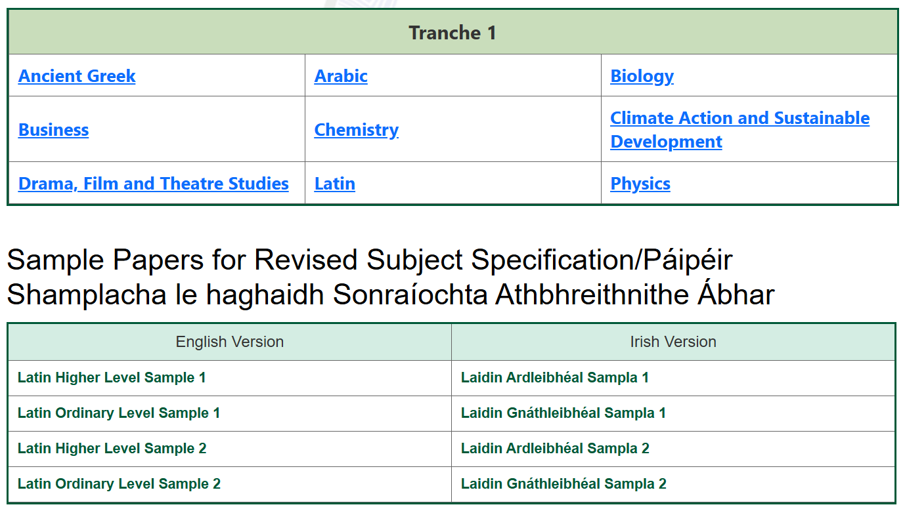

Slide 32
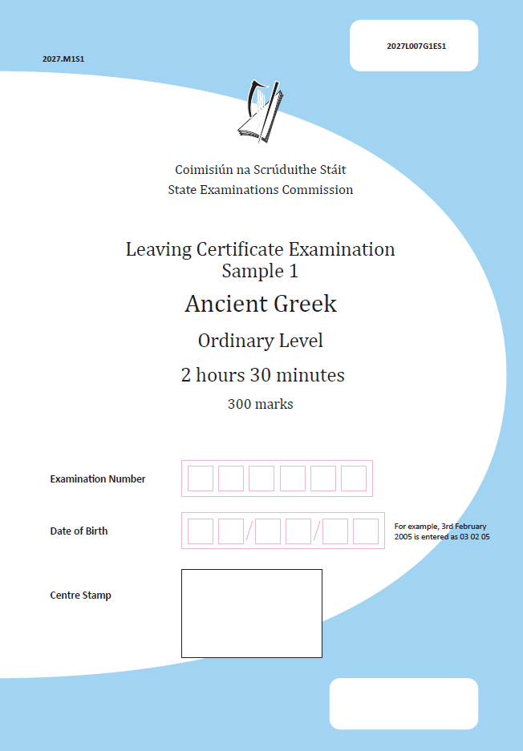
Sample Papers

Slide 33
Leaving Certificate Examination Sample Paper
There are two sections in the sample examination papers - HL and OL.
Section A: Capstone Text 100 marks
Answer Question 1 and Question 2
Section B: Unseen Texts 200 marks
Answer Question 3, Question 4, and Question 5.
There are internal choices in some questions.

Slide 34
Structure and layout

Slide 35
Time to Explore
Use the next few minutes to examine each of the sample papers in detail at both Higher and Ordinary Level.
You may want to identify the varying forms of assessment styles and stimuli used in conjunction with the type of language learning being assessed.

Slide 36
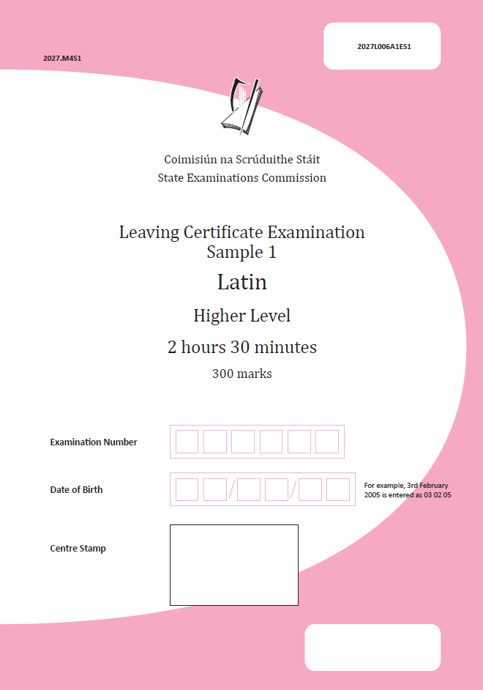
Similarities between Higher and Ordinary Level Sample Papers
Always 5 questions
Questions 1 and 2 capstone text always
2 different extracts
Questions 3-5 unseen texts
not always 3 different texts
always one 80 mark comprehension question in Section B

Slide 37
Walk-through

Slide 38
Spot the difference?

Slide 39
Identifying choice and differentiation in the sample papers
Differentiation:
Section A – Capstone
Taking SP1 Question 2 as an example:
Higher level requires language-based analysis
Ordinary level is more open
Differentiation:
Section B – Unseen
Ordinary level often includes an overlap with capstone text so students can play to their strengths in course coverage
What other examples can you find?

Slide 40
Reasonable Accommodations
… the scheme of Reasonable Accommodations, operated by the State Examinations Commission (SEC), is designed to assist students who would have difficulty in accessing the examination or communicating what they know to an examiner because of a physical, visual, sensory, hearing, or learning difficulty. The scheme assists such students to demonstrate what they know and can do, without compromising the integrity of the assessment.
Specification for Latin, pg. 26

Slide 41
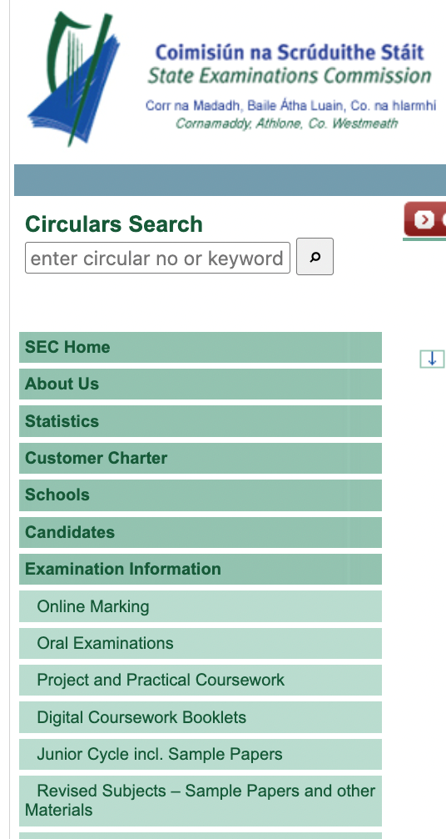
Focus on Online Marking
Answers to be written in spaces provided in booklet
Write in blue or black pen
No need to use all space allocated to answers
Space for extra work at end of booklet
Note: all extra work must be labelled with question number and part
Booklet will be scanned – writing outside the boxes may not be visible to examiner
For more information:
www.examinations.ie

Slide 42
Part 4
Leaving Certificate Examination Sample Paper Analysis

Slide 43
Learning outcomes in the specification are not distinguished between higher and ordinary level
Each action verb is described in terms of what the learner should be able to do once they have achieved the learning outcome
The learning outcome action verb details the highest level achievable by student
Command words are used for examination purposes in the examination papers

Slide 44
The Centrality of Learning Outcomes Ordinary Level SP1
Using the learning outcomes listed below identify how they are assessed in the sample papers?
1.8. describe the content and structure of Latin texts in a range of ways.
2.10 examine what we can learn from Latin texts about Roman values and attitudes.
1.14. effectively use Latin language resources, to establish the meaning of words, phrases and sentences
Students Learn About
ways to communicate knowledge and understanding such as summarising, listing, classifying
• creative ways of presenting their understanding of texts

Slide 45
The Centrality of Learning Outcomes Ordinary Level SP1
Using the learning outcomes listed below identify how they are assessed in the sample papers?
1.8. describe the content and structure of Latin texts in a range of ways.
2.10 examine what we can learn from Latin texts about Roman values and attitudes.
1.14. effectively use Latin language resources, to establish the meaning of words, phrases and sentences
Students Learn About
• Latin texts as sources of evidence for social hierarchy, status, social conventions, interpersonal relations, values, beliefs, customs, and attitudes
• what Roman authors’ representation of ‘others’ suggests about their norms and their ideas about what it means to be a Roman (elite male) citizen

Slide 46
The Centrality of Learning Outcomes Ordinary Level SP1
Using the learning outcomes listed below identify how they are assessed in the sample papers?
1.8. describe the content and structure of Latin texts in a range of ways.
2.10 examine what we can learn from Latin texts about Roman values and attitudes.
1.14. effectively use Latin language resources, to establish the meaning of words, phrases and sentences
Students Learn About
• the purpose of, and information contained within, dictionaries, vocabulary lists, grammars and commentaries, in both traditional and electronic formats, and how to use them

Slide 47
The Centrality of Learning Outcomes Ordinary Level SP1
Using the learning outcomes listed below identify how they are assessed in the sample papers?
1.8. describe the content and structure of Latin texts in a range of ways.
2.10 examine what we can learn from Latin texts about Roman values and attitudes.
1.14. effectively use Latin language resources, to establish the meaning of words, phrases and sentences
Ordinary Level Sample Paper 1
Question 5
Outline in your own words the information in paragraph 1 and paragraph 2 of Text D.
Why do you think that ancient Roman authors wrote about this story? Explain your answer.
Next slide

Slide 48
The Centrality of Learning Outcomes Ordinary Level SP1
Using the learning outcomes listed below can you identify how they are assessed in the sample papers?
1.14. effectively use Latin language resources, to establish the meaning of words, phrases and sentences

Slide 49
The Centrality of Learning Outcomes Ordinary Level SP2
Using the learning outcomes listed below can you identify how they are assessed in the sample papers?
1.8. describe the content and structure of Latin texts in a range of ways.
1.14. effectively use Latin language resources, to establish the meaning of words, phrases and sentences.
2.10 examine what we can learn from Latin texts about Roman values and attitudes.
Sample Paper – list the question(s) here

Slide 50
The Centrality of Learning Outcomes Higher Level SP1
Using the learning outcomes listed below can you identify how they are assessed in the sample papers?
1.8. describe the content and structure of Latin texts in a range of ways.
1.14. effectively use Latin language resources, to establish the meaning of words, phrases and sentences.
2.10 examine what we can learn from Latin texts about Roman values and attitudes.
Sample Paper – list the question(s) here
Question 1
(b) How does Dido react to seeing Aeneas? Support your answer with analysis of lines 1-2
(d) Translate in English lines 3-10 of Text A. (assumes that the LO has been completed prior to exam)
(a) iii In line 6, what does the phrase aliquis ultor mean and what is the significance of this phrase?

Slide 51
The Centrality of Learning Outcomes Higher Level SP1
2.10 examine what we can learn from Latin texts about Roman values and attitudes.
(a) iii In line 6, what does the phrase aliquis ultor mean and what is the significance of this phrase?

Slide 52
The Centrality of Learning Outcomes – Higher Level SP1
2.10 examine what we can learn from Latin texts about Roman values and attitudes.
(a) iii In line 6, what does the phrase aliquis ultor mean and what is the significance of this phrase?
2.5 consider the significance a literary text has for its audience.
1.1. explore a range of authentic, adapted and confected Latin texts in a variety of genres and formats.
1.2. recognise a range of lexical items at the level of words, expressions and collocations in context.
1.6. create accurate and idiomatic translations of Latin sentences and passages.
1.4. collaborate with others to understand Latin
1.14. effectively use Latin language resources, to establish the meaning of words, phrases and sentences.

Slide 53
The Centrality of Learning Outcomes Higher Level SP2
Sample Paper – list the question(s) here
Choose 2-3 learning outcomes from OL or HL SP 2 and identify how they are assessed in the sample papers?

Slide 54
Part 5
Questions and Collaboration

Slide 55
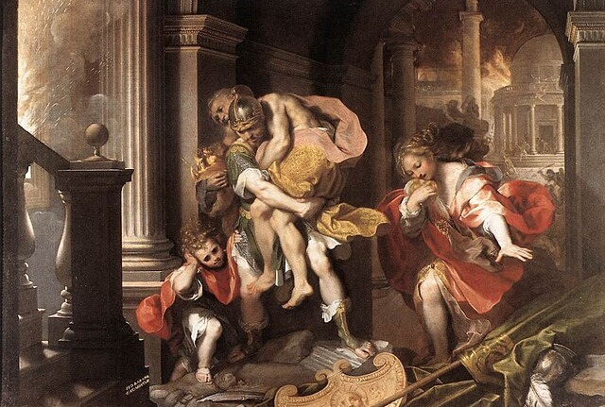
Questions and Reflection: What are your next steps?

Slide 56
Important to…
familiarise yourself with the specification
familiarise yourself with the key documents
familiarise yourself with the sample papers
check out and add to resources: CAI-T, Oide Website, Oide X accounts, Padlet etc.

Slide 57
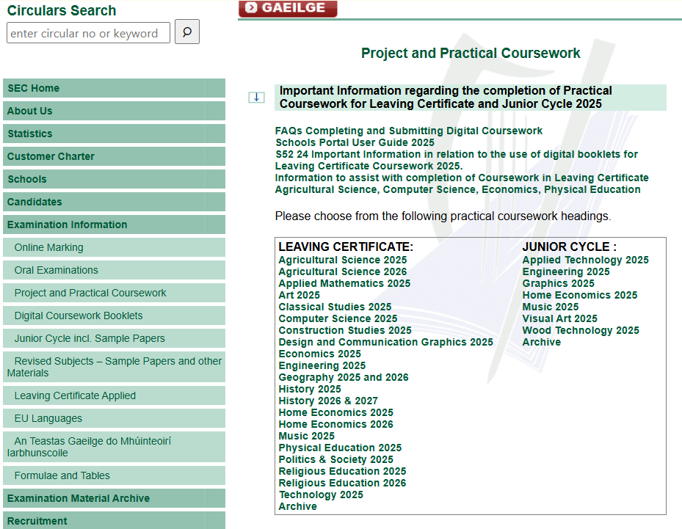
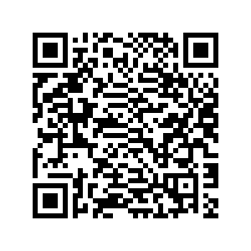
Research study arrangements for leaving certificate 2025 – examinations.ie

Slide 58
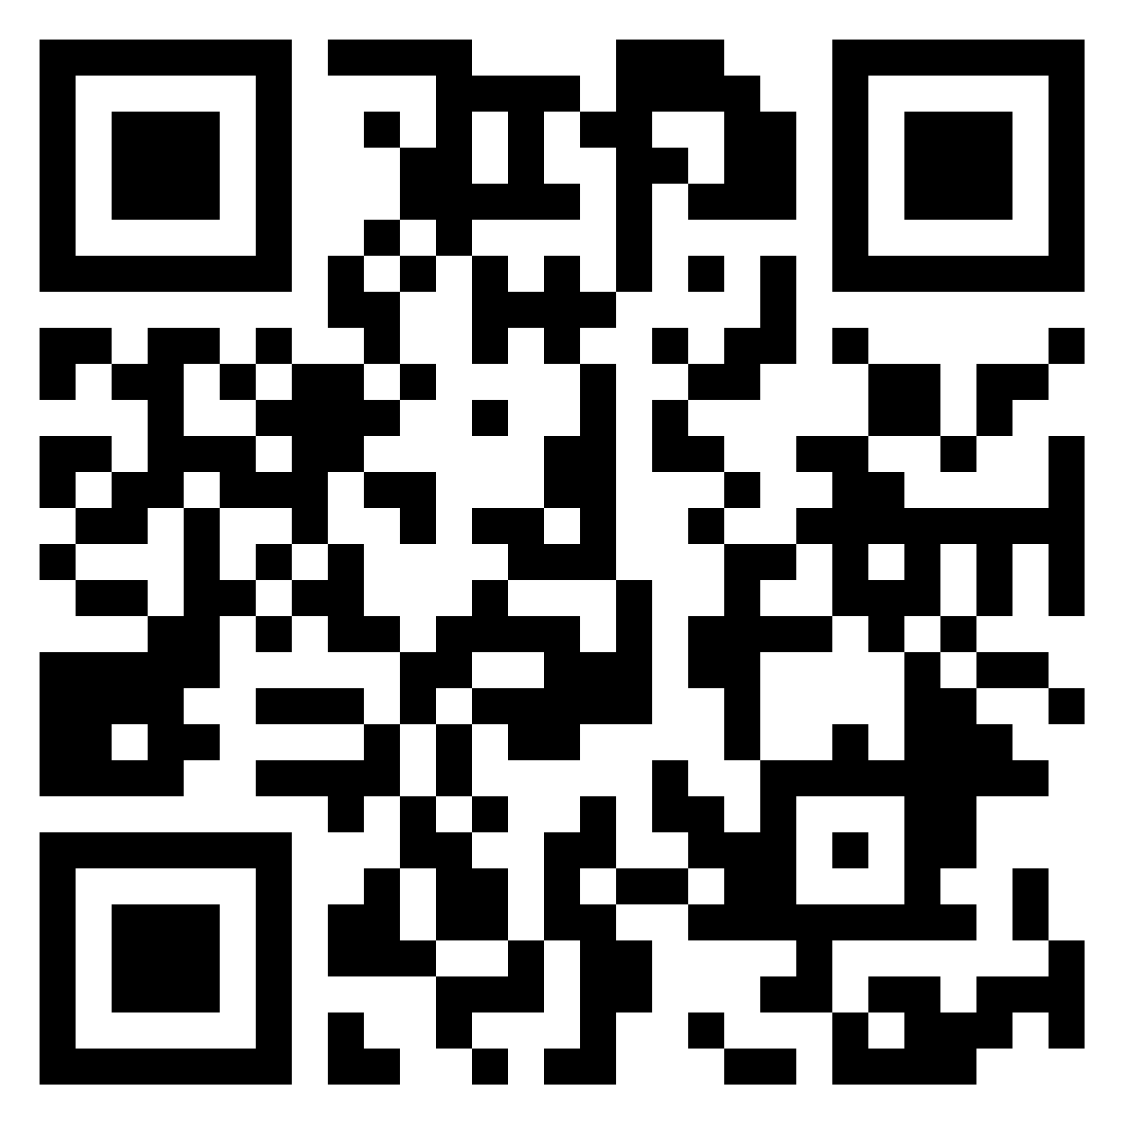
Questions

Slide 59
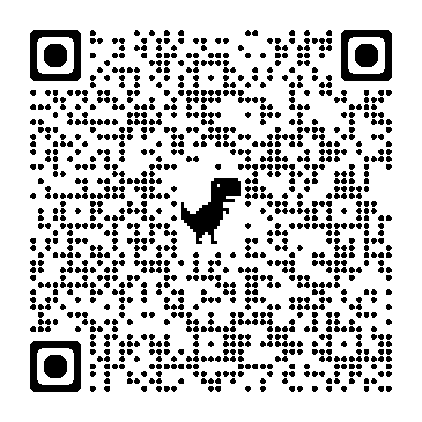
Additional Supports
Visit our website www.oide.ie
Contact: info@oide.ie
Join our new mailing list to receive news and updates
Follow us on X
@Oide_Classics

Slide 60
Thank you

