Slide 1
Oide Senior Cycle Classical Languages
Ancient Greek and Latin
Explore the research process, make connections and evaluate sources to support the Research Study

Slide 2


Slide 3





Today’s Timeline
9:30-11:00
11:00-11:15
11:20-13:00
13:00-14:00
14:00-15:30
Break
Lunch
Session 1
The role of the Research Study and fostering learner agency to support the AAC
Session 2
Making connections, evaluating sources, conducting research and finding a narrow focus for the Research Study Report
Session 3
Understanding the role of the teacher, exploring the descriptors of quality and how to support students to reflect upon the research process

Slide 4



Oide Timeline of Supports for Classical Languages
Classical Languages Introduction to Ancient Greek and Latin Specifications - Webinar
Classical Languages Sample Papers
Classical Languages Collaborative
New specifications begin to be taught in schools
November2024
March 2025
May
2025
November
2025
Term 2
2026
Full Day Face to Face PLE - UCD
Full Day Face to Face PLE – Dublin West

Slide 5

Early days
How have your students responded to continuing or starting their learning an ancient language?
Are there particular texts, topics, or themes that have sparked strong student interest?
What teaching approaches have helped students engage most with the language and cultural content?
Have you tried any new strategies or activities inspired by the new specification?
What areas of the new specification have been most enjoyable or rewarding to teach so far?
What areas of the specification are you most looking forward to teaching next?
How are you supporting students with different levels of prior experience in Classical Languages?
Other

Slide 6
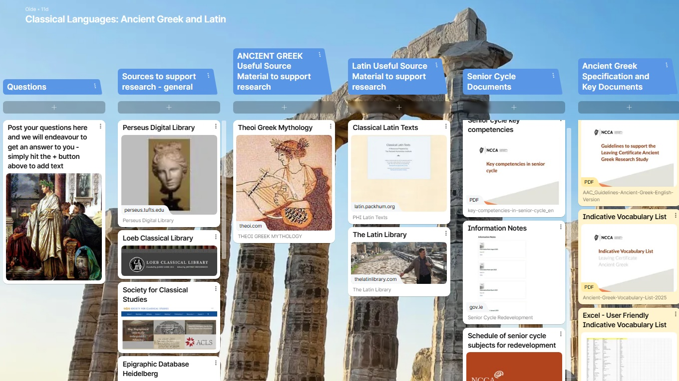

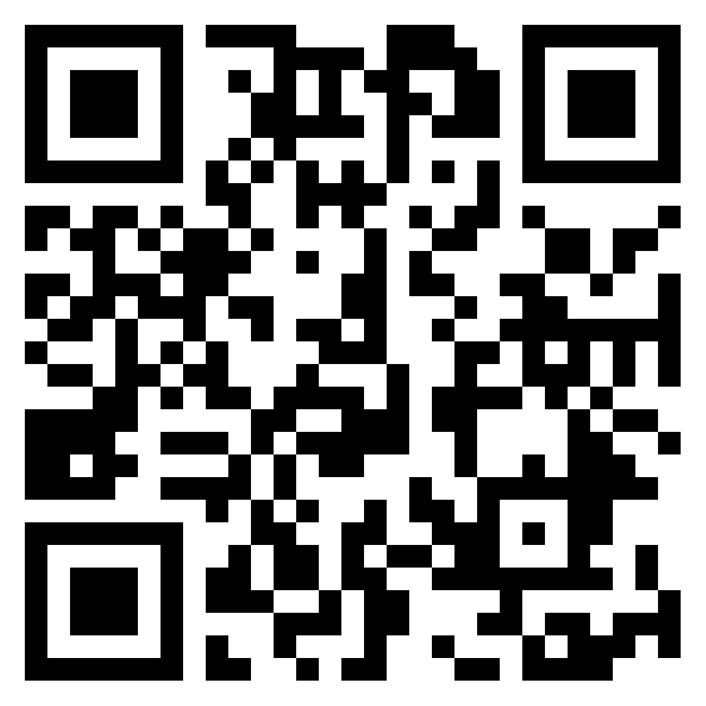
Questions

Slide 7
Session 1
The role of the Research Study and fostering learner agency to support the AAC

Slide 8
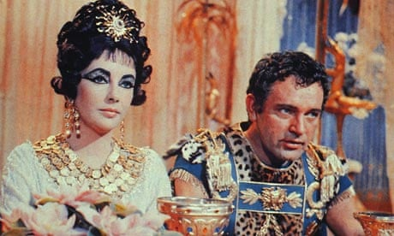
In this session we will:
  examine the role of the Research Study as part of learning, teaching and assessment.
  explore how to foster learner agency in everyday learning, teaching and assessment practices that support independent research processes and more specifically the AAC.
1963 Cleopatra Elizabeth Taylor as Cleopatra and Richard Burton as Mark Antony

Slide 9
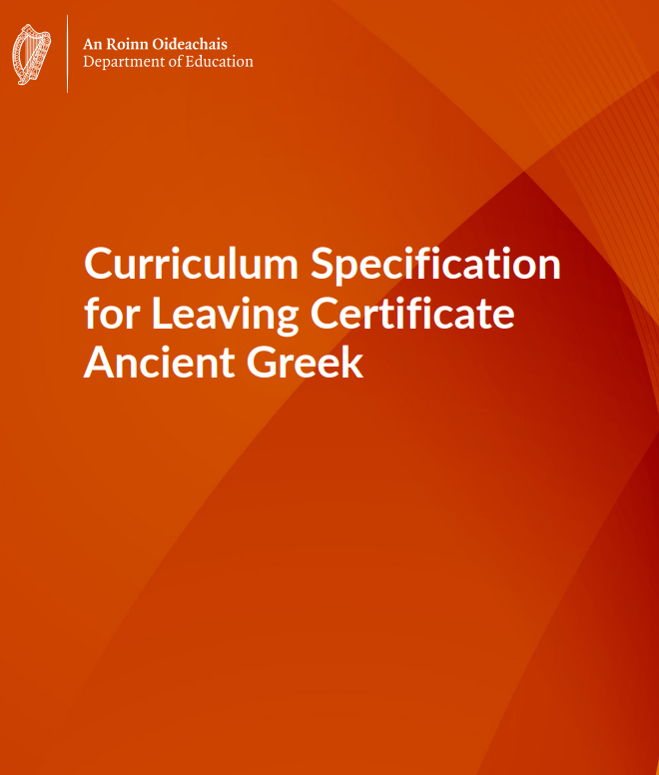
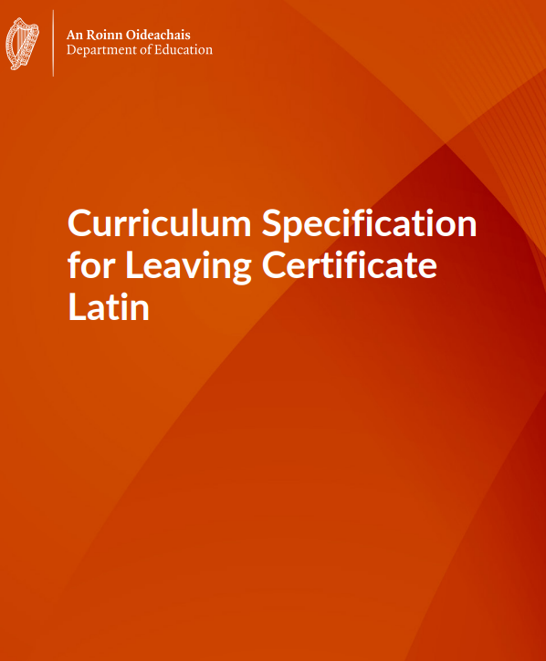
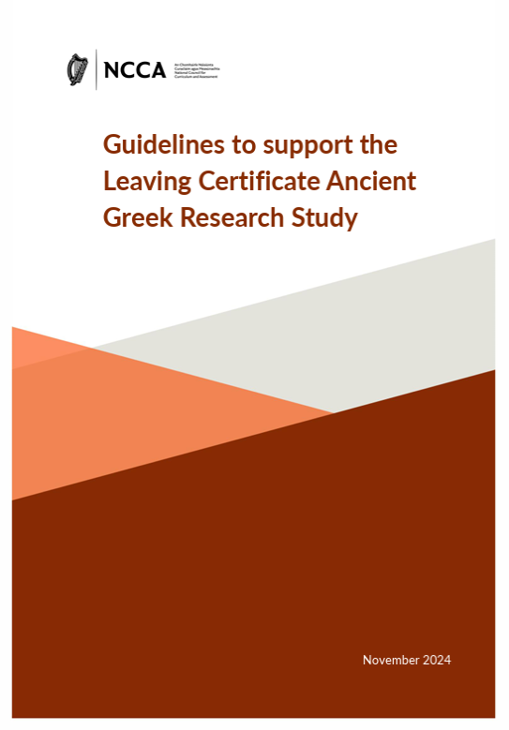
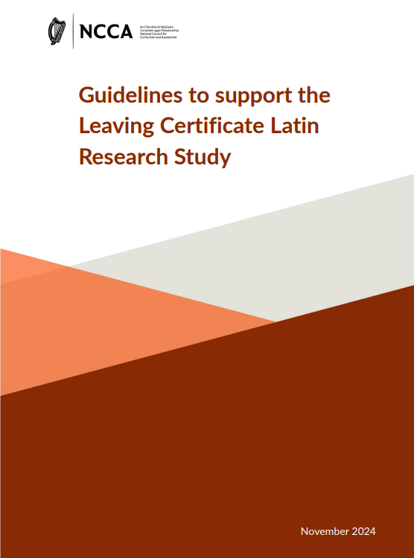
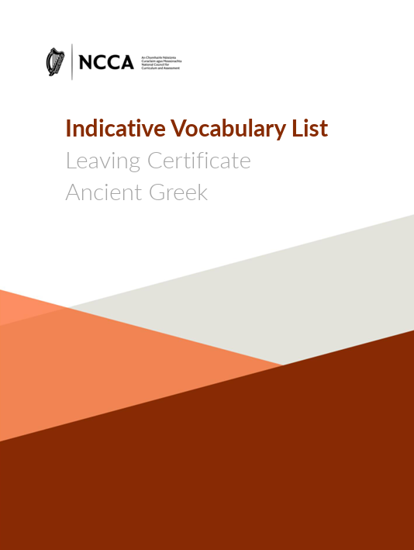
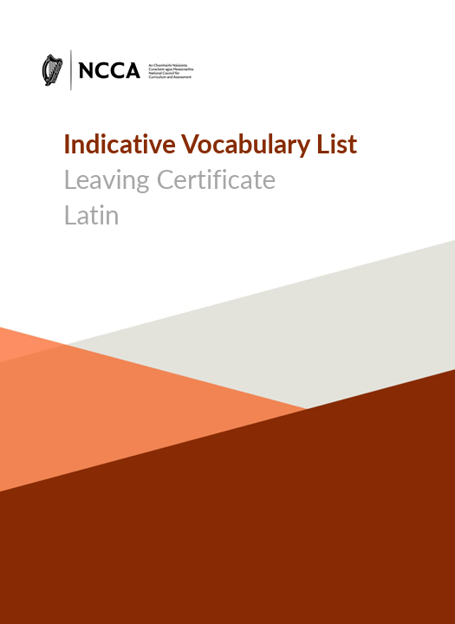
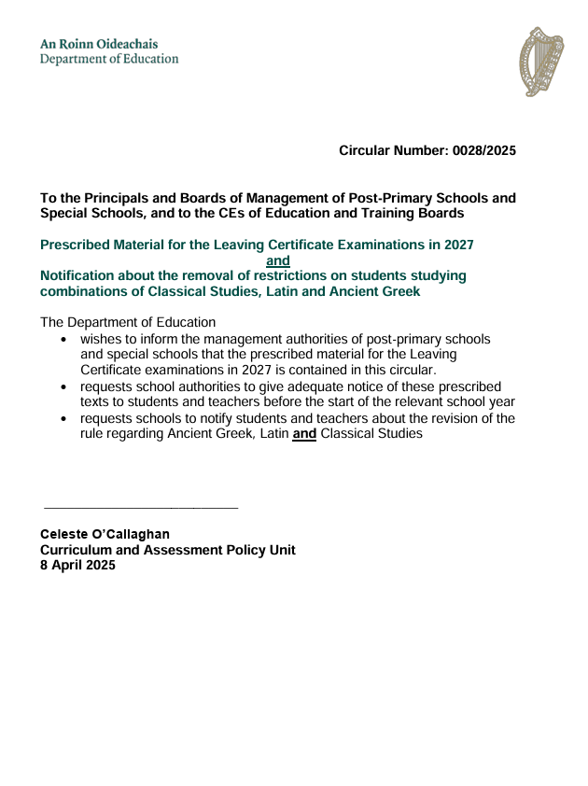
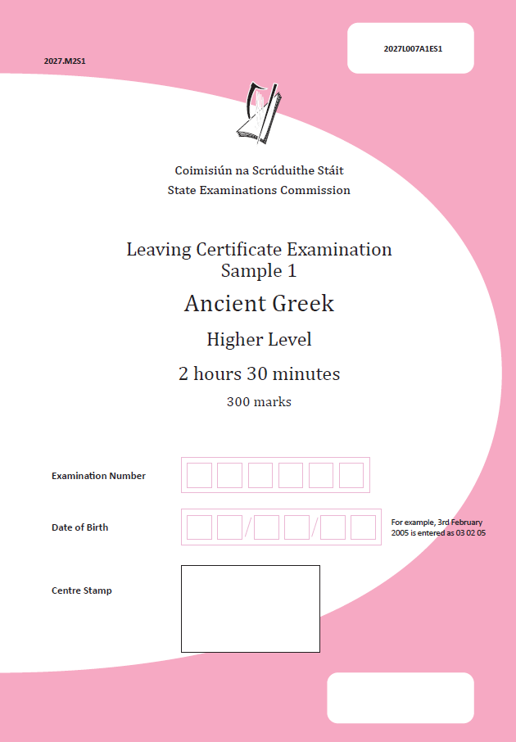
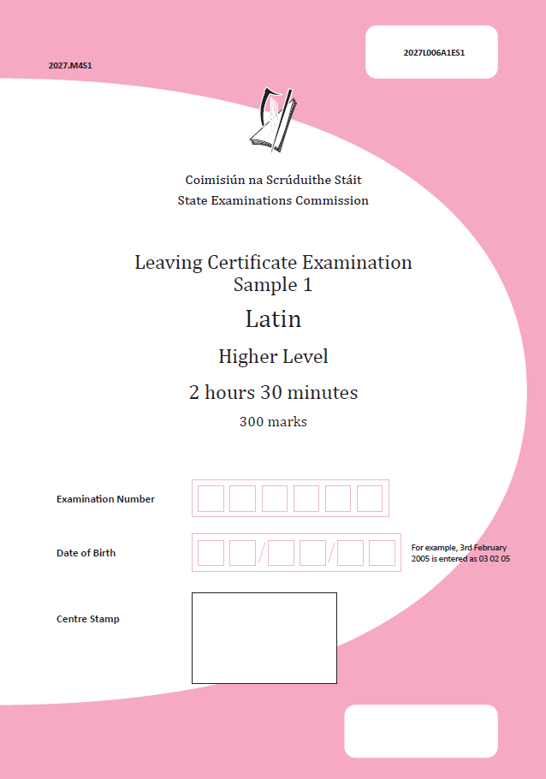
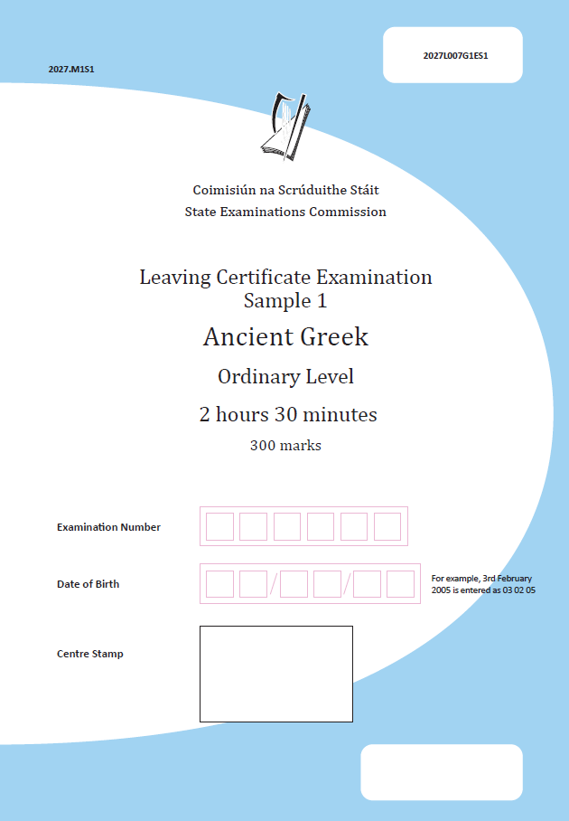
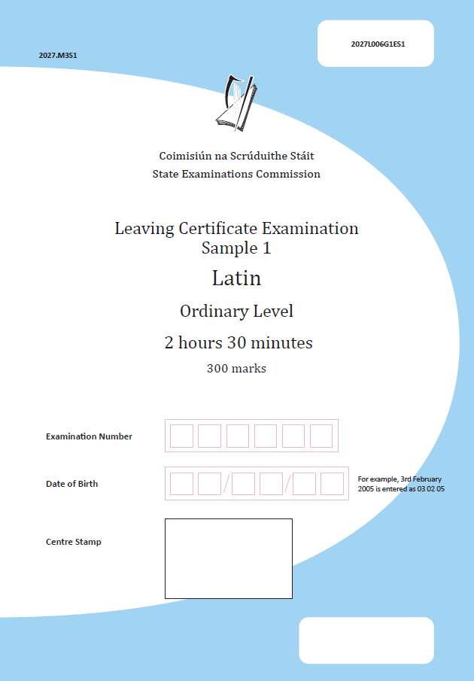


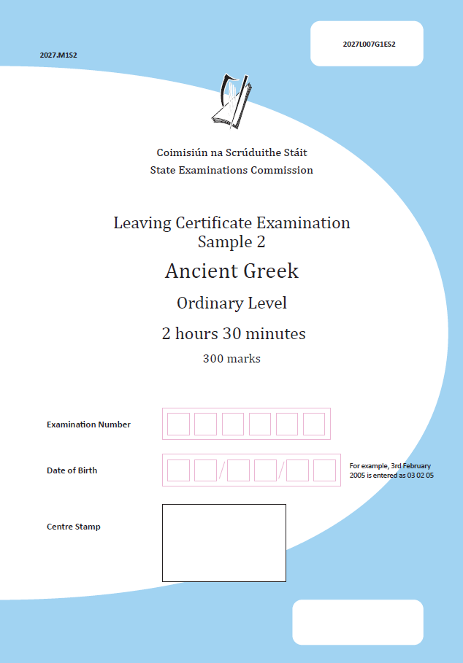
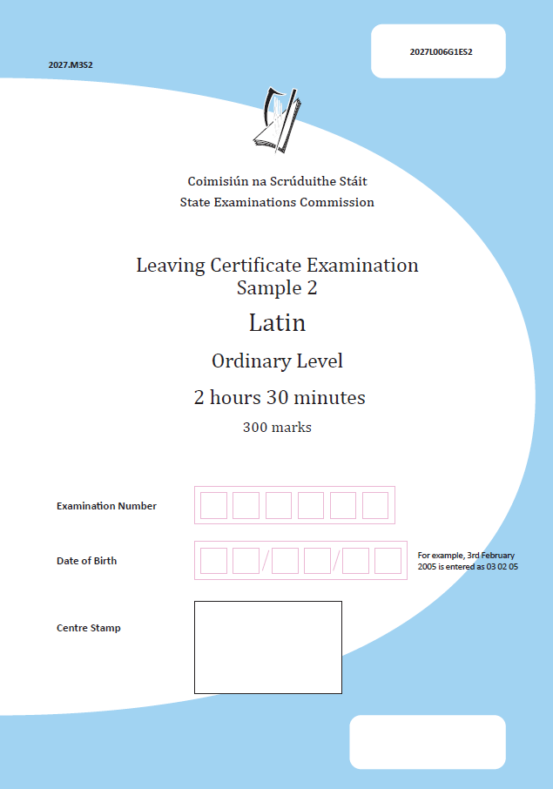
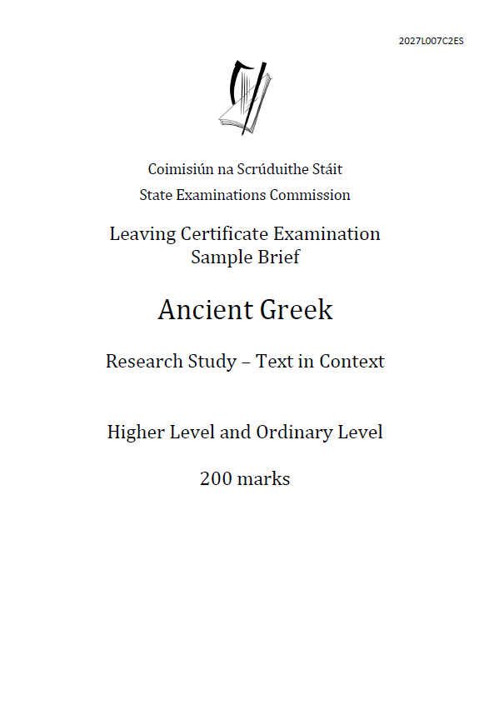
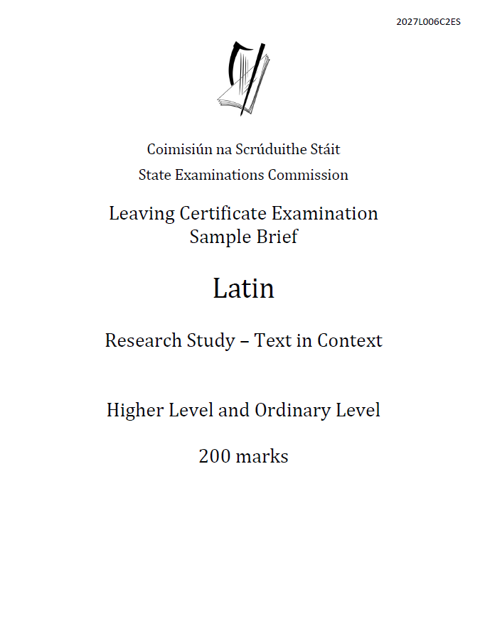
Classical Languages key documents
January 2026
Ancient Greek
Live brief for AAC issued
January 2026
Latin
Live brief for AAC issued

Slide 10
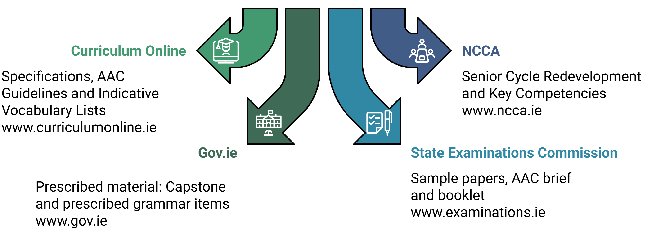
Where to find the key documents

Slide 11
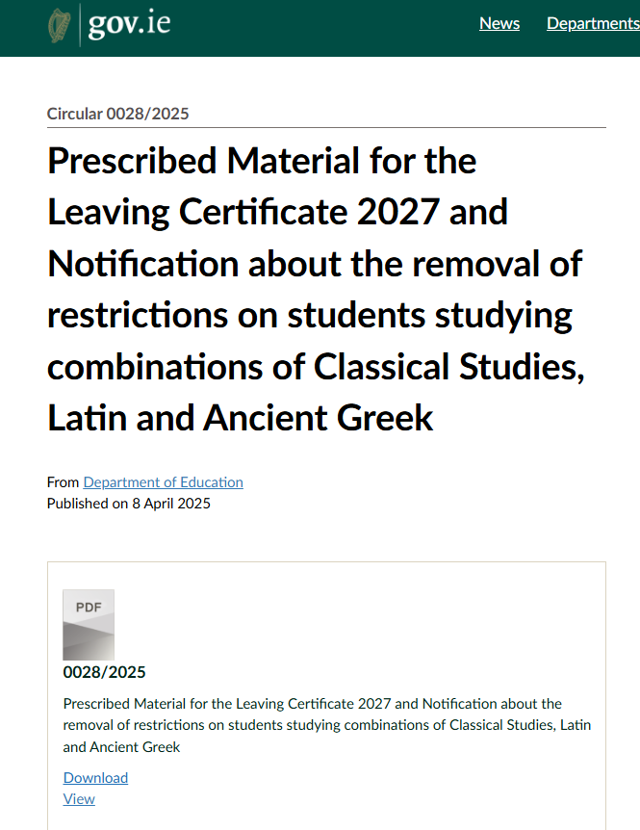
Prescribed Material for the Leaving Certificate 2027 - the Capstone Text
Circular 0028/2025

Slide 12
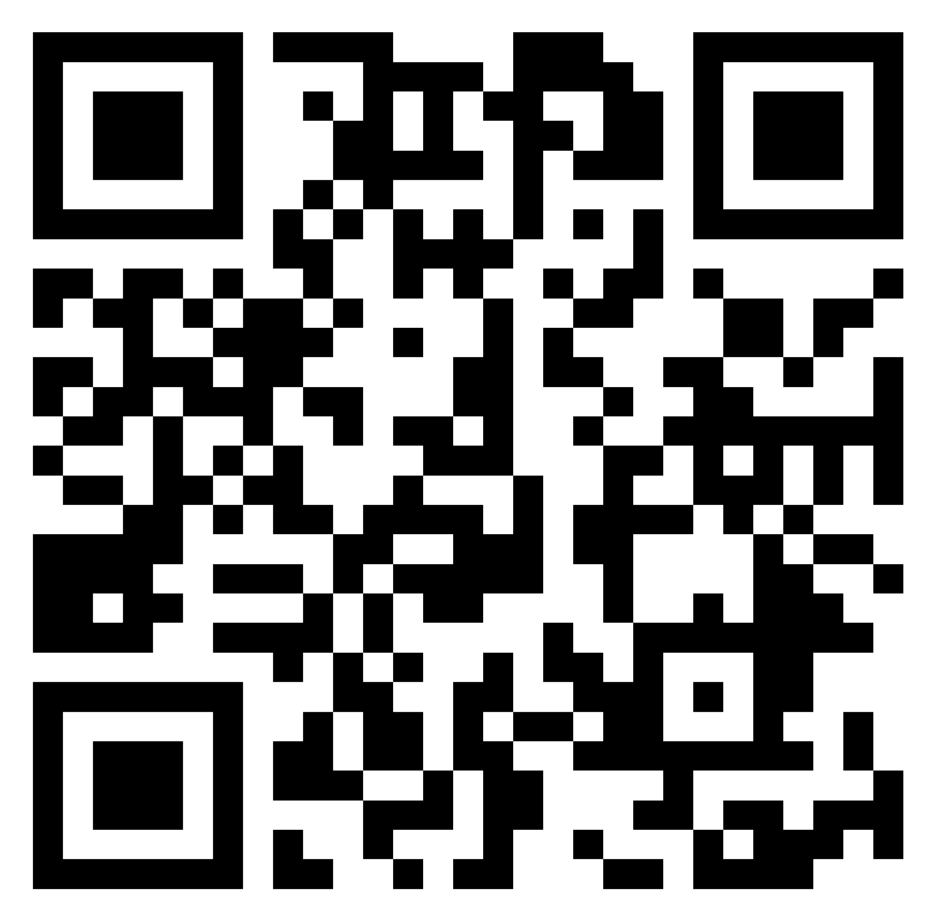
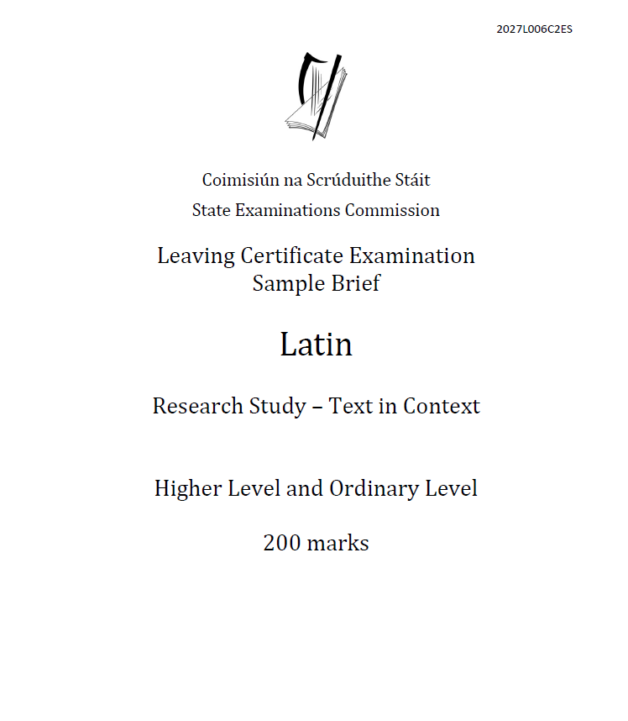
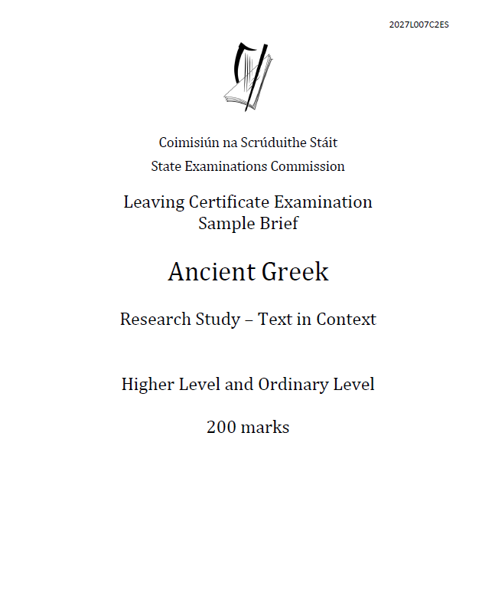
Key documents for today
Guidelines to support the Research Study
Research Study Sample Brief
Classical Languages Specifications

Slide 13

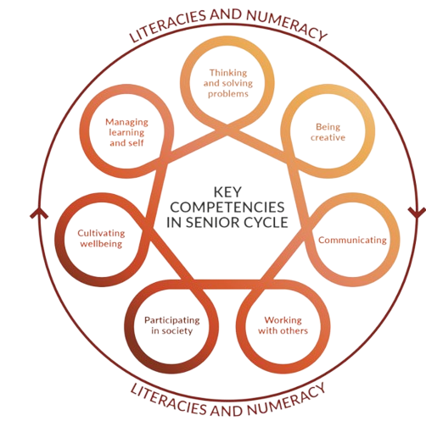
Ancient Greek/Latin
Specification
Grammar for Unseen Texts
Capstone
Text
Capstone Oide Support Document
Department Circular 0028/2025
Indicative Vocabulary List
TODAY
Teaching, Learning
and Assessment
Learning Outcomes
Key Competencies
AAC Guidelines
Additional Assessment Component
40%
Examination
60%
Sample Papers x4

Slide 14
General outline of the Research Study
Assessment of the Leaving certificate Ancient Greek and Latin comprises of two components:
  Written examination - (300 marks - 60%)
  Additional Assessment Component - Research Study – Text in Context – (200 marks - 40%) (reported through the medium of a report called the Research Study Report)
common brief for both Ordinary Level and Higher Level (differentiation is achieved at final level chosen by the student for written examination)
PDF file submitted to SEC in 6th Year
overall word count should not exceed 1700 words*

Slide 15
Key document:
Guidance to Support the Research Study
Read page 4
Overview of the Research Study
Identify the words, phrases or sentences that show the centrality of the student in the research process.
Identify and highlight the parameters within which students must complete their Research Study.

Slide 16
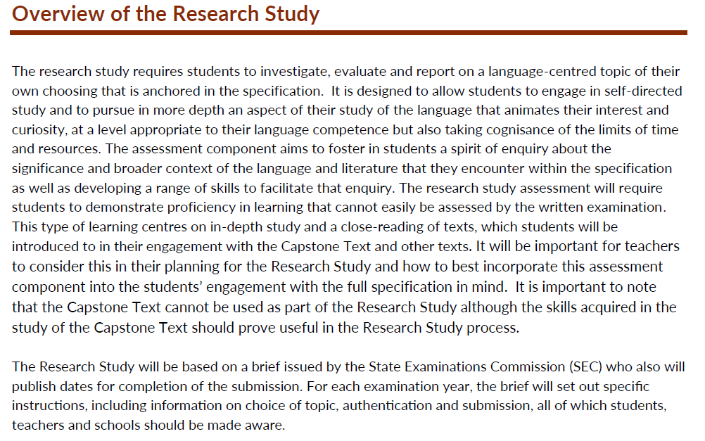
NCCA, 2024, p.4 Guidance to support the Leaving Certificate Latin Research Study

Slide 17
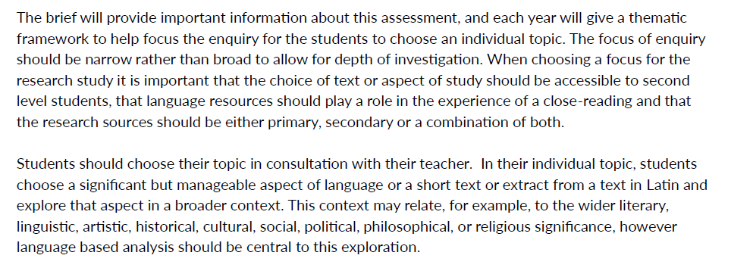
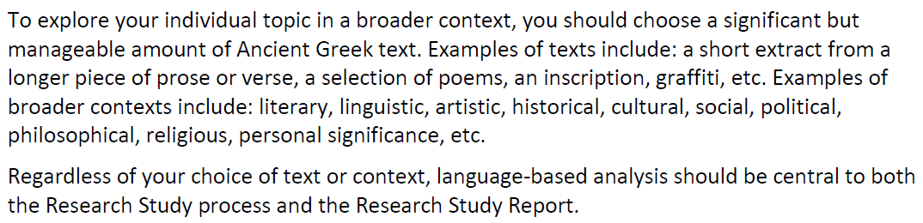
SEC, 2025, p.5 Leaving Certificate Examination
Sample Brief Ancient Greek Research Study – Text in Context
NCCA, 2024, p.4 Guidance to support the Leaving Certificate Latin Research Study

Slide 18
Key points
Students
Investigate, evaluate, report
Self-directed study
Choice of topic (language centred)
Narrow focus for depth
Use of primary and/or secondary sources
Procedures and requirements
Research Study assessment
State Examinations Commission (SEC) brief
Instructions, authentication, submission
Completion dates (annual)
Thematic framework provided each year
Individual topic linked to broader contexts:
Anchored to the specification
Literary, linguistic, artistic, historical, cultural, social, political, philosophical, religious etc.

Slide 19

Key Competencies made visible through the Research Study
Identify what key competencies can be made visible for students throughout the research process.

Slide 20

Student participation
“The quality framework emphasises the need for all students to be meaningfully included in their school community...
…student-centred, informed and evidence based, and that supports young people to participate in and make progress in all areas of their learning and development
…to ensure that all young people are provided with opportunities to meet their full potential in accordance with their abilities, strengths, stages of development, and identified learning needs.”
DE Inspectorate, 2022, p.8 Looking at Our School 2022: A Quality Framework for Post-Primary Schools

Slide 21
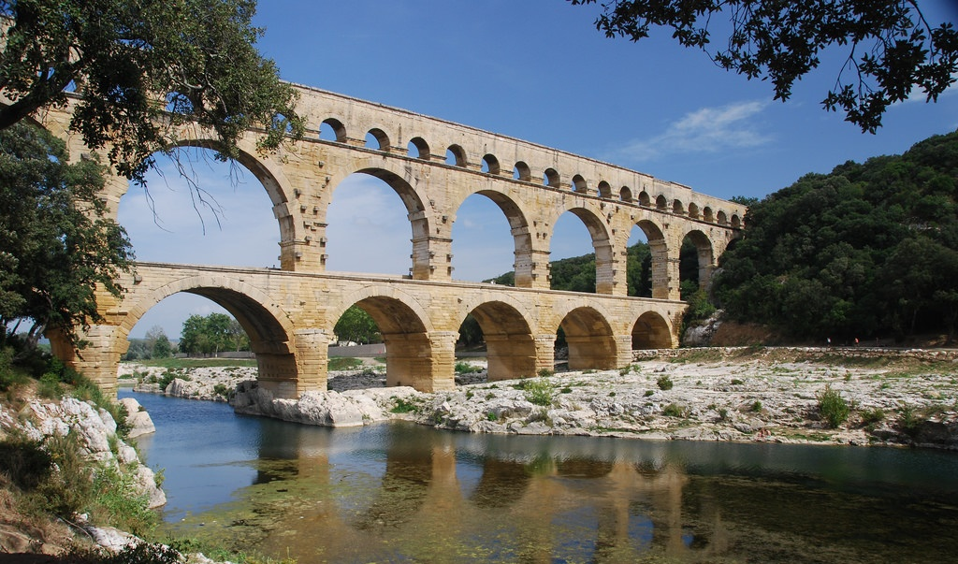

Student participation and learner agency
What does student participation and learner agency mean to you?
How do you foster learner agency in your classroom?

Slide 22

What is learner agency?
Agency
“… is understood as the capacity to act independently and to make one’s own choices.”
Manyukhina, Y. & Wyse, D., 2019
“… is a feeling of being in the driving seat when it comes to our actions.”
Moore, J. W. (2016). p.1 What is the Sense of Agency
and Why Does it Matter? Frontiers in Psychology
Learner Agency
“‘the ability and the will [of students] to positively influence their own lives and the world around them’.
Chief Inspector's Report 2021-2023, p.55
According to Albert Bandura’s social cognitive theory, agency is the "power to originate action.”

Slide 23
Lundy Model
This model provides a pathway to help conceptualise Article 12 of the UN Convention of the Rights of the Child. It focuses on four main distinct, albeit interrelated, elements. The four elements have a rational chronological order.
SPACE
Children and young people must be given safe, inclusive opportunities to form and express their views
VOICE
Children and young people must be facilitated to express their views
AUDIENCE
The views must be listened to
INFLUENCE
The views must be acted upon, as appropriate

Slide 24

What is the role of the teacher in developing learner agency?
Jennifer Bown from Brigham Young University finds a direct link between agency and students’ capacity for autonomous learning.
“... to effectively manage learning and regulate emotional responses, learners must be aware of their own agency and must believe themselves capable of exercising that agency.”
Bown, J. (2009). Self‐regulatory strategies and agency in self‐instructed language learning: a situated view. The Modern Language Journal.
“… merely instilling in children, a sense of agency is not sufficient for empowering them to take ownership of their learning. Real opportunities must be provided for students to exercise their agency to acquire effective control over it.”
Manyukhina, Y. & Wyse, D. (2019). Learner agency and the curriculum: a critical realist perspective. The Curriculum Journal.

Slide 25
What is the role of the teacher in developing learner agency?
Jennifer Bown from Brigham Young University finds a direct link between agency and students’ capacity for autonomous learning.
“... to effectively manage learning and regulate emotional responses, learners must be aware of their own agency and must believe themselves capable of exercising that agency.”
Bown, J. (2009). Self‐regulatory strategies and agency in self‐instructed language learning: a situated view. The Modern Language Journal.
“… merely instilling in children, a sense of agency is not sufficient for empowering them to take ownership of their learning. Real opportunities must be provided for students to exercise their agency to acquire effective control over it.”
Manyukhina, Y. & Wyse, D. (2019). Learner agency and the curriculum: a critical realist perspective. The Curriculum Journal.

Slide 26
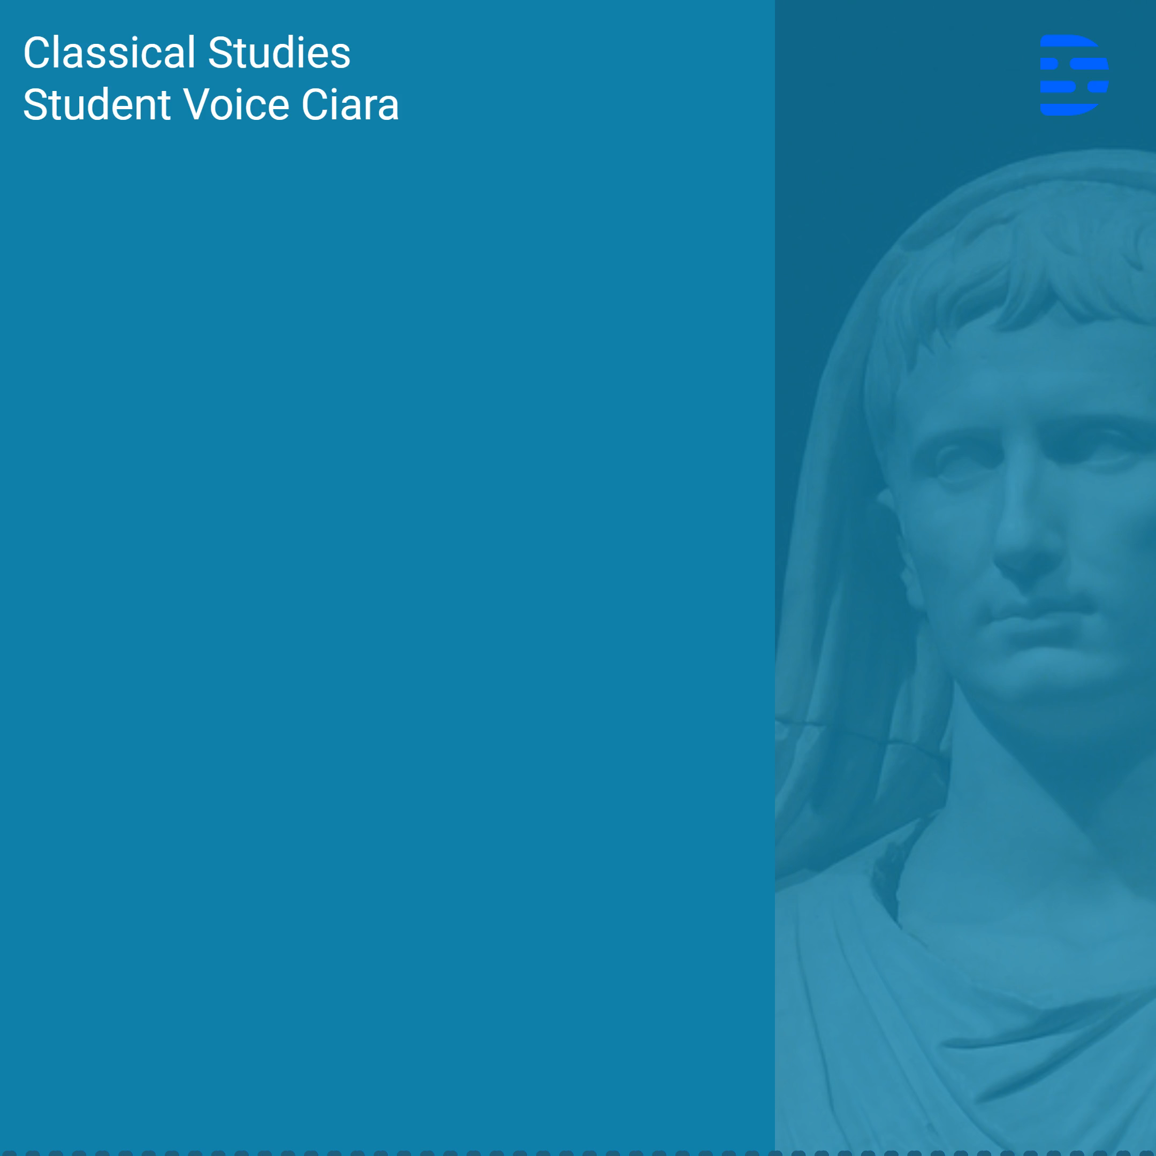
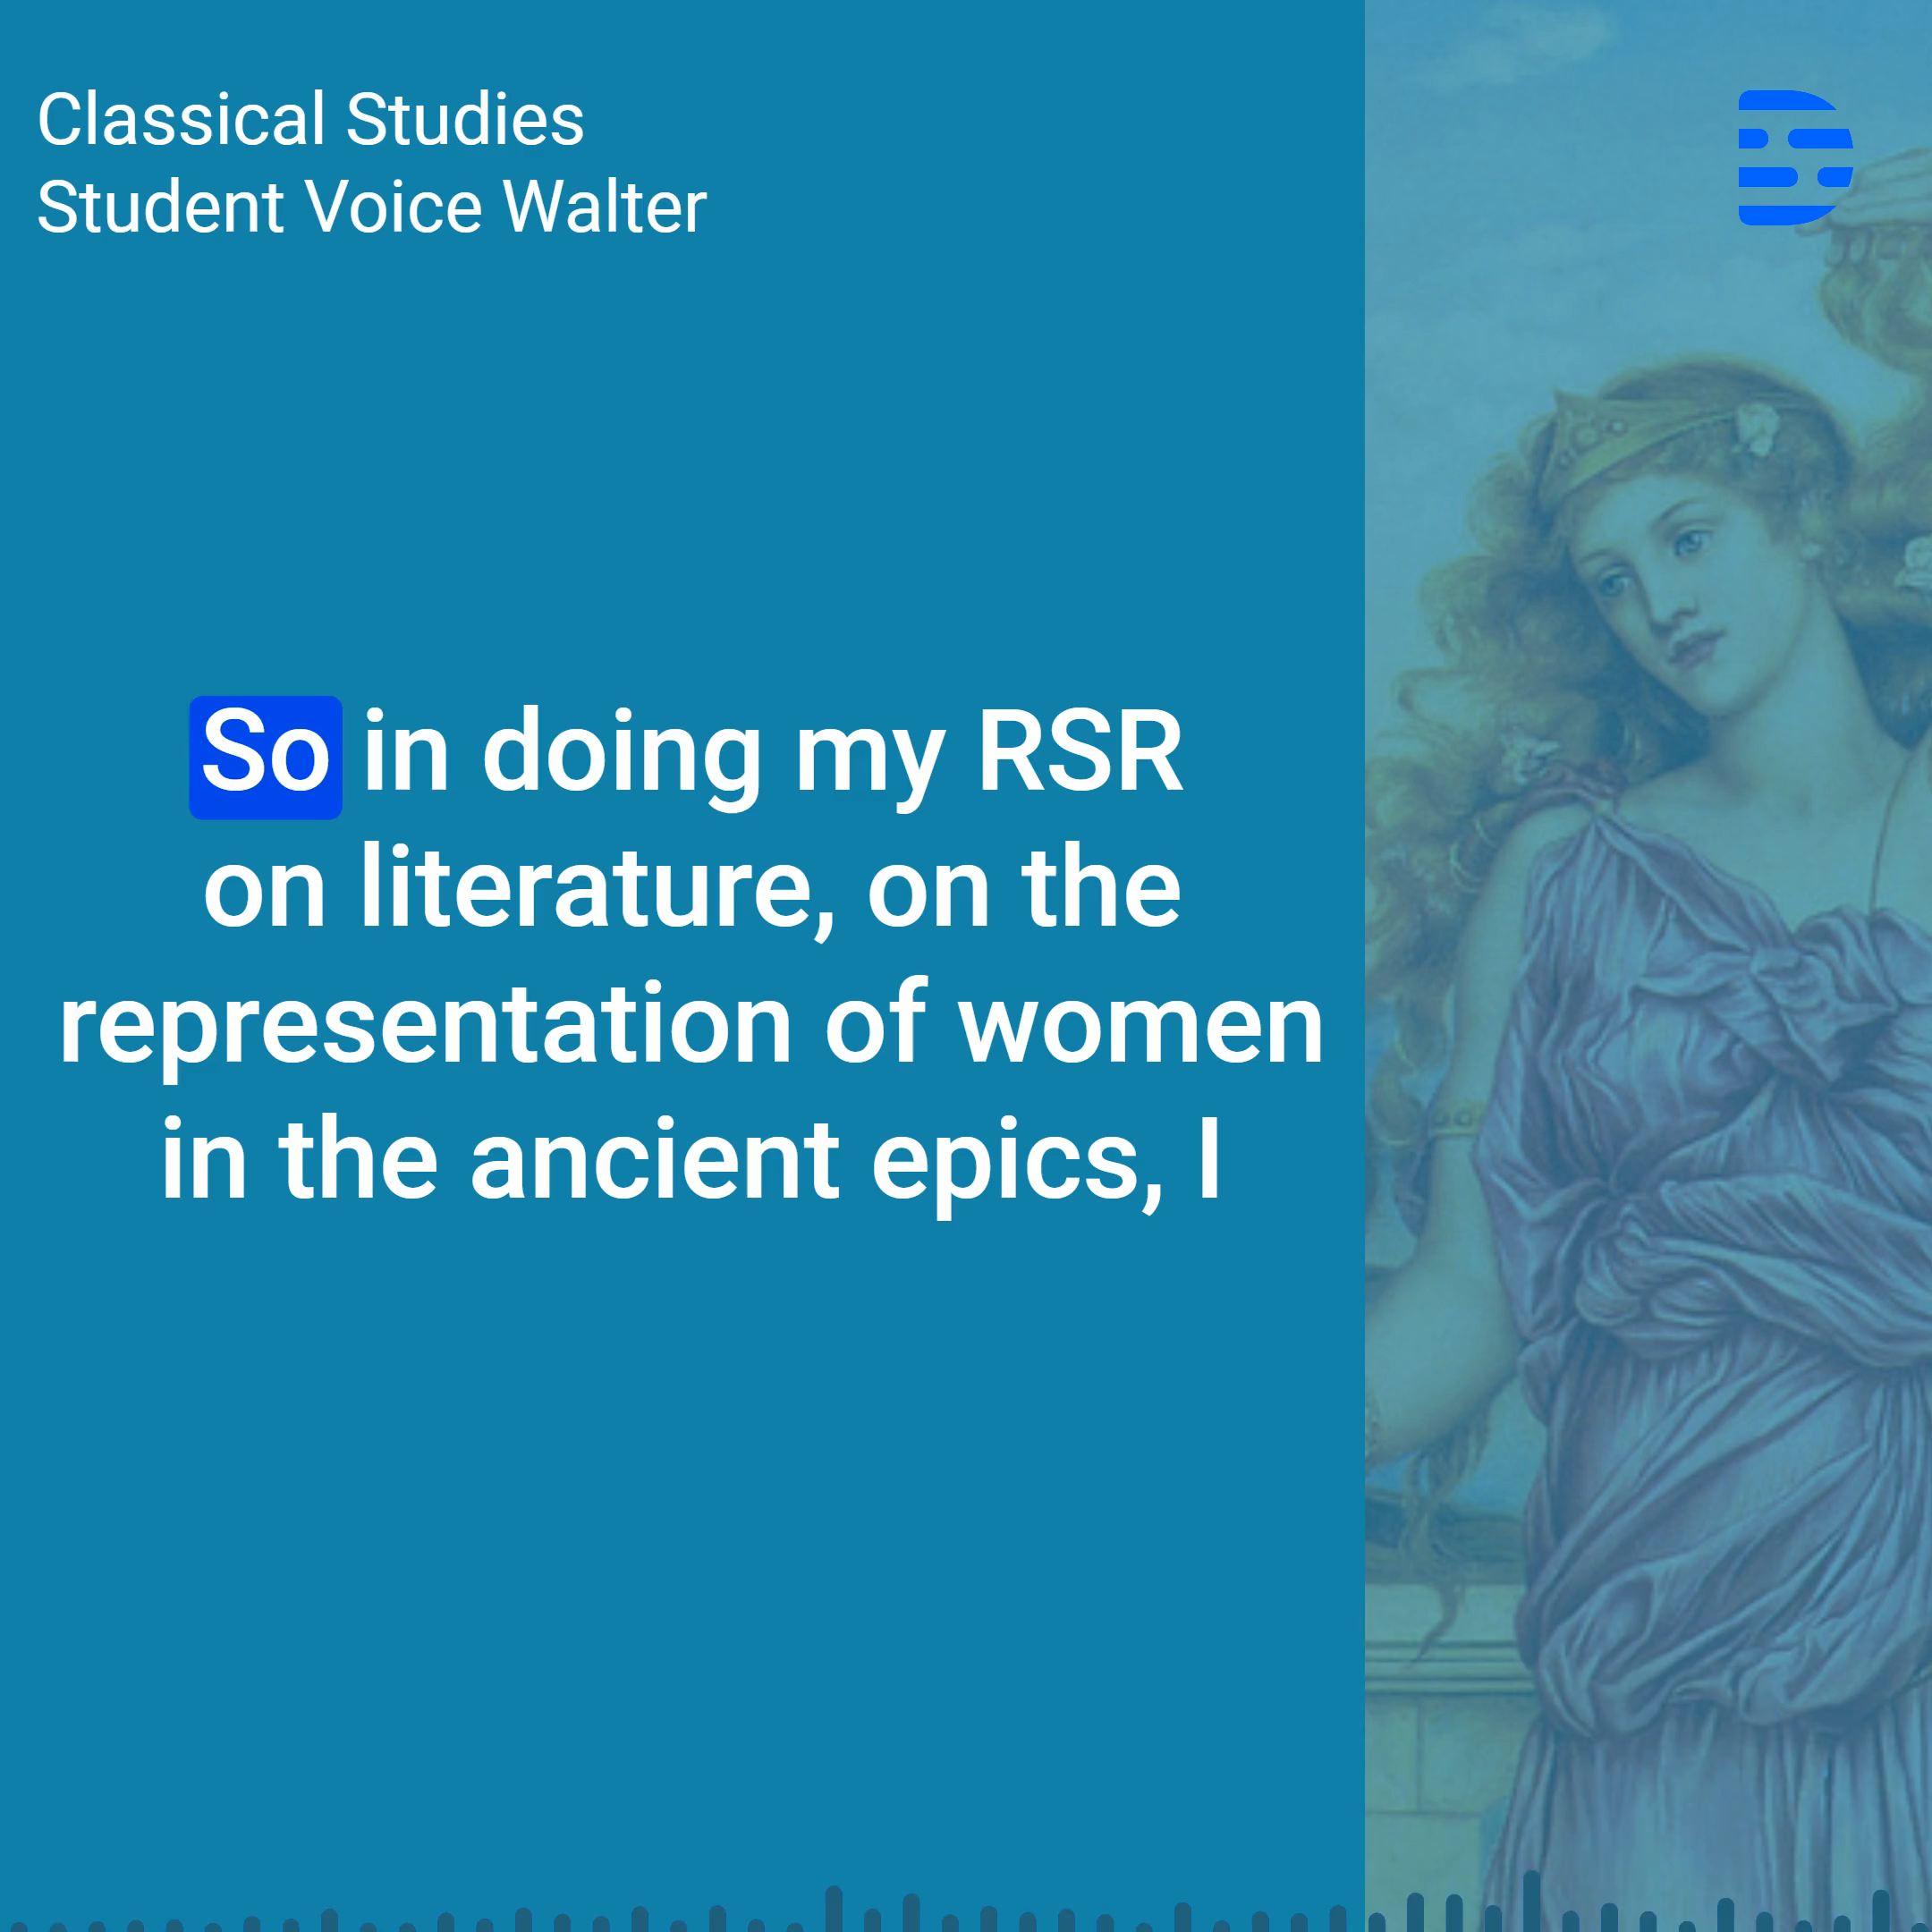
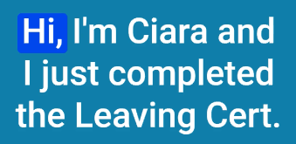
Student Voice:
Classical Studies at Leaving Certificate

Slide 27

Classroom culture
What conditions
are necessary to support learner agency?

Slide 28

Classroom culture and classroom context
How do/could you, foster learner agency in the classroom?
What supports must be in place for students to make meaningful decisions?

Slide 29

The Research Study (AAC)
“It is designed to allow students to engage in self-directed study and to pursue in more depth an aspect of their study of the language that animates their interest and curiosity…
… aims to foster in students a spirit of enquiry about the significance and broader context of the language and literature that they encounter within the specification as well as developing a range of skills to facilitate that enquiry.”
NCCA, 2024, p.4 Guidelines to support the
Leaving Certificate Latin Research Study

Slide 30
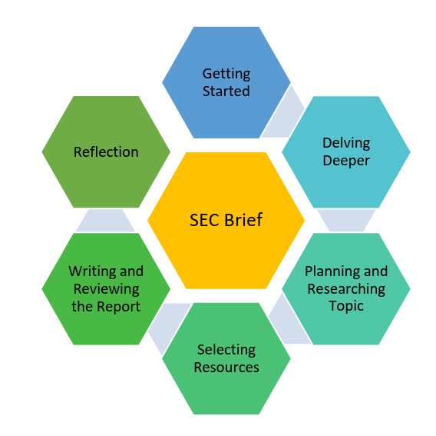
The research process
NCCA, 2024, p.5 Guidance to support the Leaving Certificate Latin Research Study

Slide 31
Key Document:
Guidance to Support the Research Study
Read pages 5 – 6
Process for the completion of the Research Study
Stages 1 and 2

Slide 32
What advice could you give to students after reading the ‘Process for the completion of the Research Study – Stages 1 and 2’?

Slide 33
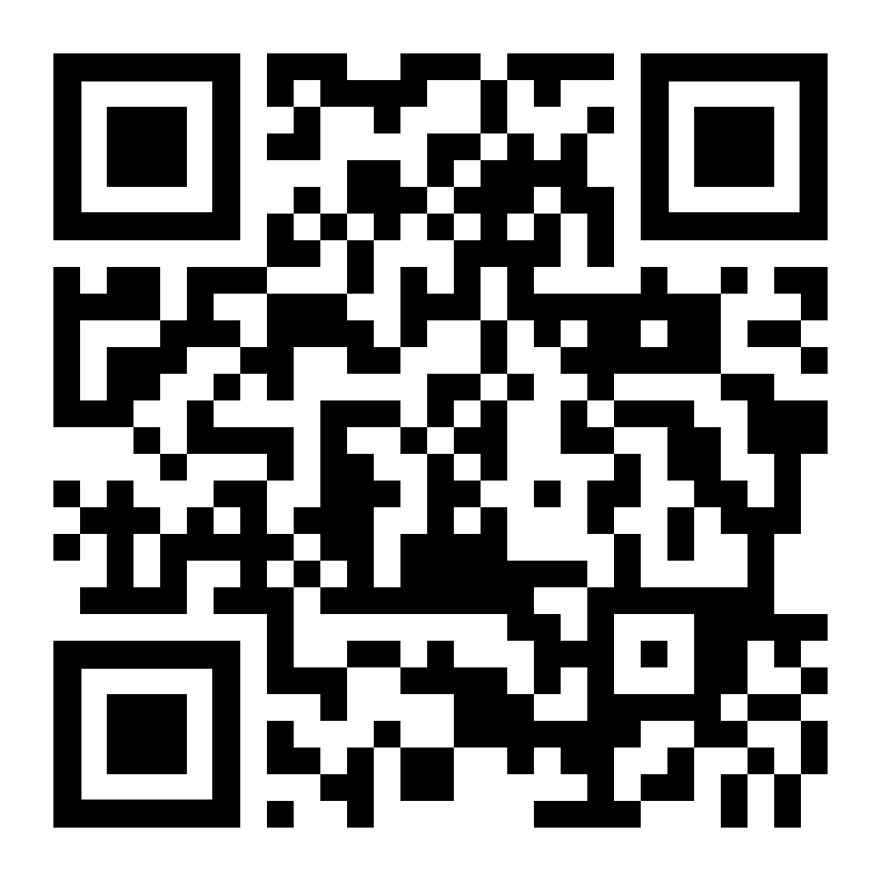
Sample Brief
Allow ample time for your students to read this very important document
Explore it and discuss it

Slide 34
Research Study Report - structure
Read pages 7-8

Slide 35
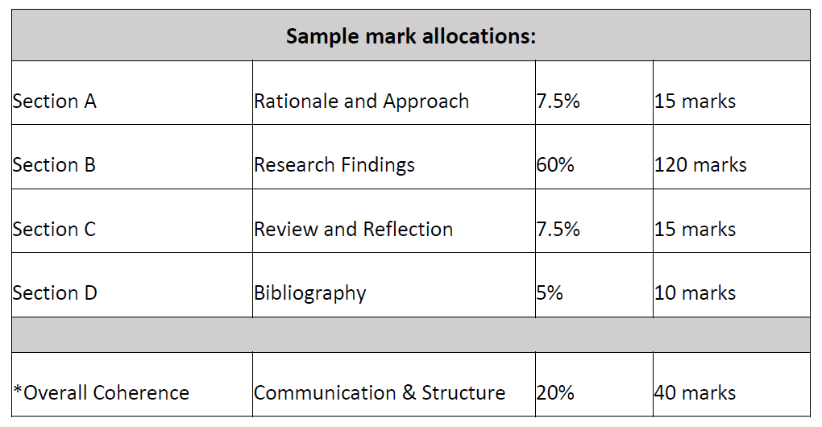
Overall structure, word count and mark allocation
100-200 words
1200-1500 words*
100-200 words
SEC, 2025, p.7-8 Leaving Certificate Examination
Sample Brief Ancient Greek Research Study – Text in Context

Slide 36
The AAC and Capstone Text
“…it is important to note that candidates are not permitted to include research on this year’s Capstone Text in their Research Study Report. This exclusion pertains to the Capstone Text in its entirety and not only the sections prescribed in Ancient Greek and in translation.”
SEC, 2025, p.6 Leaving Certificate Examination
Sample Brief Ancient Greek Research Study – Text in Context

Slide 37
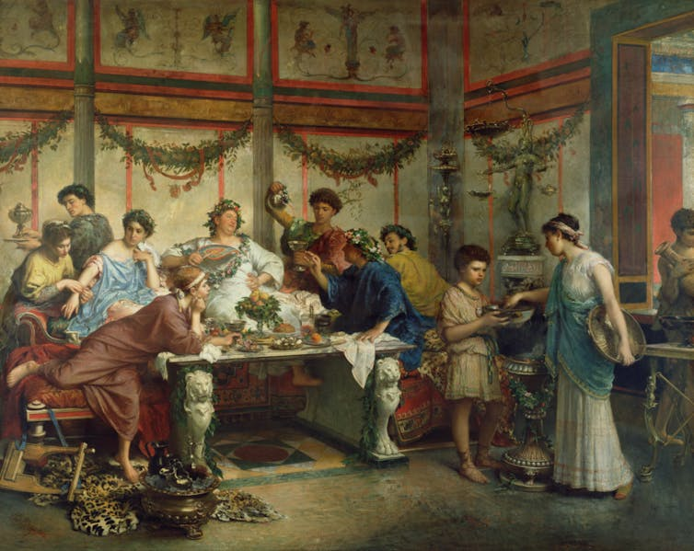
Overall structure: time to discuss
A Roman Feast depicted by Roberto Bompiani in the late 19th century. Getty Museum

Slide 38
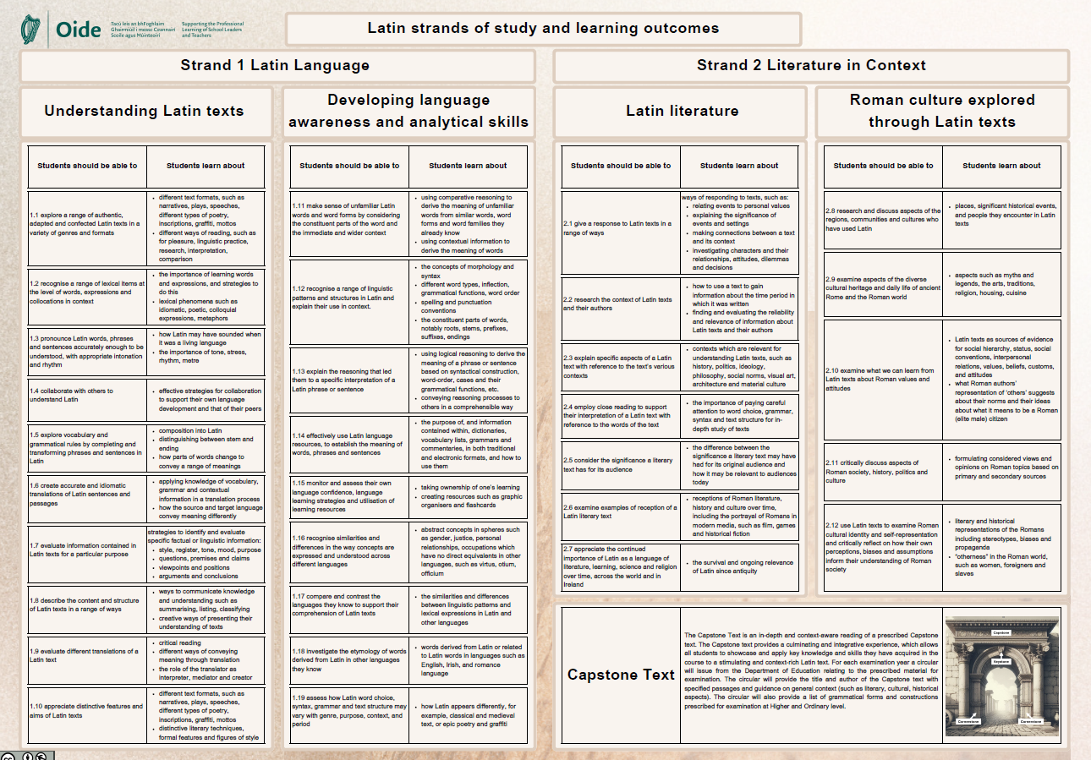
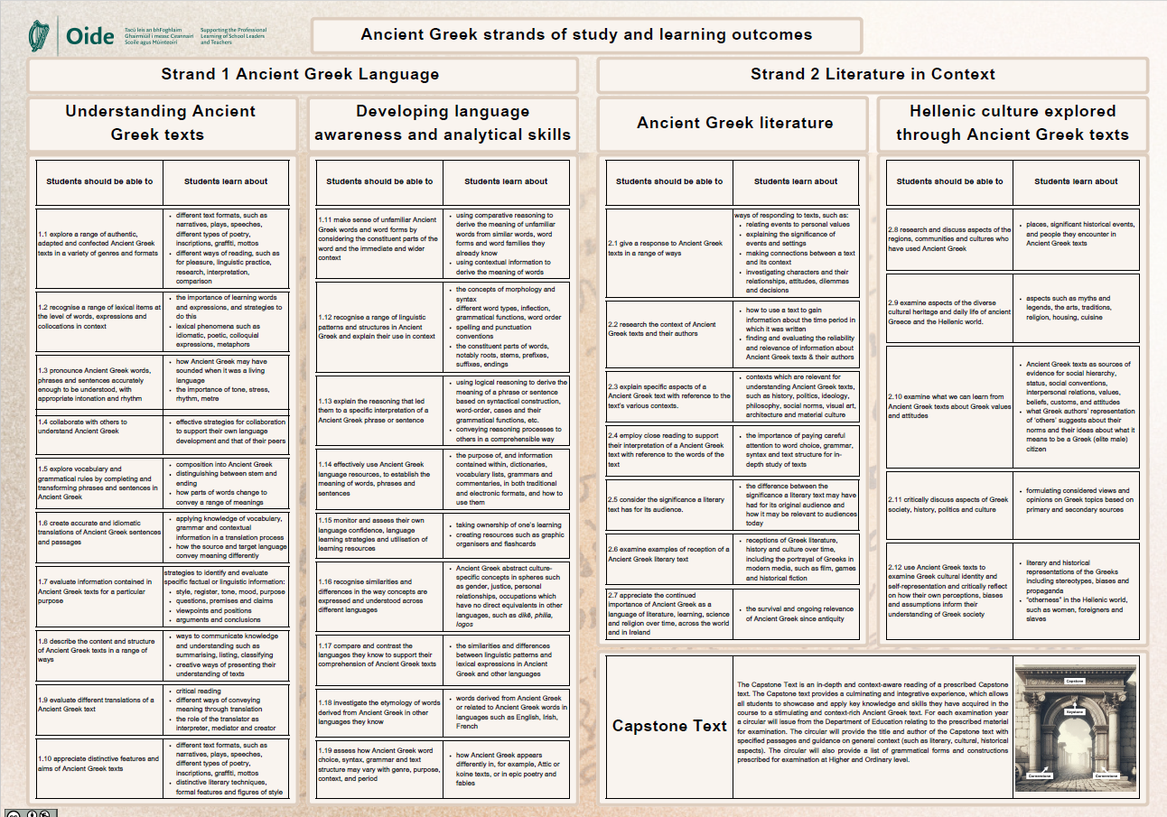
Sample Brief - Research Study - Linking to the Specification
Read pages 6

Slide 39
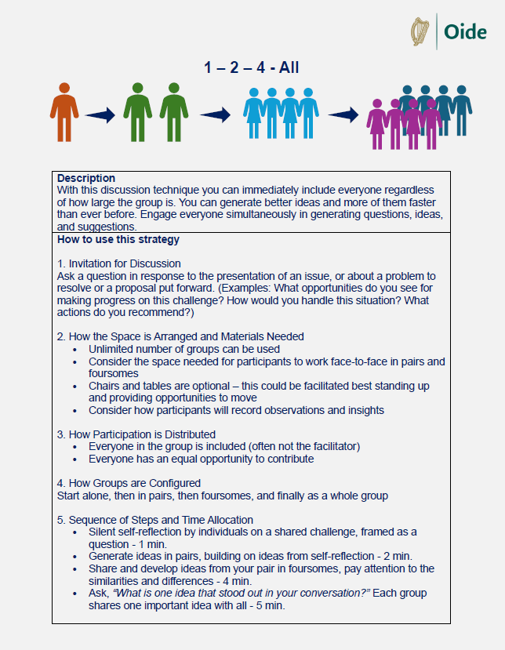
Silent self reflection
Generate ideas in pairs building on original ideas
Share and further develop ideas in foursomes – attention focused on similarities and differences
Present one idea that stood out in the conversations – each group to share

Slide 40
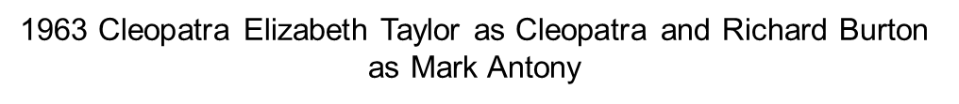
In this session we:
  examined the role of the Research Study as part of assessment for Classical Languages.
  explored how to foster learner agency in everyday learning, teaching and assessment practices that support independent research processes and more specifically the AAC.

Slide 41
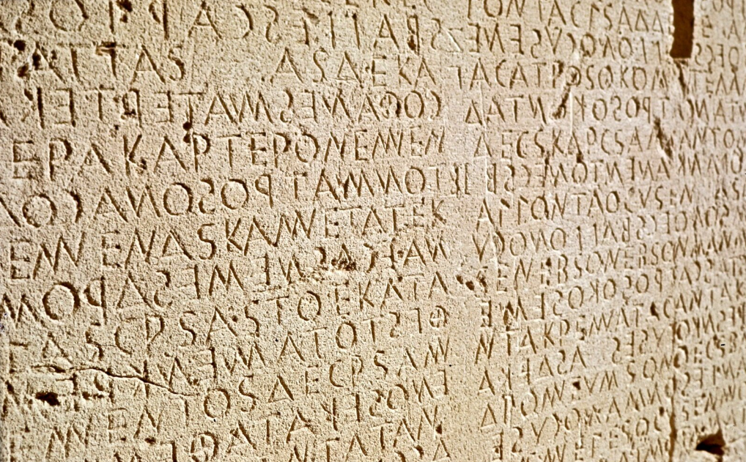
Tea/Coffee Break
A twelfth portion of the Cretan laws on the walls written in Doric Greek 5th to 6th century BCE at Gortyn, Crete, Greece. It details laws on marriage, divorce, inheritance, property, and adultery, reflecting social hierarchies and differences in treatment based on class.

