Slide 1
Session 2
Making connections, evaluating sources, conducting research and finding a narrow focus for the Research Study Report

Slide 2

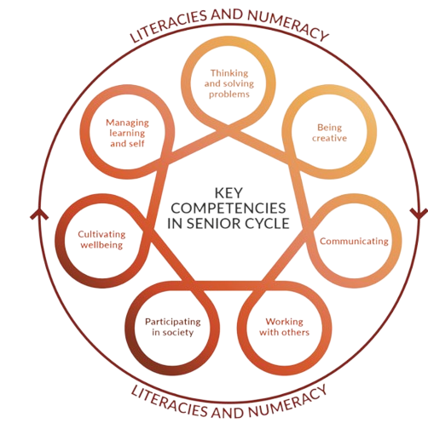
Ancient Greek/Latin
Specification
Grammar for Unseen Texts
Capstone
Text
Capstone Oide Support Document
Department Circular 0028/2025
Indicative Vocabulary List
Teaching, Learning
and Assessment
Learning Outcomes
Key Competencies
AAC Guidelines
Additional Assessment Component
40%
Examination
60%
Sample Papers x4

Slide 3
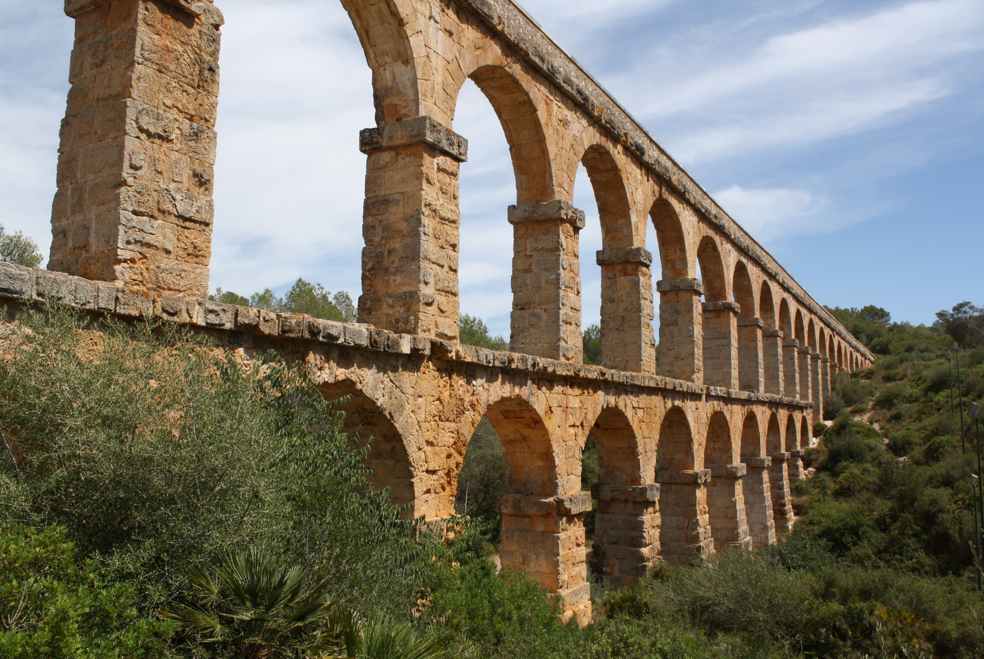


In this session we will:
explore connections between the Additional Assessment Component and the specification.
identify and examine strategies to conduct effective research.
consider how to evaluate sources as part of the research process.

Slide 4
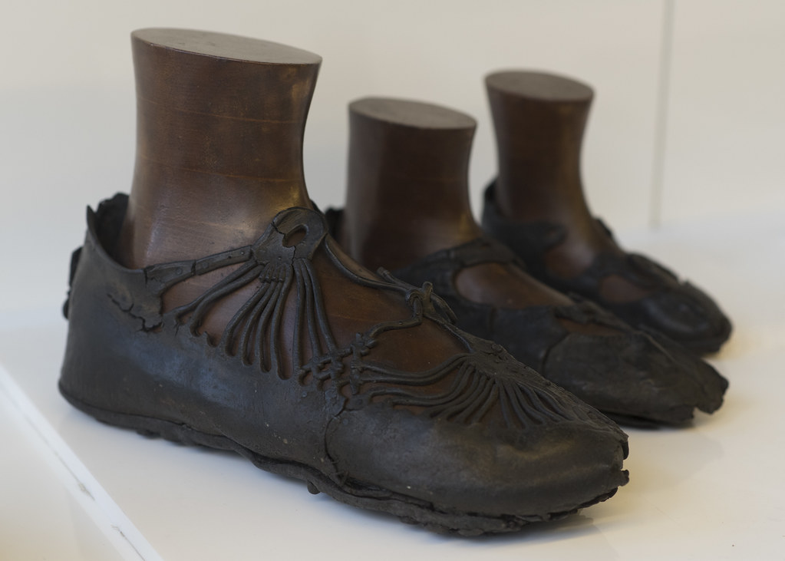
Changing perspective
Image source: https://www.flickr.com/photos/

Slide 5
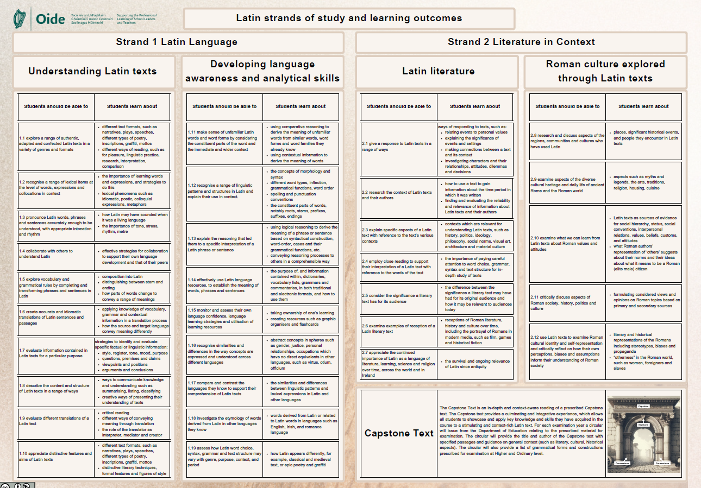
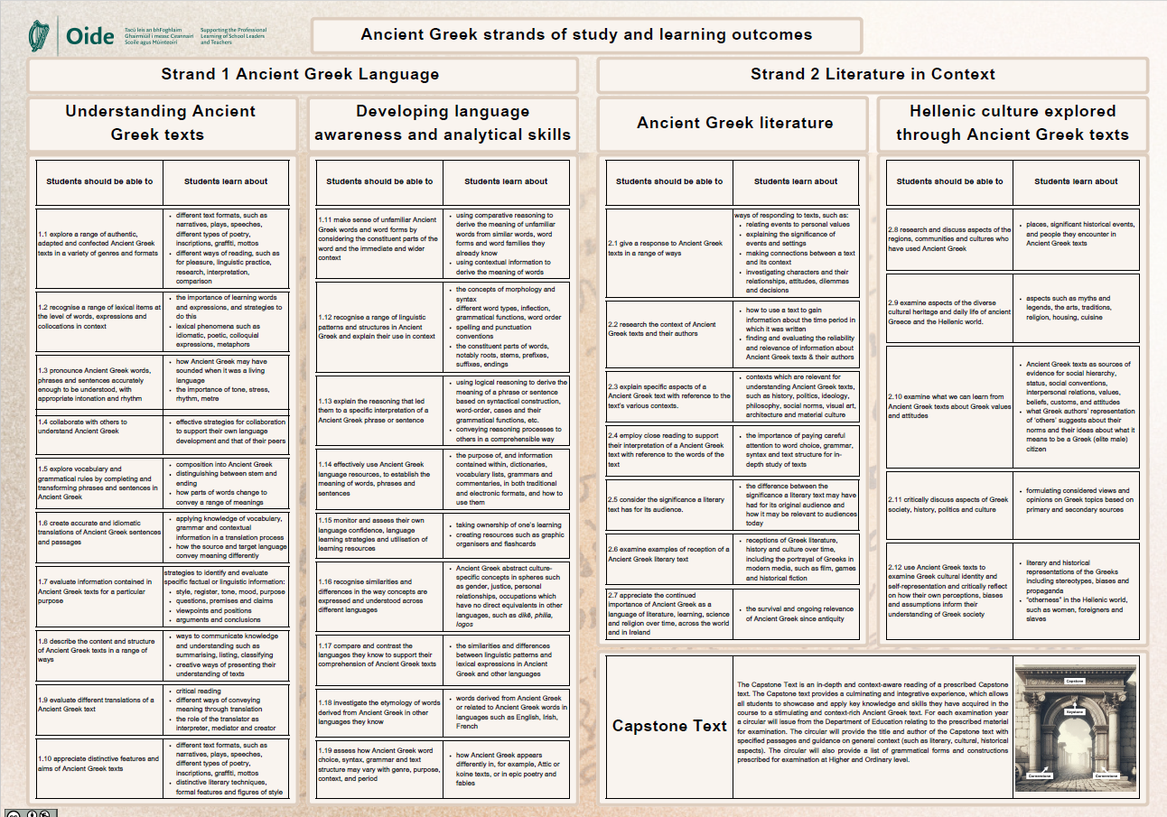
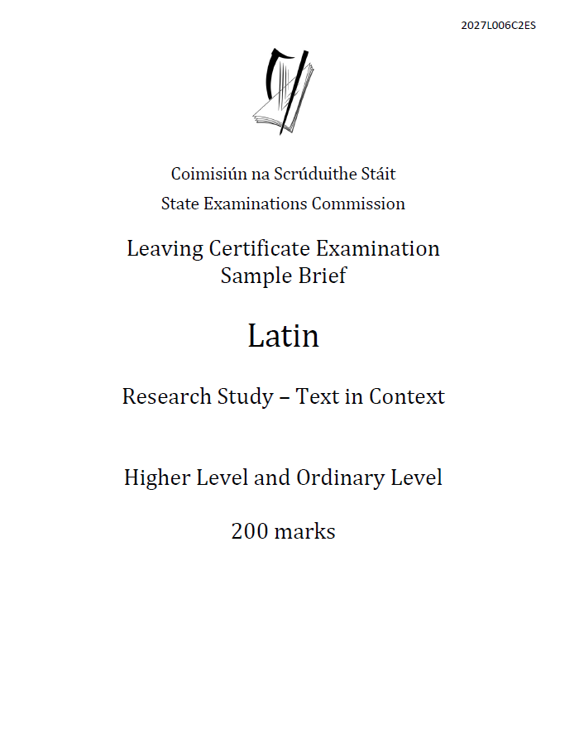
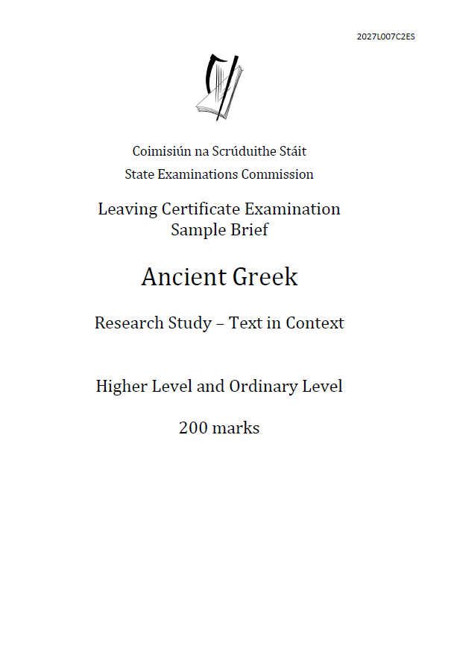
Sample Research Study - Linking to the Specification
First Steps
Topic:
Learning Outcomes:
Sources:
Broad focus/Line of enquiry:

Slide 6



THE PROCESS OF WORKING
ON THE RESEARCH STUDY

Slide 7






Slide 8


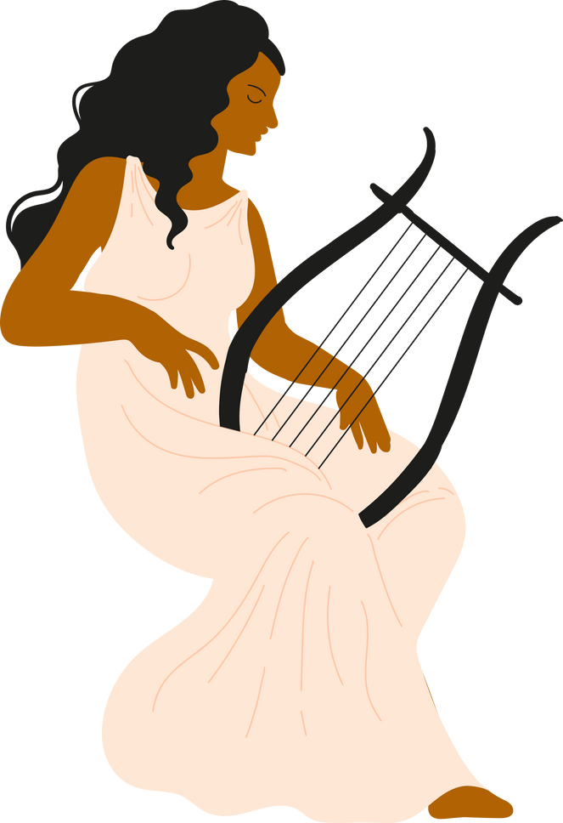



THE PROCESS OF WORKING
ON THE RESEARCH STUDY
Source choice and evaluation
Dead End
Planning
Back on track
Evaluate what is revealed by the research process and
make judgements.
Reflect
Adopt an approach to conduct research, develop key research questions that will achieve the overall intended aim.
Focus
Report
Reflect upon the research process undertaken and on learning, knowledge, skills and
insights acquired.
Focus in on a topic that is of a genuine interest followed by a deeper enquiry into the topic – rationalise the worth of such research and wider significance, importance or personal interest
I’m lost!
Develop arguments/points into a cohesive and persuasive case – this will involve critical thinking, drafting, reviewing and editing to formulate conclusions.

Slide 9
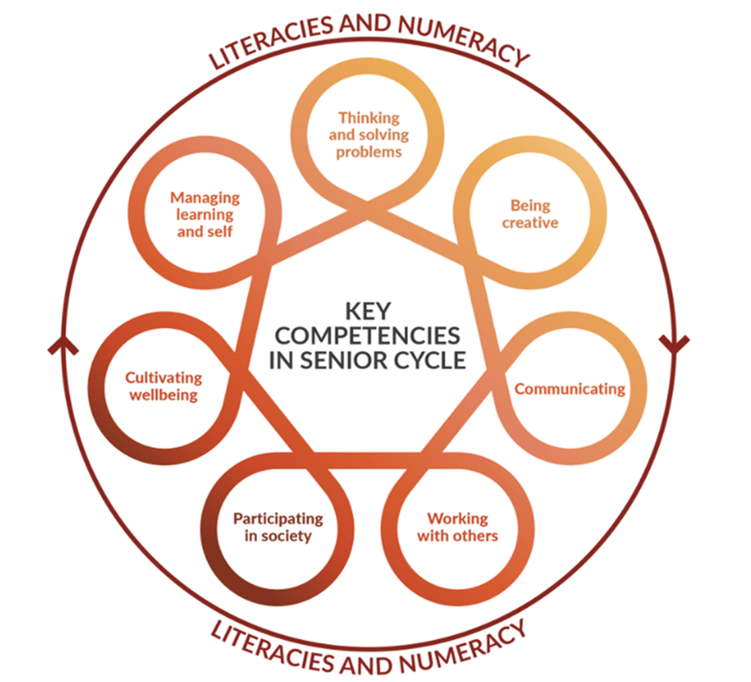
The process of working on the research study
Focus
Focus in on a topic that is of a genuine interest followed by a deeper enquiry into the topic – rationalise the worth of such research and wider significance, importance or personal interest.
Planning
Adopt an approach to conduct research, develop key research questions that will achieve the overall intended aim.
Source choice and evaluation
Evaluate what is revealed by the research process and make judgements.
Report
Develop arguments/points into a cohesive and persuasive case – this will involve critical thinking, drafting, reviewing and editing to formulate conclusions.
Reflect
Reflect upon the research process undertaken and on learning, knowledge, skills and insights acquired.
NCCA, 2024, p.5-9 Guidance to support the Leaving Certificate Latin Research Study

Slide 10

PAUSE

Slide 11

What questions do you have?
What broad area will you now examine more closely?

Slide 12
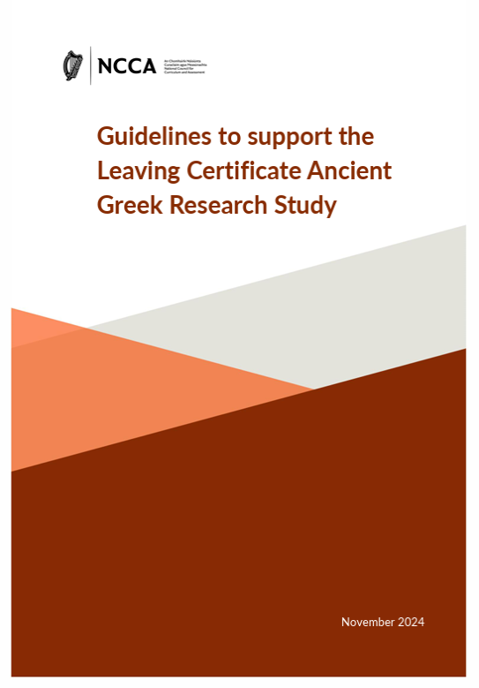
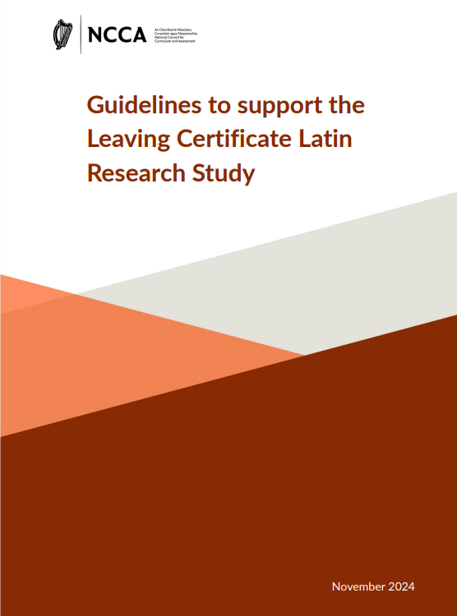
Key Document:
Guidance to Support the Research Study
What questions do you want answered?
Read page 6 closely with purpose

Slide 13
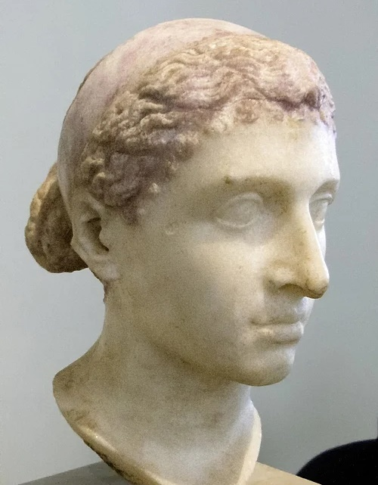
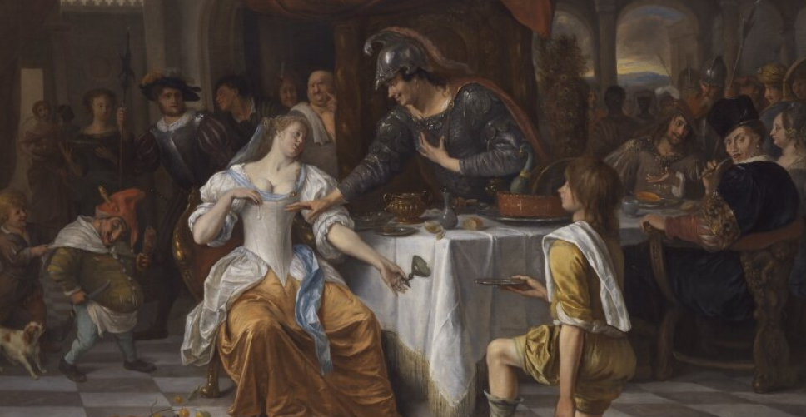
What is your research focus? Share
[2] αὐτὴ δὲ κατέκειτο μὲν ὑπὸ σκιάδι χρυσοπάστῳ κεκοσμημένη γραφικῶς ὥσπερ Ἀφροδίτη, παῖδες δὲ τοῖς γραφικοῖς Ἔρωσιν εἰκασμένοι παρ᾽ ἑκάτερον ἑστῶτες ἐρρίπιζον. ὁμοίως δὲ καὶ θεραπαινίδες αἱ καλλιστεύουσαι Νηρηΐδων ἔχουσαι καὶ Χαρίτων στολάς, αἱ μὲν πρὸς οἴαξιν, αἱ δὲ πρὸς κάλοις ἦσαν. ὀδμαὶ δὲ θαυμασταὶ τὰς ὄχθας ἀπὸ θυμιαμάτων πολλῶν κατεῖχον.
Plut. Ant. 26.2

Slide 14
Key Document:
Guidance to Support the Research Study
Read page 7
Planning and researching the topic

Slide 15
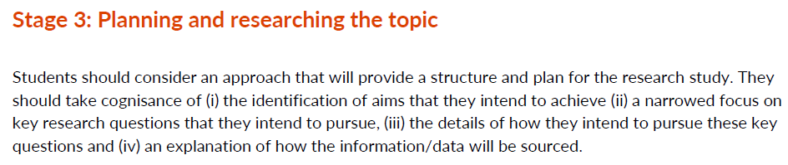

What strategies/methods have, or could you use to help students conduct effective research?
NCCA, 2024, p.7 Guidance to support the Leaving Certificate Latin Research Study

Slide 16
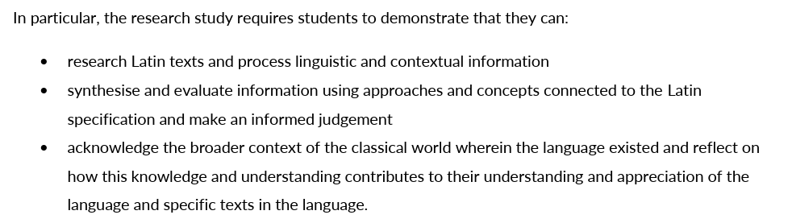
Key Document:
Guidance to Support the Research Study
NCCA, 2024, p.7 Guidance to support the Leaving Certificate Latin Research Study

Slide 17


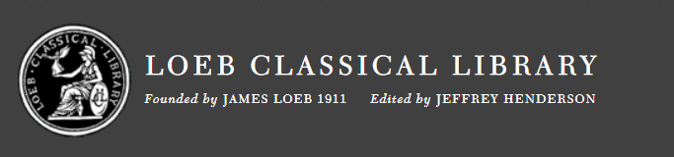
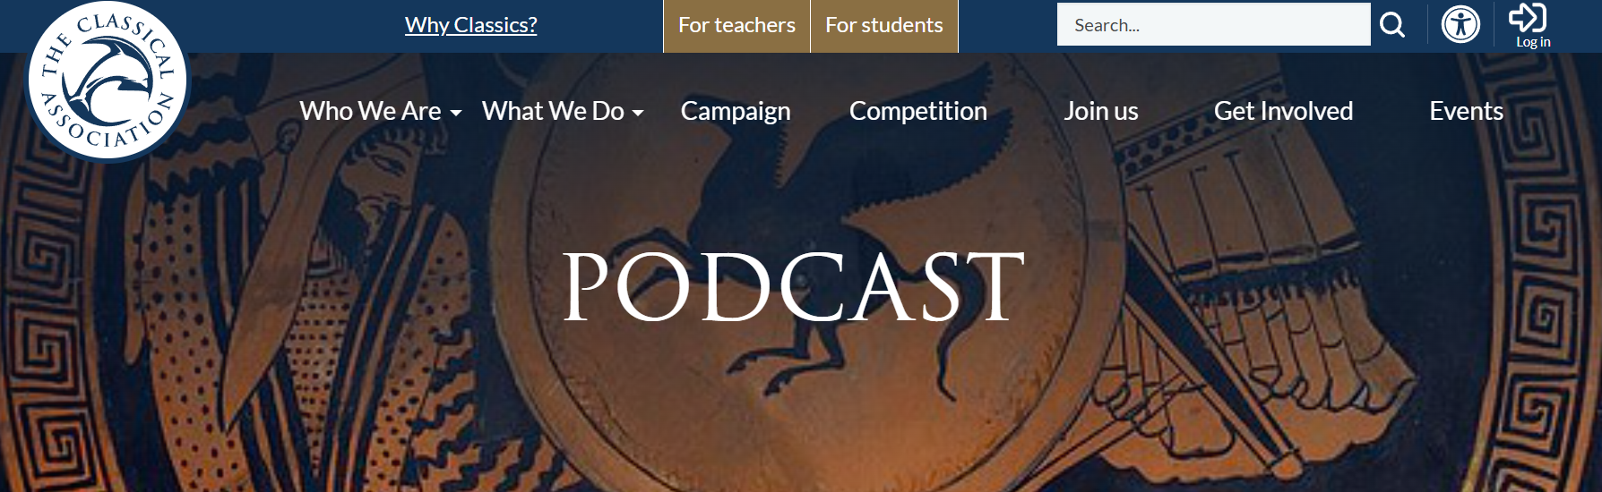
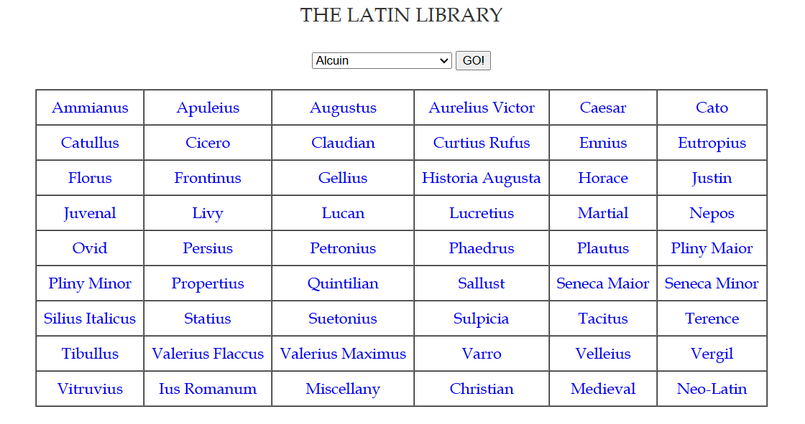


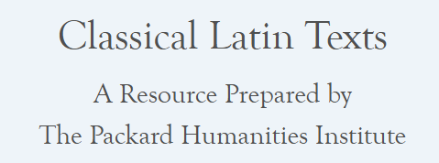
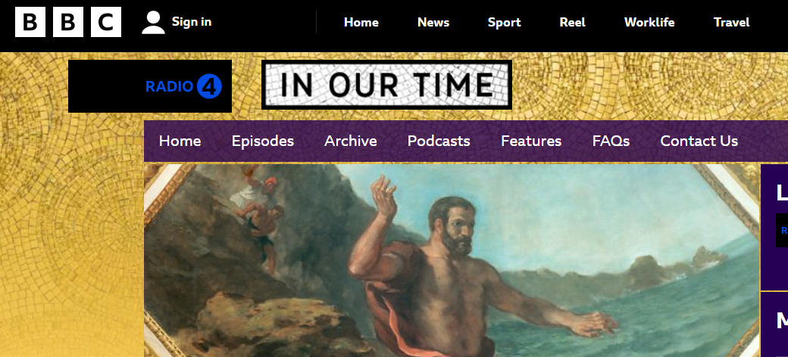

How to conduct research?
Selecting appropriate and reliable sources
“Appropriate sources for the research study could include books, dictionaries, commentaries, translations, journal articles, newspaper or magazine articles, images, websites, podcasts, blogs, interviews or television and radio documentaries.”
NCCA, 2024, p.7 Guidance to support the Leaving Certificate Latin Research Study

Slide 18
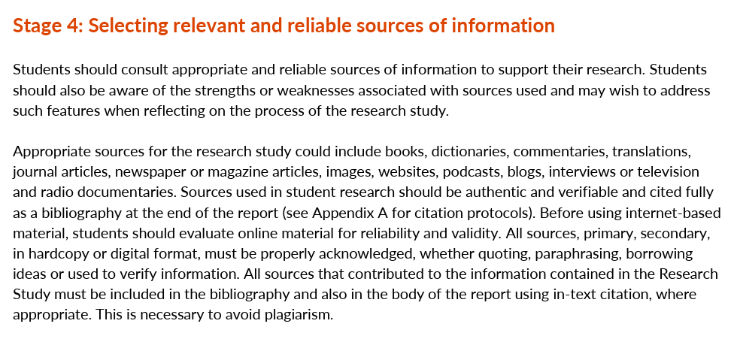
Read page 7
Selecting relevant and reliable sources of information
NCCA, 2024, p.7 Guidance to support the Leaving Certificate Latin Research Study

Slide 19
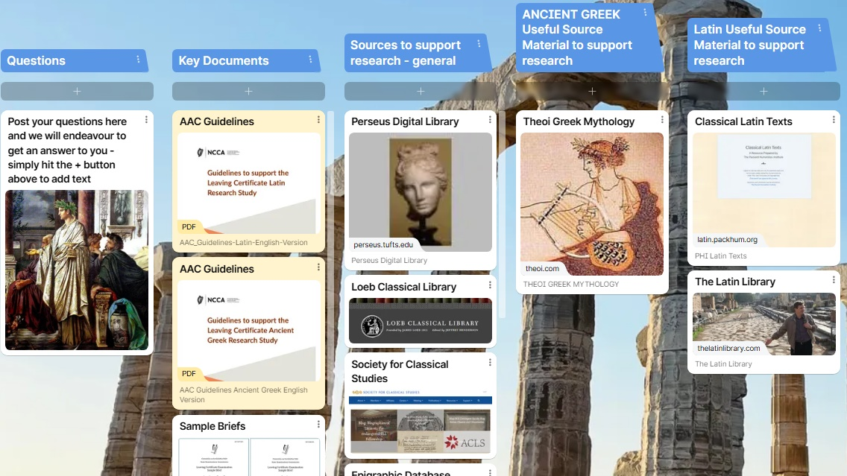
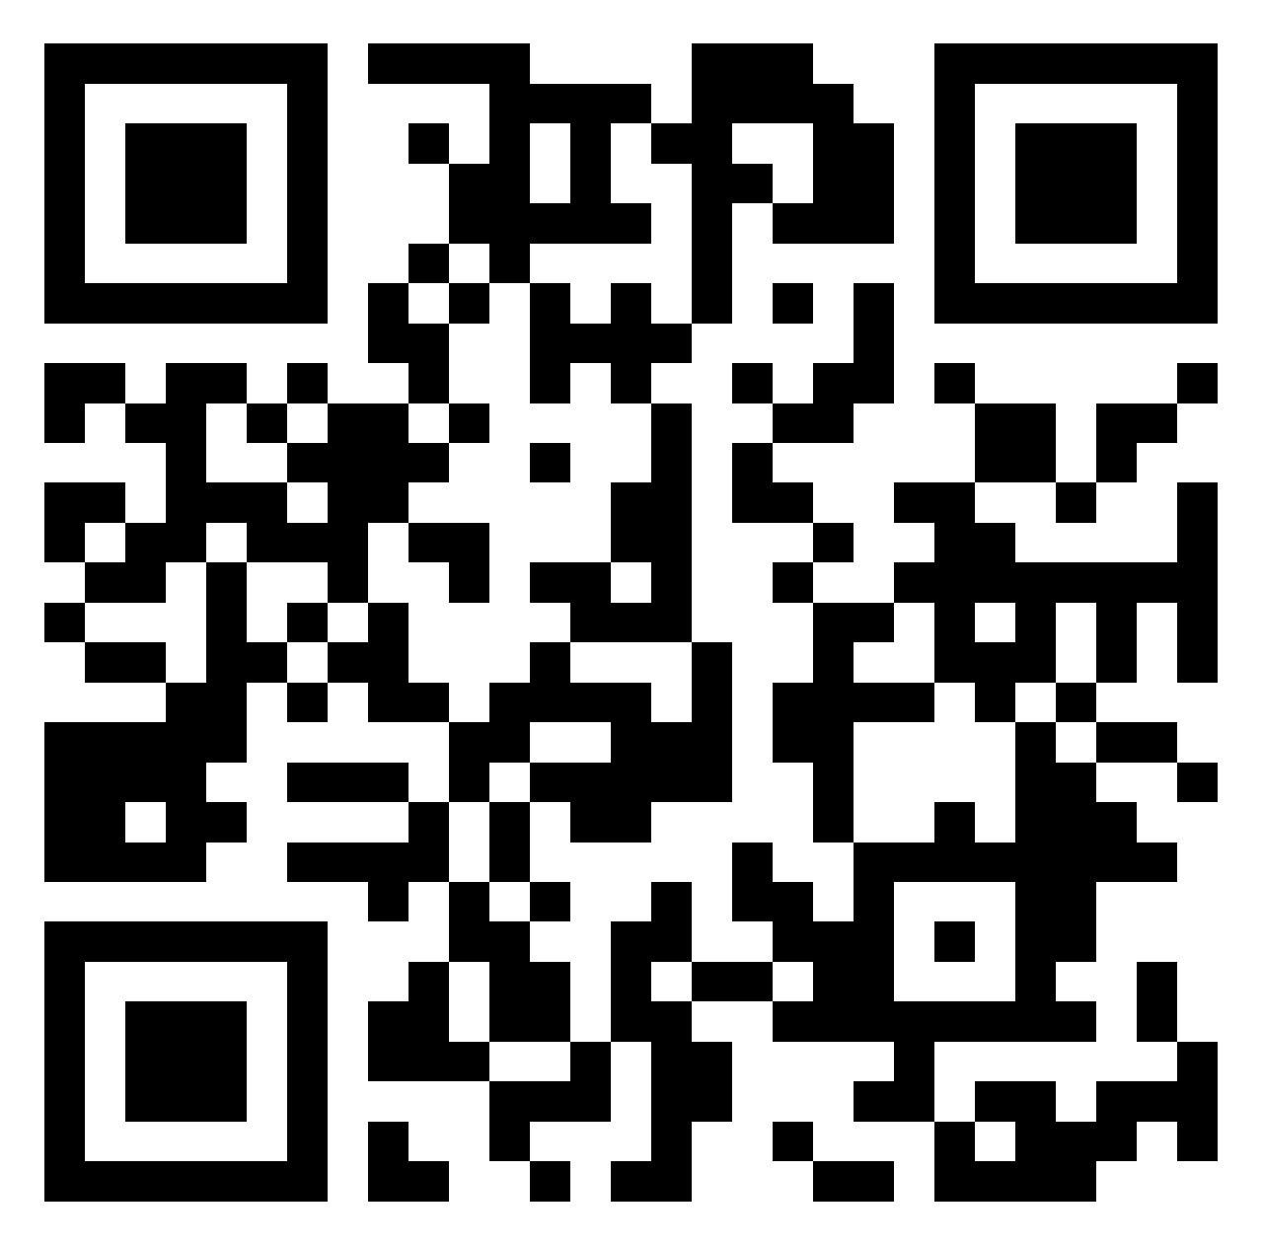

Slide 20

Approaches to the use of AI
“Plagiarism is a serious offence and occurs when work other than the student’s own is used without clear acknowledgement of the source of the work. This includes the use of material generated using artificial intelligence (AI) software or AI applications. Direct copying of material from any source without proper acknowledgement is not permitted and may incur penalties, up to and including the withholding of related results.”
“Where students have used material generated by artificial intelligence (AI) software and AI applications this must be acknowledged. The reference should include the name of the AI tool used, the date the content was generated and provide a brief explanation of how it was used. Many Generative AI tools generate shareable URLs that set out the content of chat sessions that took place. Where such a tool has been used, the URL should be included in the list of research sources. Where an AI tool does not generate a sharable URL, student should include the name of the tool and the prompt used.”
“Quis custodiet ipsos custodes?
Who will watch the watchers?”
Juvenal, The Sixteen Satires
NCCA, 2024, p. 15-16 Guidance to support the Leaving Certificate Latin Research Study

Slide 21

How do/could you support your students to evaluate sources specific to an ancient language?

Slide 22

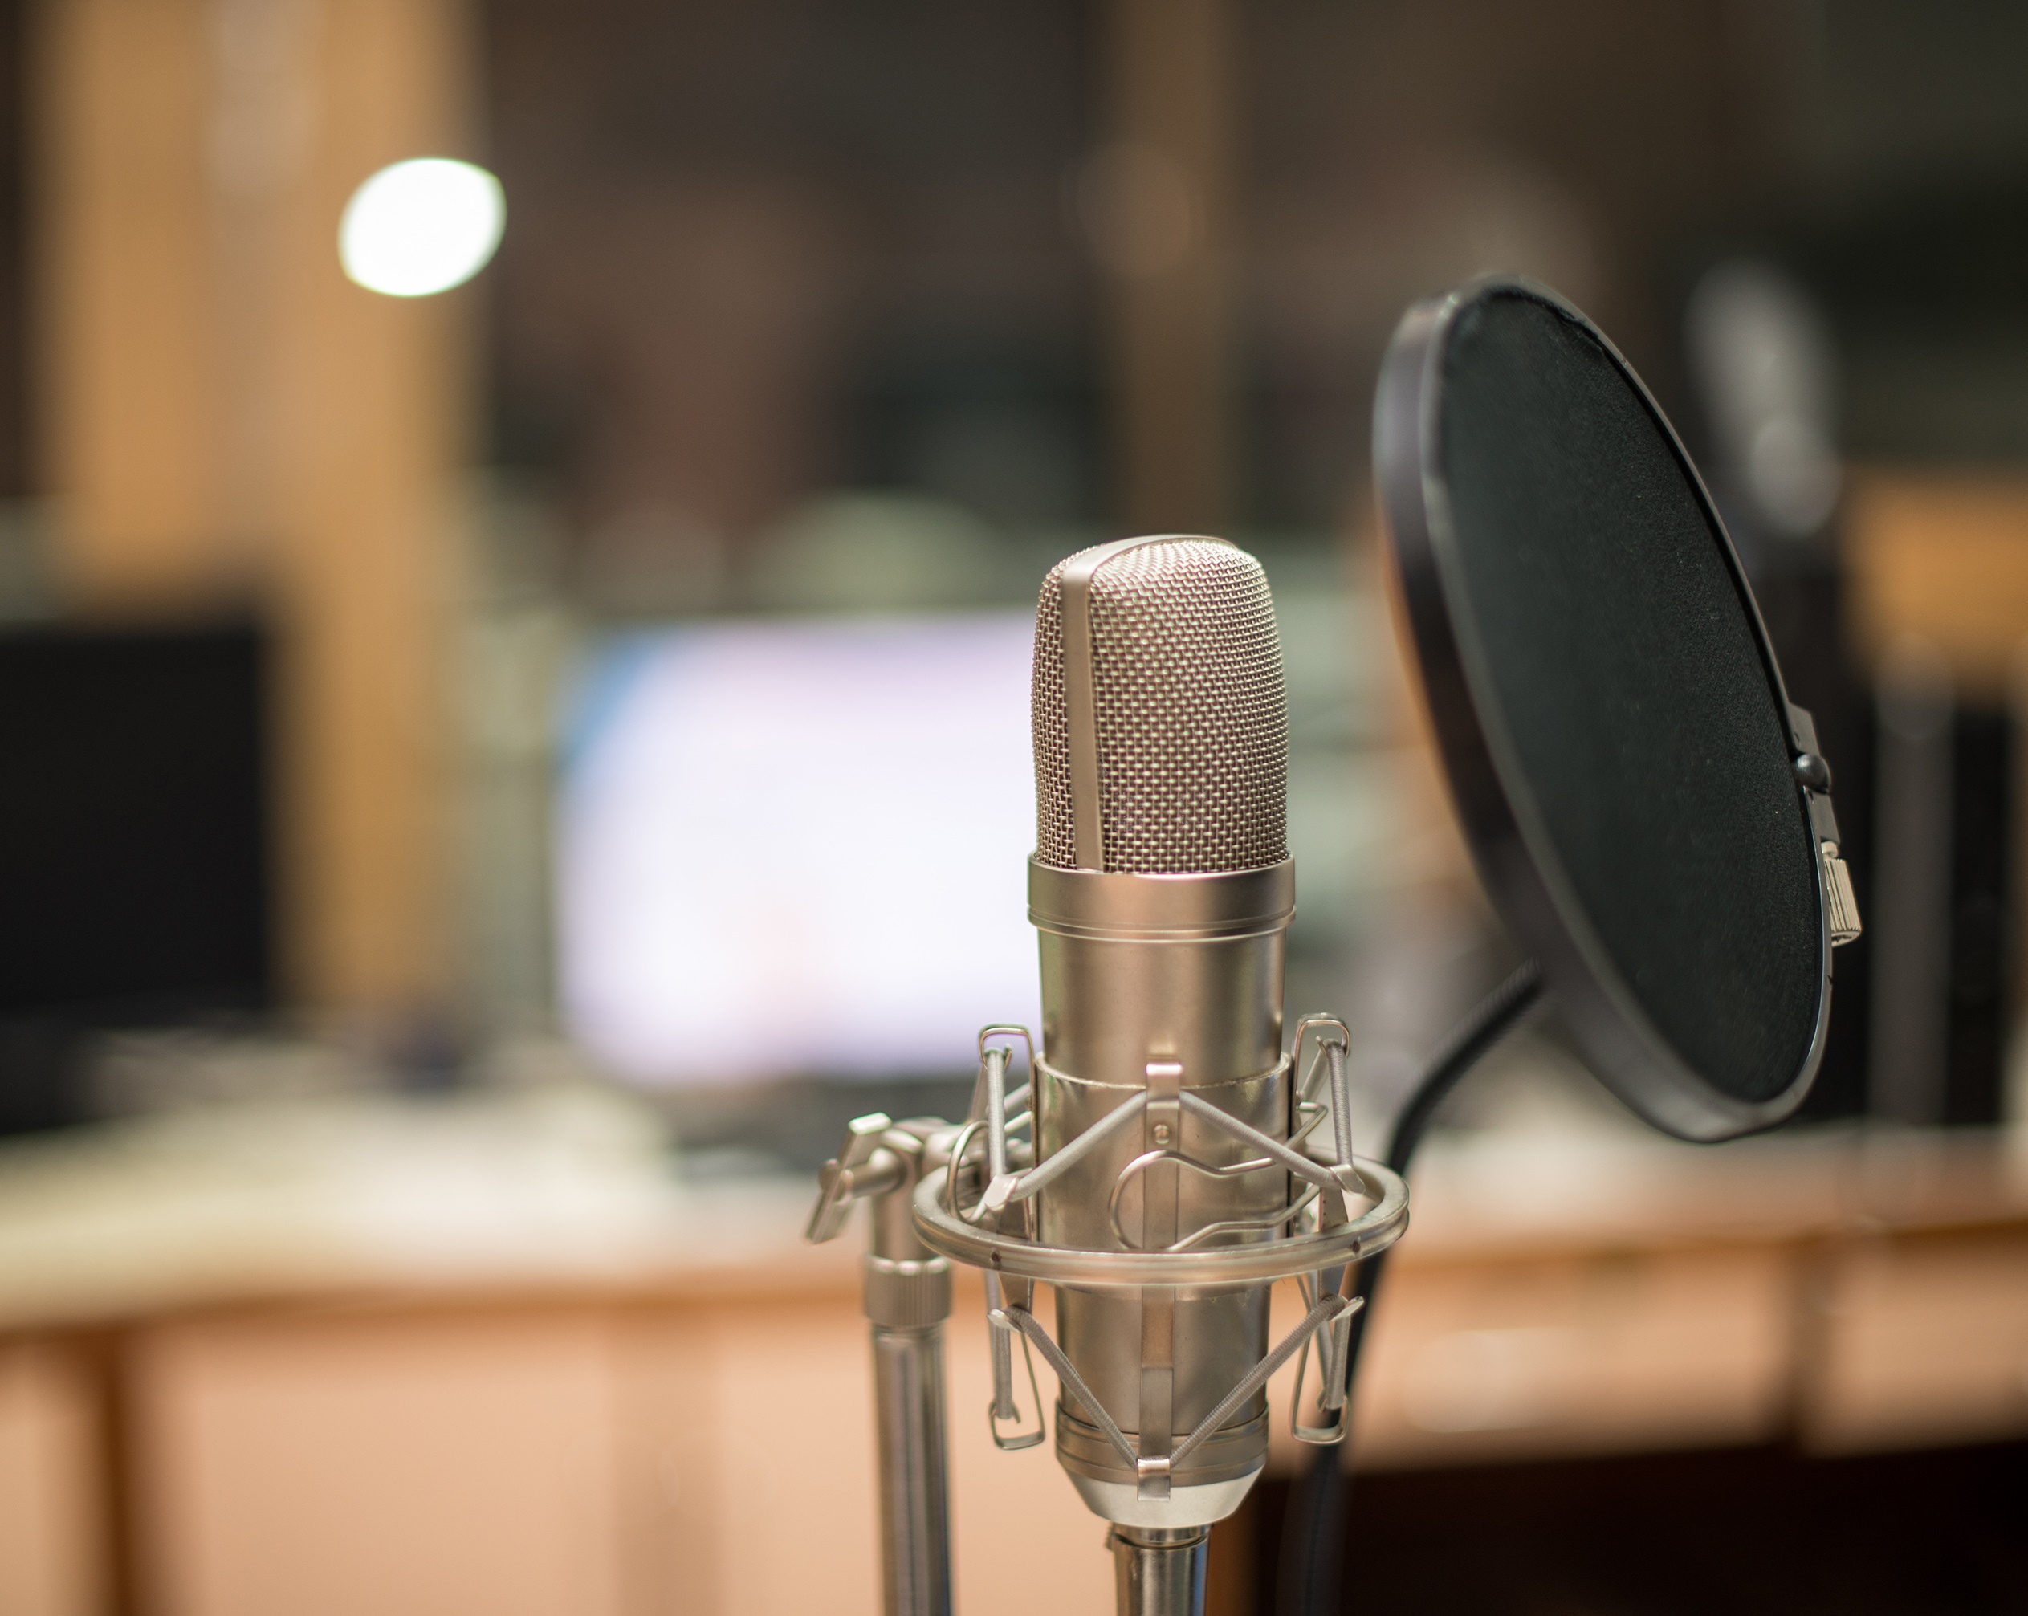
Other voices

Slide 23
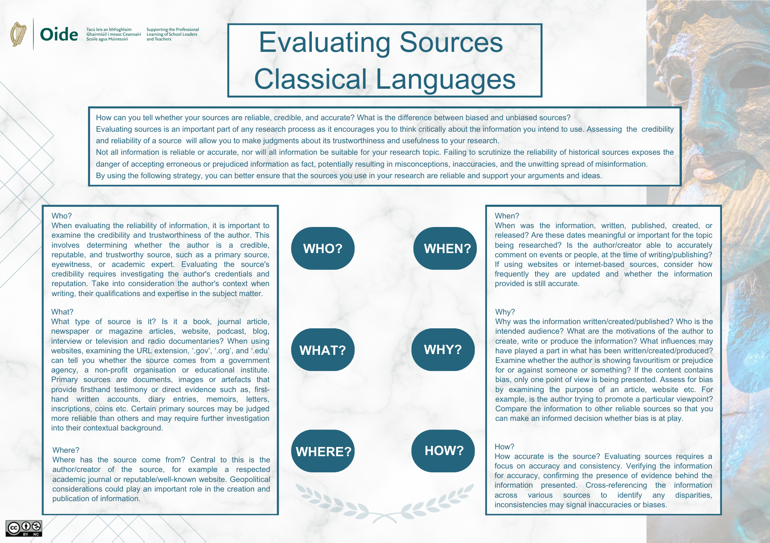

Slide 24
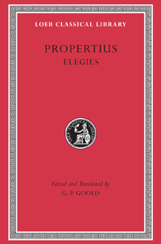
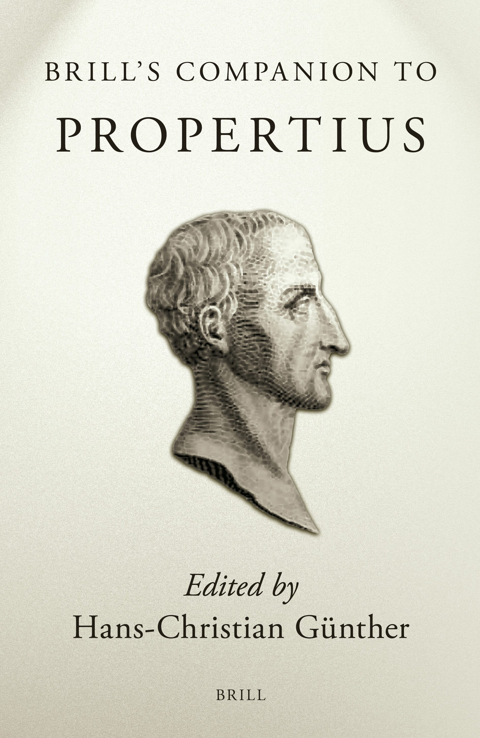
Evaluating sources
Who? Sextus Propertius a Roman elegiac poet born around 50– 45 BCE in Umbria, Italy. He was active in Rome during the reign of Augustus.
What? Author of Elegies (Elegiarum Libri Quattuor), a collection of Latin love poetry that explores themes of passion, jealousy, and poetic identity. His verses combine personal emotion with mythological allusion and reflect on the nature of love, art, and Roman society.
When? Composed between approximately 30 and 15 BCE during the early Augustan period.
Where? Rome
Why? Propertius aimed to express the complexities of love and individuality within the constraints of Roman society.
How? His poetry survives through manuscript tradition and is studied through critical editions by reputable classical scholars.

Slide 25


Slide 26
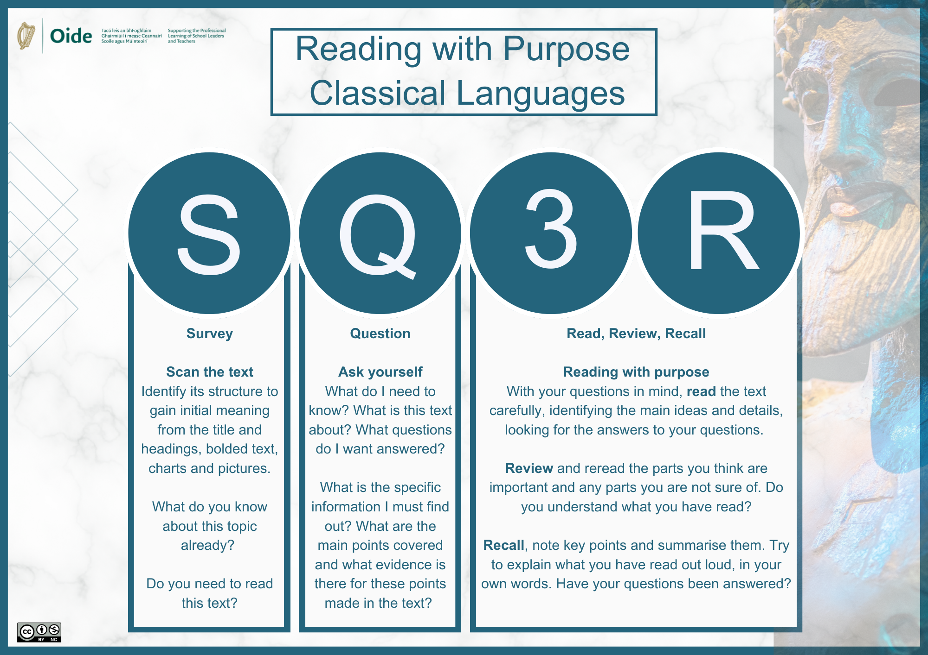

Reading with Purpose
When undertaking research how might someone go about reading with purpose?

Slide 28


Reading with Purpose
Survey: Skim the text of Elegy 3.11 - love and desire, personal emotion vs. public life, mythological references reflections on poetry itself. Look for mentions/references of Roman political figures.
Questions: How does Propertius depict Cleopatra’s influence over Rome and its leaders? In what ways is Cleopatra compared to mythological women. How does the poem reflect Roman attitudes toward foreign women in positions of power?
Read: read the whole article through noting descriptive language, literary devices, context and symbolism.
Review: through lens of foreign queen challenging Roman authority.
Recall: Write the answers to my questions, and retell in my own words, back to myself.
Survey: Keywords identified and noted.
Questions: Propertius presents Cleopatra as a symbol of the threat posed by powerful, foreign women, blending fascination with fear, and reinforcing Roman anxieties about female authority outside traditional domestic and cultural norms. She is depicted as exotic and alluring, with qualities that are both seductive and dangerous.
Read: Cleopatra’s power, cunning, attempts to dominate Rome, mythological allusions, contrasts, and hyperbole that emphasise her threat.
Review: Reviewed highlighted sections - mythological allusion, imagery, and Roman moral ideology.
Recall: answered my questions and told it back to myself.

Slide 29


Slide 30
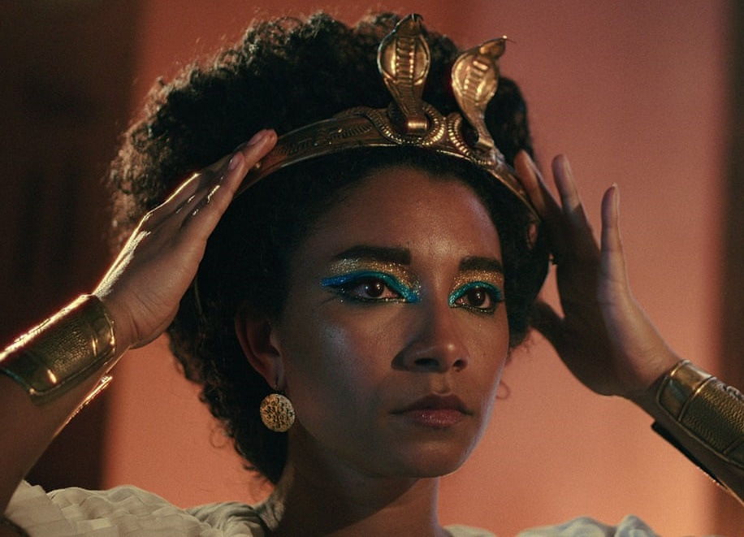
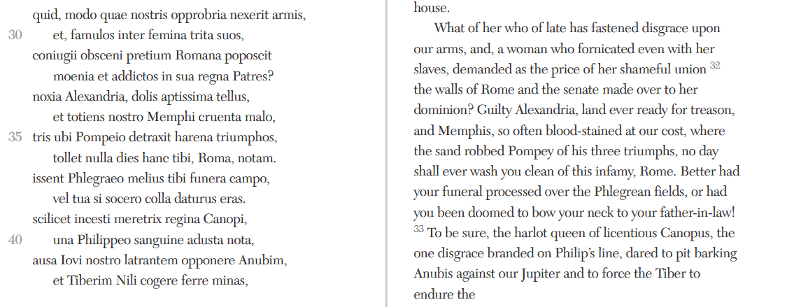
Supporting the research process
Broad Topic:
Cleopatra and her affairs with Roman men.
  Why am choosing this?
Sources:
Need to find some primary sources for text-based analysis.
Adele James as Cleopatra - Netflix
Propertius 3.11 (Loeb)

Slide 31
Latin source example: close-reading
Close reading
What are the key words here?
What is the imagery?
What themes can be identified?
What does the language/ style/ historical references in this text tell me about Rome’s opinion of Cleopatra?
What do I learn about Cleopatra from this poem?
What is this poem about?
How many ways can it be read?
What will other translations tell me about the Latin language and its interpretation? (source evaluation – Bloomsbury)
Propertius 3.11 (Loeb)

Slide 32
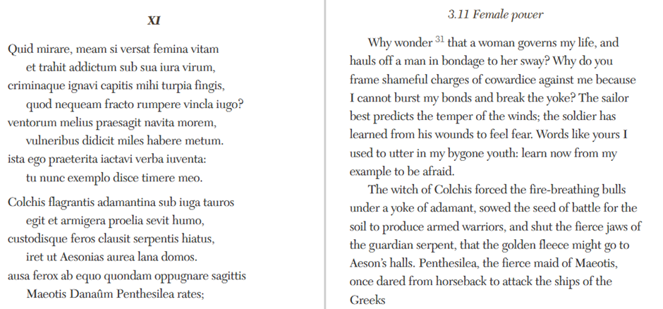
Further research

Slide 33
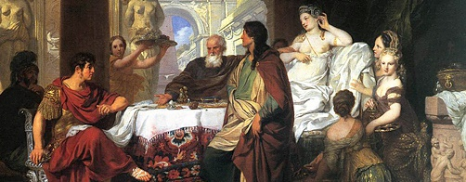
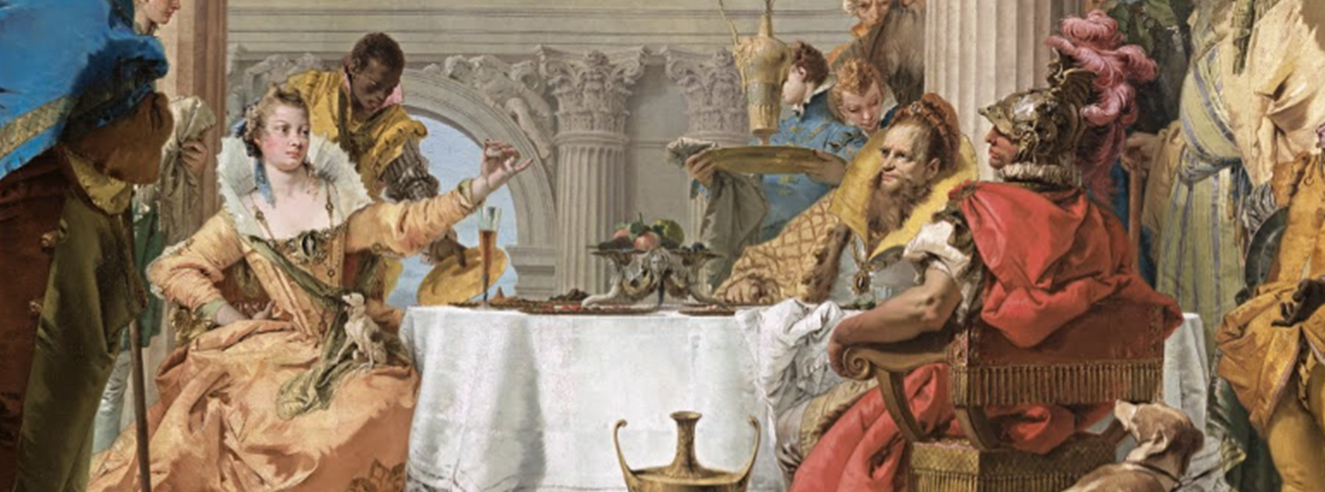
Cleopatra’s Magistery of Pearl
εὐθὺς οὖν τινὰ βουλόμενος εὐκολίαν ἐπιδείκνυσθαι καὶ φιλοφροσύνην ὑπήκουσε καὶ ἦλθεν. ἐντυχὼν δὲ παρασκευῇ λόγου κρείττονι μάλιστα τῶν φώτων τὸ πλῆθος ἐξεπλάγη. τοσαῦτα γὰρ λέγεται καθίεσθαι καὶ ἀναφαίνεσθαι πανταχόθεν ἅμα, καὶ τοιαύταις πρὸς ἄλληλα κλίσεσι καὶ θέσεσι διακεκοσμημένα καὶ συντεταγμένα πλαισίων καὶ περιφερῶν τρόπῳ, ὥστε τῶν ἐν ὀλίγοις ἀξιοθεάτων καὶ καλῶν ἐκείνην γενέσθαι τὴν ὄψιν.
τῇ δ᾽ ὑστεραίᾳ πάλιν ἀνθεστιῶν αὐτὴν ἐφιλοτιμήθη μὲν ὑπερβαλέσθαι τὴν λαμπρότητα καὶ τὴν ἐμμέλειαν, ἀμφοῖν δὲ λειπόμενος, καὶ κρατούμενος ἐν αὐτοῖς ἐκείνοις, πρῶτος ἔσκωπτεν εἰς αὐχμὸν καὶ ἀγροικίαν τὰ παρ᾽ αὑτῷ. πολὺν δὲ ἡ Κλεοπάτρα καὶ τοῖς σκώμμασι τοῦ Ἀντωνίου τὸν στρατιώτην ἐνορῶσα καὶ βάναυσον, ἐχρῆτο καὶ τούτῳ πρὸς αὐτὸν ἀνειμένως ἤδη καὶ κατατεθαρρηκότως.
Plut. Ant. 26.4
Plut. Ant. 27.1

Slide 34
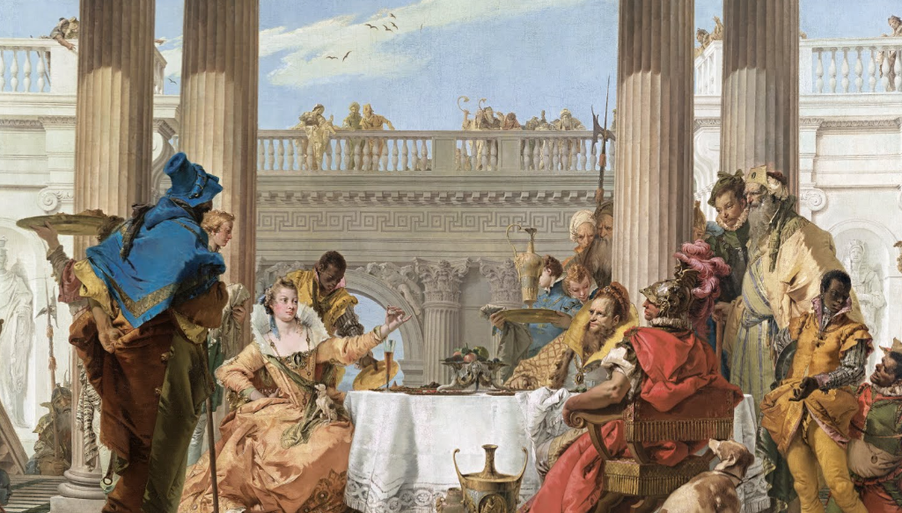
The episode represented in this painting is drawn from the Roman historian Pliny’s Historia naturalis (Natural History). Here Pliny recounted the tale of a famous contest between the Egyptian and Roman rulers, whereby Cleopatra wagered that she could stage a feast more lavish than the legendary excesses of Mark Antony.
Tiepolo’s 1743-44- Google Arts and Culture

Slide 35
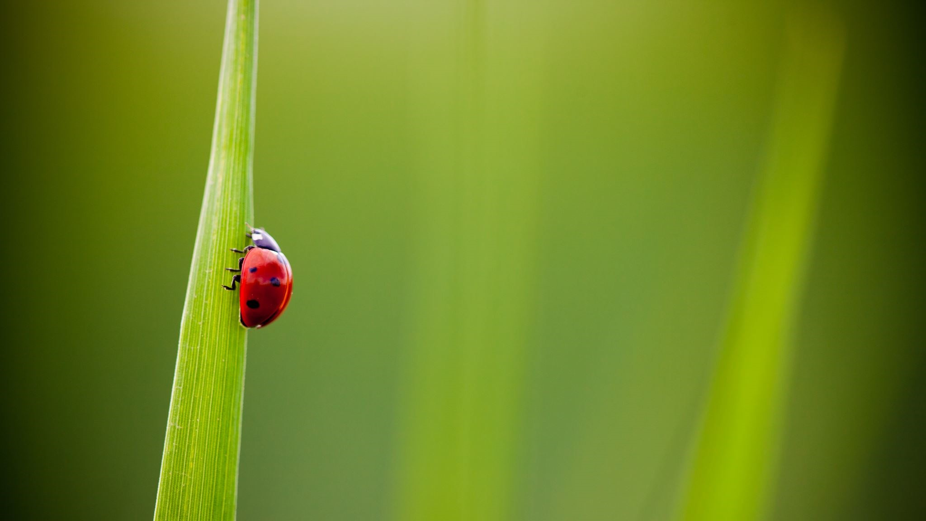
A narrowed focus

Slide 36
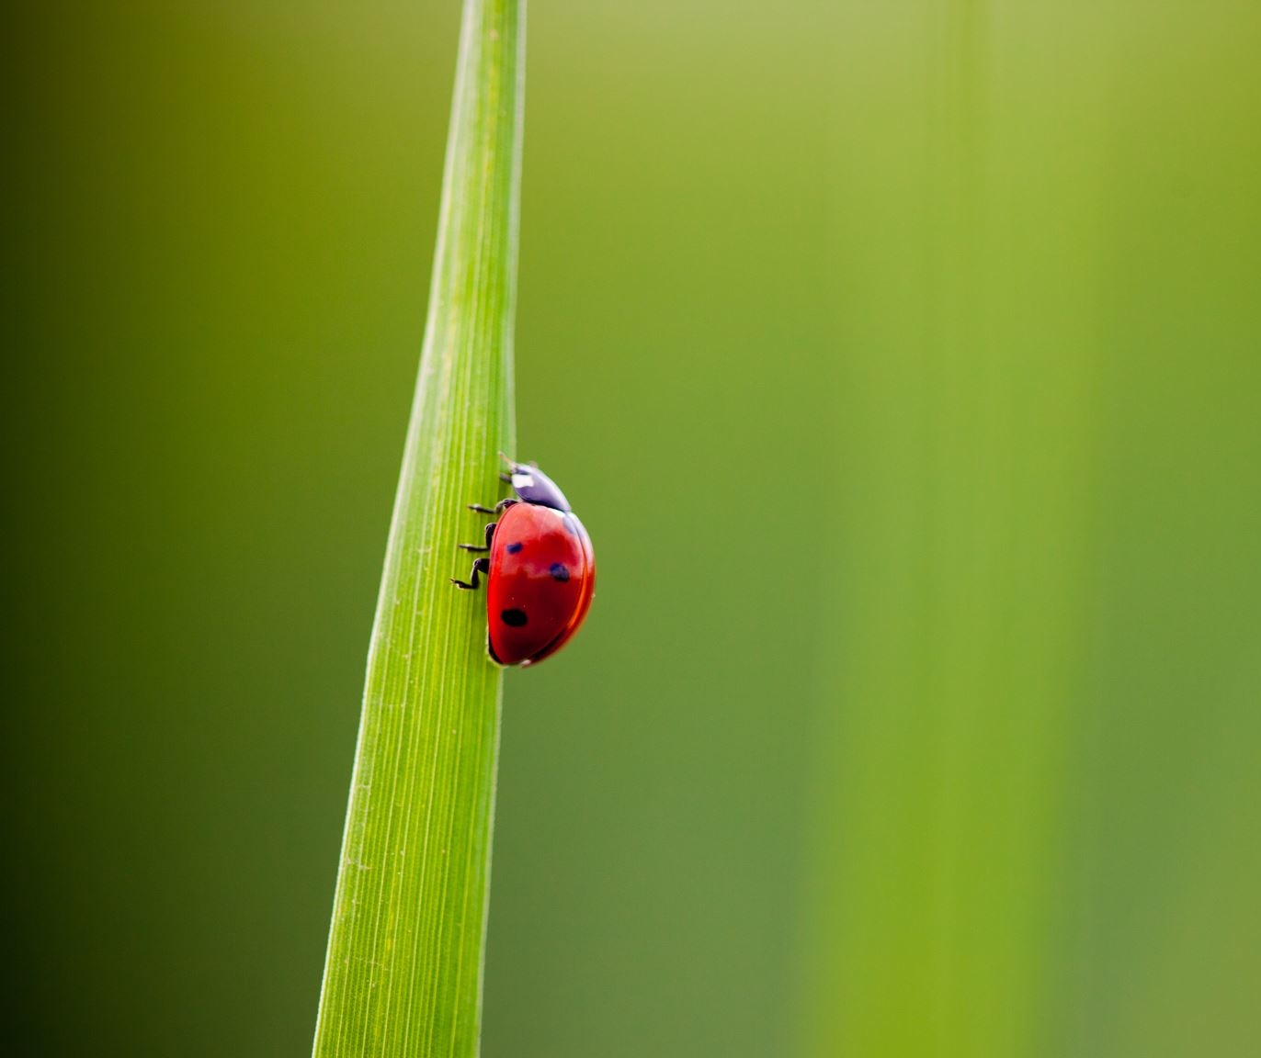
Narrowing the topic – student perspective
Some questions that could be considered at this stage:
Will I just focus on this one poem by Propertius and write about portrayal of women in this poem?
Will I focus on Cleopatra and use the Propertius poem along with Pliny as a secondary source?
Will I look for secondary sources to help develop or support my argument?

Slide 37
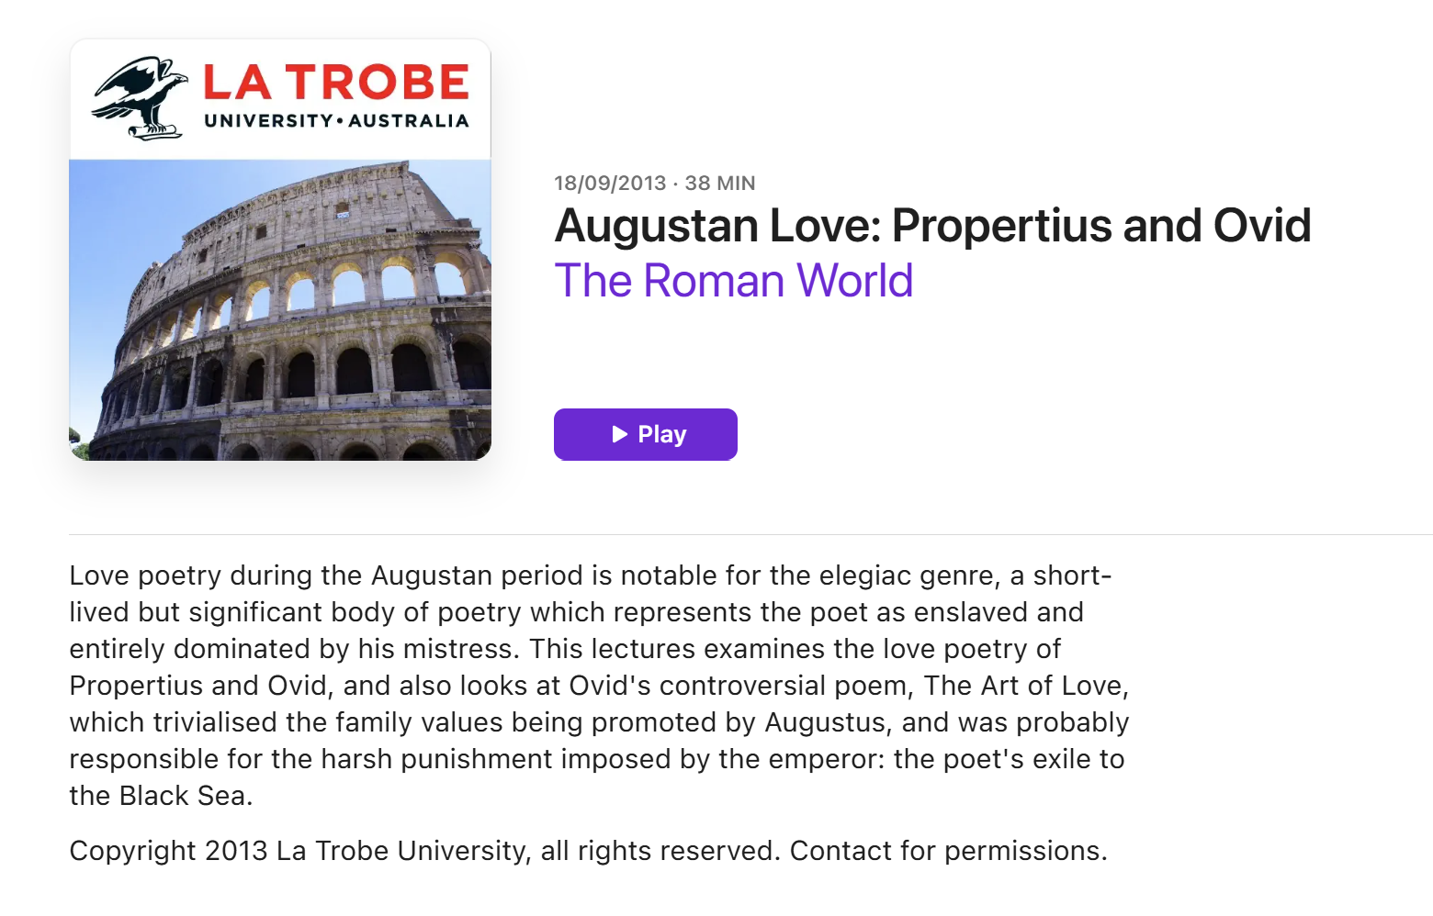

Slide 38
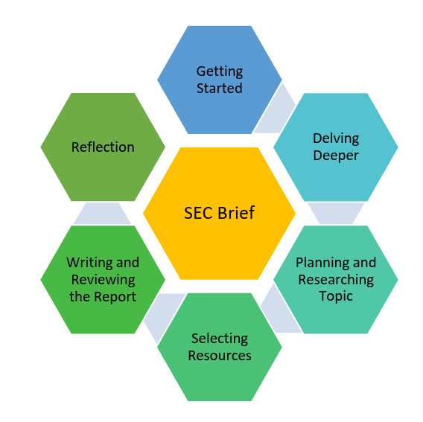
The research process
NCCA, 2024, p.7 Guidance to support the Leaving Certificate Latin Research Study

Slide 39
In this session we:
explored connections between the Additional Assessment Component and the specification.
identified and examine strategies to conduct effective research.
considered how to evaluate sources as part of the research process.

Slide 40
Lunch 1-2pm

