Slide 1
Session 3
Understanding the role of the teacher, exploring the descriptors of quality and how to support students to reflect upon the research process

Slide 2



In this session we will:
consider the role of the teacher and the importance of feedback as part of the research process.
explore the descriptors of quality to support students with the writing process.
consider how to support students to reflect upon the research process.

Slide 3
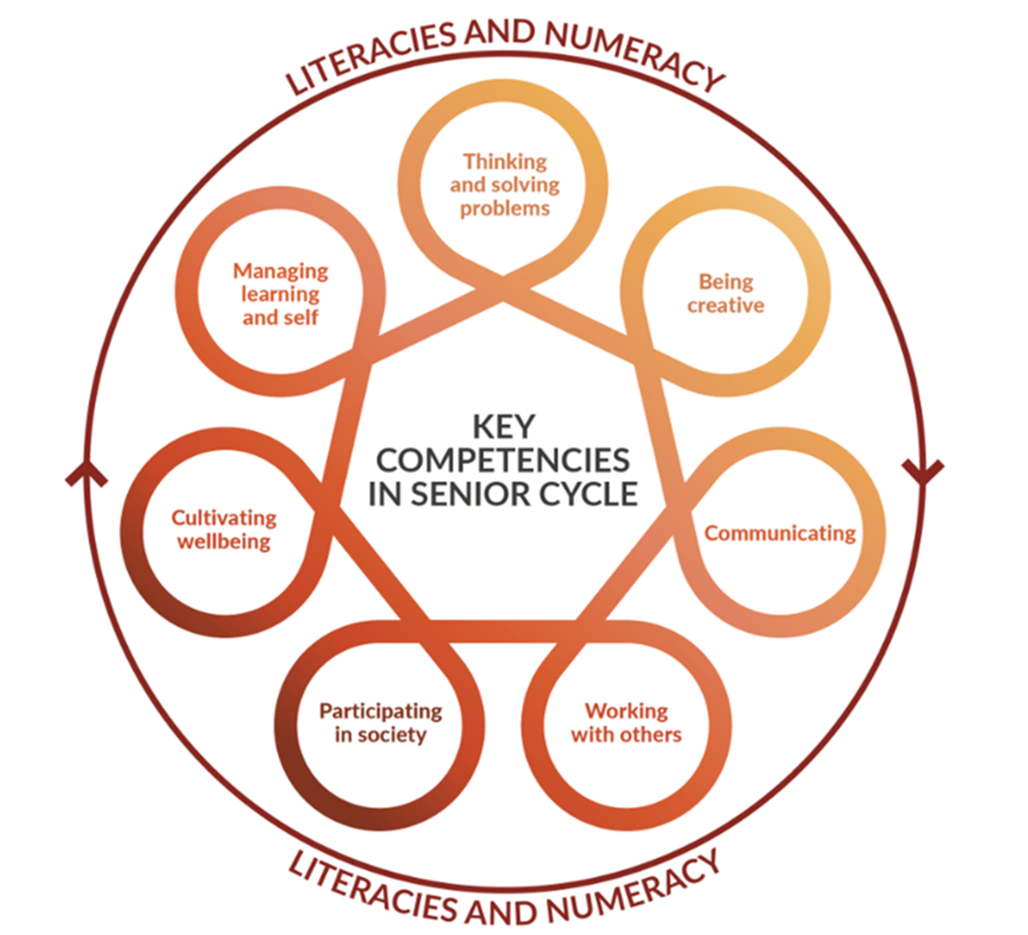
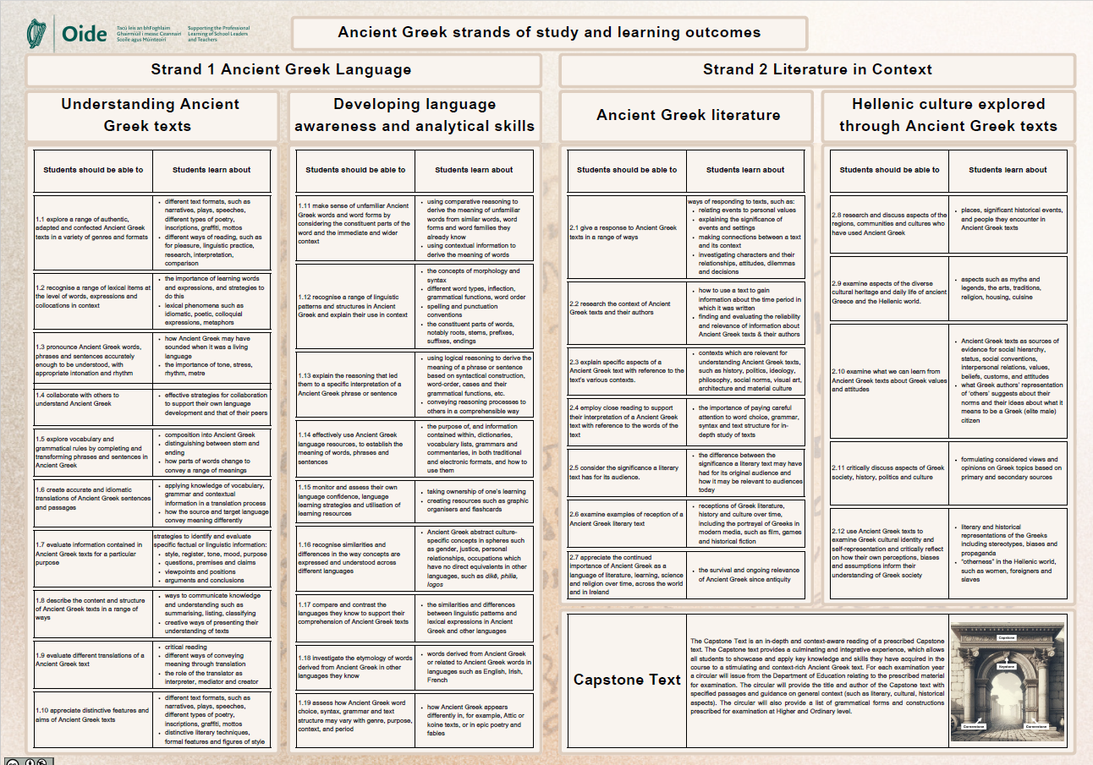
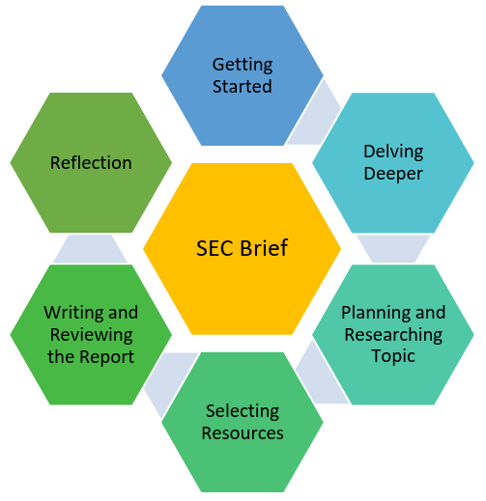
Key Competencies
Consider where the key competencies are made visible throughout the research process?

Slide 4
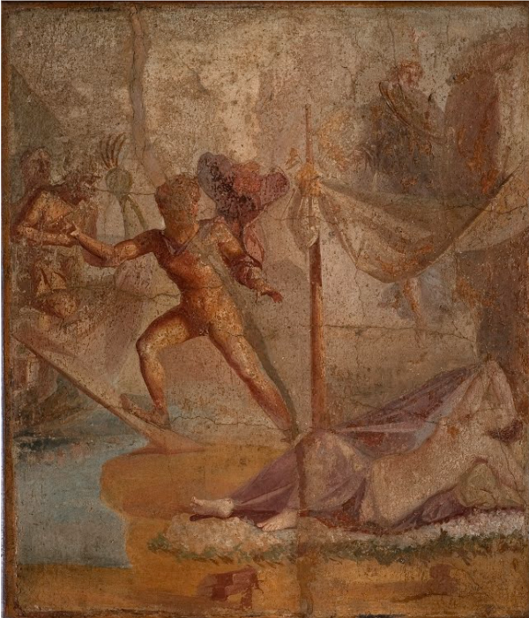
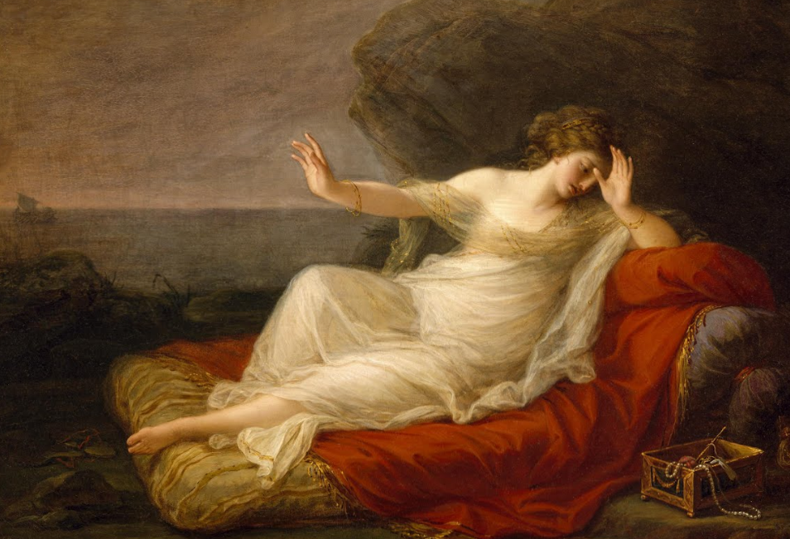
How will you support your students with the writing process?

Slide 5


Key Document: Guidance to Support the Research Study
Read page 12

Slide 6
Learner agency
“Through engaging in self-directed learning activities and reflection students will plan, monitor, and evaluate their own learning and develop a positive sense of their own capacity to learn.”
NCCA, 2016, p.13 Junior Cycle Classics Specification
“By setting appropriate, real-life and engaging tasks, by asking higher-order questions and by giving feedback that promotes student agency, assessment will support learning as well as capturing achievement.”
Department of Education, 2024, p.2 Curriculum Specification for Leaving Certificate Latin
“Students are able to negotiate and reflect on their learning, thereby increasing their autonomy and effectiveness as learners.”
Looking at Our School, 2022, p.29
A Quality Framework
for Post-Primary Schools

Slide 7
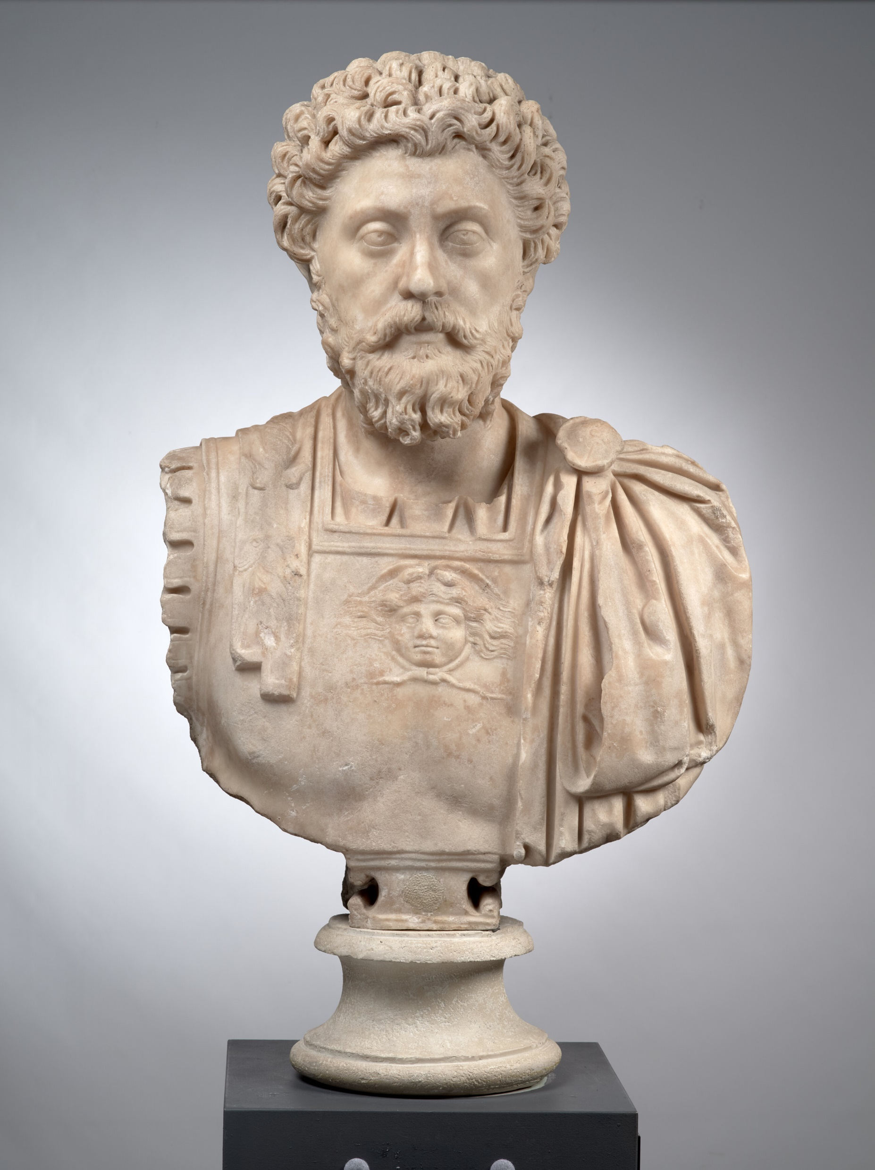
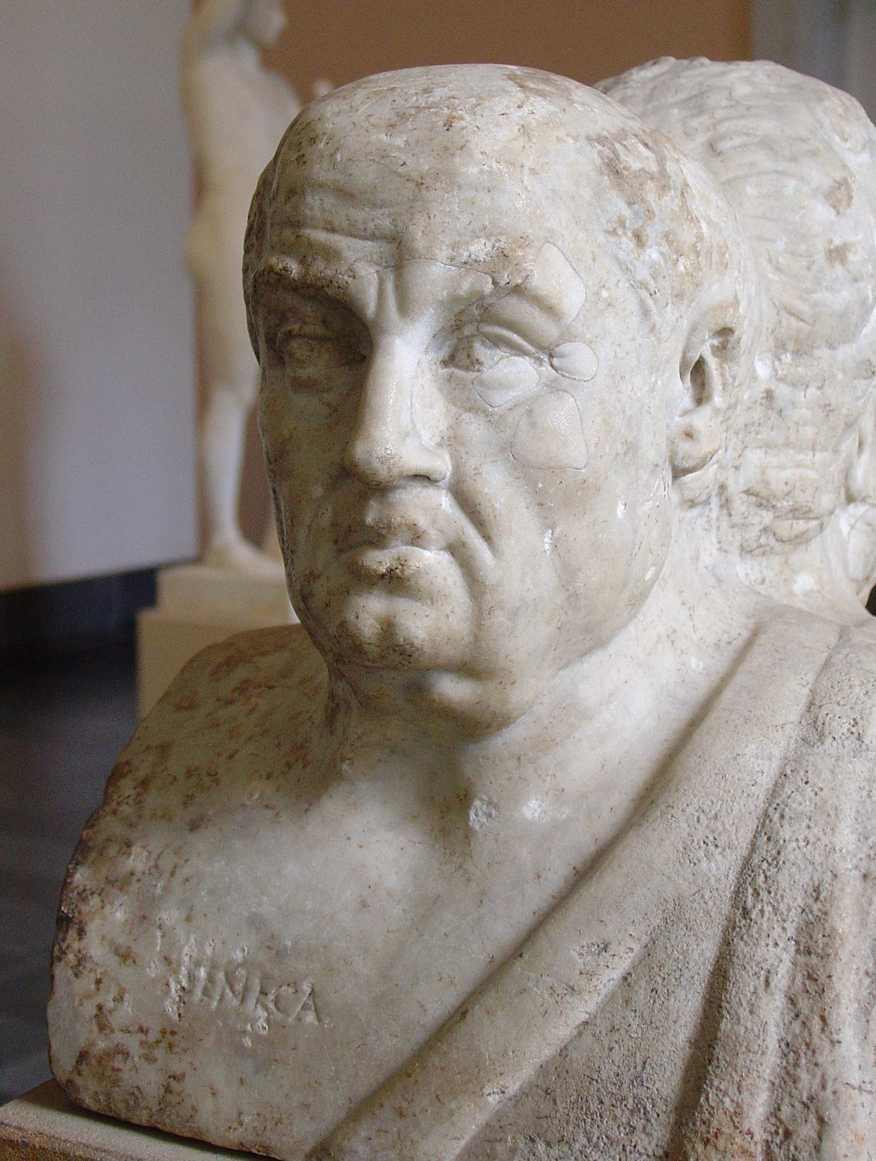
What feedback encourages students to reflect and improve their enquiry and thinking skills?
“A benefit consists not in what is done or given, but in the intention of the giver or doer.”
Seneca the Younger, De Beneficiis, Book I, section 6
“We were born to work together like feet, hands and eyes, like the two rows of teeth, upper and lower. To obstruct each other is unnatural. To feel anger at someone, to turn your back on him: these are unnatural".
Marcus Aurelius book 2 chapter 1 Mediations

Slide 8
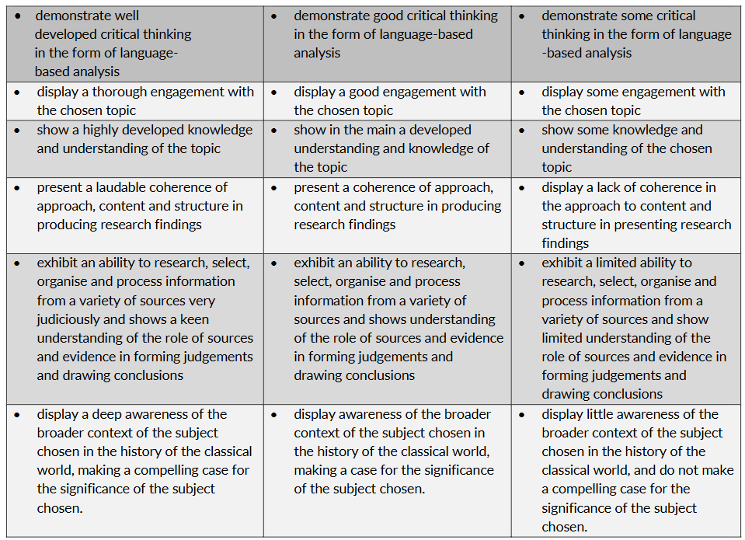
Meaningful feedback
Focuses on the quality of the work
Indicates suggestions for improvement
Prompts student thinking
Allows time for improvement to take place
Identifies success and achievement
Relates to what success could look like
Descriptors of Quality

Slide 9


Feedback loop
What strategies do you use to provide feedback to support students becoming self-reflective and active agents in their learning?
What happens with the feedback you give?
Where are the opportunities for students to be self-reflective?

Slide 10
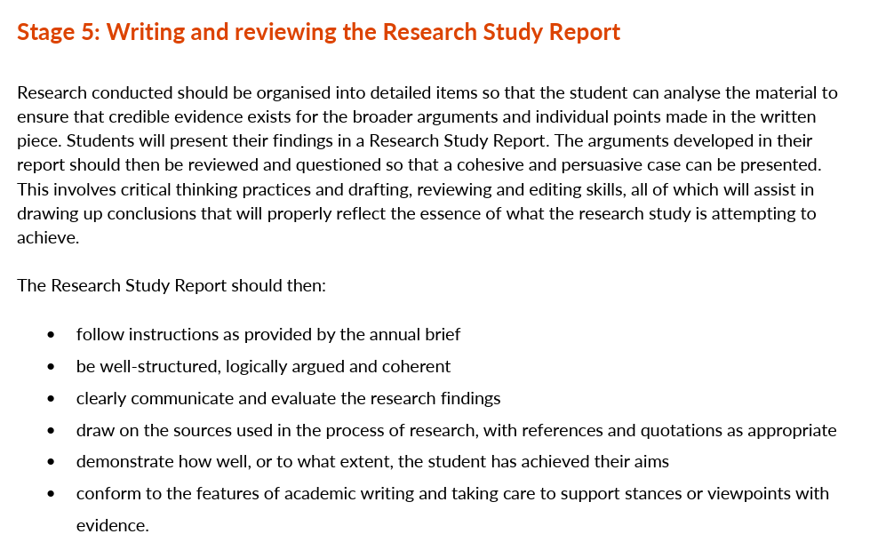
NCCA, 2024, p.8 Guidance to support the Leaving Certificate Latin Research Study

Slide 11
Key Document Guidance to Support the Research Study
Read page 9-10

Slide 12
Descriptors of Quality
NCCA, 2024, p.10 Guidance to support the Leaving Certificate Latin Research Study

Slide 13
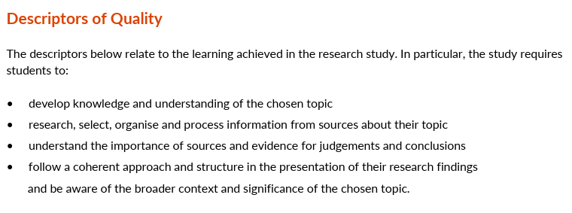
NCCA, 2024, p.9 Guidance to support the Leaving Certificate Latin Research Study

Slide 14
Descriptors of Quality
NCCA, 2024, p.10 Guidance to support the Leaving Certificate Latin Research Study

Slide 15
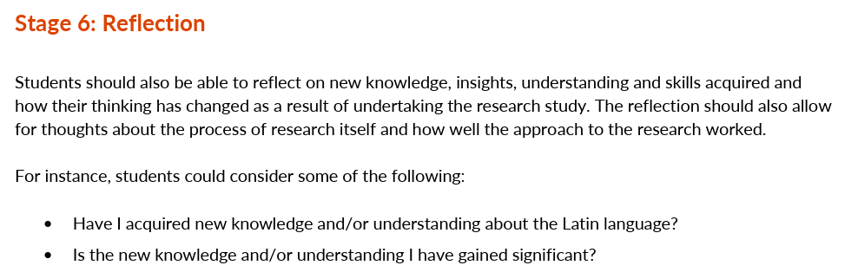
Reflection questions
Develop 3 effective questions that you could ask your students to elicit responses that would enable students to match the quotation above.
NCCA, 2024, p.8-9 Guidance to support the Leaving Certificate Latin Research Study

Slide 16
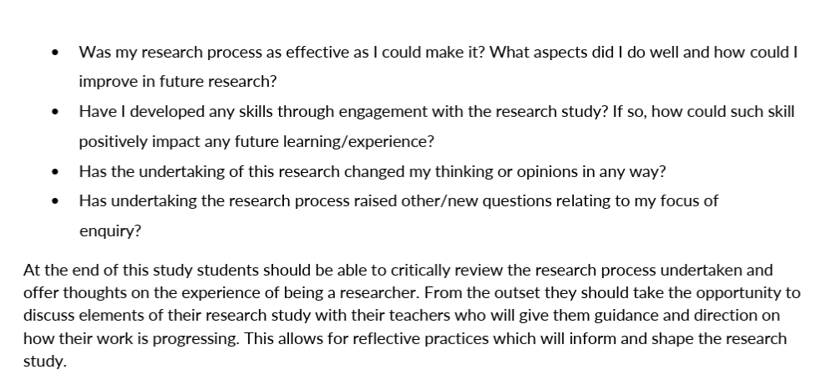
NCCA, 2024, p.8-9 Guidance to support the Leaving Certificate Latin Research Study

Slide 17
Next steps
What are your next steps on how to support your students?

Slide 18
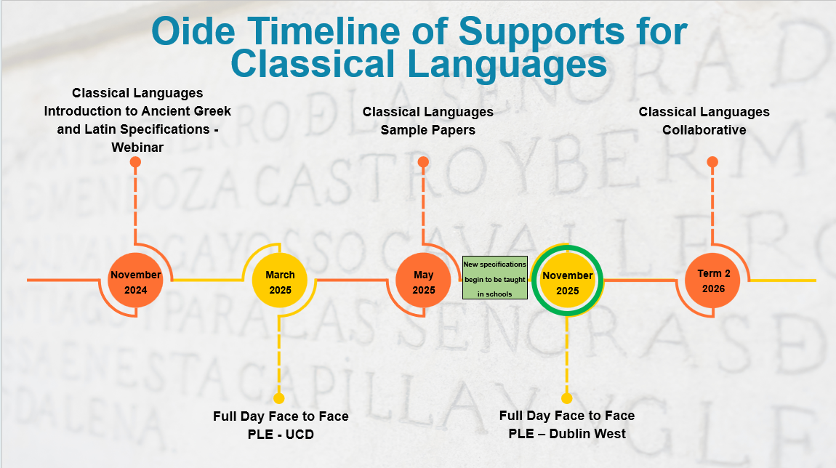
Format and submission of the Research Study Report

Slide 19
In this session we:
considered the role of the teacher and the importance of feedback as part of the research process.
explored the descriptors of quality to support students with the writing process.
considered how to support students to reflect upon the research process.

Slide 20

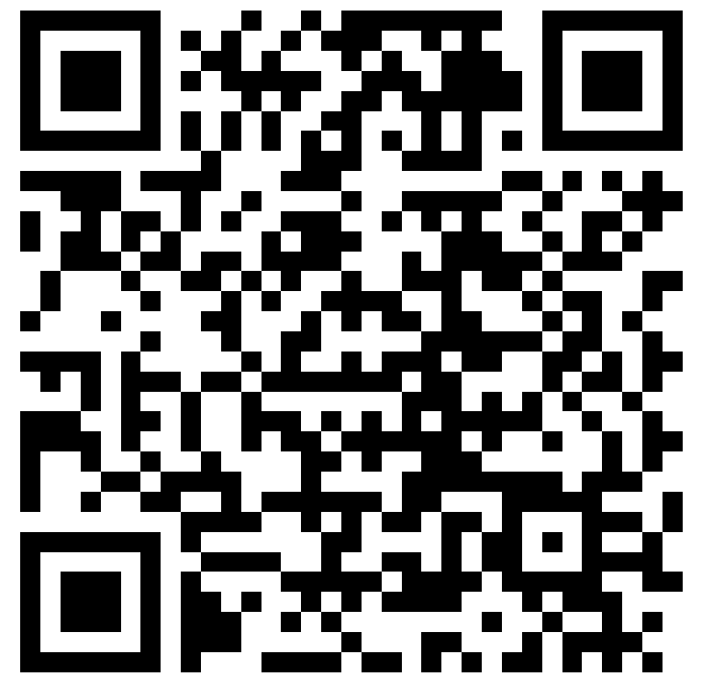
Feedback
What professional support would be most valuable at this stage?
https://forms.office.com/e/9xzT9Zg1Uv

Slide 21
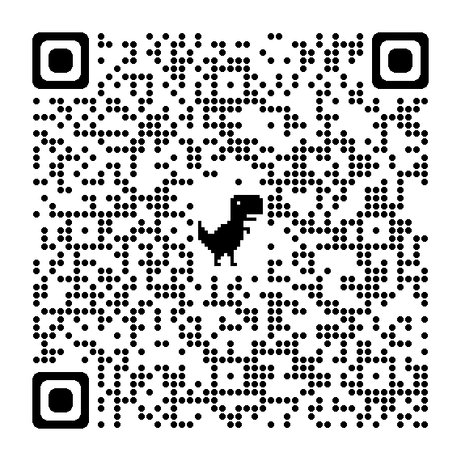


Additional supports
Visit our website www.oide.ie
Contact: info@oide.ie
Join our new mailing list to receive news and updates
Follow us on X
@Oide_Classics

