Slide 1
Leading a Whole School Approach to Supporting AACs
Margaret Cooney
Norma Lenihan
Matthew Coldrick

Slide 2


Professional Learning Booklet
Leadership

Slide 3
In this session we will...
Leadership
consider the role of the school leader in relation to the AAC.

Slide 4
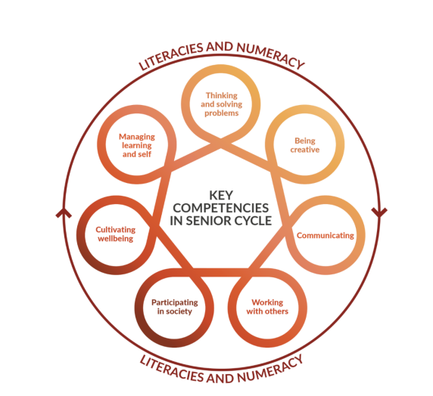
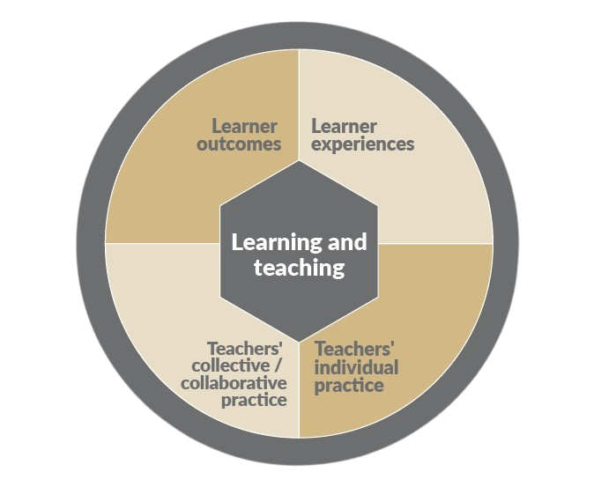
Purpose and Aims of the AACs
The AACs aim to reduce the pressure on students that comes from final assessments based primarily on written examinations conducted at the end of sixth year. These AACs are designed to assess students’ skills and key competencies , developed through the study of their chosen subject, in a way that a terminal written examination can not.
AACs aim to assess skills and competencies of candidates that might not be readily assessed in the terminal written examination.
(SEC Coursework Rules & Procedures 2025-2026 p. 7)
Information for Schools on Delivering Revised and New Specifications
(LAOS, 2022, p.13)

Slide 5
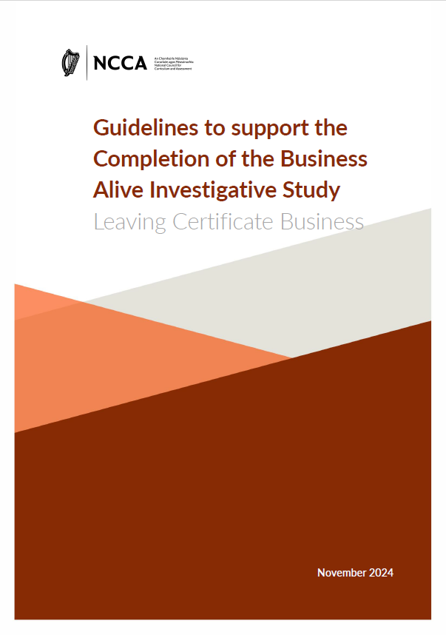
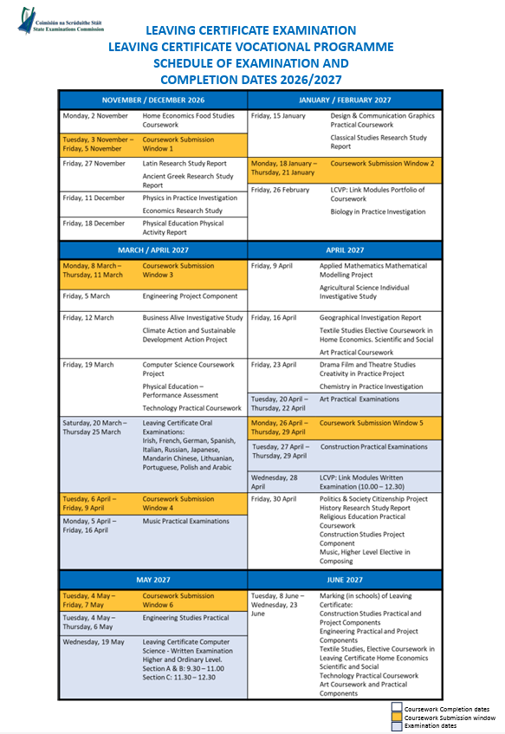


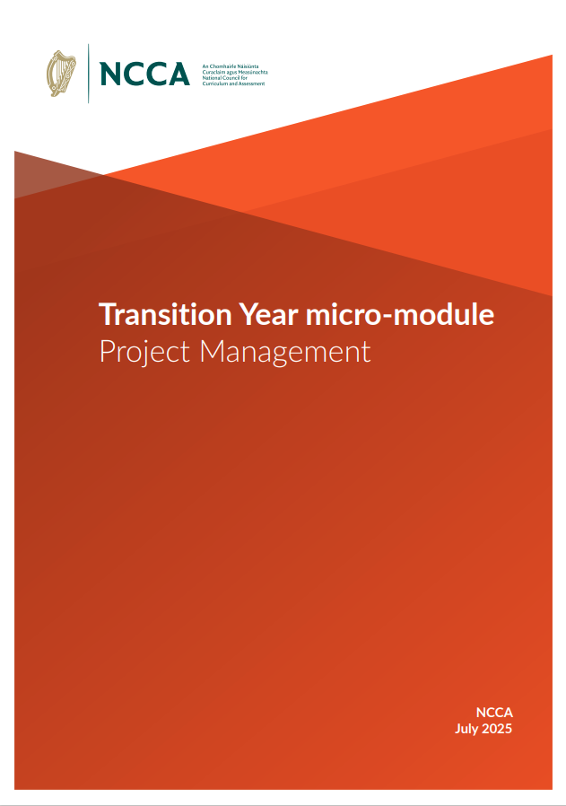
Planning the pathway
Calendar mapping
Senior Cycle Redevelopment
Transition year
Junior Cycle
Junior Cycle
Transition year
Senior Cycle Redevelopment
Calendar mapping

Slide 6
Planning the pathway
Calendar mapping
Senior Cycle Redevelopment
Transition year
Junior Cycle
Junior Cycle
Transition year
Senior Cycle
Calendar mapping

Slide 7
Planning the pathway
Calendar mapping
Senior Cycle Redevelopment
Junior Cycle
Transition year

Slide 8
Planning the pathway
Calendar mapping
Transition year
Junior Cycle
Senior Cycle Redevelopment

Slide 9
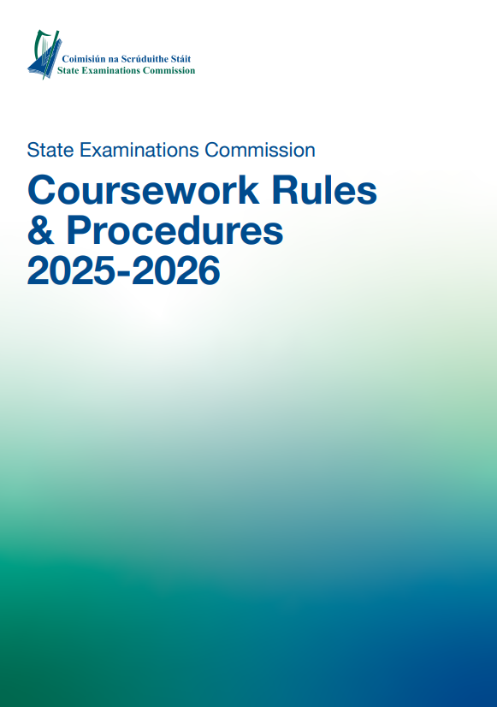
Planning the pathway
Senior Cycle Redevelopment
Transition year
Junior Cycle
Calendar mapping

Slide 10
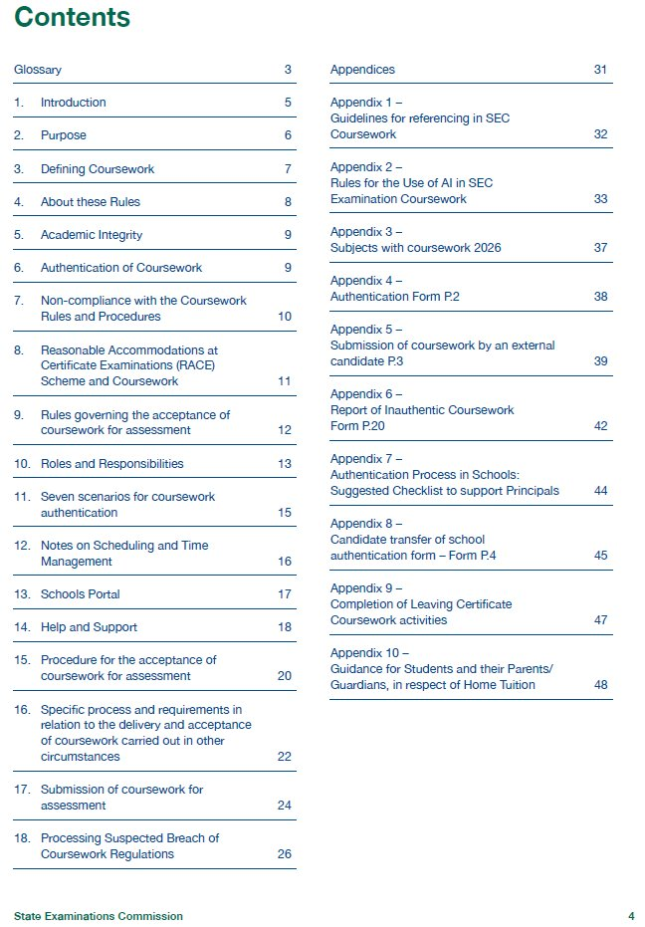

Authentication: Ensuring academic integrity
Integrity
Transparency
Accountability
Coursework must be candidate’s own
SEC regulations apply
All research sources acknowledged.
AI use explicitly referenced (Appendix 2)
Candidate
Class teacher
Principal
Breach of regulations will be investigated by the SEC (Section 15)
SEC: Coursework Rules
& Procedures
2025-2026 p.20-21
Shared Responsibility: Candidate – Teacher - Principal

Slide 11
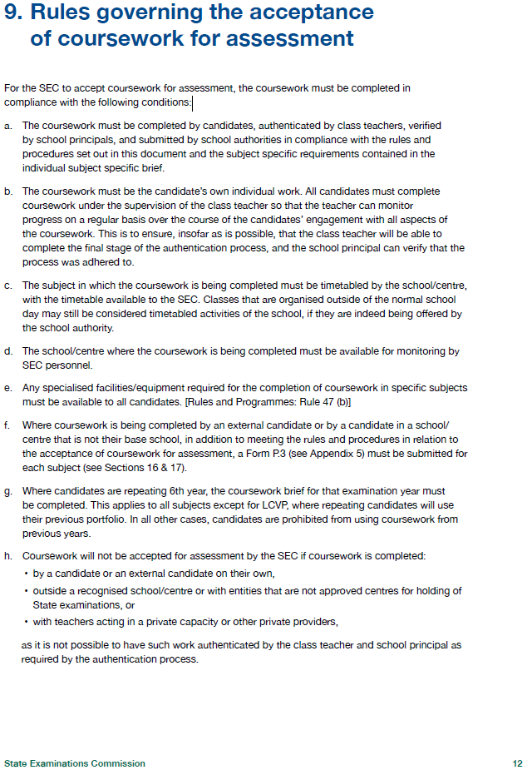
Ensuring academic integrity
Student’s record of learning
Feedback – prompt questions
Evidence of the process
Facilitates teacher authentication of work
Track decision making (feedback)
Develops students’ ability to reflect on their learning
9. Rules governing the acceptance of coursework for assessment
For the SEC to accept coursework for assessment, the coursework must be completed in compliance with the following conditions:
The coursework must be the candidate’s own individual work. All candidates must complete coursework under the supervision of the class teacher so that the teacher can monitor progress on a regular basis over the course of the candidates’ engagement with all aspects of the coursework. This is to ensure, insofar as is possible, that the class teacher will be able to complete the final stage of the authentication process, and the school principal can verify that the process was adhered to.
(SEC Coursework Rules & Procedures 2025-2026 p. 12)

Slide 12
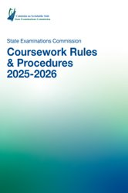
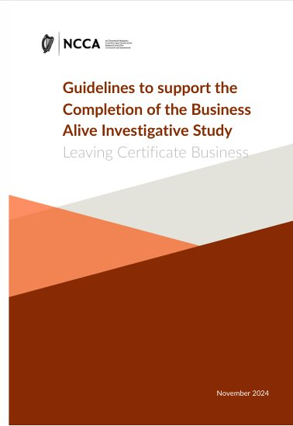

ACC at subject level…
Read
Read the role of the teacher in the AAC guidelines (Business) provided and highlight key considerations.
Consistent Student Experience
Clarity
Predictability
Balance
Voice
Discuss
How does this support student autonomy?
Where are opportunities to activate student responsibility?

Slide 13
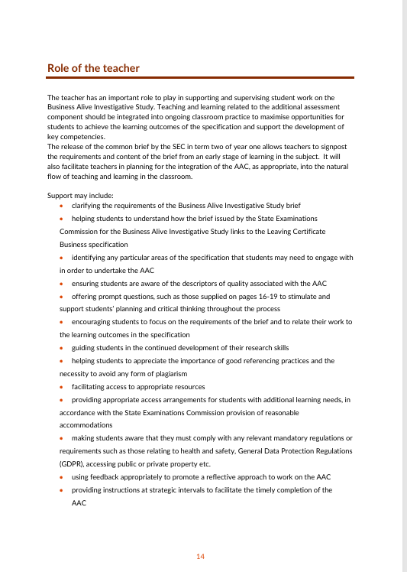
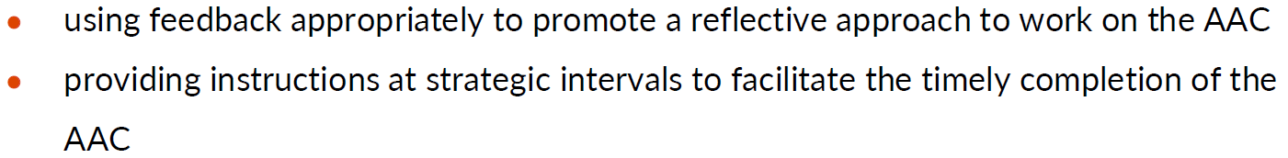
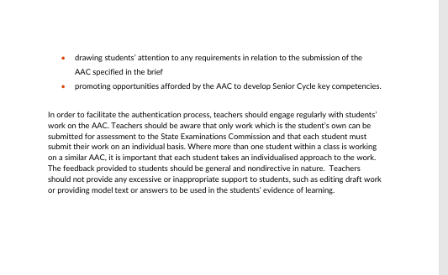
Directive and non-directive feedback
Good feedback should guide thinking, support reflection, and maintain the student’s ownership of the work.
Directive Feedback
Non-Directive Feedback
Tells the student what to write or change
Edits or corrects the work
Provides answers or model texts
Helps the student think about how to improve
Asks questions about the work
Points students back to the task or brief (See Pg 14, 16 and 19)

Slide 14
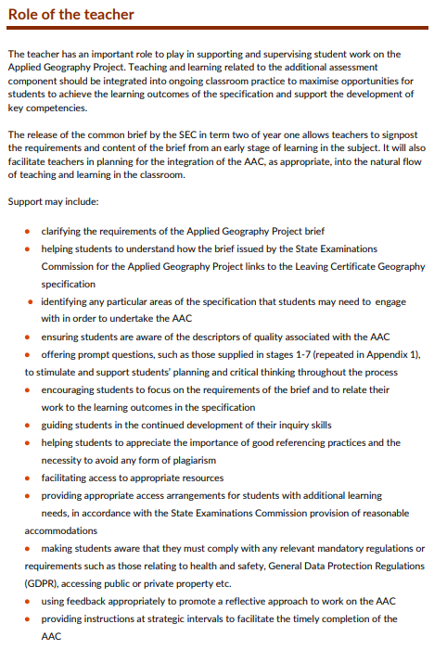
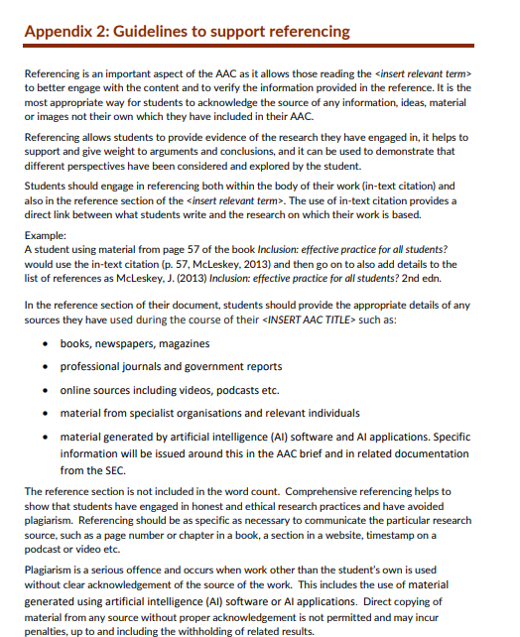
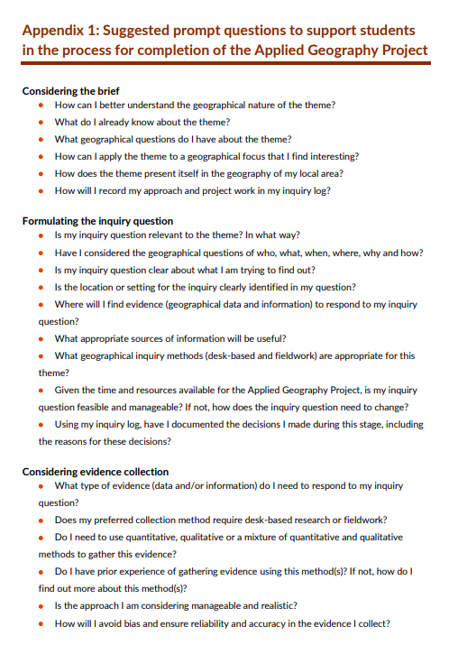
Leading a Whole School Approach to AACs
What protocols/common practices are needed?
Clarify expectations around authentication and class time
AAC as part of subject planning
Agree on whole school approaches to feedback and referencing
How will these be communicated to students and parents?
Shared practice and support, including professional learning

Slide 15
Existing Practice
Senior Cycle Redevelopment
Builds on established assessment practices already embedded in schools.
Existing System Expertise
Schools already manage:
Coursework
Practical assessments
Oral examinations
Project submissions to the SEC
Established Practice
28 out of 40 Leaving Certificate subjects already include additional assessment components, many of which involve an authentication process.

Slide 16
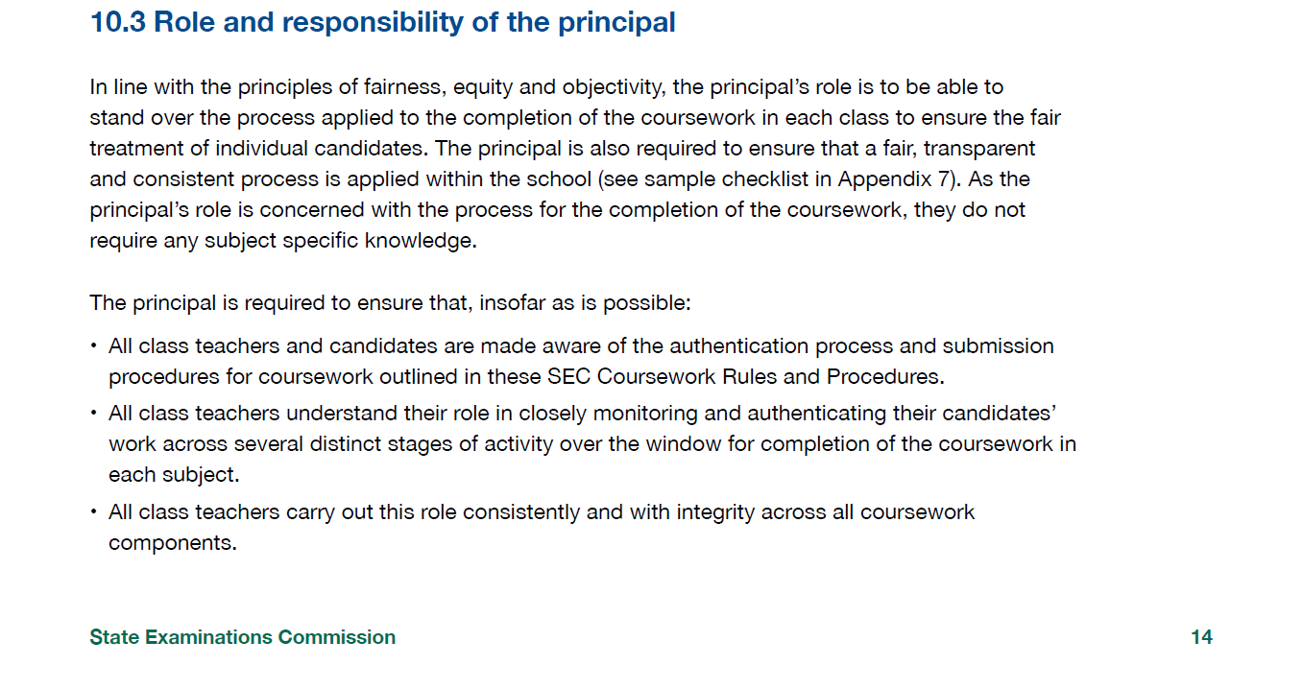
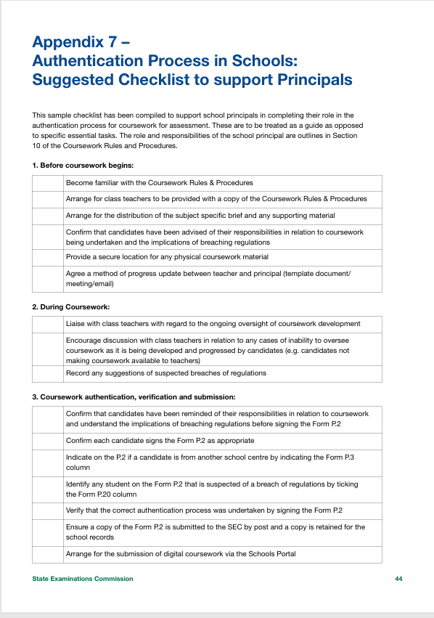
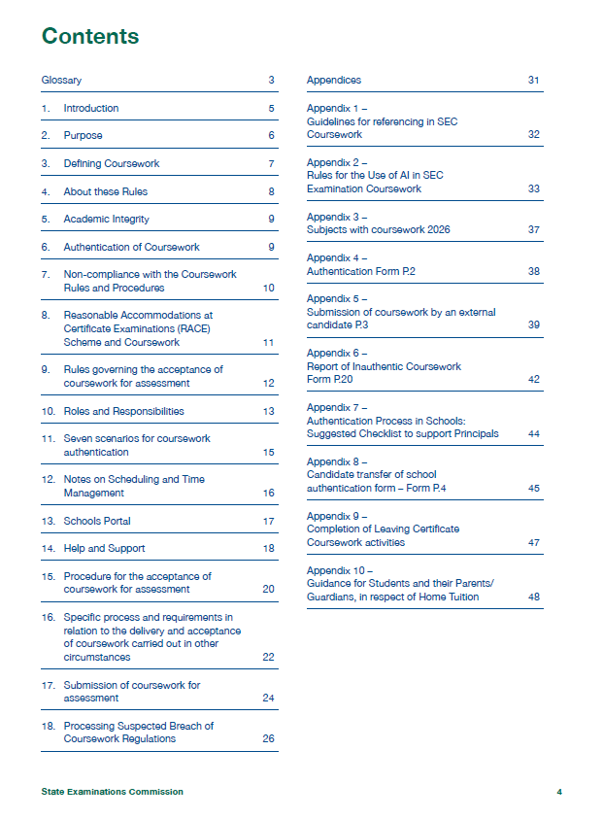
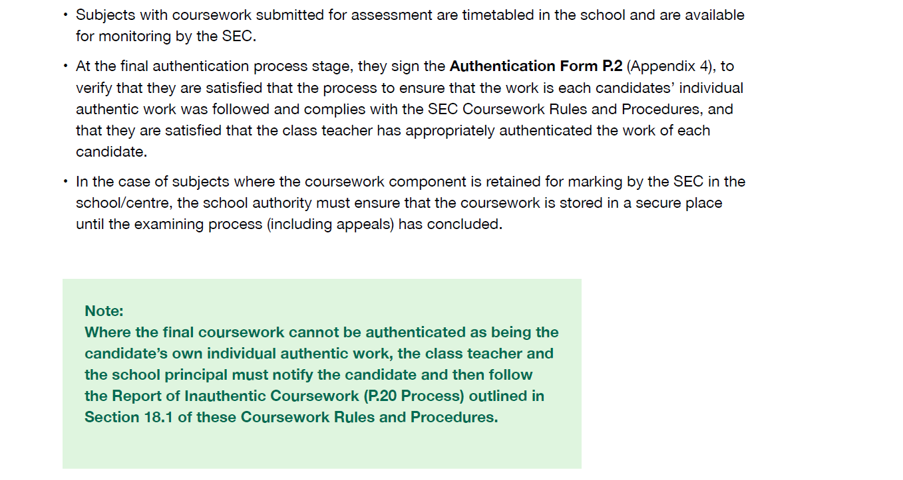
The Role of Leadership

Slide 17



As a school leader…
What whole school approaches will we need to take as a leadership team to ensure the coursework rules and procedures are adhered to.

Slide 18
In this session we...
Leadership
considered the role of the school leader in relation to the AAC.

Slide 19


Feedback
Leadership
https://forms.office.com/e/EsvQ1ZiGLY
transitionyear@oide.ie
@oide_Ireland

Slide 20
Míle buíochas
Leadership

