Slide 1
Senior Cycle Redevelopment
Facilitating Teacher Engagement in Senior Cycle Redevelopment

Slide 2
Webinar Objectives
Objective 1
To provide an overview of new developments in the Senior Cycle from September 2024.
Objective 2
To provide you, as a school leader, with strategies to actively engage your teachers in meaningful discussions about upcoming changes.

Slide 3
The Purpose of Senior Cycle
Question to discuss:​
As an individual, what do you think the purpose of Senior Cycle is?

Slide 4
Rationale

Slide 5
Rationale
Senior Cycle Redevelopment is a planned process over time.
"The last structural changes to Senior Cycle curricula and programmes took place more than 20 years ago and since then, much has shifted in learning, schools, education systems, the wider society and in the national and global environment.”
Senior Cycle Review Advisory Report (2022), p.5

Slide 6
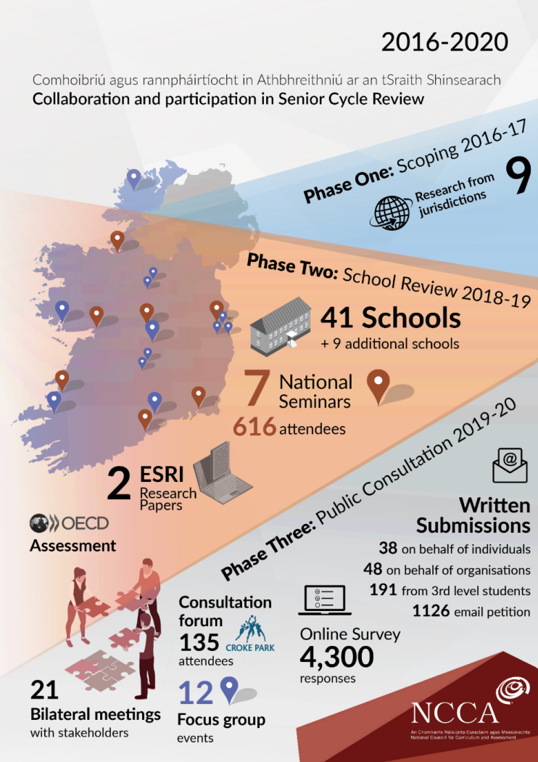
Senior Cycle Review to Redevelopment
Phase One:
Scoping
2016 – 17
Phase Two:
School Review
2018 – 19
Phase Three:
Public Consultation
2018 – 19

Slide 7
Purpose and Vision for Senior Cycle
Continue to educate the whole person
Help every student to become more enriched, engaged and competent
Help students to access diverse futures.
Serve collective as well as individual purposes
Help every student further develop their knowledge, skills, values and dispositions

Slide 8
Senior Cycle Key Competencies

Slide 9
Senior Cycle Key Competencies

Slide 10
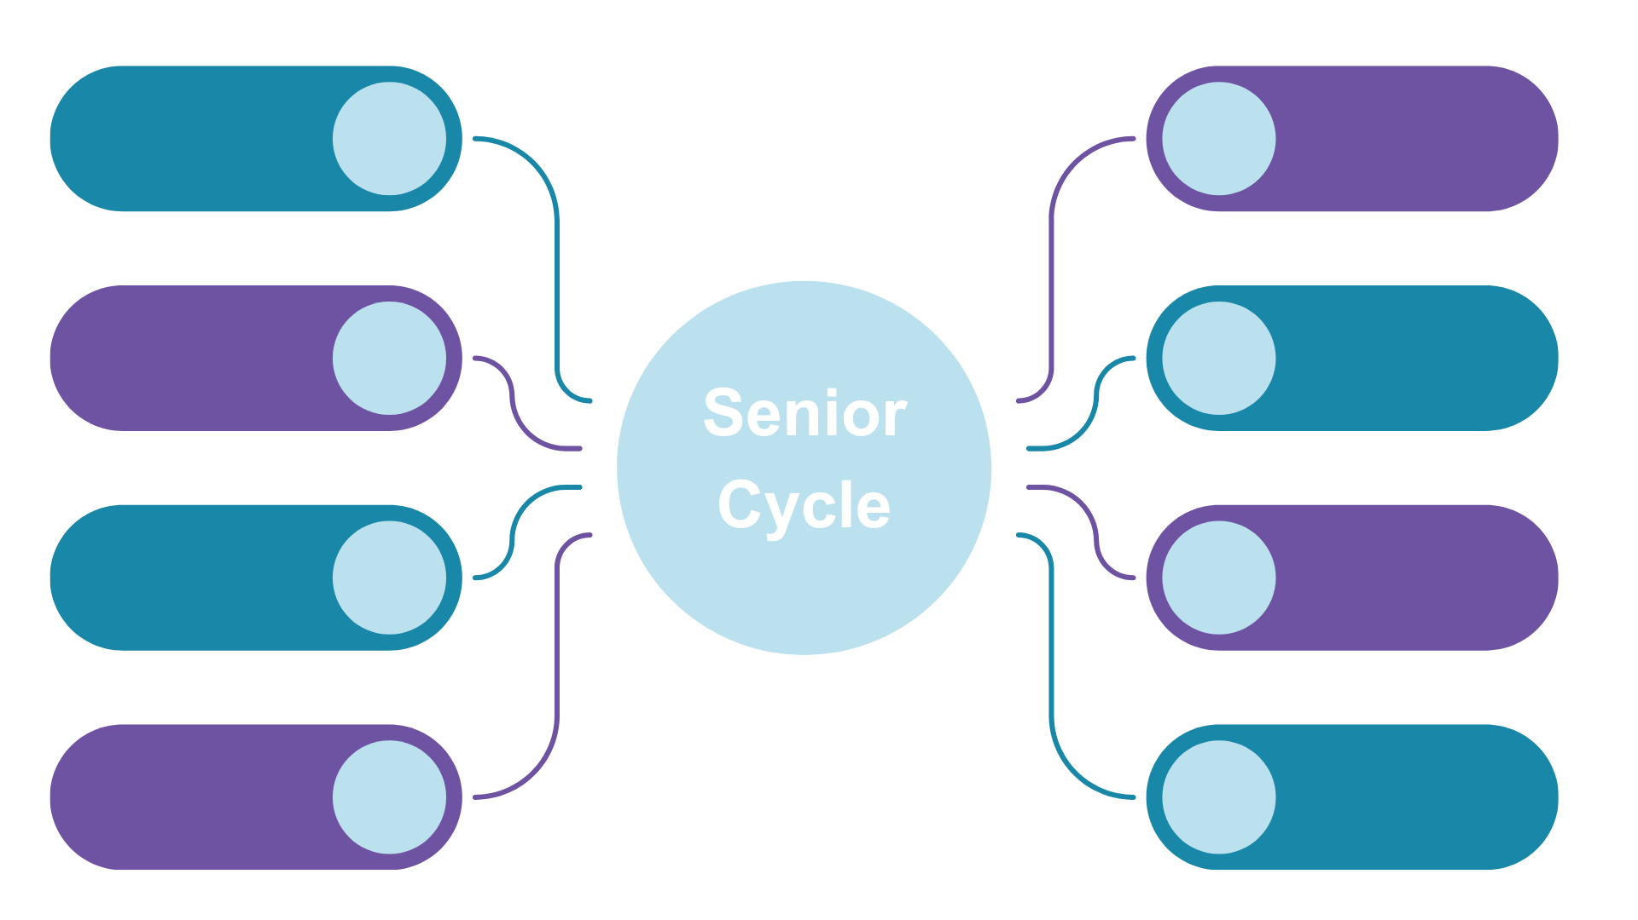
Senior Cycle Redevelopment
Question:
As a teacher, which of these elements will impact your classroom practice?
Leaving Certificate
Vocational Programme
Revised Leaving
Certificate Specifications
Leaving
Certificate
Applied
New Subjects
Transition Year
Assessment
Senior Cycle
Level 1 and Level 2 Programmes
Senior Cycle
SPHE

Slide 11
Senior Cycle Redevelopment
Leaving Certificate
Vocational Programme
Revised Leaving Certificate
Specifications
Leaving
Certificate
Applied
Question:
As a teacher, which of these elements will impact your classroom practice?
New Subjects
Transition Year
Assessment
Senior Cycle
Level 1 and Level 2 Programmes
Senior Cycle
SPHE

Slide 12
September 2024
Support for Tranche 1 begins
Tranche 1
Ancient Greek
Arabic
Biology
Business
Chemistry
Climate Action and Sustainable Development
Drama, Film & Theatre Studies
Latin
Physics
Senior Cycle
Level 1 & Level 2
Transition Year

Slide 13
Considerations for Teaching and Learning - Tranche 1 Subjects
In Classrooms September 2025
Questions to discuss:
As an individual, what impact do you feel Tranche 1 will have on your classroom practice?
In your subject department, are there tangible next steps for you to engage with to prepare for Tranche 1 and subsequent Tranches?
Within your school community, are there any considerations emerging as a result of Tranche 1 for this academic year and beyond?
Tranche 1
Ancient Greek
Arabic
Biology
Business
Chemistry
Climate Action and Sustainable Development
Drama, Film & Theatre Studies
Latin
Physics

Slide 14
Senior Cycle Redevelopment
Oide Professional Learning Experiences (PLEs) 2024/25

Slide 16
Senior Cycle Redevelopment
Oide Professional Learning Experiences (PLEs) 2024/25

Slide 18
Transition Year

Slide 19
TY Programme Statement
Designed around the developmental and learning needs of students moving from Junior Cycle into Senior Cycle as they prepare for their future lives.
Schools have autonomy and flexibility to design their TY programme within the design parameters of the TY Programme Statement.
The statement offers guidance to schools on how to develop a TY programme to meet the needs of all their students.

Slide 20
TY Programme Statement: Dimensions
Student Dimensions
Curriculum Dimensions
Student Dimensions
Personal Growth
Being a Learner
Civic and Community Engagement
Career Exploration
Curriculum Dimensions
Components
Teaching and Assessment
Recognising and Reporting
Reflection and Renewal

Slide 21
TY Programme Statement
The time allocation for PE should be aligned to the Senior Cycle PE Framework
SPHE should be provided once per week
The organisation of the components into semesters, blocks or across the entire year is decided at school level, including provision of experiences aligned to the values, ethos and pastoral care of the school.

Slide 22
TY Programme Statement
The class time allocation for each continuity subject should not exceed 2 hours per week
3-4 hours per week for elective modules
1 class per week

Slide 23
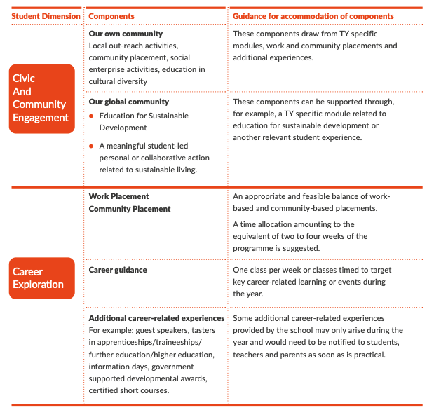
TY Programme Statement
Suggested 2 to 4 weeks

Slide 24
TY Programme Statement
Questions to discuss:
How will we review our TY programme considering the new TY Programme Statement?
What opportunities do we envisage around this review of TY?

Slide 25
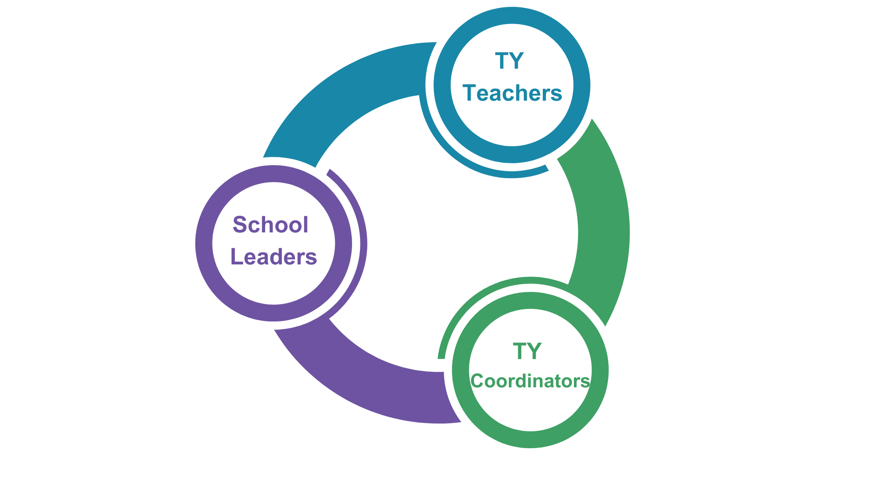
TY Supports During 2024/2025
A webinar specifically for TY Coordinators and school leaders will take place on October 10th at 09:30, October 16th at 11:30
Scoileanna Gaeltachta agus Gaelcholáistí on October 21st at 11:30

Slide 26
SPHE

Slide 27
Senior Cycle SPHE
“Provides a dedicated space and time where students can further develop the knowledge, understanding, skills, values and dispositions needed to support their physical, emotional, social and spiritual wellbeing, now and in their future lives” (p.4)
Mandatory specification for all students in 5th and 6th Year
Designed for a minimum of 60 hours of class contact time over the final two years of senior cycle education.
Three strands:
Health and Wellbeing
Relationships and Sexuality
Into Adulthood
Schools have until September 2027 to introduce the specification for students entering fifth year

Slide 28
Senior Cycle Learning Programmes:
Level 1 and Level 2

Slide 29
Senior Cycle Level 1 & Level 2 Learning Programmes
September 2024
Programme Statement
Curriculum Areas & modules at Levels 1 & 2
Communication and Literacy
Numeracy
Supports
Live Webinar
Full Day PLE for SET and special class teachers on school closure days
Bi-termly online Information sessions
Monthly newsletter with new resources & updates

Slide 30
Further Supports
Department of Education Senior Cycle Redevelopment Information Notes – click here
NCCA Senior Cycle Redevelopment website: click here
Oide website: www.oide.ie
Oide X account: @oide_Ireland

