Slide 1
Senior Cycle Social Personal and Health Education
Workshop for School Leaders
March 2026
Wellbeing/SPHE- Sarah Clarke
Leadership - Catriona Murray
Leadership - June O'Brien

Slide 2


Professional Learning Booklet
Leadership

Slide 3
In this session we will...
recognise the role of SPHE in supporting student wellbeing and preparation for adulthood.
Leadership
consider the role of the school leader in supporting effective planning for SPHE.

Slide 4






Continuum of SPHE
'Senior Cycle Social, Personal and Health Education (SPHE) provides a dedicated space and time where students can further develop the knowledge, understanding, skills, values and dispositions needed to support their physical, emotional, social and spiritual wellbeing, now and in their future lives.’
(Curriculum Specification for SC SPHE, NCCA, 2024, p.4)

Slide 5

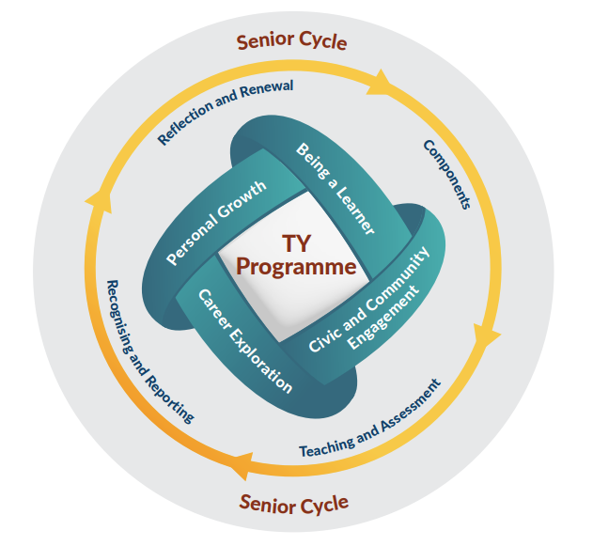




Transition Year SPHE
Requirements
SPHE now timetabled under the new TY Programme dimension 'Personal Growth'
One class per week (max. one hour)​
No prescribed curriculum​ – must continue to include RSE (Circular 37/2010)​
Student voice is central​ – consultation on prior learning, including:​
Junior Cycle SPHE​
JCL1LP PLU Personal Care and Wellbeing and JCL2LP PLU Personal Care
Resources​​
NCCA TY SPHE Toolkit​​
NCCA 3 x 10-hour micro-modules
NCCA TY SPHE Toolkit
5
​

Slide 6
Specification for Senior Cycle SPHE
LCE and LCA engage with the same learning in SPHE

Slide 7

Senior Cycle SPHE LCE and LCA
6
Mandatory implementation – LCA from 2025 – LCE from 2027
Standalone subject in LCA
60 hours of learning delivered over two years
8 Key Assignments
NCCA Senior Cycle SPHE Toolkit
Timetabling LCE and LCA students together for SPHE in your school context – What could work well and what could be challenging?

Slide 8

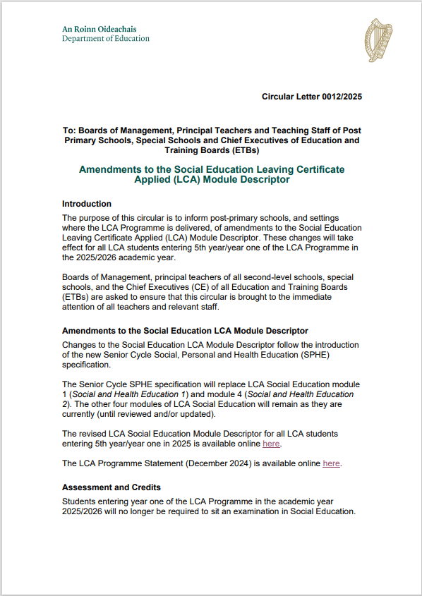
SPHE in Leaving Cert. Applied
 | Session 1 | Session 2
Year 1 | Social and Health Education 1
 | My Community | Contemporary Issues 1
 | Session 3 | Session 4
Year 2 | Social and Health Education 2
 | Contemporary Issues 2 | Taking Charge
 | Session 1 | Session 2
Year 1 | Senior Cycle SPHE
 | My Community | Contemporary Issues 1
 | Session 3 | Session 4
Year 2 | Senior Cycle SPHE
 | Contemporary Issues 2 | Taking Charge
Circular 12/2025
Year 1 – Four SPHE Key Assignments – 2 Credits
Year 2 – Four SPHE Key Assignments – 2 Credits
Circular 12/2025

Slide 9
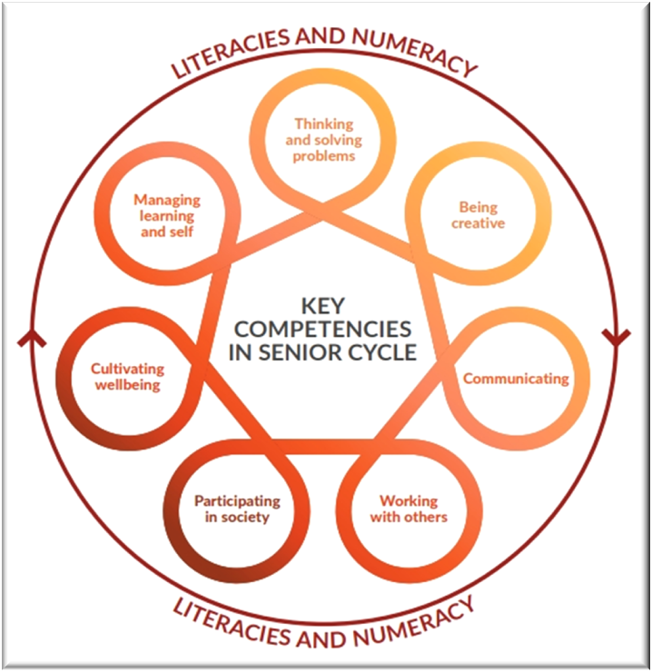
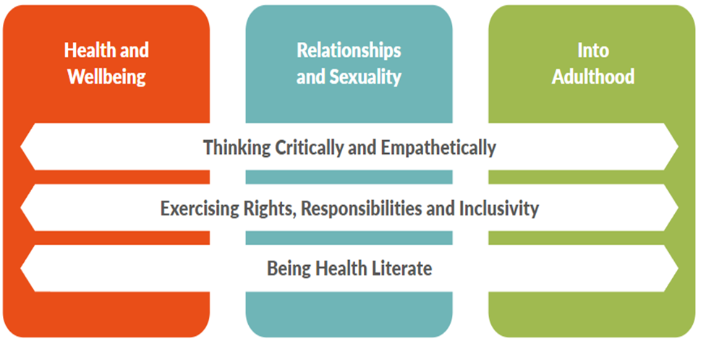
Cross-cutting Elements and Strands
Health and Wellbeing
Factors influencing health and wellbeing
Fostering positive mental health
Coping with emotional or mental health challenges
Safely managing social situations
Relationships and Sexuality
Healthy relationships
Gender, culture and social norms
Abusive and violent relationships
Sexual health
Into Adulthood
Self-management and self-care skills
Rights and responsibilities before the law
Ways to advocate for and create greater equality

Slide 10
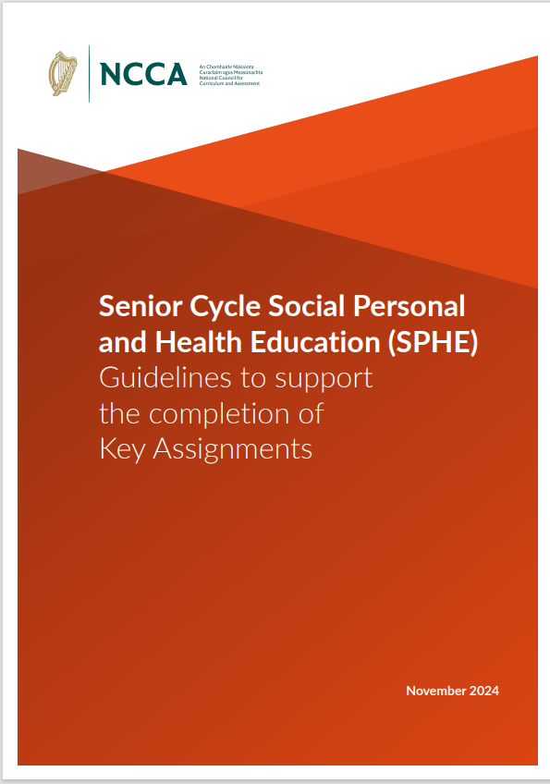
Guidelines to Support the Completion of Key Assignments
8

Slide 11
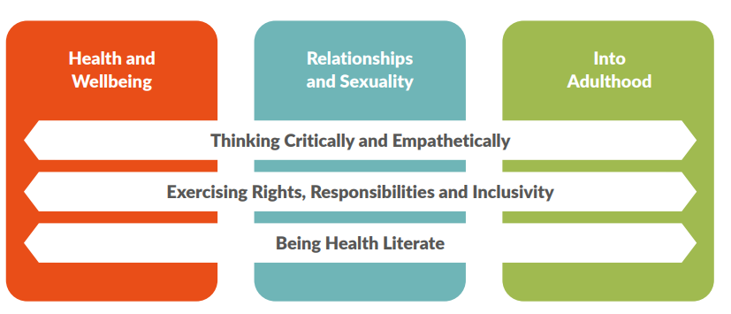
Guidelines to Support the Completion of Key Assignments
8
Leaving Certificate Established (LCE)
Leaving Certificate Applied (LCA)
Consider how reporting on and/or providing certification for Key Assignments might be beneficial in your own school context?
Credits are recorded for certification for students following the LCA programme
(Circular 0012/2025)
Record of Key Assignments
'Can report on assessment and learning in SPHE through the regular school reporting system and/or award a school certificate of completion of SC SPHE' P.7
3 Key Assignments linked to Strand 1
3 Key Assignments linked to Strand 2
2 Key Assignments linked to Strand 3
Reflection
Minimum of 8 Key Assignments across two years of SPHE

Slide 12
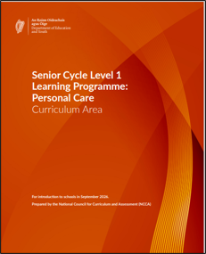
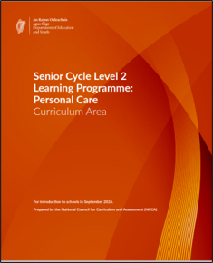
L1L2LP Personal Care Curriculum Areas
7
Meets the requirement for SPHE for students following Senior Cycle Level 1 or Level 2 programmes
Minimum time allocation
Level 1: three modules – 180 hours over two years
Level 2: one module – 60 hours over two years
Designed for learning to be integrated into subjects, supporting students where appropriate, to engage with their learning alongside their peers
High collaboration between SPHE and SET Core Teams

Slide 13
Supporting the Provision of SPHE in your school for your students
4, 9, 10, 11, 12
Leadership Foundations
Reviewing current provision and capacity
Building Teacher Capacity
A committed core team of teachers with both interest in, and capacity for teaching SPHE
Working Together
Collaborative SPHE subject planning and review
Appointment of an SPHE coordinator
Consultation with teachers before timetabling
Allocation of appropriate time
Teacher engagement in professional learning
Ongoing professional development in SPHE
Collaboration with relevant teams
Communication with parents / guardians
Culture and Sustainability
Planning for the future teaching of SPHE
Whole-school focus on wellbeing
Student Voice and Participation
Alignment with other school policies
Teacher wellbeing

Slide 14
Senior Cycle SPHE Readiness Audit
13
What is a strength in my school that will support effective SPHE implementation in one programme?​
Is there one area in SPHE provision that will require focused planning or leadership attention?
What key decisions and actions might help me to support the work of my SPHE core team?​
Activity Instructions
4 mins – Review a SPHE audit for one programme
3 mins – Complete the three reflection questions
3 mins – Share key points in pairs
2
3
1

Slide 15




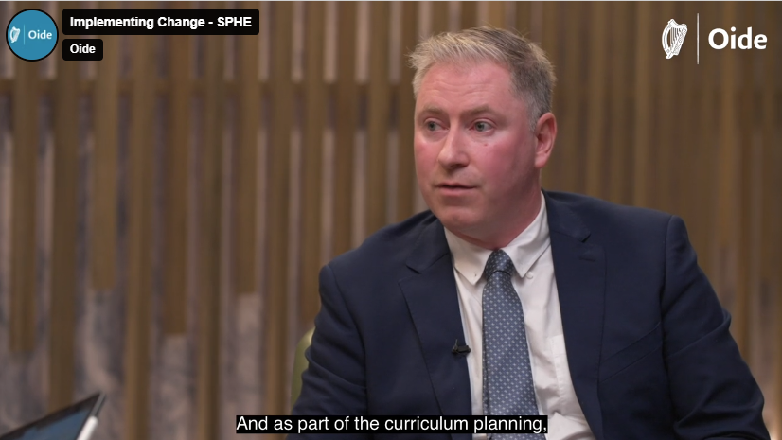

Tacú: Implementing Change
Reflective professional conversations on leadership insights and practical advice for implementing change to support Senior Cycle Redevelopment
A series of reflective professional conversations with education leaders sharing their knowledge and experience of implementing change.
SPHE was one of the initial conversations.
David McCormack
St. Joseph's Mercy Secondary School
More conversations with school leaders to follow
Conversation focusing
on Senior Cycle SPHE

Slide 16
In this session we ...
Recognised the role of SPHE in supporting student wellbeing and preparation for adulthood
Leadership
Considered the role of the school leader in supporting effective planning for SPHE

Slide 17


Feedback
Leadership
https://forms.office.com/e/EsvQ1ZiGLY
transitionyear@oide.ie
@oide_Ireland

Slide 18
Míle buíochas
Leadership

