Slide 1

Leading Effective Subject Planning in Senior Cycle
Michelle Hession
Lorraine O'Keeffe

Slide 2


Professional Learning Booklet
Leadership

Slide 3
In this session we will...
Leadership
explore how to lead effective subject planning in senior cycle.

Slide 4

Planning to Support Student Learning
15
Individual Reflection
What does effective subject planning look like in your school?
In Pairs
How does effective subject planning support student learning?

Slide 5


Effective Subject Planning
APPROACH
Scope
and
Sequence
For Whom?
How?
What does it do for me?
Schemes of Work
Units of Learning
Classroom Practice
Learning Intentions
Success Criteria
Prior Knowledge
Learning Experiences
Assessment Modes
Differentiation/Inclusion
Reflection
Students
Learner Outcomes and Experiences
How will it empower me to lead learning, teaching and assessment?
What does effective subject planning mean for me as a school leader?
How does effective subject planning empower me to lead learning, teaching and assessment?

Slide 6
Some Components of a
Subject Department's overarching plan
Organisational Structure for the Subject
Subject department personnel, and professional learning
Curricular provision and timetable hours
Resources and facilities
Scheme of Work (Learning, Teaching and Assessment Section)
2-year Scheme of Work (Learning and Teaching Section)
Units of Learning (UoLs) sequenced over the 2-year plan cycle
Units of Learning
A UoL is a planned sequence of learning experiences that engages a range of learning outcomes across strands in the specification to focus on a particular theme or topic.
It will include learning outcomes, active methodologies, inclusion and assessment modes.

Slide 7

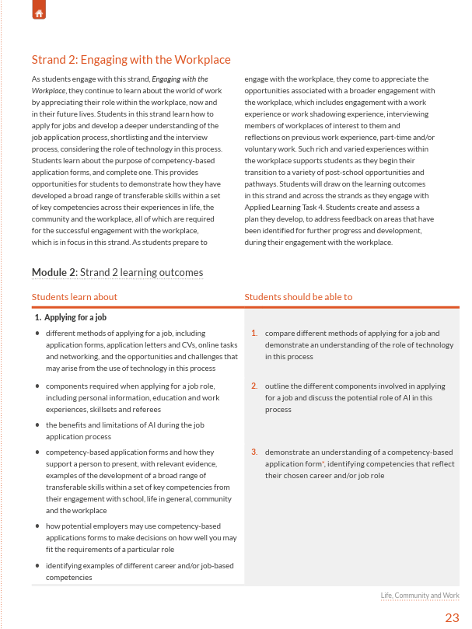
Subject planning through a leadership lens
Curriculum
Specification
Curriculum Specification
How are the learning outcomes and action verbs shaping what students are expected to know, understand and do over time?
In what ways can the Students Learn About (SLA) column be applied to design meaningful learning experiences rather than simply covering content?

Slide 8
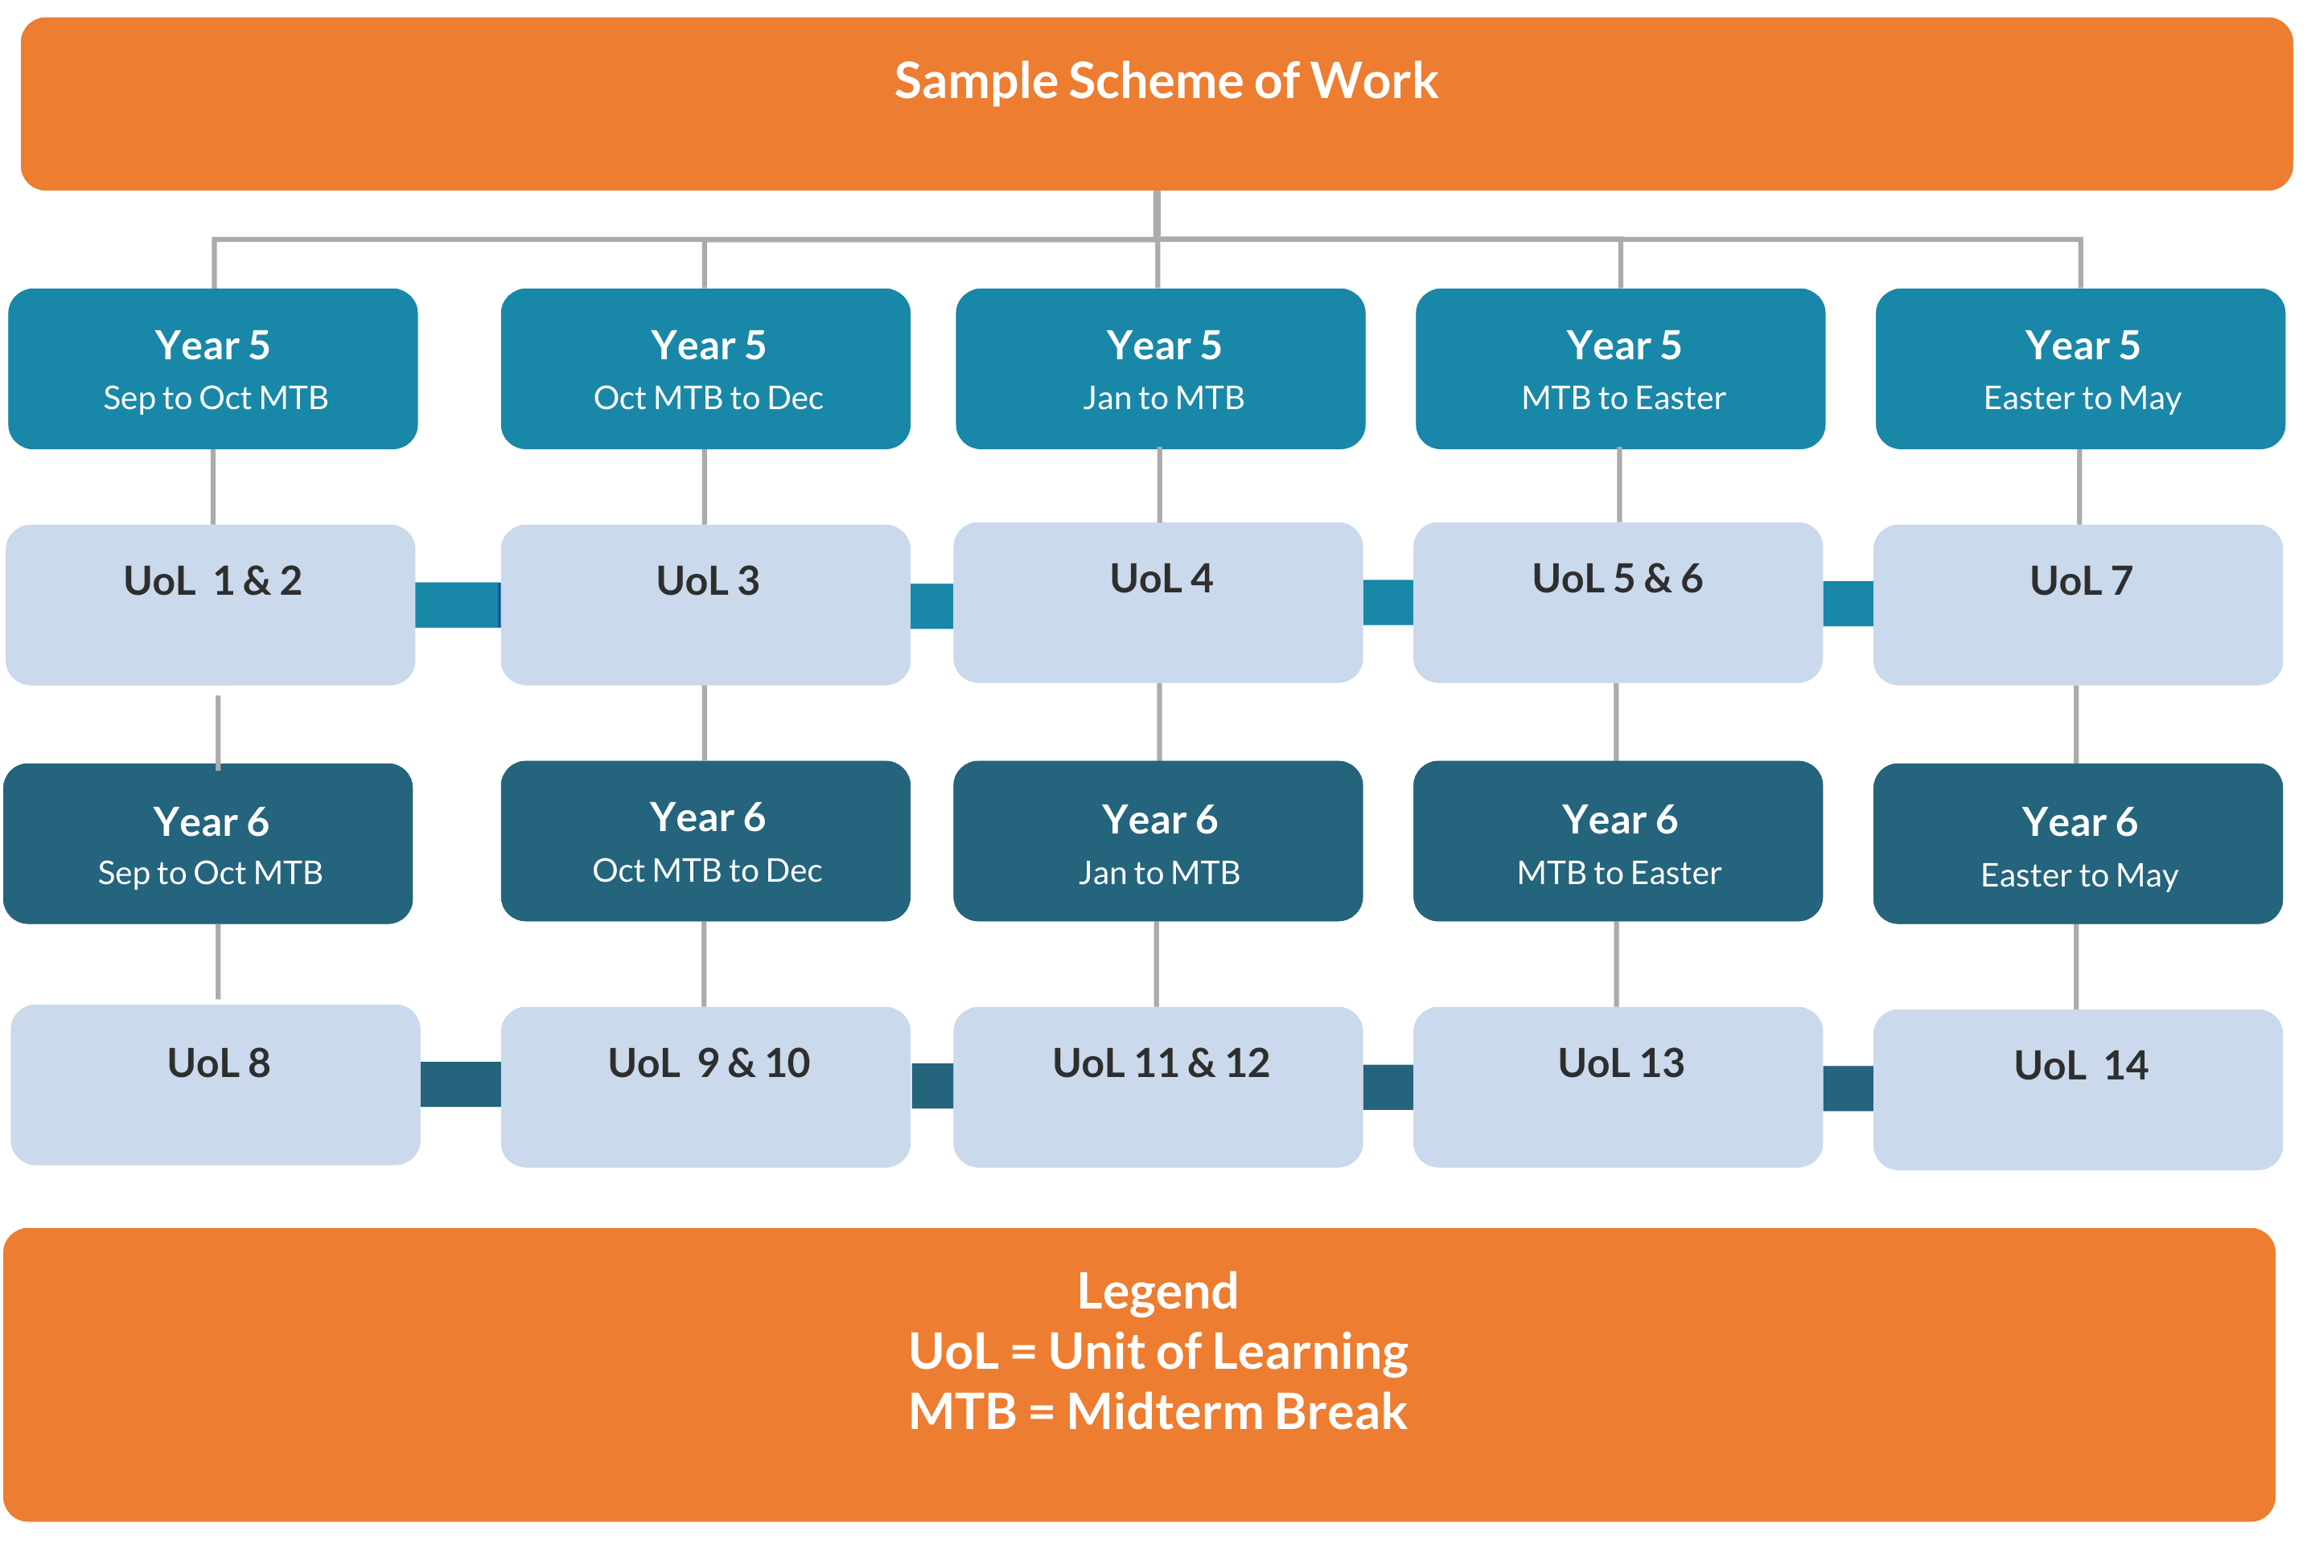
Subject planning through a leadership lens
Scheme of Work
How does a scheme of work ensure clear progression of knowledge, skills, values and dispositions across the year or two-year programme?
In what ways could the units of learning be sequenced and revisited over time to allow students to develop a deeper understanding?

Slide 9
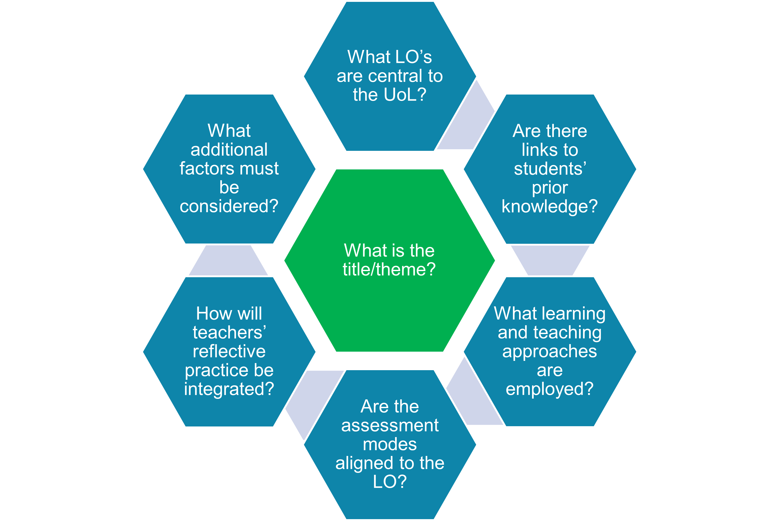
Subject planning through a leadership lens
Unit of Learning
How do the selected learning outcomes connect to the focus and purpose of this unit?
How do the learning experiences in this unit help students develop the knowledge, skills, values and dispositions required by the learning outcomes?
How will we know that students are progressing towards demonstrating the learning outcomes by the end of the unit?

Slide 10



Reflective Activity
To what extent do our subject department meetings and professional conversations demonstrate meaningful engagement with subject planning?
Leadership

Slide 11
Reflective Activity
How will we know that our subject plans are supporting effective classroom practice?
Leadership

Slide 12
Points to reflect on
Knowledge and skills needed to engage with the AAC are developed as part of everyday learning and teaching.
Build on good practice already developed in Junior Cycle
This is an iterative process – these are living documents & will need ongoing review
Teacher flexibility and agency in developing and scheduling the UoLs across the two years
Planning is strengthened through ongoing collaboration and professional dialogue

Slide 13

Leadership Action
1
As a school leader, what will you prioritise as you lead effective subject planning?

Slide 14
In this session we ...
Leadership
explored how to lead effective subject planning in senior cycle.
Notes:
Purpose: This slide outlines reminds participants our learning intentions in this session which were
Activity: Talk to the slide
Resource: Session objective slide
Clarity:
(Click 1) LI 1: Explored how to lead effective subject planning in senior cycle.

Slide 15
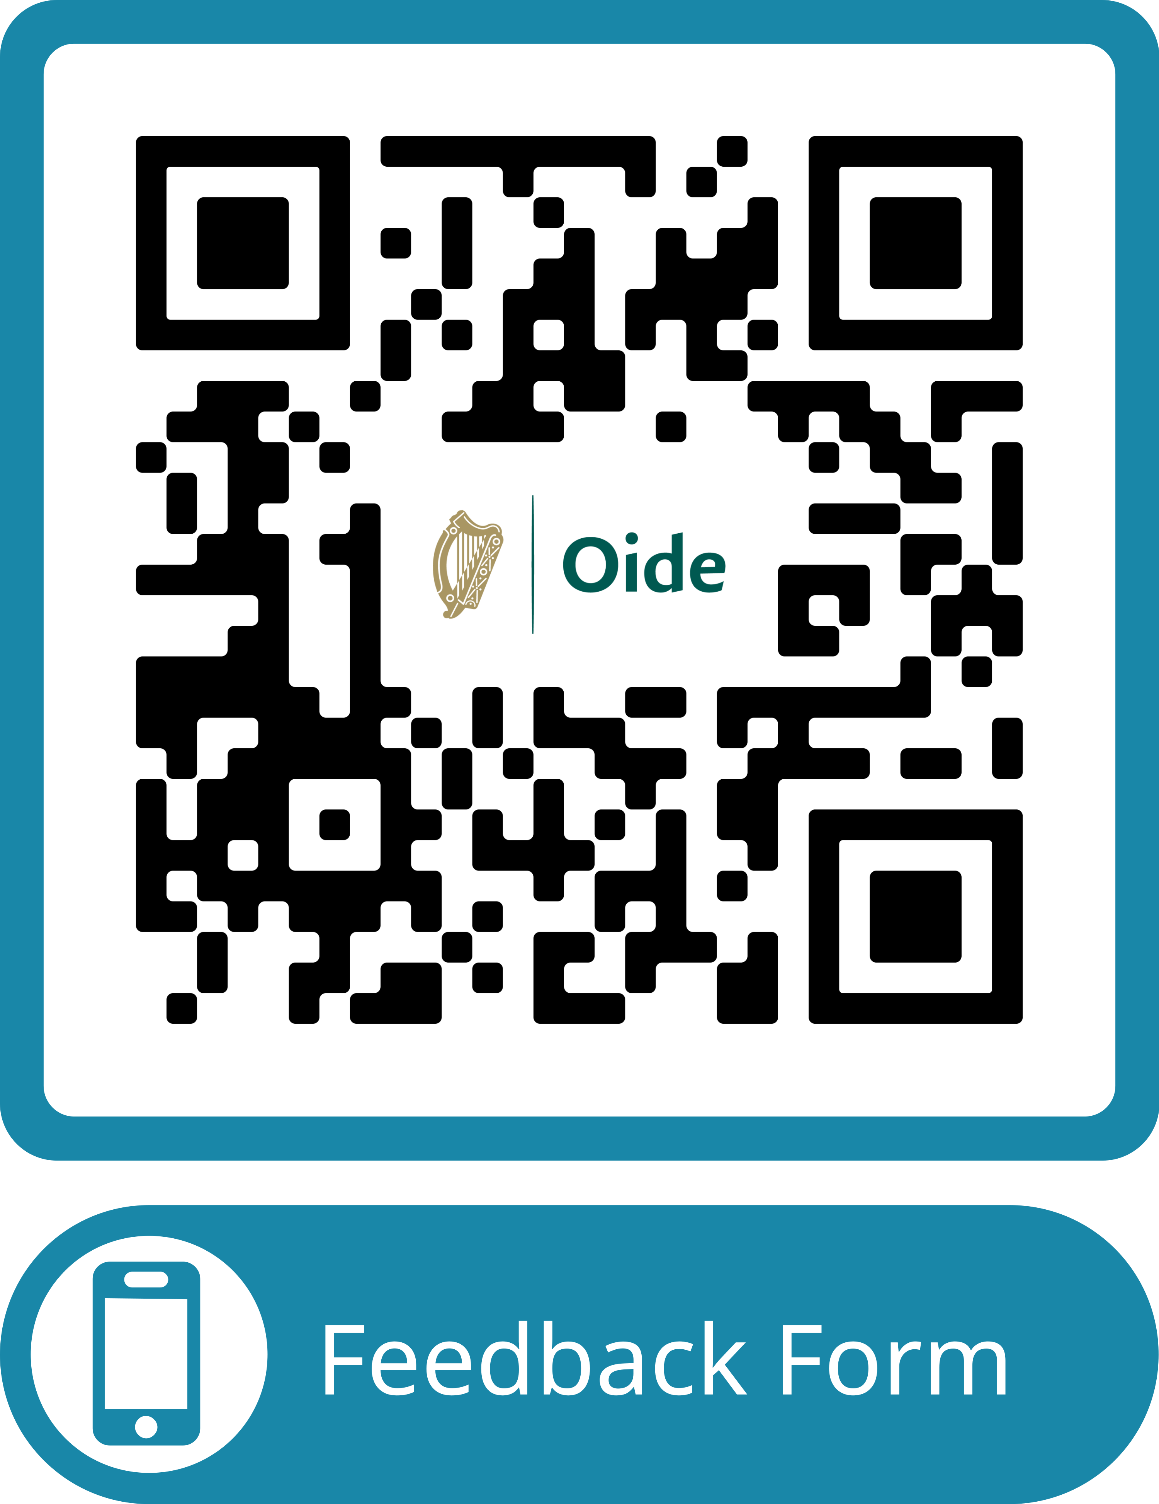

Feedback
Leadership
https://forms.office.com/e/EsvQ1ZiGLY
transitionyear@oide.ie
@oide_Ireland

Slide 16
Míle buíochas
Leadership

