Slide 1

Leading an Inclusive and Coherent
Transition Year Aileen O’Driscoll-Programme Support
Orla Jackson- Leadership

Slide 2

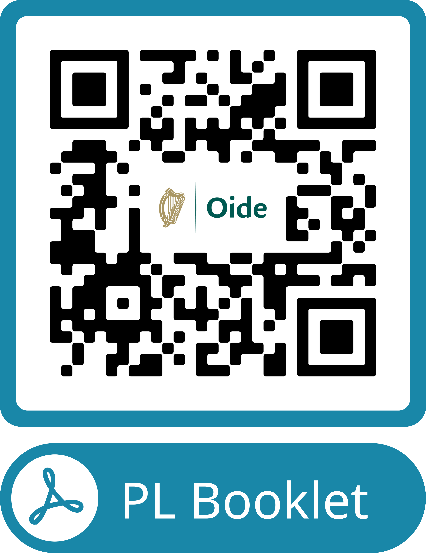
Professional Learning Booklet
Leadership
Notes:
Purpose: Professional Learning Booklet
Activity: Talk to the slide
Resource: Professional Learning Booklet
Clarity:

Slide 3
In this session we will...
consider the role of the leader to ensure inclusion and access into TY.
Leadership
enable leaders to support the work of the TY Core Team.

Slide 4



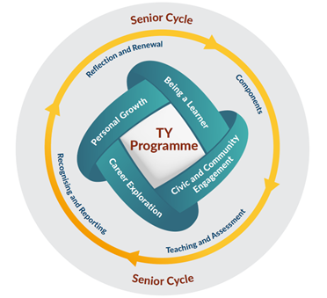
What is Transition Year?
TY is a stand-alone senior cycle programme with a clear developmental purpose
TY supports students to become more adaptable, empathetic, competent, and resilient people
Leadership

Slide 5
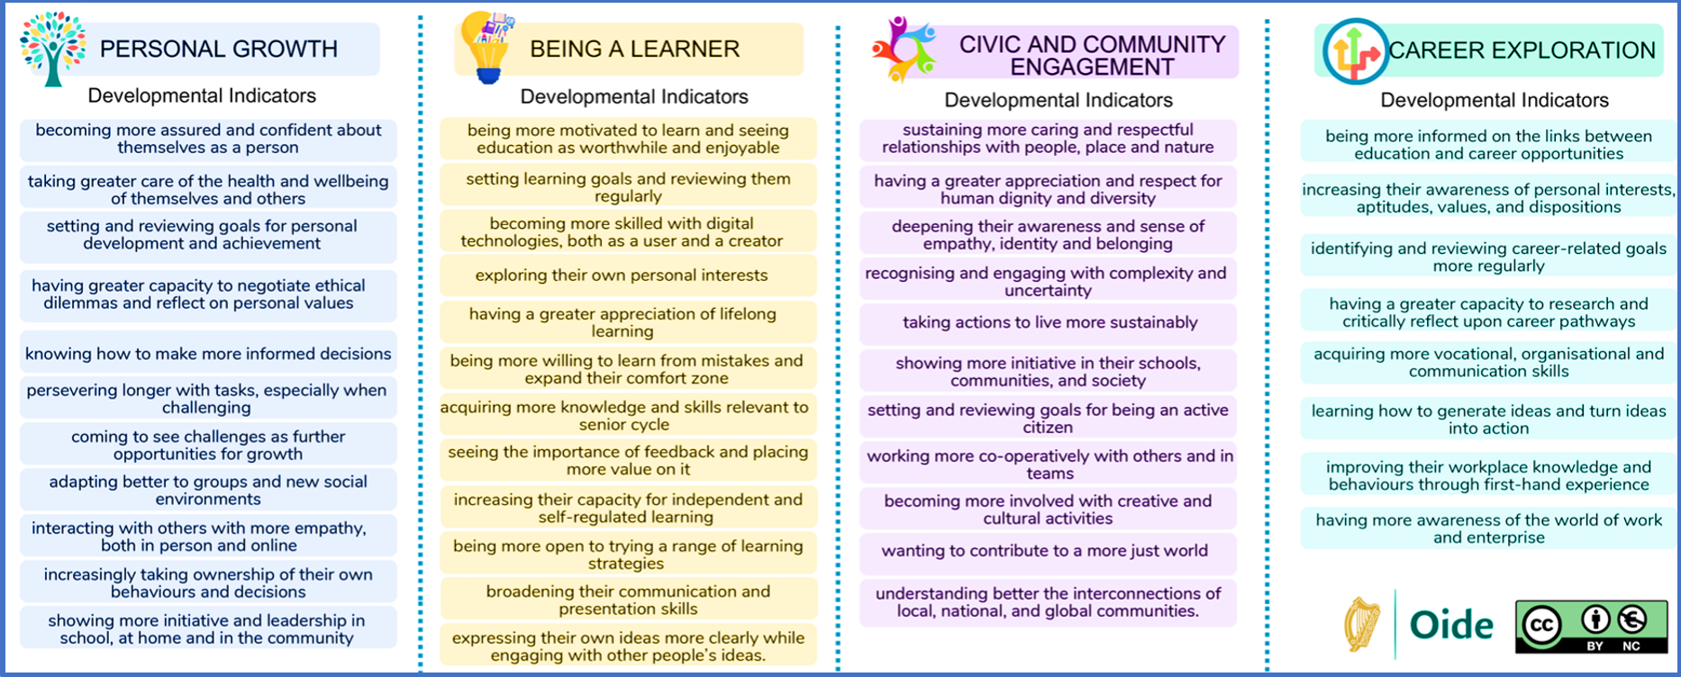

Student Dimensions Developmental Indicators
Leadership

Slide 6



Inclusion by Design1
Leadership
1: Inclusive Access & Participation in TY
How do we ensure that our TY Programme provides access and inclusion for all?(6 mins)

Slide 7
Inclusion by Design 2
2: TY, School Identity & Community​
​
How is the voice of our whole community (students, staff, parents, wider community) reflected in our TY programme? How could we build on this further? (6 mins)
Leadership
Notes:
Time: 20 mins 2 (set up)+6 (q1)+6 (q2)+6 (feedback)
Purpose: Link inclusion to intentional leadership rather than goodwill.
Activity: World Café Style activity (modified for workshop). The room will be divided by tables (if cabaret style).
See detailed descriptions below.
Participants will discuss both questions at their table, after 6 mins they will be asked move to the second questions. Each table will have 2 A0 sheets with the questions and prompts on them.
They will hold a plenary discussion and record their thoughts on both sheets
The facilitator will ask for feedback (without repetition ) from each table
Resource: A0 flip chart sheets at each table and coloured whiteboard markers.
The flip charts will have the prompts below on them.
The facilitator will give context for each flipchart in advance
Flipchart 2: TY, School Identity & Community (4 min)
Facilitator Script The TY Programme Statement encourages programmes that reflect the identity, values, and context of the school, and asks us to connect learning meaningfully to students’ lived experiences and communities.
What does our TY programme say about who we are as a school?
Whose voice is loudest? Why?
Whose voices, cultures, and strengths are most visible in TY, and whose are less so?
How well does TY connect with our local community, student voice, and school values?
Leadership Prompt :
How is the voice of our whole school community (students, staff, parents, wider community) reflected in in our TY Programme. How can we build on this further?
Orla to Set up activity
Split the A0 sheet in 2.
-------------------------------------------------------------------------------------------------------------------------

Slide 8
TY Core Team
The strongest Core TY Teams are not the biggest, they are the most aligned.
They share:
Clear understanding of TY’s developmental purpose
Shared language around inclusion and student growth
Authority to influence structures
Connection to classroom reality
Connection to student experience
Leadership

Slide 9
TY Core Team
Senior Leadership Representation(Principal / Deputy / AP with Senior Cycle Oversight)
TY Coordinator (Operational and Pedagogical Lead)
Guidance Counsellor
SEN / Inclusion Lead (SET / SEN Coordinator / Inclusion Post Holder)
Representative Subject Teachers (Not Just “TY Enthusiasts”)
Student Voice (Structured, Not Tokenistic)
HSCL / Community Link (Where Relevant)
Leadership

Slide 10



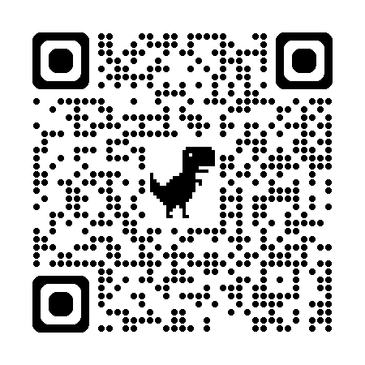
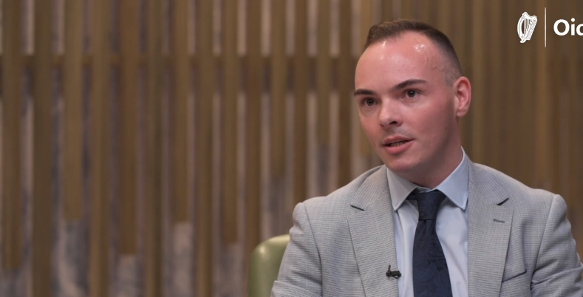

Tacú: Implementing Change
Reflective professional conversations on leadership insights and practical advice for implementing change to support Senior Cycle Redevelopment
A series of reflective professional conversations with education leaders sharing their knowledge and experience of implementing change.
Transition Year was one of the initial conversations.
Mark Rossiter
Gaelcholáiste an Phiarsaigh
Conversation focusing
on TYPS
More conversations with school leaders to follow

Slide 11

Key Learning Reflection - Activity
What?
One idea about leading an inclusive TY Programme I’m taking away is…
So What?
Now What?
One conversation I will be having as a result of my learning today...
How inclusive is our TY Programme...
Leadership
Reflective Model, Rolfe et al (2001)

Slide 12
In this session we ...
considered the role of the leader to ensure inclusion and access into TY.
Leadership
enabled leaders to support the work of the TY Core Team.

Slide 13
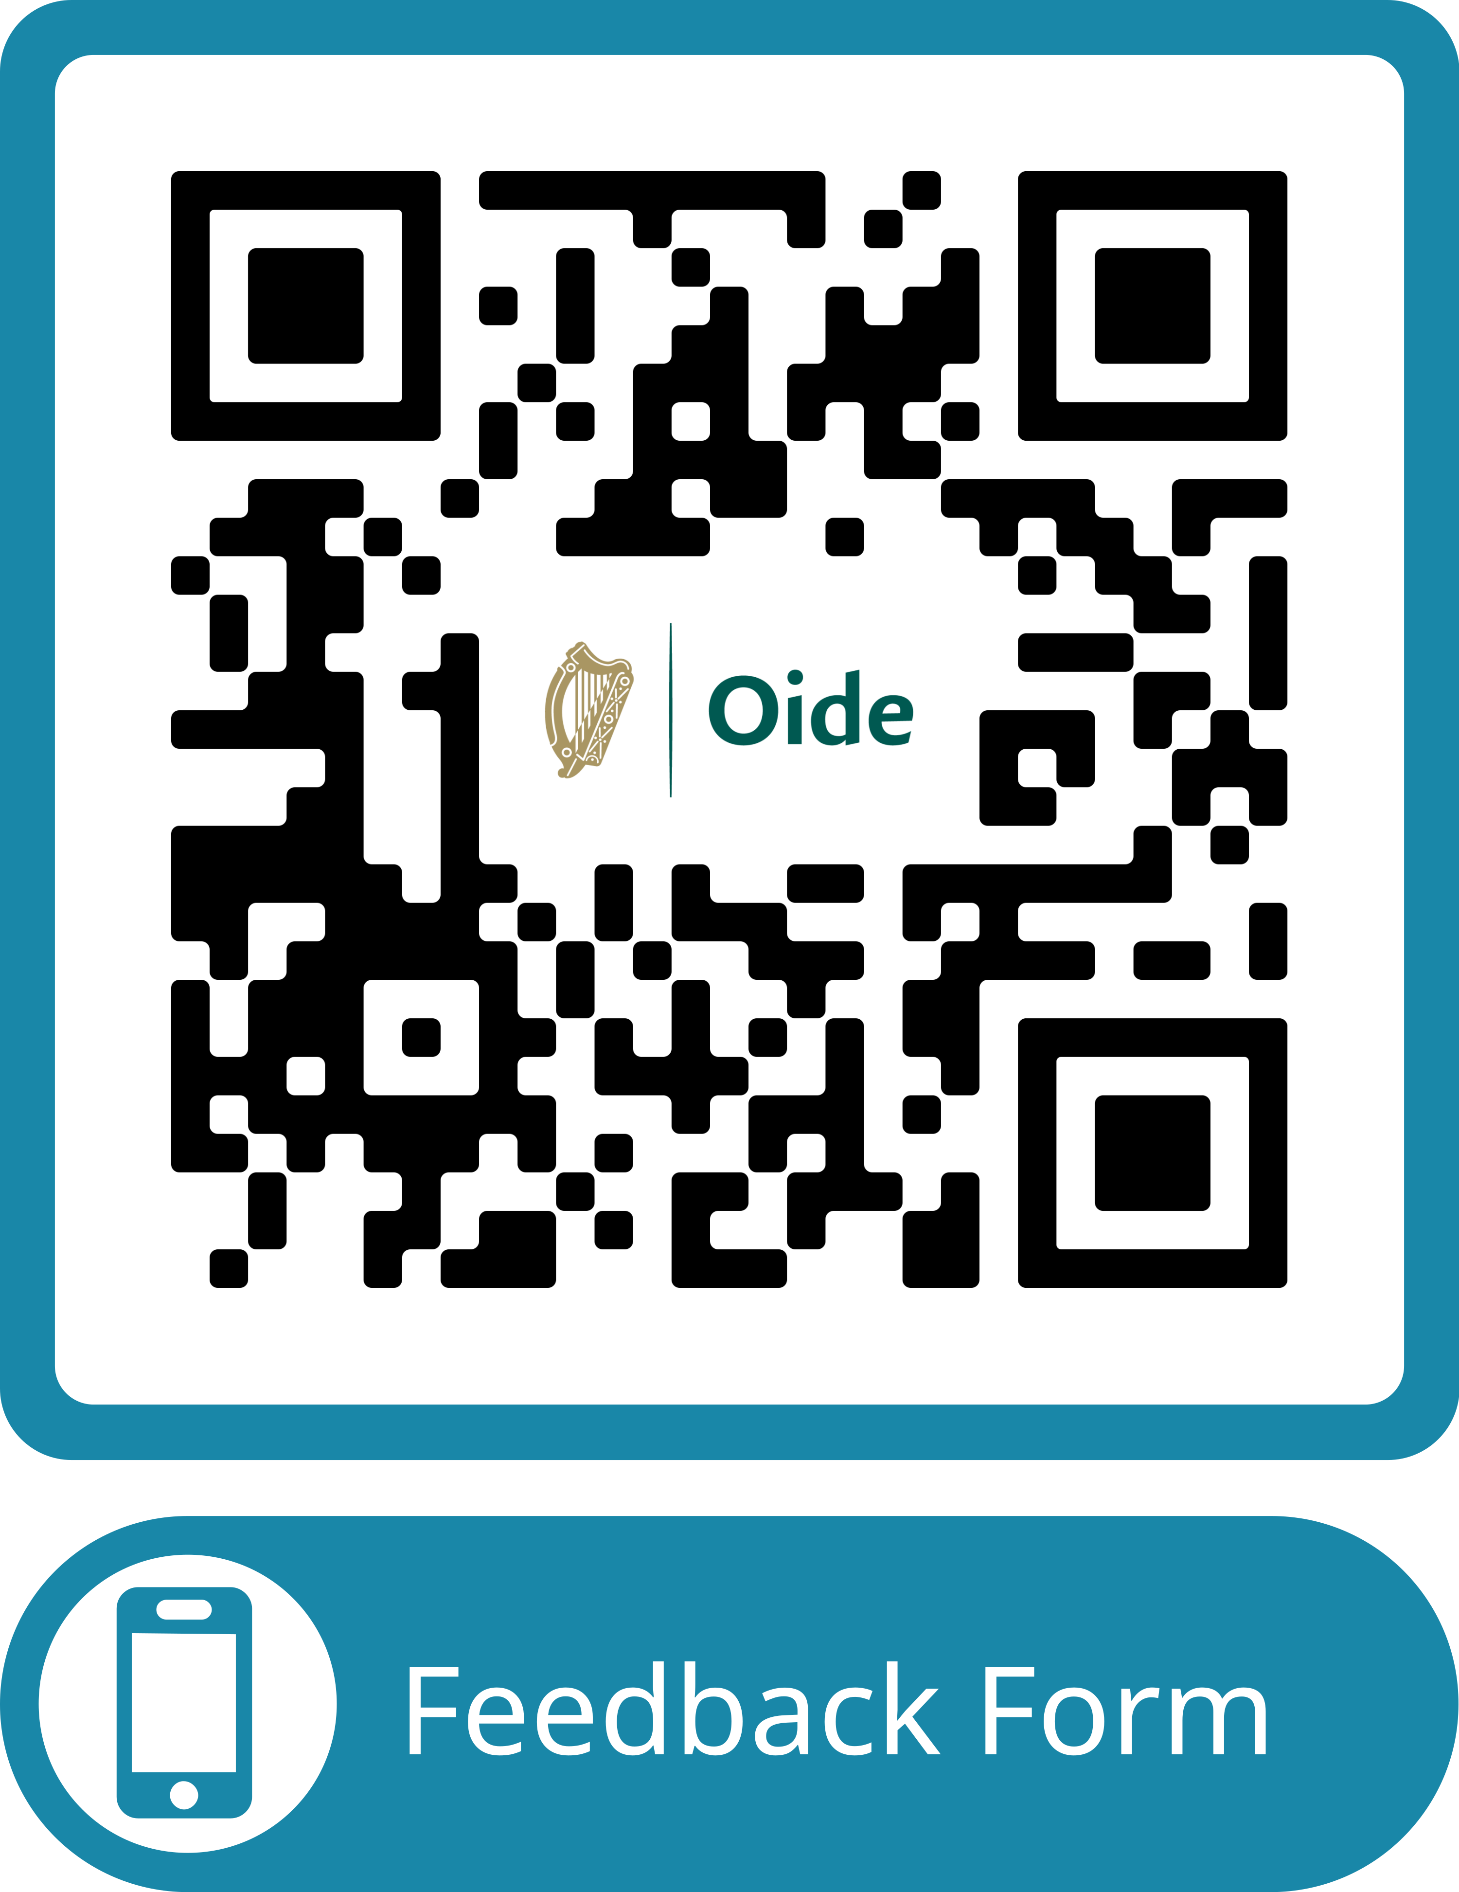

Feedback
Leadership
https://forms.office.com/e/EsvQ1ZiGLY
transitionyear@oide.ie
@oide_Ireland

Slide 14
Míle buíochas
Leadership

