Slide 1
Junior Cycle Science Online CPD Workshop 2022-2023

Slide 2
Learning Intentions
To appreciate the importance of assessment as an integral part of everyday teaching and learning
To recognise the opportunities afforded by formative assessment in providing support, access and challenge for each learner
To develop our understanding of how our classroom approaches to teaching and learning can support all students, including students engaging with L2LPs

Slide 3
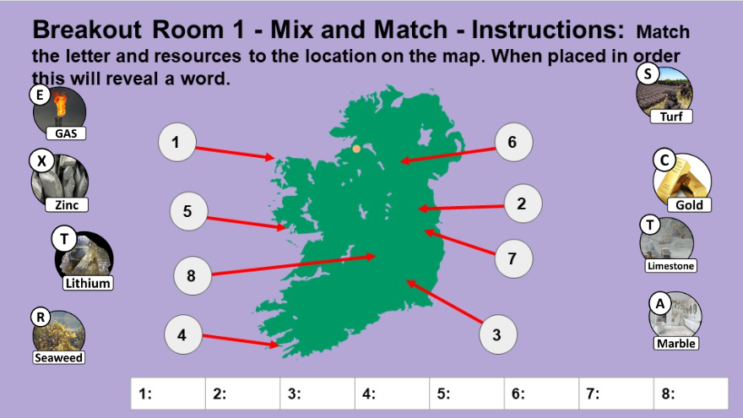
Can you match the material to its source in Ireland?

Slide 4
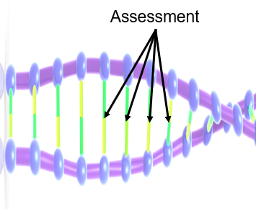
Learning Intention
To appreciate the importance of assessment being an integral part of everyday teaching and learning

Slide 5
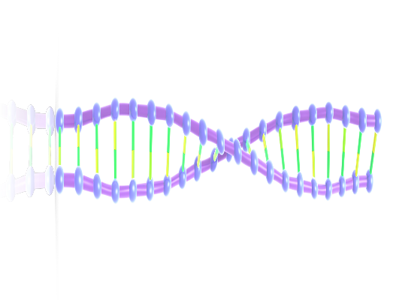
Assessment and Learning
Assessment
Learning
Classroom
Experience

Slide 6
Dylan Wiliam Quote
Assessment is the bridge between teaching and learning. It is only through assessment that we can find out what sense our students made of our teaching so that we can plan our next steps.
Adapted from Assessment: The Bridge between Teaching and Learning Dylan Wiliam, 2013

Slide 7
Assessment and Learning in Science
Summative
Assessment and Learning in Science
Formative

Slide 8
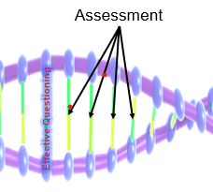
Learning Intention
To appreciate the importance of assessment being an integral part of everyday teaching and learning
Examining the role of effective questioning to support each student

Slide 9
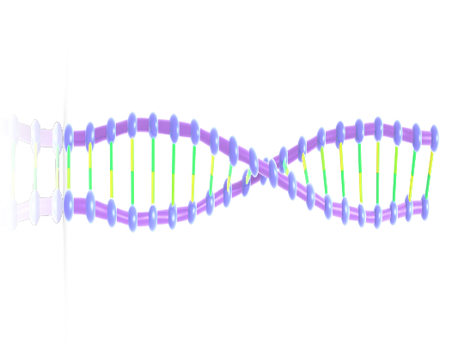
Assessment and Learning
Assessment
Learning
Effective Questioning
Classroom
Experience

Slide 10
NCCA, Effective Questioning, 2015, p. 5
Interest, challenge
or engage
Key concepts
Assess prior knowledge and understanding
Extend and deepen learners’ thinking
Create new understanding

Slide 11
How do I ensure the questions I plan support each learner in my classroom?
Individual
Reflection
How do I sequence the questions for my learners?

Slide 12
Sample Unit of Learning

Slide 13
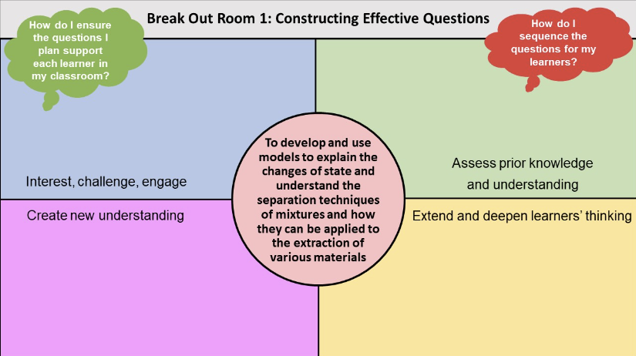
Constructing Effective Questions

Slide 14
Interest, challenge
or engage
Key concepts
Assess prior knowledge and understanding
Create new understanding
Extend and deepen learners’ thinking
NCCA, Effective Questioning, 2015, p 5

Slide 15
Hexagonal Thinking

Slide 16
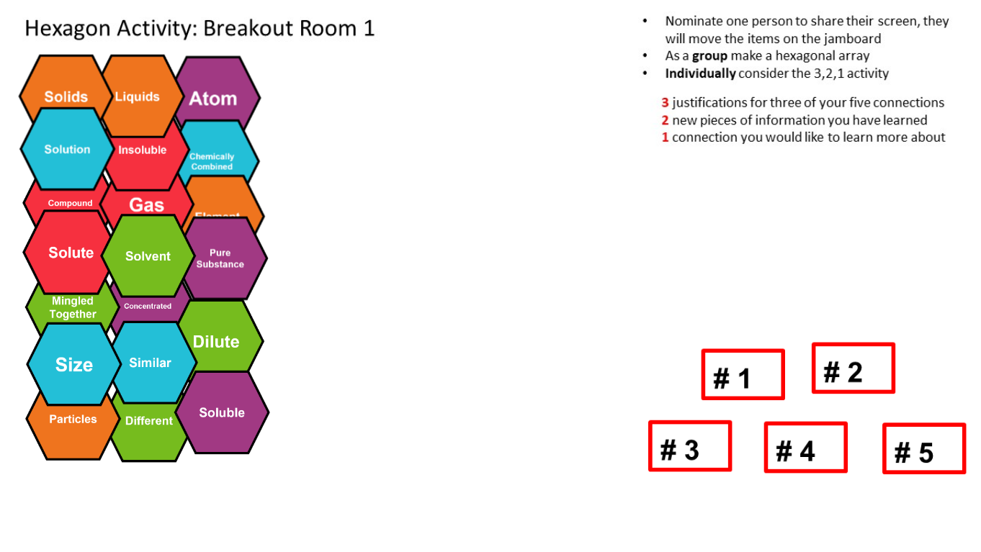
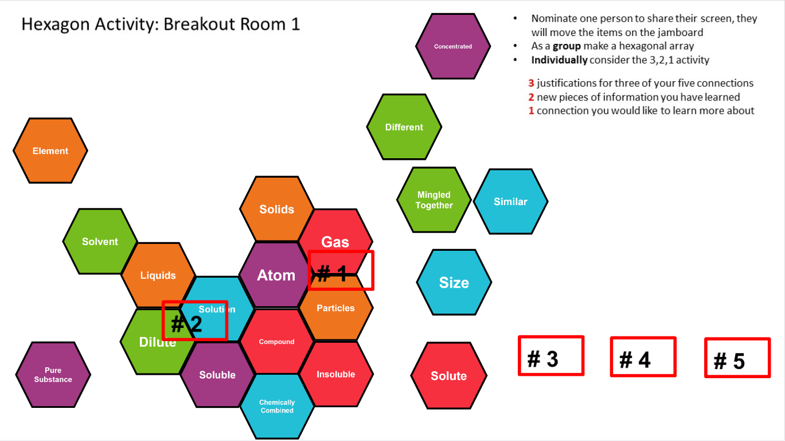
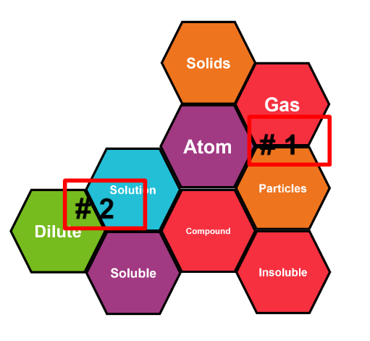
Hexagonal Thinking
3,2,1 Activity
This is a 3,2,1, group activity
Justify 3 connections you made
Identify 2 new pieces of information
Choose 1 connection you would like to know more about
Teachers will work in a breakout room to make connections between the hexagons, engaging as students would with the activity. Once the connections are made, to push the learning further, they are asked to justify 3 connections made, identify new learning for 2 connections and 1 connection they would like to know more about.

Slide 17
 | Focus Question: How might this experience support each learner?

Slide 18
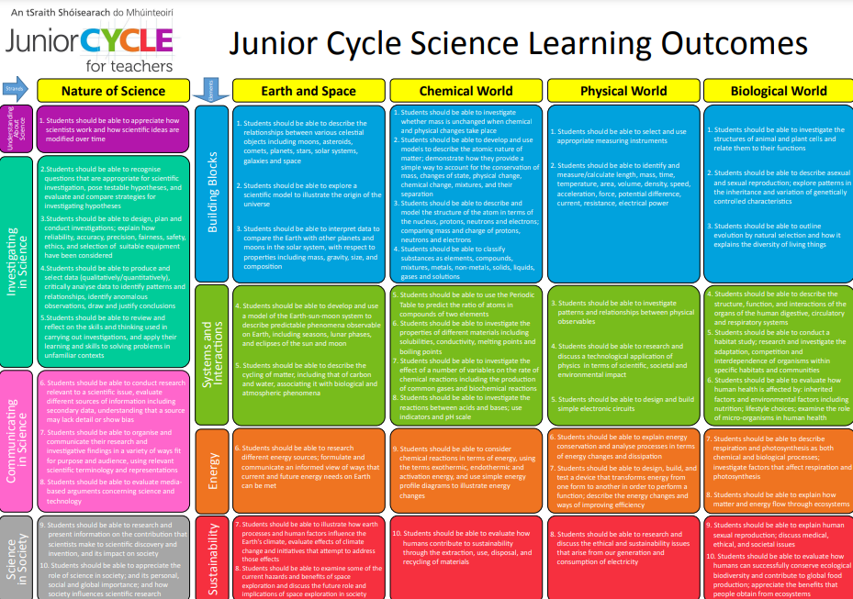
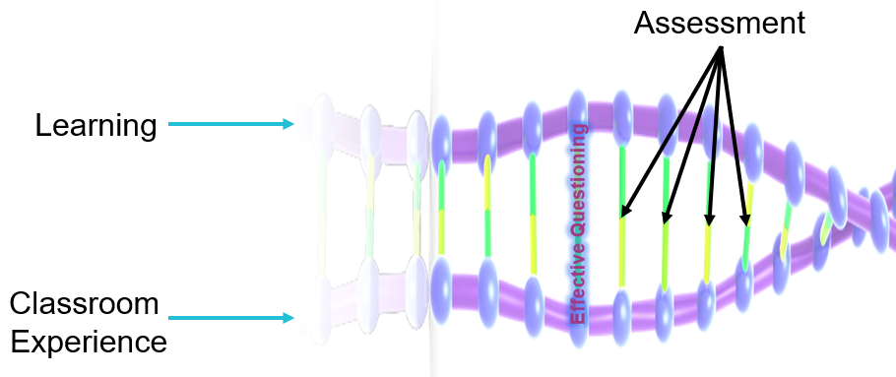
Learning Intention
To recognise the opportunities afforded by formative assessment in providing support, access and challenge for each learner
Learning Experiences

Slide 19
Sample Unit of Learning
To evaluate evidence to make judgements about how humans can contribute to the sustainability of the extraction of materials

Slide 20
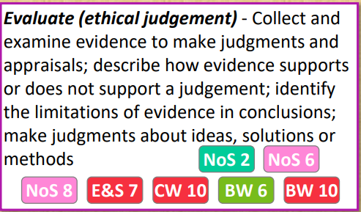
CW 10. Students should be able to evaluate how humans contribute to sustainability through the extraction, use, disposal, and recycling of materials

Slide 21
Strategies for Student Learning
Speak like a Scientist
Connect the Pictures
Five Cs
Paired Quizzing

Slide 22
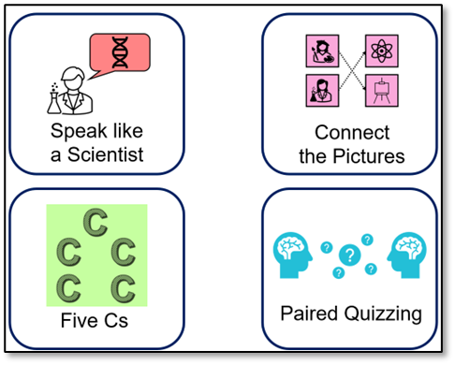
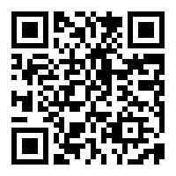
 | Focus Questions: How might these strategies be used to build knowledge and deepen students’ understanding of scientific concepts? 2. How might you adapt the strategies for your students?

Slide 23
Material Stimuli

Slide 24
 | Focus Questions: How might these strategies be used to build knowledge and deepen students’ understanding of scientific concepts? 2. How might you adapt the strategies for your students?

Slide 25
Assessment and Learning
Assessment
Learning
Classroom
Experience

Slide 26
CW 10. Students should be able to evaluate how humans contribute to sustainability through the extraction, use, disposal, and recycling of materials

Slide 27
Focus of Learning
What do I want my students to learn when engaging with
this learning outcome and action verb?
How will I know they got there?
Individual
Reflection

Slide 28
CW 10. Students should be able to evaluate how humans contribute to sustainability through the extraction, use, disposal, and recycling of materials

Slide 29
Creating an Assessment
Assessing the Learning Outcome
and Action Verb
How can you scaffold the assessment to allow all learners to show what they know?
CW 10. Students should be able to evaluate how humans contribute to sustainability through the extraction, use, disposal, and recycling of materials

Slide 30
Creating an Assessment

Slide 31
Collaboration and the Framework
The Framework for Junior Cycle (2015) recognises the importance of professional development and collaboration between teachers for informing their understanding of teaching, learning and assessment and their practice in the classroom.

Slide 32
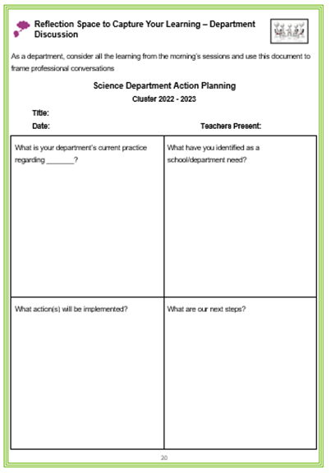
Supporting the Process
Today’s learning
Identify your students’ needs
What practice will we implement?
What are our next steps and actions?

Slide 33
Looking at Our School (LAOS) 2022
‘Teachers ….. engage in professional learning and professional collaboration’
‘Teachers work together to devise learning opportunities for students across and beyond the curriculum’

Slide 34
The most valuable resource that all teachers have is each other. Without collaboration, our growth is limited to our own perspectives.​
Robert John Meehan ​

Slide 35
Learning Intention
To develop our understanding of how our classroom approaches to learning and teaching can support all students, including students engaging with the L2LP

Slide 36
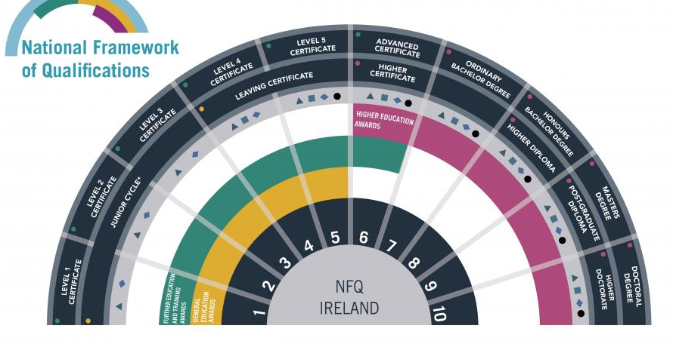
What are Level 2 Learning Programmes?
“(L2LPs) are suited to students with general learning disabilities in the higher functioning moderate and low functioning mild categories. The special needs of these students is such as to prevent them from accessing some or all of the subjects and short courses on offer at junior cycle that are broadly aligned with Level 3 NFQ.”
(Framework for Junior Cycle 2015, p23)

Slide 37
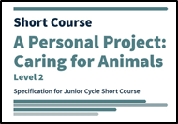
What are Level 2 Learning Programmes?
There are 5 Priority Learning Units (PLUs)
2 short courses
Communication and Literacy
Numeracy
Personal Care
Living in the Community
Preparing for Work

Slide 38
Working with L2LPs – a Collaborative Journey

Slide 39
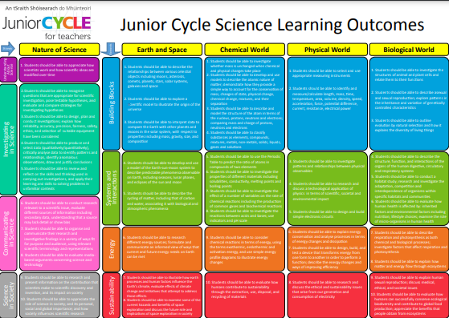
Assessment in a Science Classroom
Students engaging with the Level 2 Programme
Students engaging with the Level 3 Programme
Both engage in the same classroom learning experience
Will gather evidence of achievement from the relevant Learning Outcomes from the Level 2 programme
Will be assessed using the
relevant Learning Outcomes from the Level 3 programme

Slide 40
Learning science through inquiry enables students to ask more questions, and to develop and evaluate explanations of events and phenomena they encounter.
Students enhance their scientific literacy by developing their….understanding of scientific inquiry…
Science Specification P. 4

Slide 41
Scientific Method - Scientific Inquiry
Scientific Method
Fixed set of sequences
and steps
Not an accurate representation of how scientists work
Scientific Inquiry
Questions guide the
approach
The approaches vary
widely within and
across scientific
disciplines and fields
(Concept of scientific inquiry 2020)

Slide 42
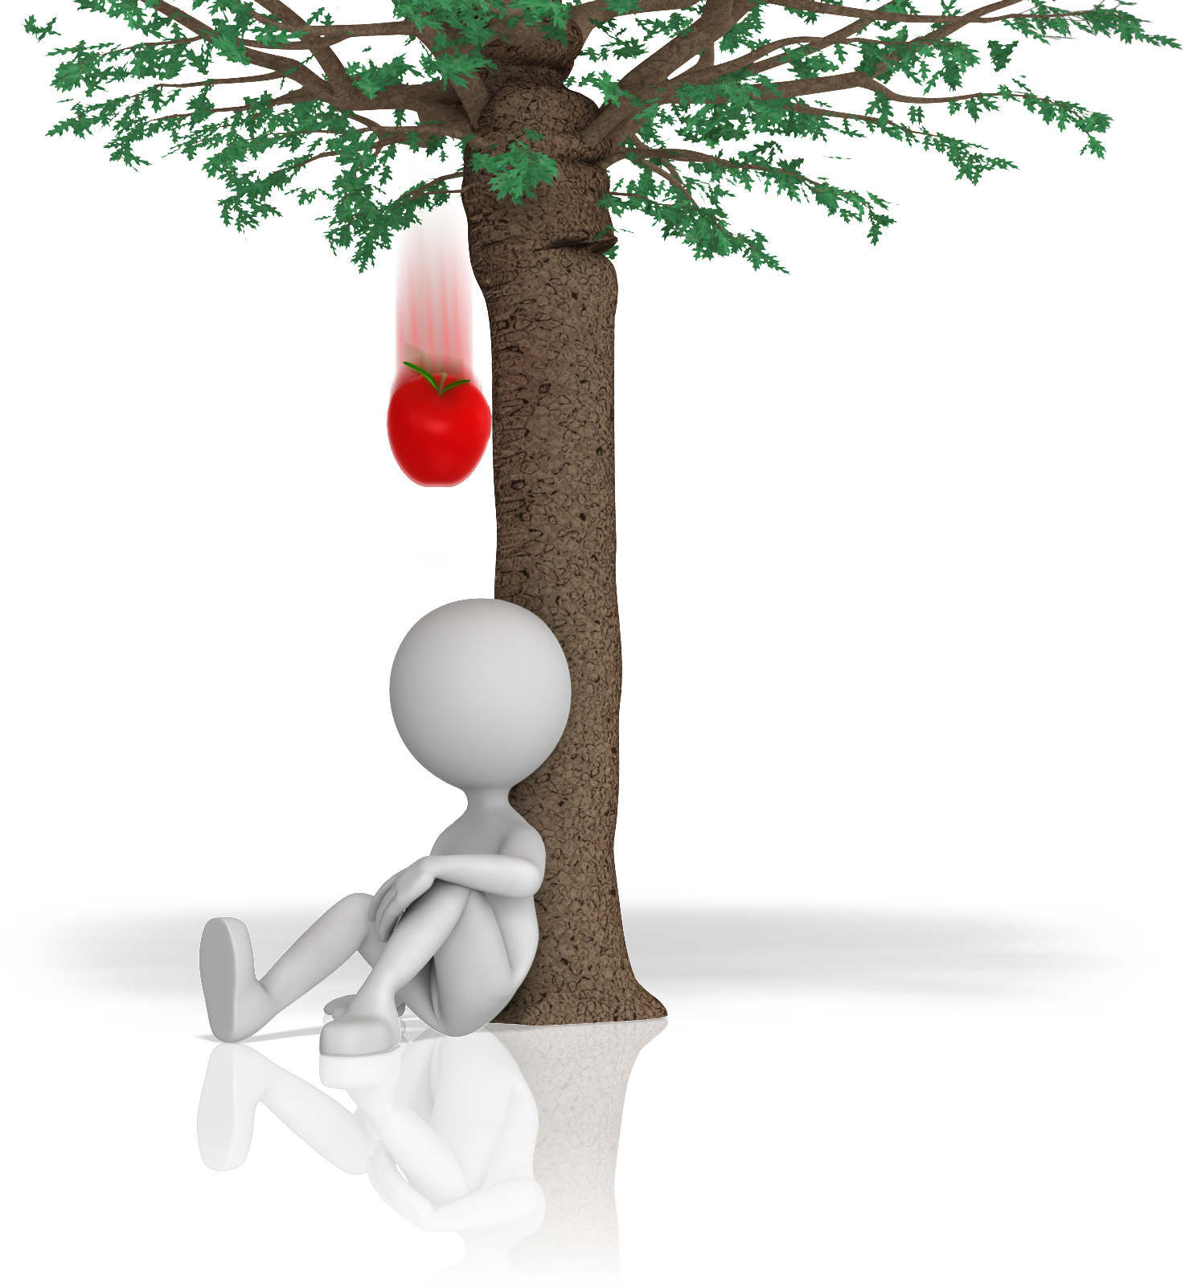
What is Inquiry?
Observe
Question
Investigate
How did that happen?
Make Connections
Examine/ Reflect
Communicate Findings

Slide 43
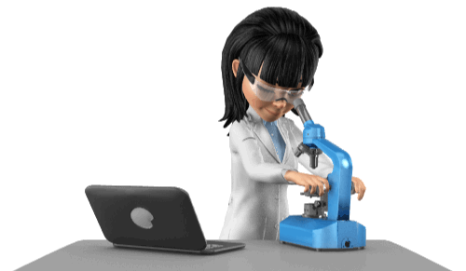
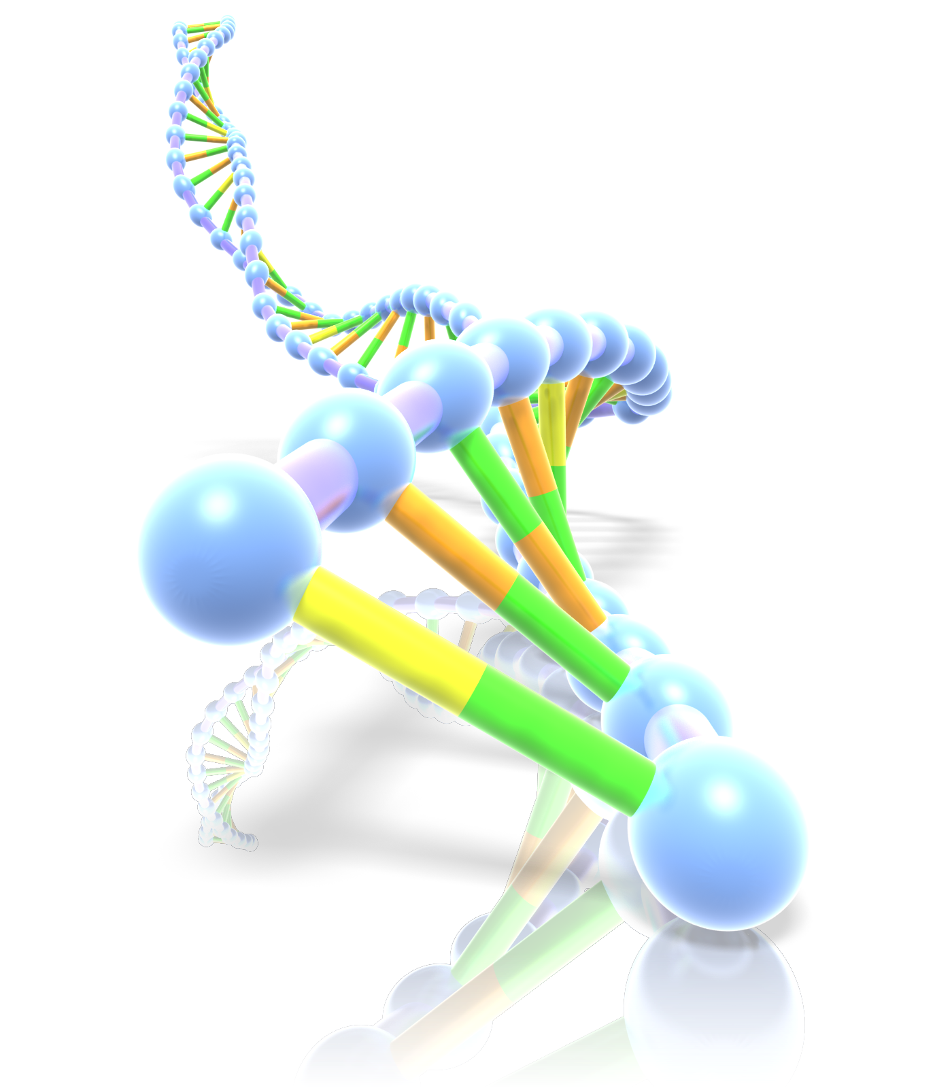
Investigating in Science
Exploring and Observing
Classifying
and Identifying
Modelling
Pattern seeking
Experiment –
Fair Testing
The University of Waikato Te Whare– Landcare Research

Slide 44
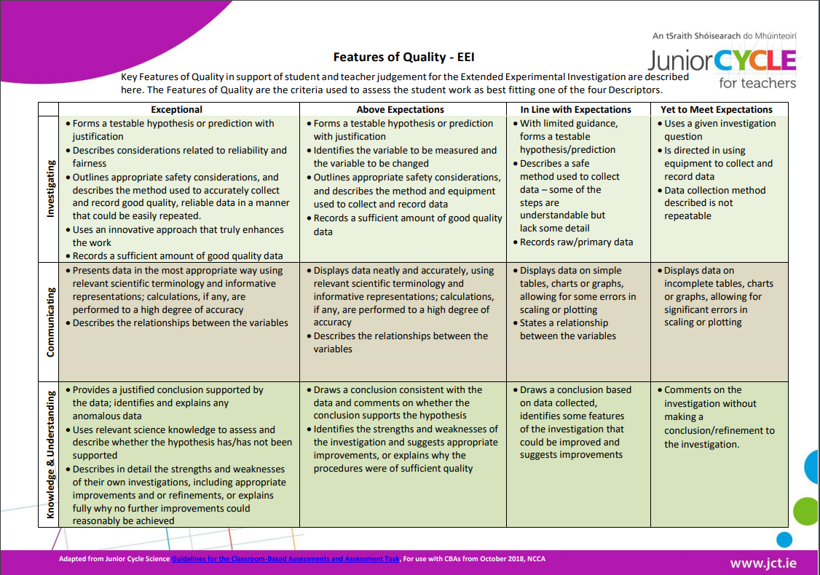
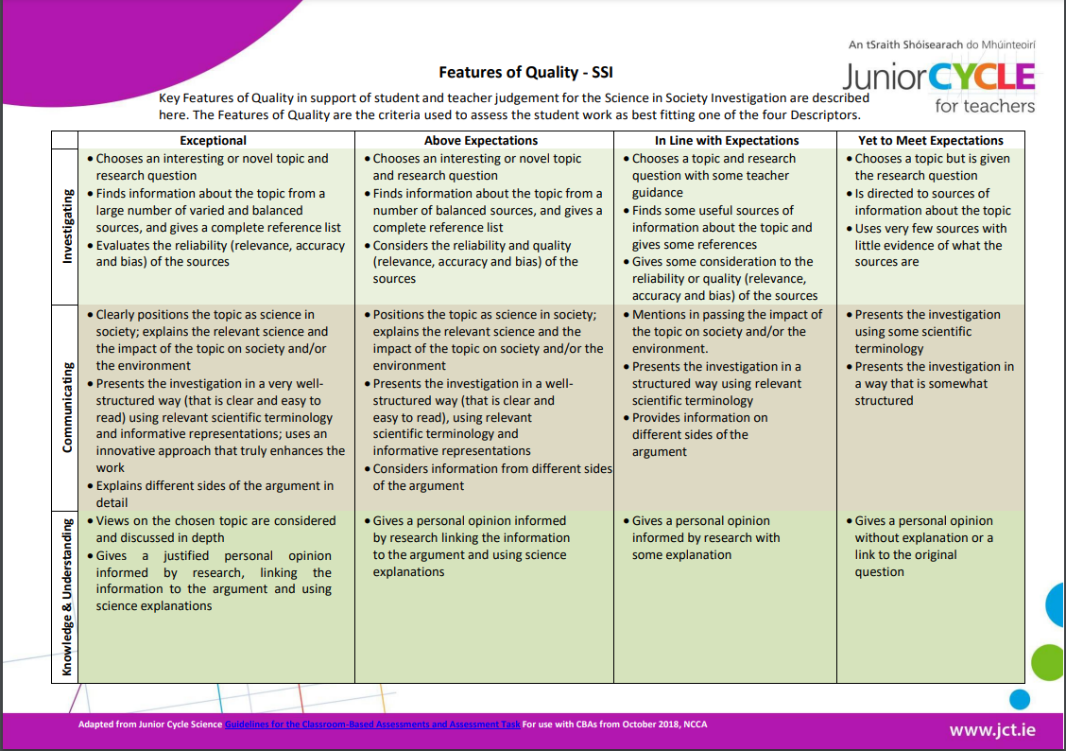
Investigations in the Science Classroom
Extended Experimental Investigation
Science in Society Investigation

Slide 45
Inquiry Continuum
Teacher
Student
limited
structured
guided
open
Questions are more open, students may be asked to provide an explanation or to explore, however they may be guided in terms of equipment
Students develop their own questions and methods of answering those questions
Question and method are pre-directed by the teacher but the outcome is unknown to students
Students are led sequentially through a series of questions or activities, and as a consequence construct knowledge

Slide 46
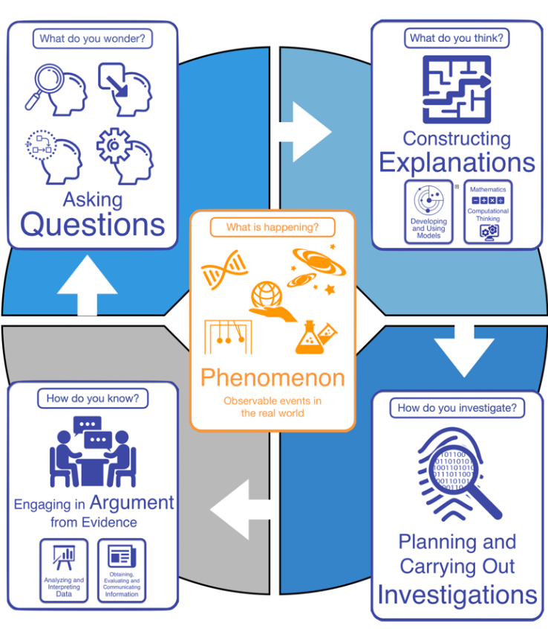
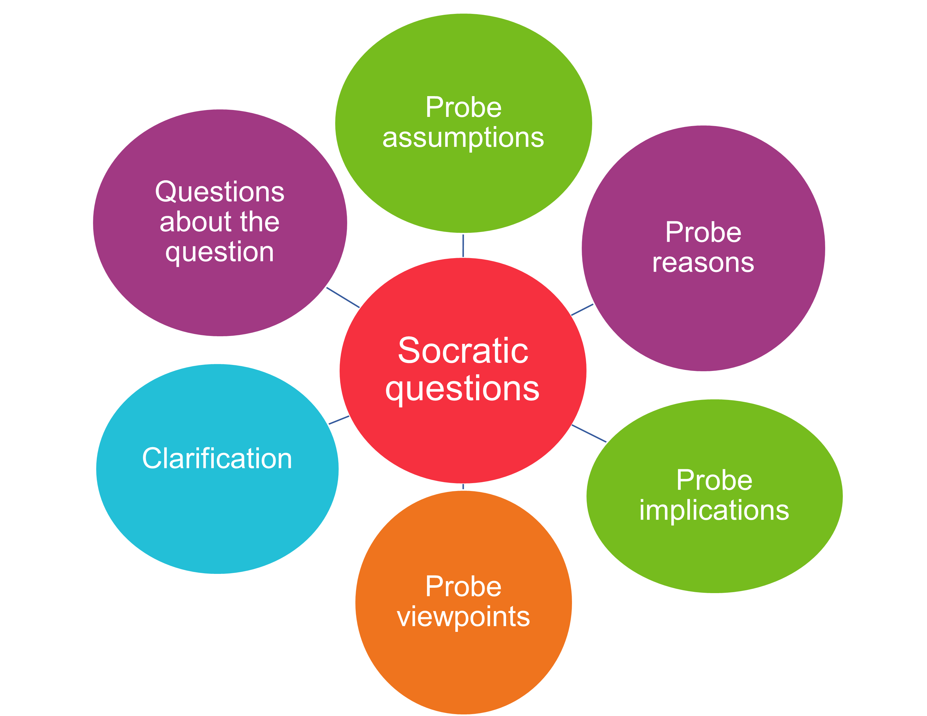
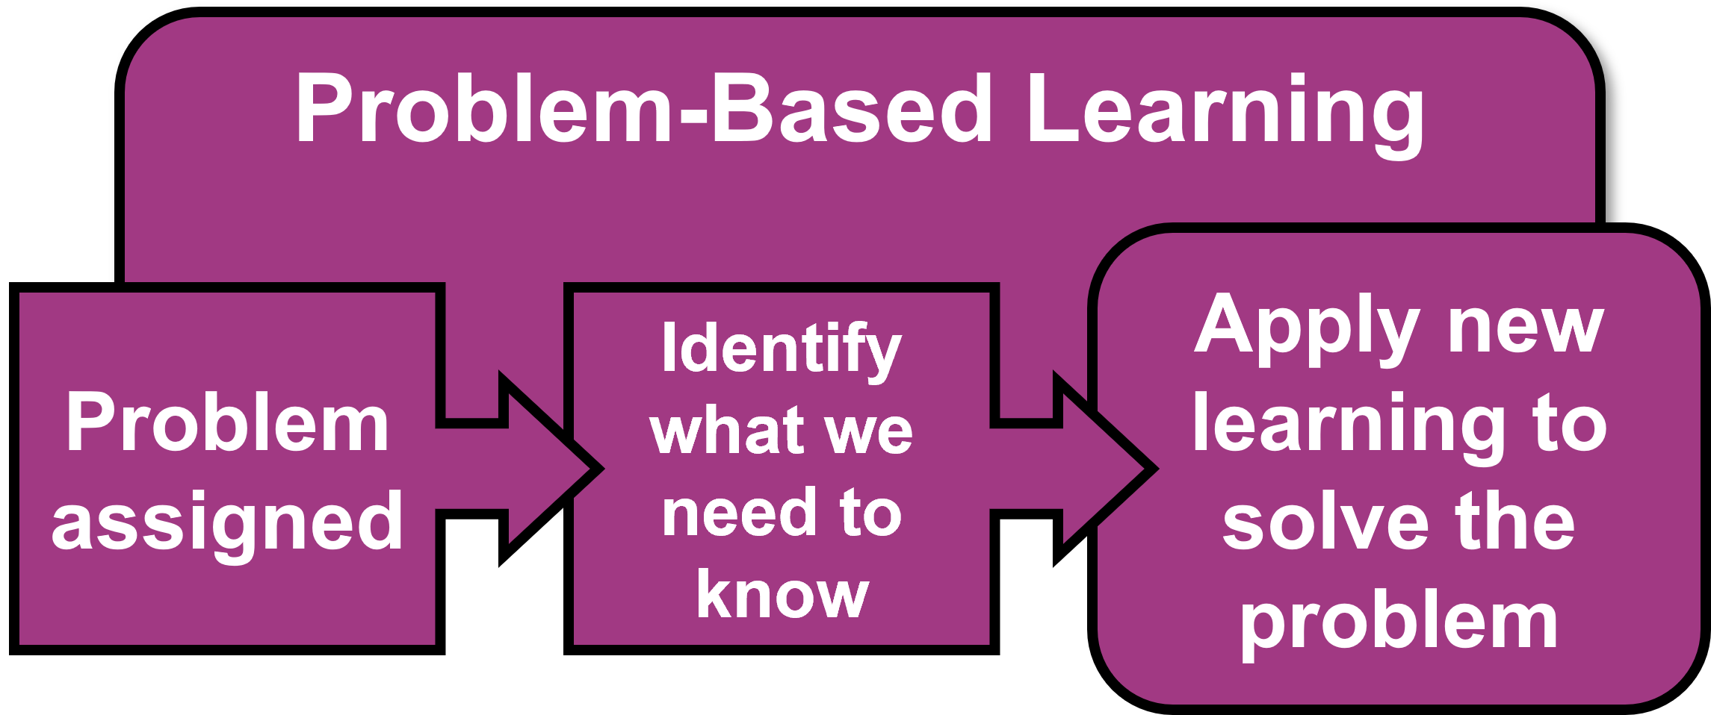
Approaches to Inquiry

Slide 47
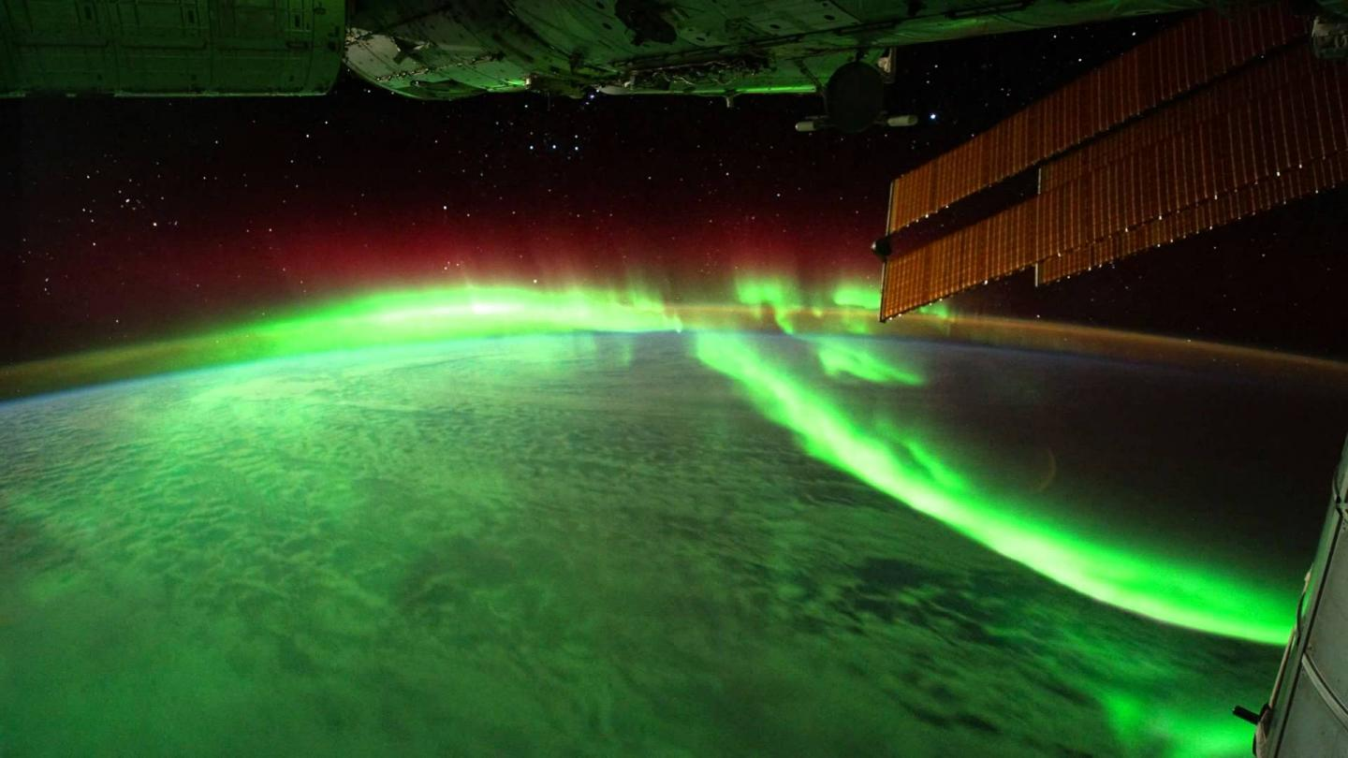
Phenomenon Based Inquiry
Meaningful learning experiences
Actively engaging learners
Solve real-world problems
Make connections across different disciplines

Slide 48
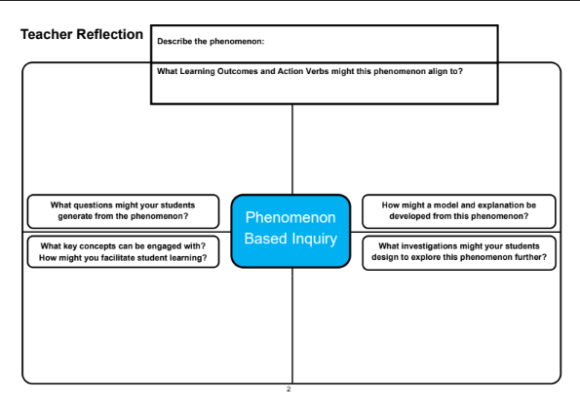
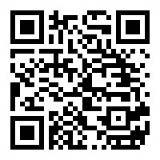
Breakout Room Instructions

Slide 49
Priority Learning Units

Slide 50
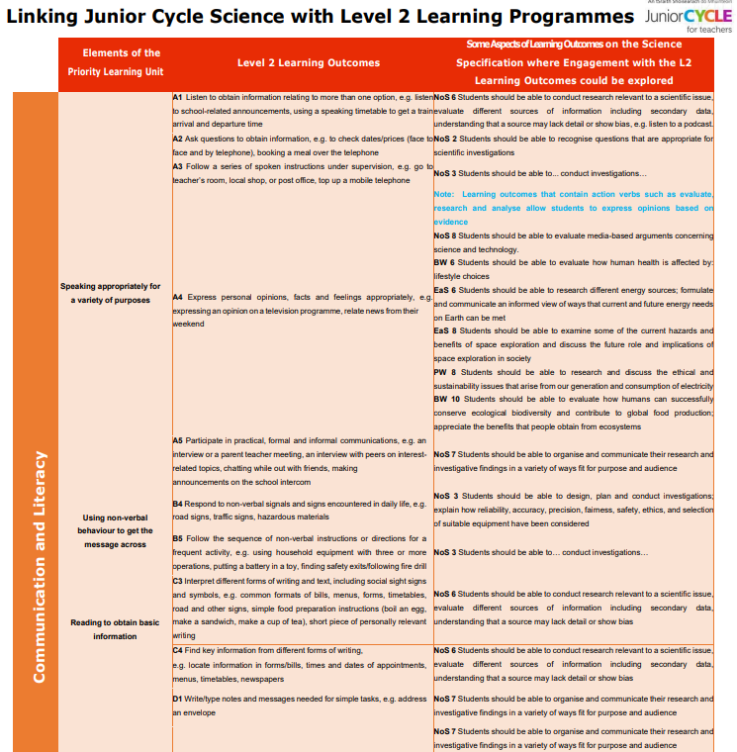
L2LP in the Science Classroom
C1 Use appropriate words to describe temperature
C2 Identify instruments used for indicating and adjusting temperature
PW 2 Students should be able to identify temperature
PW 2 Students should be able to measure temperature
Developing awareness of temperature

Slide 51
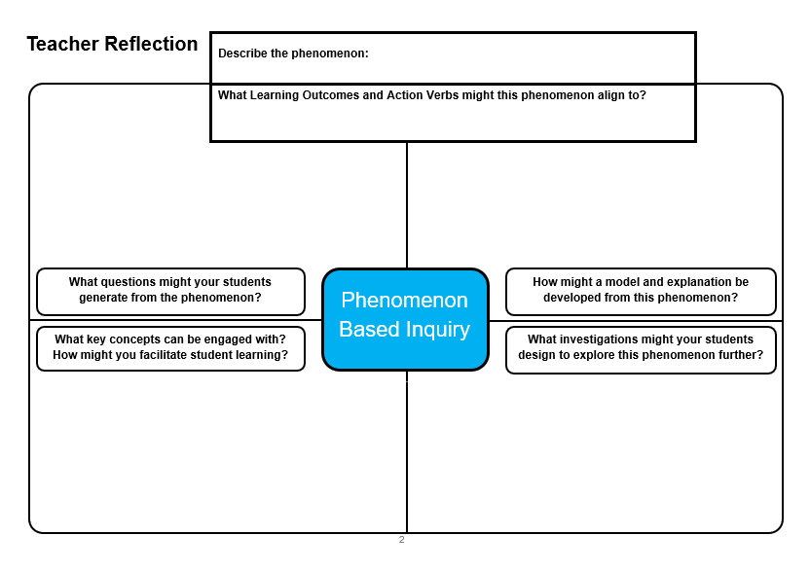
Inquiry and L2LP

Slide 52
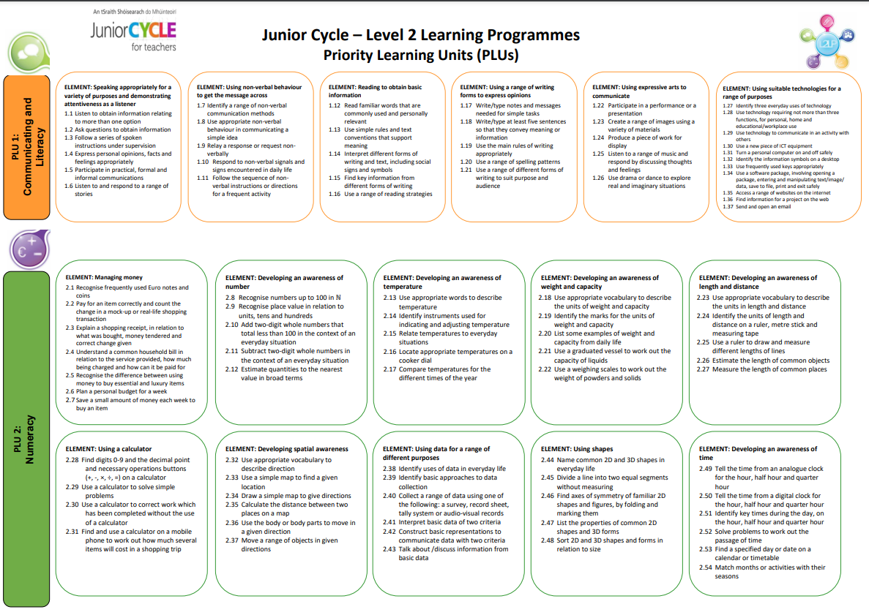
Including the Students Engaging in an L2LP in the Mainstream Classroom
What may students engaging with an L2LP achieve with this learning experience
Using the L2LP poster, identify which learning outcomes you think are aligned
What key concepts can be engaged with?
How might you facilitate student learning?

Slide 53
Including Students Engaging in an L2LP
What may students engaging with an L2LP achieve with this learning experience?
Align the Learning Outcomes from the L2LP poster to the learning experience

Slide 54
Methods of Gathering Evidence (L2LP)

Slide 55
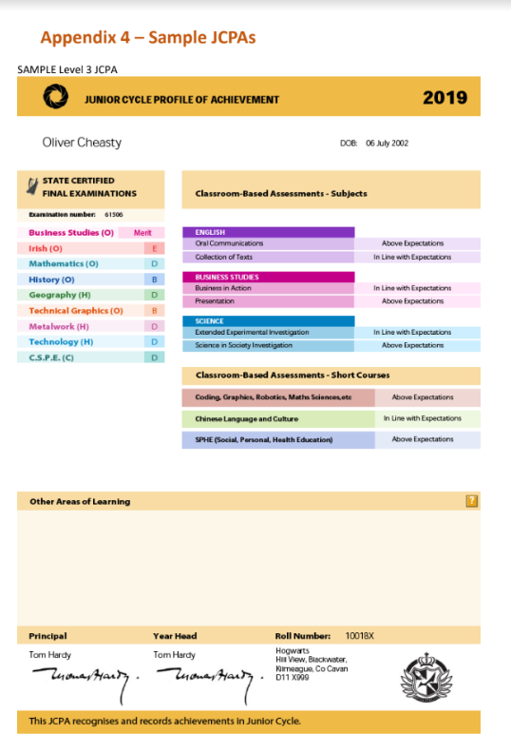
Portfolio (L2LP)
Science
Other Areas of Learning
Other Subjects
Short Courses

Slide 56
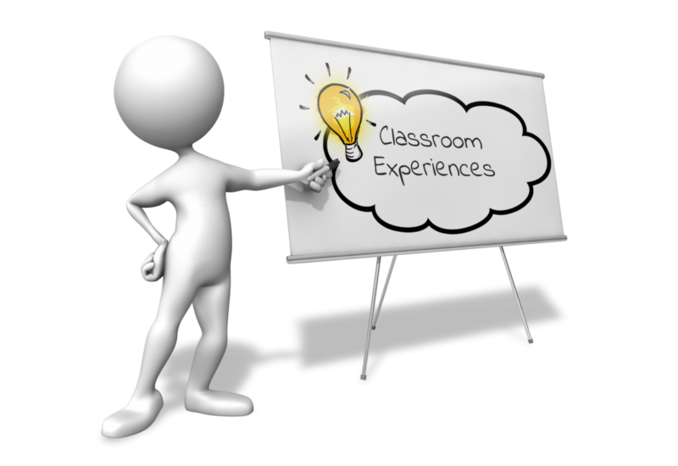
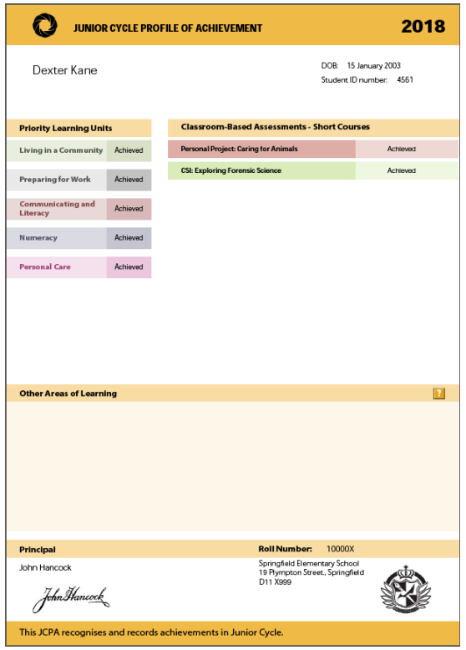
Gathering Evidence of Learning (L2LP)
Classroom Based
Portfolio
JCPA

Slide 57
Learning Intention
To develop our understanding of how our classroom approaches to learning and teaching can support all students, including students engaging with the L2LP

Slide 58
Supporting the Process
Today’s learning
Identify your students’ needs
What practice will we implement?
What are our next steps and actions?

